Slide 1
Repetition HTML
xbi@2026

Slide 2
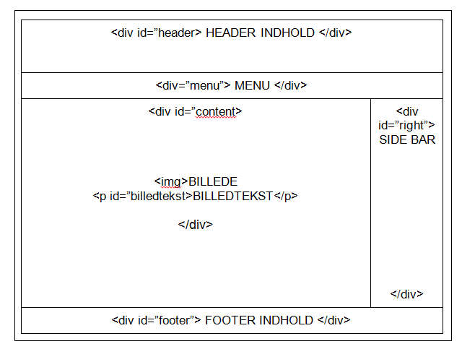
The Old Div and New html5 element

Slide 3
HTML5
Semantic
Notes:
Why?

Slide 4
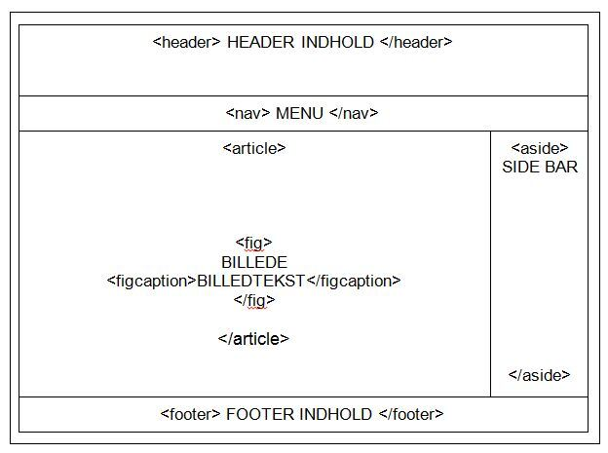

Slide 5
HTML5 Semantic Structure Elements
Header
Nav
Main
Section
Article
Figure
Figcaption
Aside
Footer

Slide 6
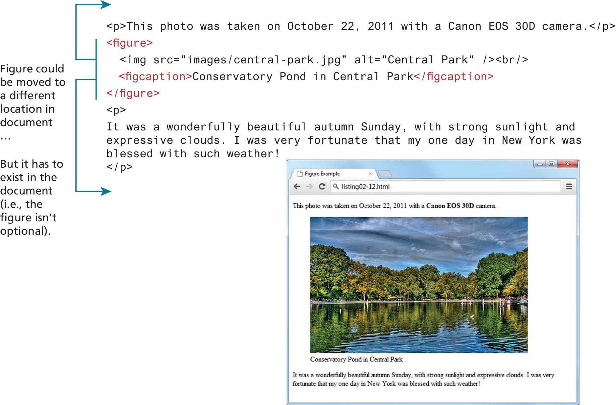
Figure and fig caption

Slide 7
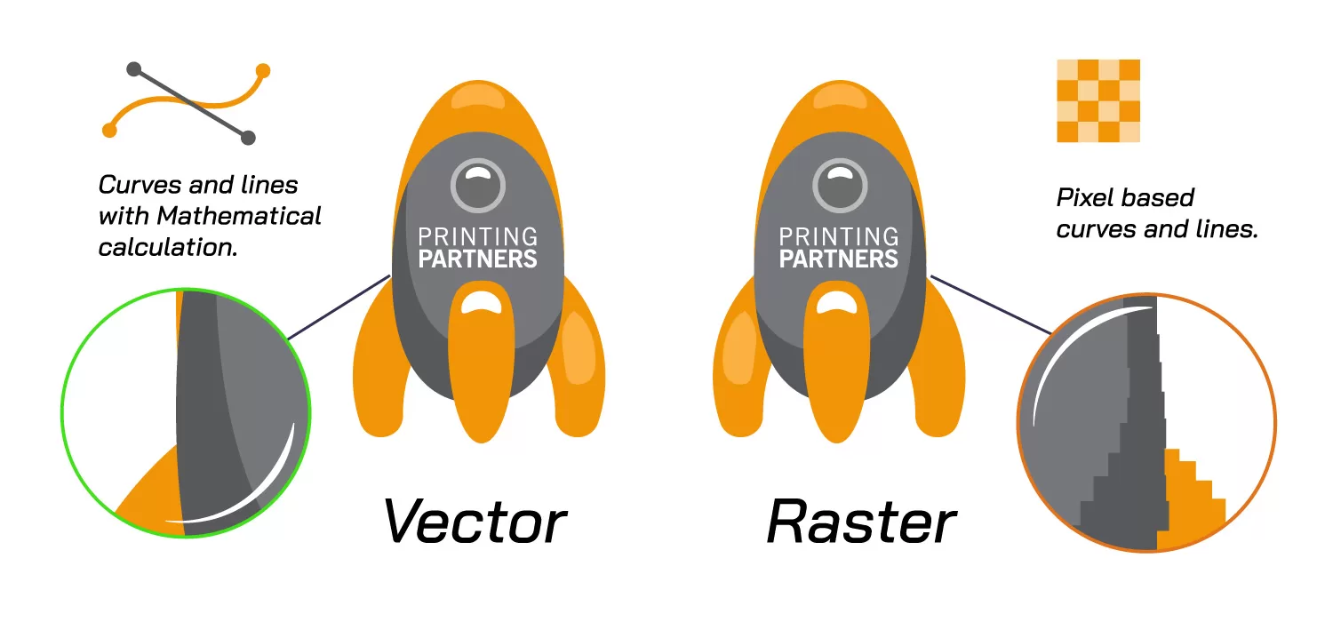
Pixel vs. Vector Graphics

Slide 8
New image formats
WebP Image Format
File extension: .webp
Developed by: Google
Purpose: Provide smaller image file sizes with high quality, to make websites faster.
Notes:
Why it is better to use- show in photoshop online

Slide 9
Title (title tag)
Very important:
The <title> tag is required in HTML documents!
The contents of a page title is very important for search engine optimization (SEO)! The page title is used by search engine algorithms to decide the order when listing pages in search results.

Slide 10
Meta tags
<meta charset="utf-8">
It ensures that text, including special characters (like accents, emojis, or non-Latin scripts), displays correctly in the browser.
Without it, browsers might misinterpret characters (e.g., Å. © ).
Notes:
Html lang.

Slide 11
Meta No index
<meta name="robots" content="noindex">
tell search engines not to include a page in their search results.

Slide 12
Alt text
Alt text (alternative text) is a short, descriptive text associated with images in HTML, specified using the alt attribute within the <img> tag. It serves several important purposes for SEO
If an image fails to load, the alt text appears in place of the image, providing context so users aren’t left guessing.
Notes:
Giver google og evt. skærmlæser information om hvad der er på billedet. Alternativ tekst hvis billeder ikke loader eller der er brug for oplæsning af beskrivelsen af billedet.

Slide 13
Validering
Check your code for syntax errors
Benefit:
Valid code →
more consistent browser display
W3C HTML Validation Tool
http://validator.w3.org

Slide 14
opgave
Gruppe opave

Slide 15
Pre-launch check
you’ll want to run through a quick checklist:
Is your website folder organized
Are all of your links properly formatted?
Are there any references to images/videos works

