Slide 1
CSS
COLORS AND BACKGROUNDS

Slide 2
Color spaces and models
CSS color names
RGB and HSL color values
Foreground and background colors
Tiling background images
More selectors and external style sheets

Slide 3
Color Spaces and Models
A color space is a vocabulary for defining and reproducing colors (like Pantone for ink colors, or RGB for screen colors)
A color model is a system for describing colors numerically. It is one way to describe the colors in a particular color space.
Gamut refers to the range of colors a color model or a screen can represent.
CSS Color Module Level 4 expands the options for specifying colors to accommodate wide-gamut devices.

Slide 4
Named Color Values
Specify foreground or background color using one of 140 predefined CSS3 color names:
h1 { color: red; }
h2 { color: darkviolet; }
body { background-color: papayawhip; }

Slide 5
Numeric Color Values
For more control, define colors numerically. Color models include:
  RGB (combination of red, green, and blue light values)
  HSL (hue, saturation, and luminosity)
  Each model may include an alpha transparency value

Slide 6
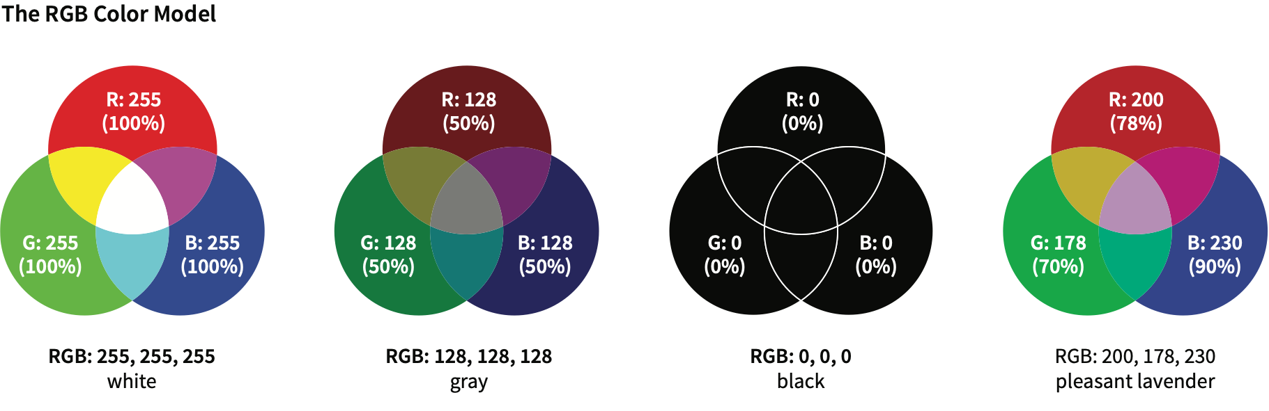
RGB Color
The RGB color model mixes color with red, green, and blue light.
Each channel can have 256 shades, for millions of color options.

Slide 7
RGB Values in Style Rules
There are four formats for providing RGB color values:
  RGB values (0 to 255): rgb(200 178 230)
  NOTE: Old browsers require commas between values
  Percentage values: rgb(78% 70% 90%)
  NOTE: Old browsers require commas between values
  Hexadecimal values: #C8B2E6
  Condensed hexadecimal values (for double-digits only): #F06 is the same as #FF0066

Slide 8
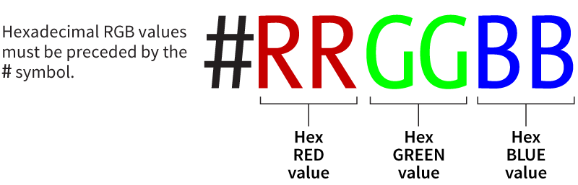
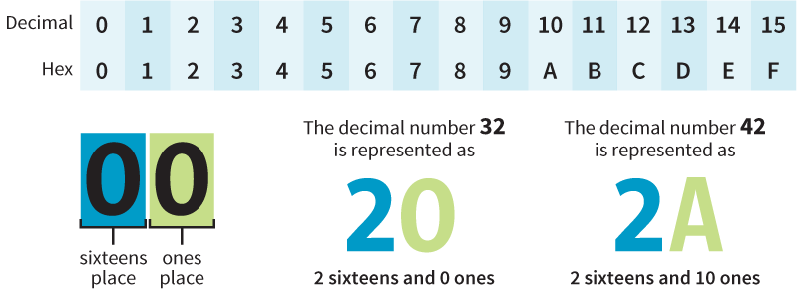
Hexadecimal RGB Values
Red, green, and blue values converted to hexadecimal and preceded by the # symbol.

Slide 9
HSL
Colors described by values for hue (°), saturation (%), and luminosity (%):
hsl(180 50% 75%)
Hue specifies the position on a color wheel (in degrees) that has red at 0°, green at 120°, and blue at 240°.
HSL is less commonly used than RGB, but some find it more intuitive.
Older browsers require commas between values

Slide 10
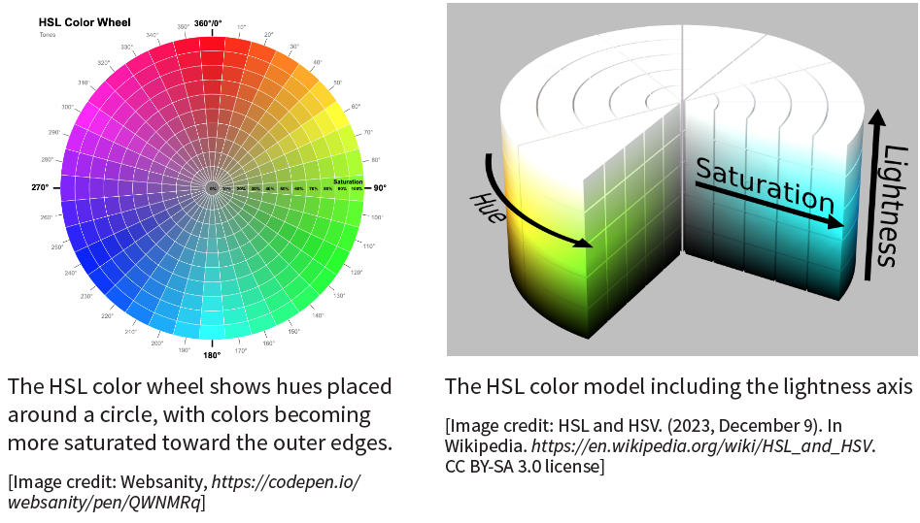
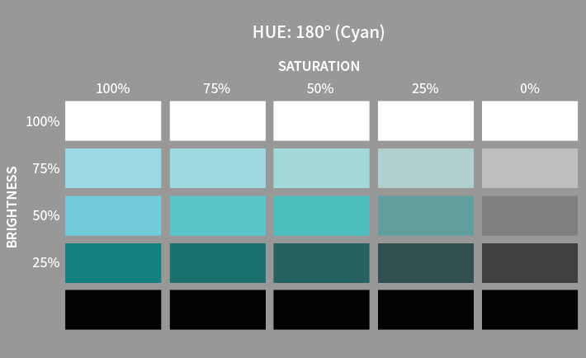
HSL, continued

Slide 11
HSL, continued
One hue in the HSL color model, with its associated saturation and lightness values

Slide 12
Adding Transparency
Specify an alpha transparency value for any color model by adding a transparency value after a slash:
rgb(0 0 0 / .5)
hsl(0 0% 0% / 50%)
oklch(0% 0 0 / .5)
NOTE: To support older browsers, use the specialized
rgba() or hsla() notation; e.g. rgba(0, 0, 0, .5)

Slide 13
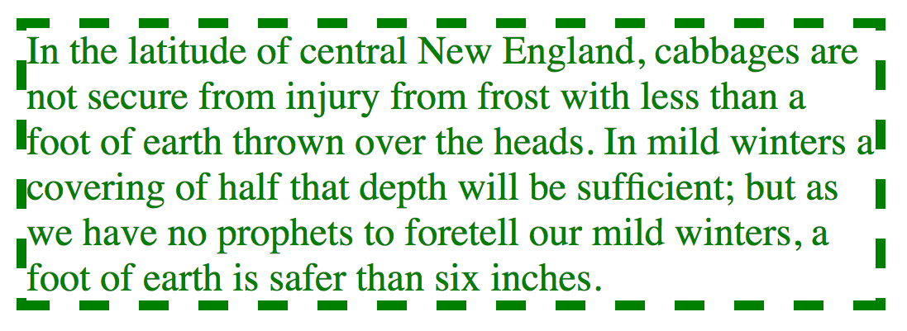
Foreground Color
color
Values: Color value (named or numeric)
Example: blockquote {border: 4px dashed; color: green;}
The foreground of an element consists of its text and border
(if one is specified).

Slide 14
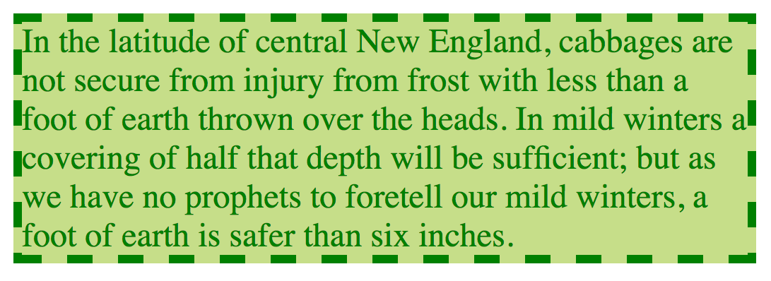
Background Color
background-color
Values: Color value (named or numeric)
Example: blockquote {border: 4px dashed;
background-color: lightgreen;}
The background painting area of an element fills the area behind the text to the outer edge of the border.

Slide 15
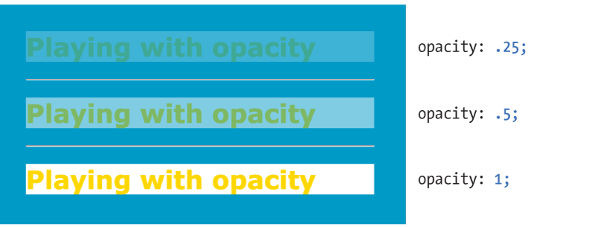
Opacity
opacity
Values: number (0 to 1)
Example:
h1 {color: gold; background: white; opacity: .25;}
Specifies the transparency level from 0 (transparent) to 1 (opaque):

Slide 16
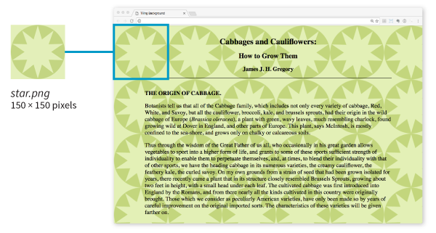
Tiling Background Images
background-image
Values: url(location of image), none
Example: body {background-image: url(star.png);}
Locates an image to be used as a tiling background image behind an element. By default, it starts at the top, left corner and repeats horizontally and vertically:

Slide 17
Background Repeating
background-repeat
Values:
repeat, no-repeat, repeat-x, repeat-y, space, round
Specifies how the background image repeats and can restrict it to tiling in one direction or not at all:
  repeat-x: Tiles horizontally only
  repeat-y: Tiles vertically only
  space: Adds space around images so they fit in the window with no clipping
  round: Distorts the image so it fits without clipping

Slide 18
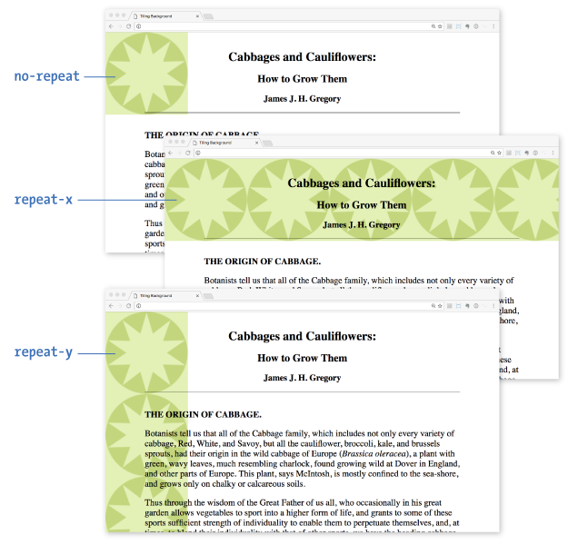
Background Repeating (cont’d)

Slide 19
Background Position
background-position
Values:
Length, percentage, left, center, right, top, bottom
Specifies the position of the origin image, the first image that is placed in the background from which tiling images extend.
Examples (horizontal position goes first):
background-position: left bottom;
background-position: 300px 100px;
background-position: 25% 100%;

Slide 20
Shorthand background Property
background
Values:
background-color background-image background-repeat background-attachment background-position background-clip background-origin background-size
Specifies all background properties in one declaration
      background: white url(star.png) no-repeat top center fixed;
Properties are optional and may appear in any order
Properties not represented reset to their defaults—be careful it doesn’t overwrite previous background settings.

Slide 21
Multiple Background Images
You can place more than one background image in a single image (separated by commas):
    body {
    background:
    url(image1.png) left top no-repeat,
    url(image2.png) center center no-repeat,
    url(image3.png) right bottom no-repeat;
    }

Slide 22
Gradient Fills
A gradient is a transition from one color to another.
Linear gradients change colors along a line.
Radial gradients start at a point and spread outward in a circular or elliptical shape.
You can generate a gradient image for use as a background using linear-gradient() and radial-gradient() notation.
Example:
  #banner {
  background-image: linear-gradient(180deg, aqua, green);
  }

Slide 23
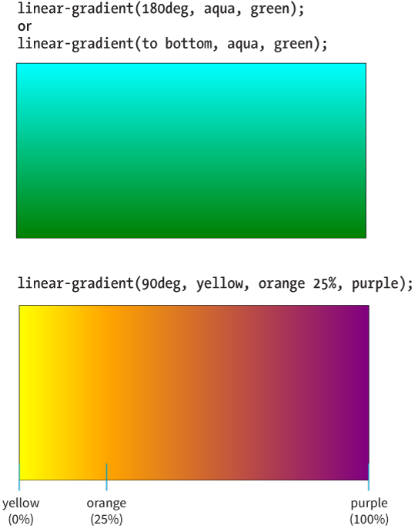
Linear Gradient
The linear-gradient() notation provides the angle of a gradient line and the colors the line passes through.
It is specified in degrees (deg) or keywords (to top, to right, to bottom, to left).

Slide 24
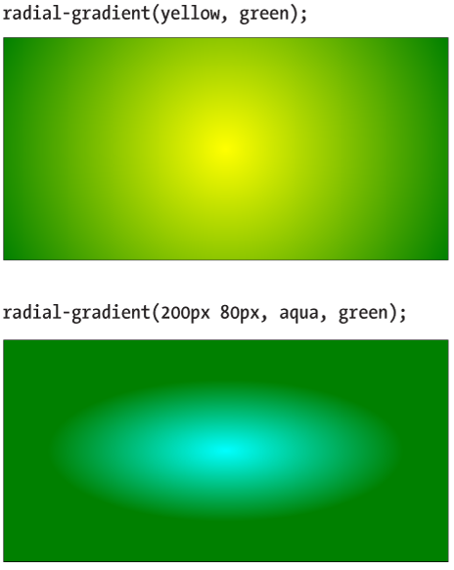
Radial Gradients
The radial-gradient() notation provides the color values and optional size, shape, and position information.

