Slide 1
INTRODUCING CSS

Slide 2
The benefits of CSS
Understanding document structure
Writing style rules
Attaching styles to the HTML document
Inheritance
The cascade
The box model
CSS units of measurement
Developer tools

Slide 3
The Benefits of CSS
Precise type and layout control
Less work: Change look of the whole site with one edit
Accessibility: Markup stays semantic
Flexibility: The same HTML markup can be made to appear in dramatically different ways

Slide 4
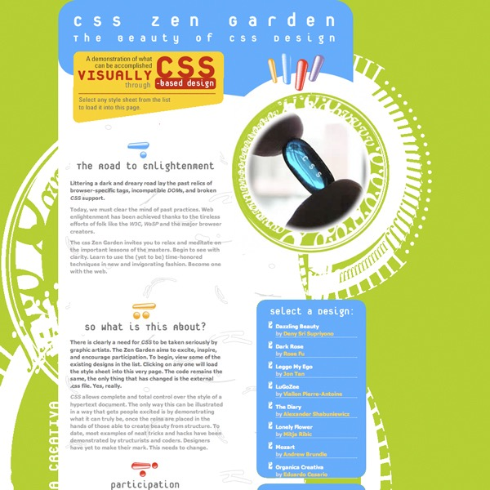

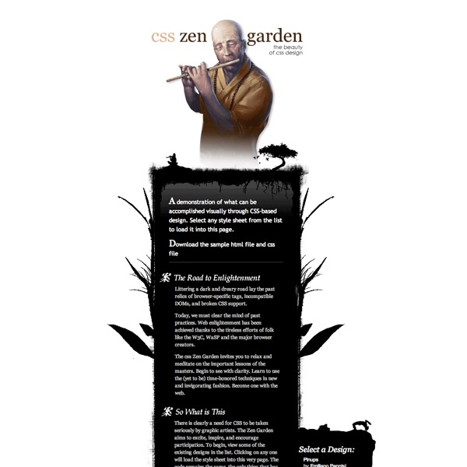
Style Separate from Structure
These pages have the exact same HTML source but different style sheets:
(csszengarden.com)

Slide 5
CSS rendering algorithm
HTML
↓
DOM (Document Object Model)
↓
CSS
↓
Style calculation
↓
Layout
↓
Paint
↓
Compositing
↓
Pixels on screen

Slide 6
Adding Styles to the Document
There are three ways to attach a style sheet to a document:
External style sheets
A separate, text-only .css file associated with the document with the link element or @import rule
Embedded style sheets
Styles are listed in the head of the HTML document in the style element.
Inline styles
Properties and values are added to an individual element with the style attribute.

Slide 7
External Style Sheets
The style rules are saved in a separate text-only .css file and attached via link
Via link element in HTML:
<head>
<title>Titles are require</title>
<link rel="stylesheet" href="/path/example.css">
</head>

Slide 8
Embedded Style Sheets
Embedded style sheets are placed in the head of the document via the style element:
      <head>
      <title>Titles are required</title>
      <style>
      /* style rules go here */
      </style>
      </head>

Slide 9
Inline Styles
Apply a style declaration to a single element with the style attribute:
<p style="font-size: large;">Paragraph text...</p>
To add multiple properties, separate them with semicolons:
<h3 style="color: red; margin-top: 30px;">Intro</h3>

Slide 10
Style Rules
Each rule selects an element and declares how it should display.
h1 { color: green; }
This rule selects all h1 elements and declares that they should be green.

Slide 11
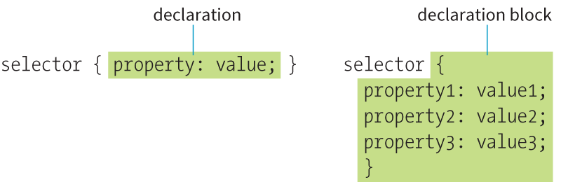
Style Rule Structure
  A style rule is made up of a selector a declaration.
  The declaration is one or more property / value pairs.

Slide 12
Selectors
There are many types of selectors. Here are just two examples:
p {property: value;}
Element type selector: Selects all elements of this type (p) in the document.
#intro {property: value}
ID selector (indicated by the # symbol) selects by ID value. In the example, an element with an id of “intro” would be selected.

Slide 13
Declarations
The declaration is made up of a property/value pair contained in curly brackets { }:
selector { property: value; }
Example
    h2 { color: red;
    font-size: 2em;
    margin-left: 30px;
    opacity: .5;
    }

Slide 14
Declarations (cont’d)
End each declaration with a semicolon to keep it separate from the next declaration.
White space is ignored, so you can stack declarations to make them easier to read.
Properties are defined in the CSS specifications.
Values are dependent on the type of property:
    Measurements
    Keywords
    Color values

Slide 15
CSS Comments
/* comment goes here */
Content between /* and */ will be ignored by the browser.
Useful for leaving notes or section labels in the style sheet.
Can be used within rules to temporarily hide style declarations in the design process.

Slide 16
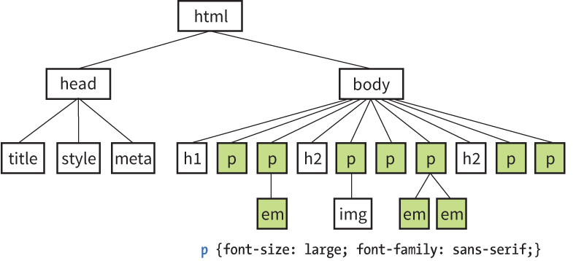
HTML DOM

Slide 17
Absolute Units
With the exception of pixels, absolute units are not appropriate for web design:
    px pixel
    in inches
    mm millimeters
    cm centimeters
    q 1/4 millimeter
    pt points (1/72 inch)
    pc pica (1 pica = 12 points = 1/6 inch)

Slide 18
Relative Units
Relative units are based on the size of something else:
    em a unit equal to the current font size
    ex x-height, equal to the height of a lowercase x
    rem root em, equal to the font size of the html element
    ch zero width, equal to the width of a zero (0)
    vw viewport width unit (equal to 1/100 of viewport width)
    vh viewport height unit (1/100 of viewport height)
    vmin viewport minimum unit (value of vh or vw, whichever is smaller)
    vmax viewport maximum unit (value of vh or vw, whichever is larger)

Slide 19
RELATIVE UNITS
The rem Unit
The rem (root em) unit is based on the font size of the html element, whatever that happens to be.
Default in modern browsers: Root font size is 16 pixels, so a rem = a 16-pixel unit.
If the root font size of the document changes, so does the size of a rem

Slide 20
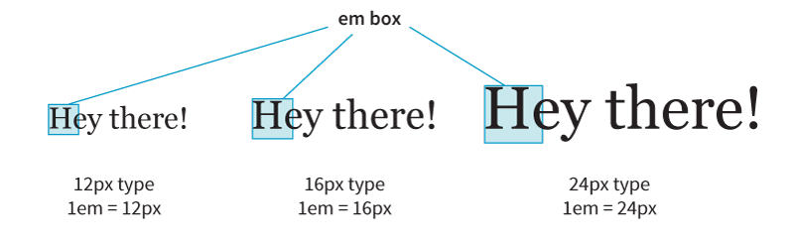
RELATIVE UNITS
The em Unit
When the font size is 16 pixels,1em = 16 pixels, 2em = 32 pixels, and so on.
NOTE: Because they’re based on the font size of the current element, the size of an em may not be consistent across a page.

Slide 21
RELATIVE UNITS
Viewport Percentage Lengths (vw/vh)
Viewport width (vw) and viewport height (vh) units are relative to the size of the viewport (browser window):
    vh = 1/100th width of viewport
    vh = 1/100th height of viewport
They’re useful for making an element fill the viewport or a specified percentage of it. This image will be 50% the width and height of the viewport:
img { width: 50vw; height: 50vh; }

Slide 22
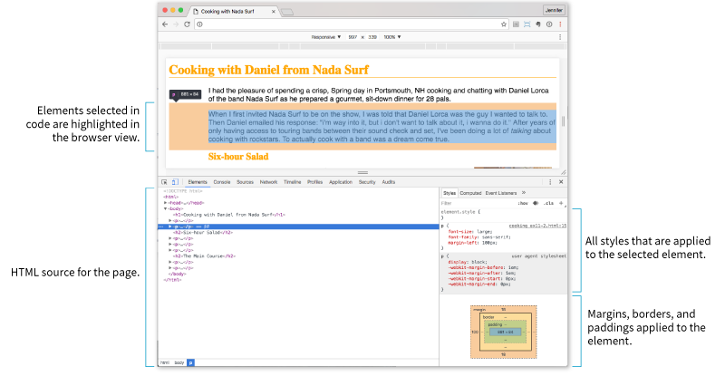
Browser Developer Tools
Chrome DevTools (View > Developer > Developer Tools)
Firefox, Safari, Opera, and Microsoft Edge also have developer tools.

