Slide 1
HTML semantiske elementer
xbi@2026

Slide 2
Form
<form action">
<!-- Form content and inputs here -->
</form>

Slide 3
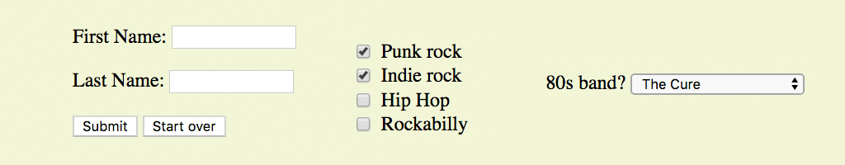
Form Control Elements
Form control elements (also called widgets) collect data from the user. A few examples:
<input type="text">
<input type="submit">
<input type="checkbox">
<select>

Slide 4
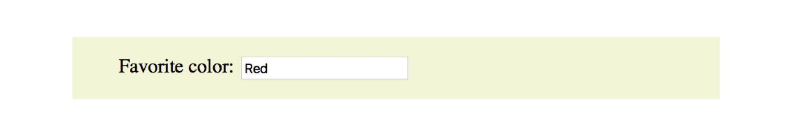
FORM CONTROL ELEMENTS
Text Entry Input
<input type="text" name="color" value="Red" maxlength="24">
type: Type of input control, in this case a single-line text field
name: Required variable name
value: Default text that appears in the field and is sent to server if the field is left blank
maxlength, minlength: Sets a character limit for the field
size: The length of the field in number of characters

Slide 5
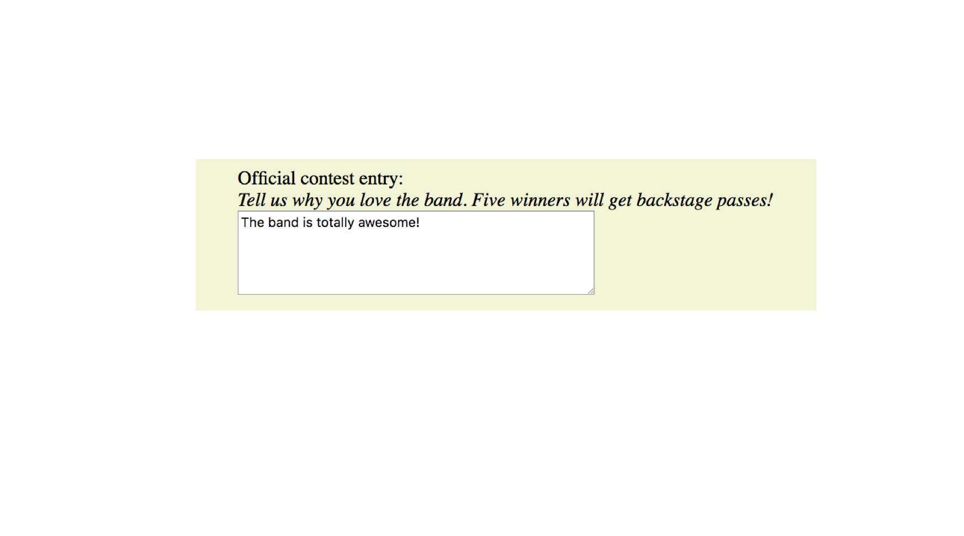
FORM CONTROL ELEMENTS
Multi-line Text Entry
<textarea name="entry" rows="6" cols="64">This band is totally awesome!</textarea>
The content of the textarea element is the default value.

Slide 6
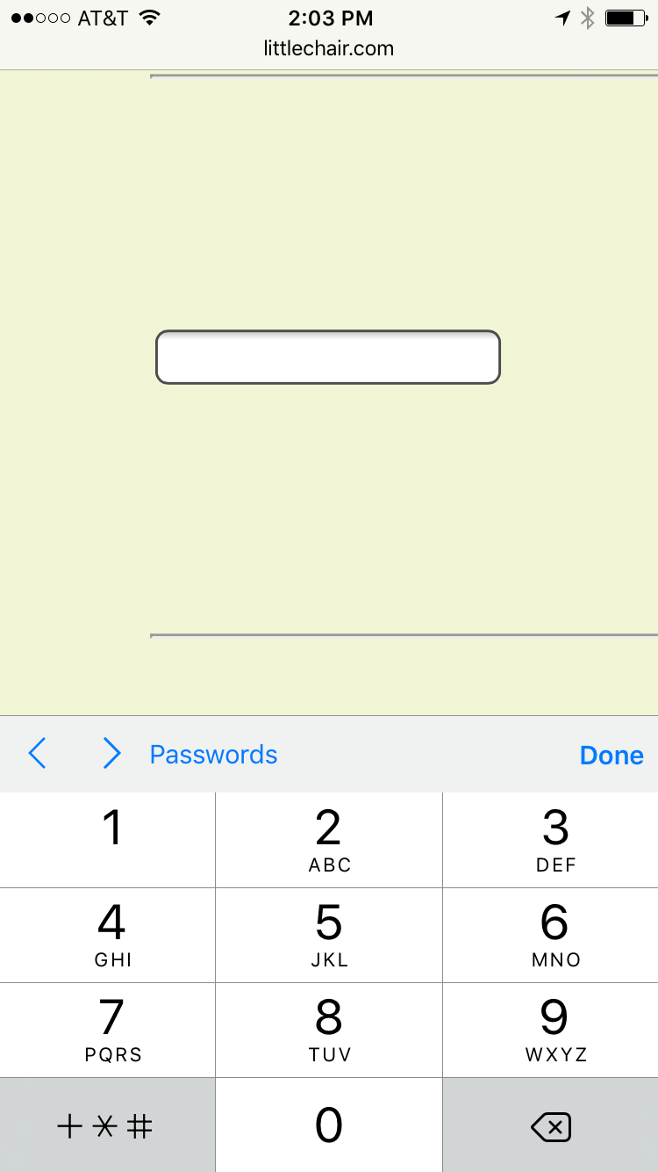
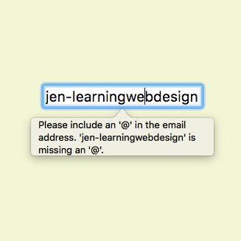
Specialized Text Entries (cont’d)
<input type="tel" name="">
<input type="email" name="">

Slide 7

FORM CONTROL ELEMENTS
Custom Buttons
<button> </button>
The button element is used for creating custom buttons with JavaScript.

Slide 8
FORM CONTROL ELEMENTS
Radio Buttons
<input type="radio">
Only one radio button may be selected at a time.
<p>How old are you?</p>
<ol>
<li><input type="radio" name="age" value="under24" checked> under 24</li>
<li><input type="radio" name="age" value="25-34"> 25 to 34</li>
<li><input type="radio" name="age" value="35-44"> 35 to 44</li>
<li><input type="radio" name="age" value="over45"> 45+</li>
</ol>

Slide 9
FORM CONTROL ELEMENTS
Checkbox Buttons
<input type="checkbox">
Multiple checkbox buttons may be selected.
<p>What type of music do you listen to?</p>
<ul>
<li><input type="checkbox" name="genre" value="punk" checked> Punk rock</li>
<li><input type="checkbox" name="genre" value="indie" checked> Indie rock</li>
<li><input type="checkbox" name="genre" value="hiphop"> Hip Hop</li>
<li><input type="checkbox" name="genre" value="rockabilly"> Rockabilly</li>
</ul>

Slide 10
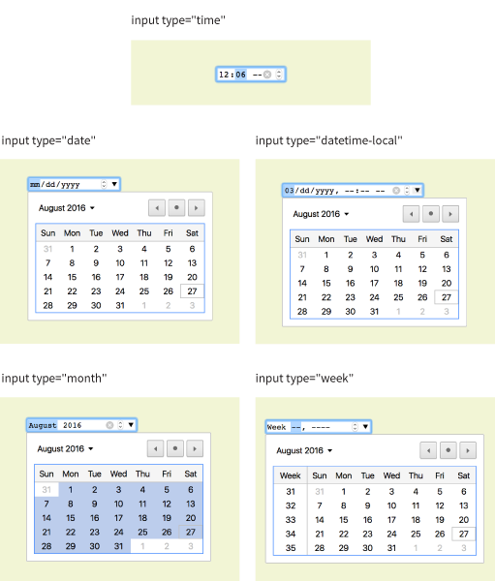
FORM CONTROL ELEMENTS
Date and Time Controls
<input type="date">
<input type="time">
<input type="datetime-local">
<input type="month">
<input type="week">

Slide 11
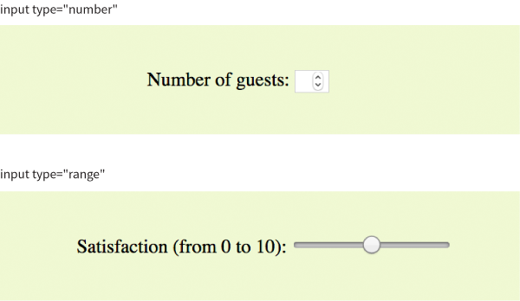
FORM CONTROL ELEMENTS
Numerical Controls
<input type="number">
<input type="range">
Number and range controls collect numerical data. Browsers may render counter or slider widgets.
Both types accept min and max attributes for setting limits on the allowed values.

Slide 12
Labels
The label element associates a descriptive label with a form field.
<label for="name">Name:</label>
<input type="text" id="name" name="name">
Notes:
If the user clicks the word "Name:", the cursor will automatically move into the input field.

Slide 13
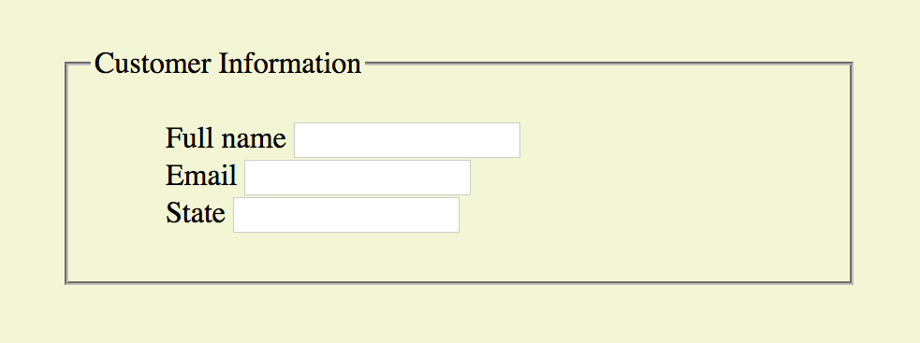
Fieldsets and Legends (cont’d)
<fieldset>
<legend>Customer Information</legend>
<ul>
<li><label>Full name: <input type="text" name="fullname"></label></li>
<li><label>Email: <input type="text" name="email"></label></li>
<li><label>State: <input type="text" name="state"></label></li>
</ul>
</fieldset>

Slide 14
Gruppe exercise

Slide 15
HTML5
Semantic
Notes:
Why?

Slide 16
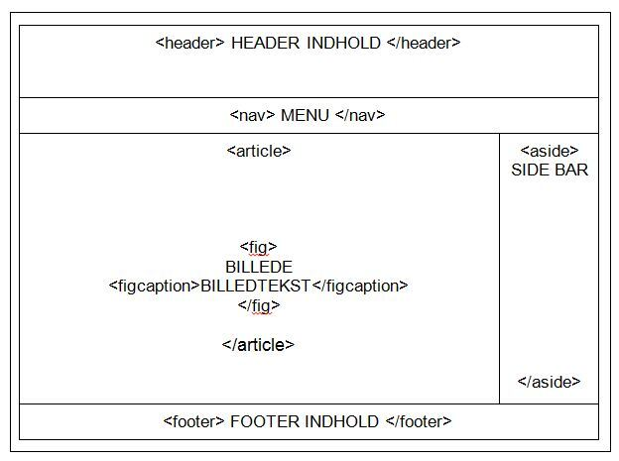

Slide 17
HTML5 Semantic Structure Elements
Header
Nav
Main
Section
Article
Figure
Figcaption
Aside
Footer

Slide 18
Validering
Check your code for syntax errors
Benefit:
Valid code →
more consistent browser display
W3C HTML Validation Tool
http://validator.w3.org

Slide 19
Gruppe Project

