Slide 1
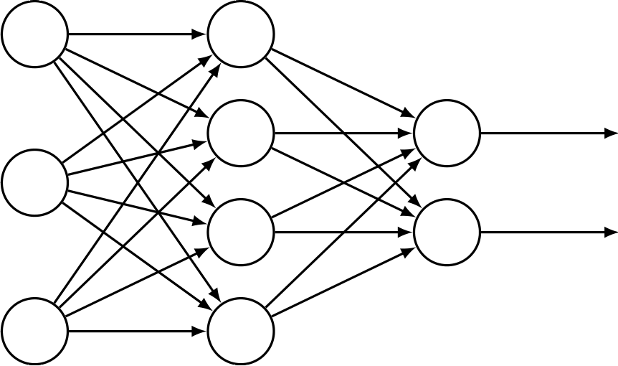







Prediction Network
$$w·L(y_{c}, fθ\left(c | X\right))$$
Backpropagation
Morality Prediction
Loss
Backpropagation
⊙
Tweets
$$fθ(c|X)$$
$$X$$
Neural Extractor
$$w$$
$$X$$
Weighting Network
$$L(y_{d}, fφ\left(d | X\right))$$
Domain Prediction
Loss
Backpropagation
$$fφ(d|X)$$
Backpropagation

