Slide 1




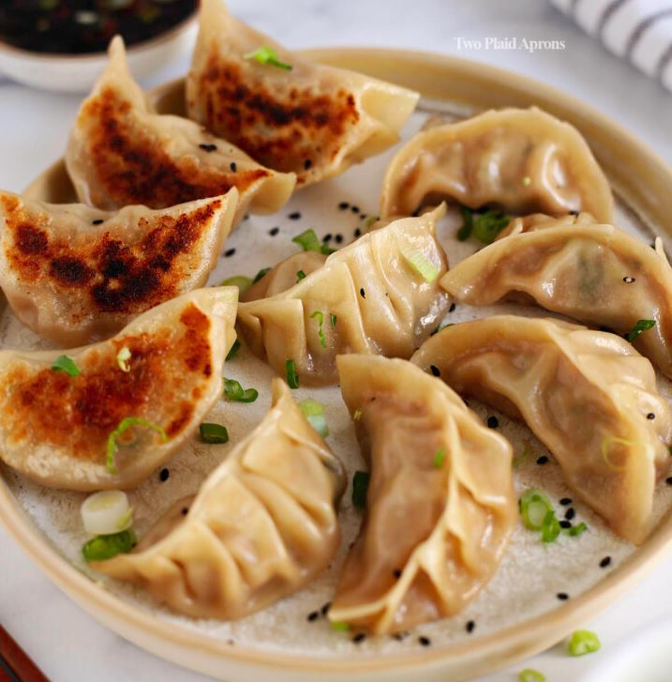
FoodVision APP

Slide 2
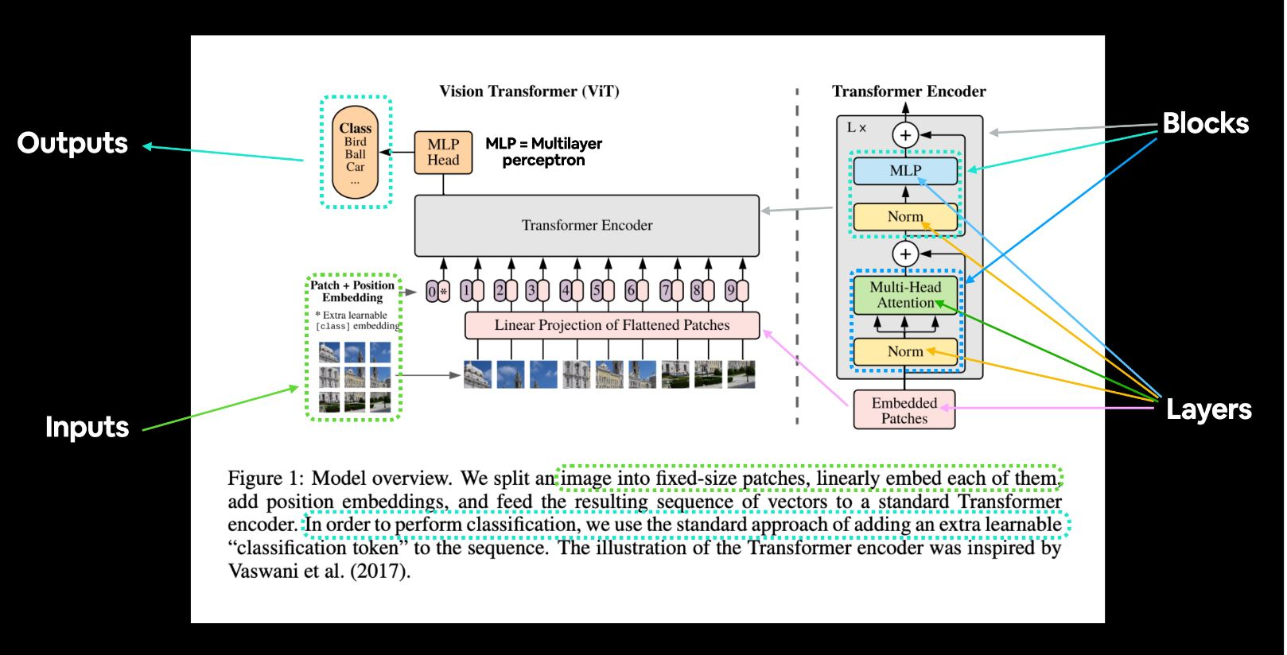
https://arxiv.org/abs/2010.11929

Slide 3
