Slide 1
Planning by Dynamic Programming
姜玥旭

Slide 2
Outline
Introduction
Policy Evaluation
Policy Iteration
Value Iteration

Slide 3
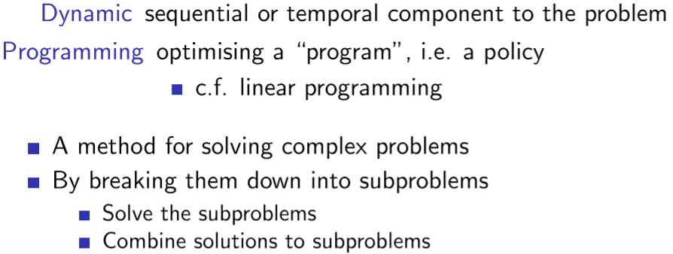
What is Dynamic Programming?

Slide 4
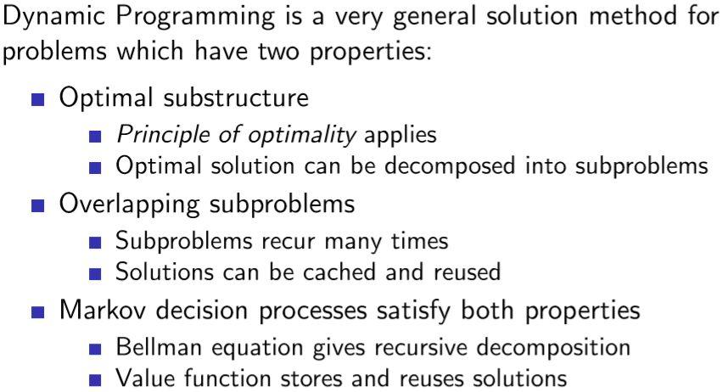
Requirements for Dynamic Programming

Slide 5
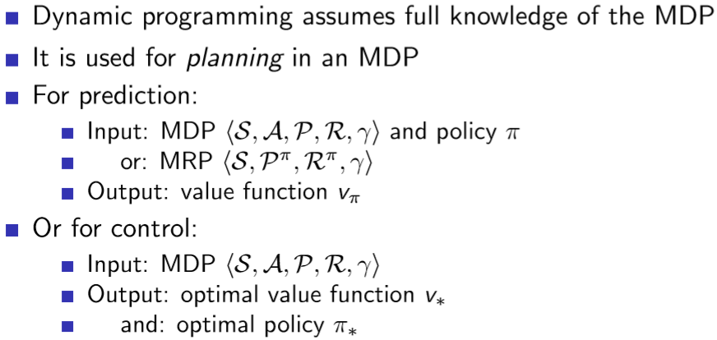
Planning by Dynamic Programming

Slide 6
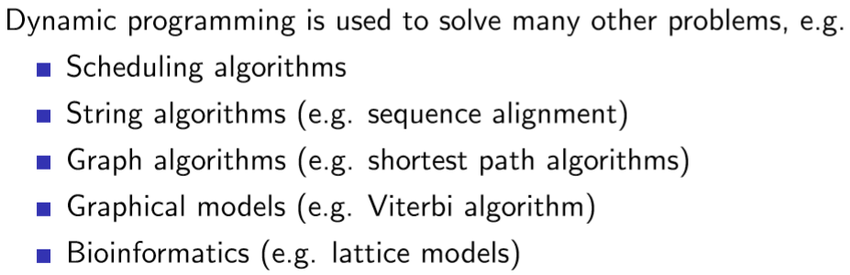
Other Applications of Dynamic Programming

Slide 7
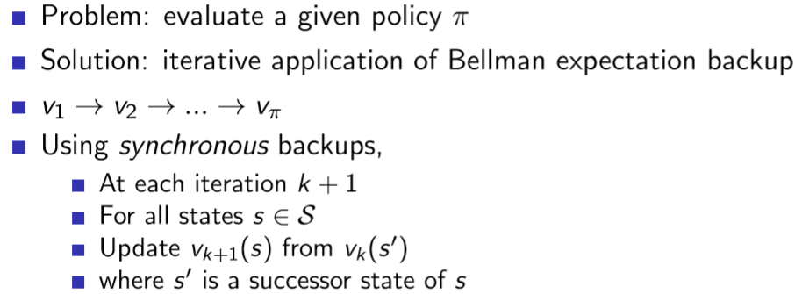
Iterative Policy Evaluation

Slide 8
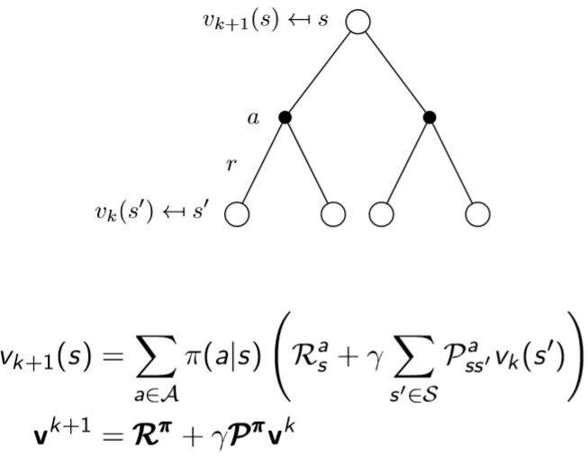
Iterative Policy Evaluation (2)

Slide 9
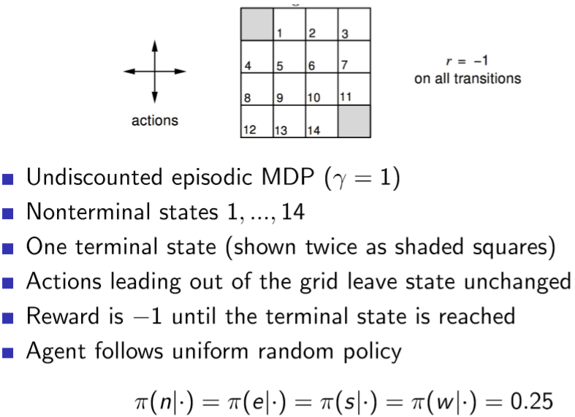
Evaluating a Random Policy in the Small Gridworld

Slide 10
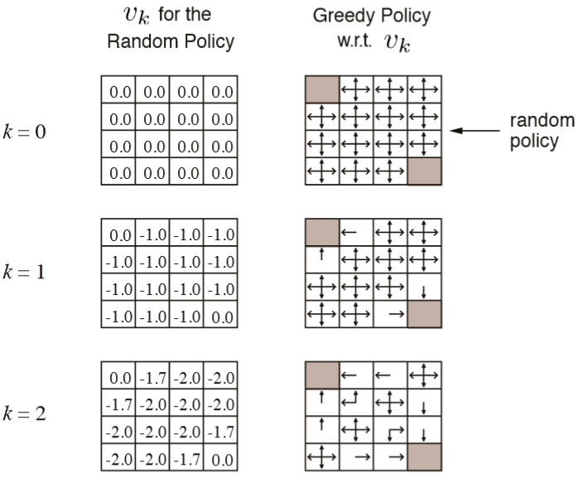
Iterative Policy Evaluation in Small Gridworld

Slide 11
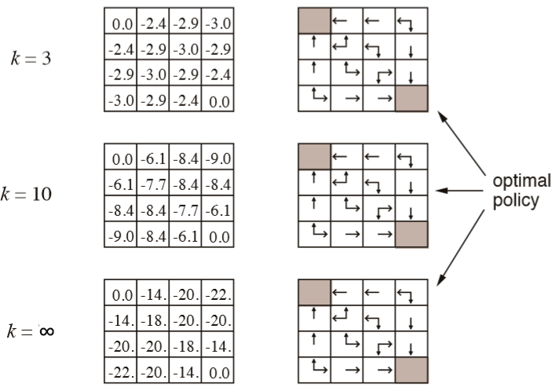
Iterative Policy Evaluation in Small Gridworld (2)

Slide 12
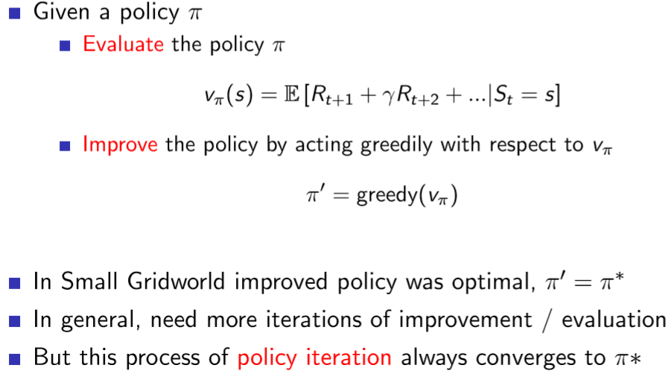
How to Improve a Policy

Slide 13
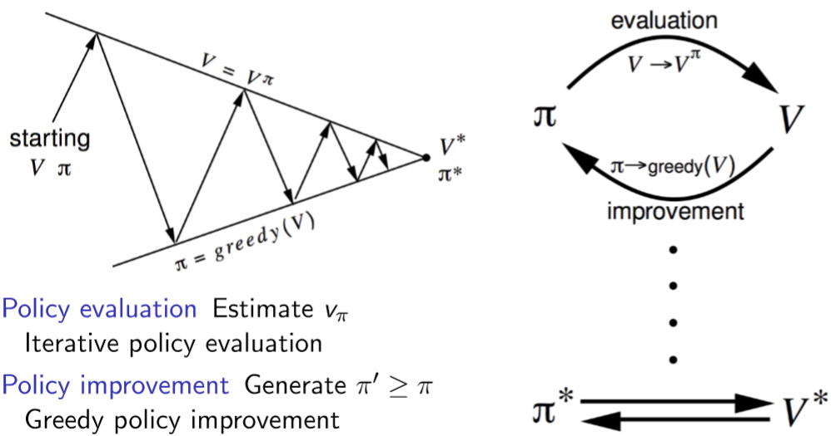
Policy Iteration

Slide 14
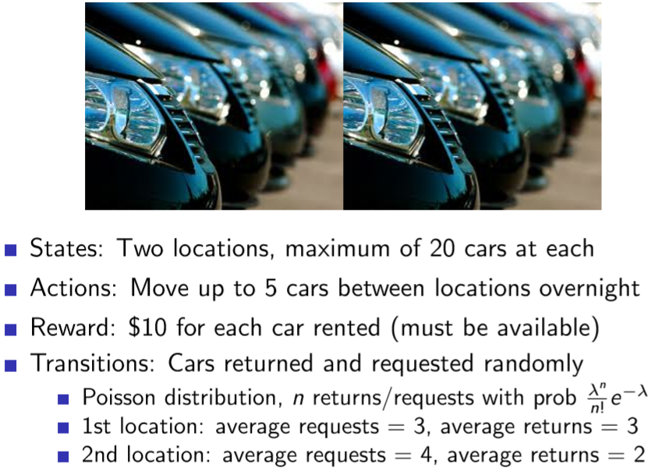
Jack’s Car Rental

Slide 15
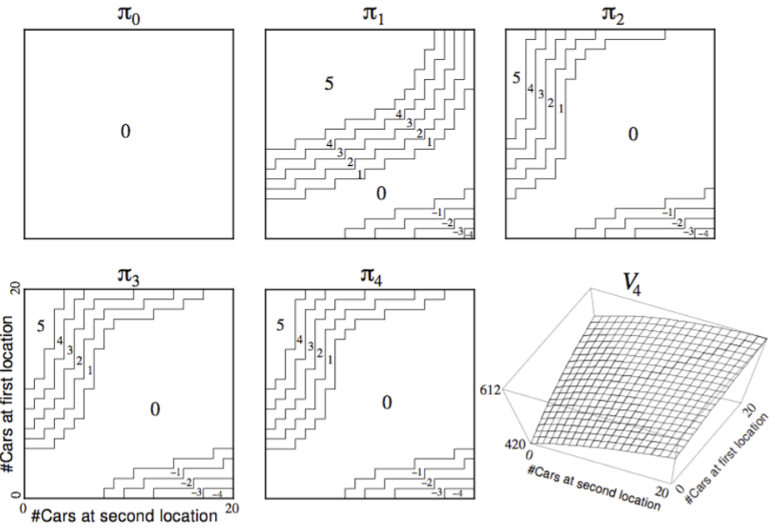
Policy Iteration in Jack’s Car Rental

Slide 16
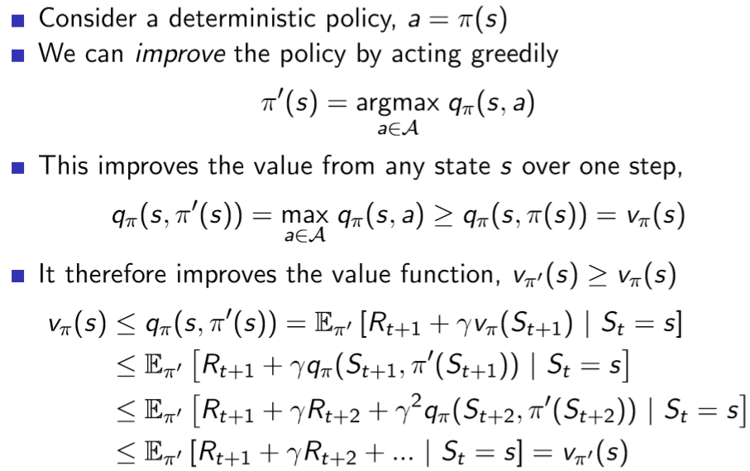
Policy Improvement

Slide 17
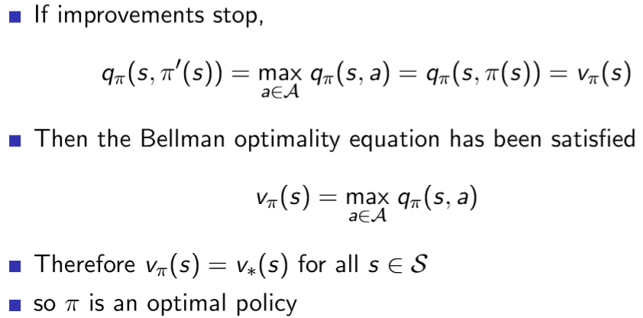
Policy Improvement (2)

Slide 18
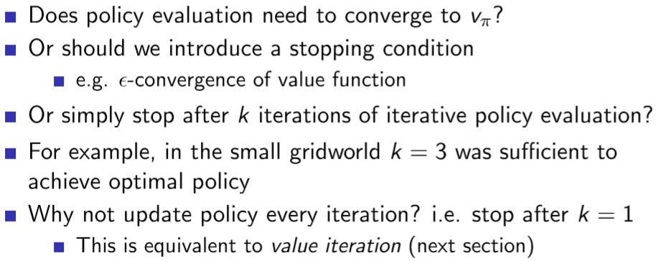
Modiﬁed Policy Iteration

Slide 19
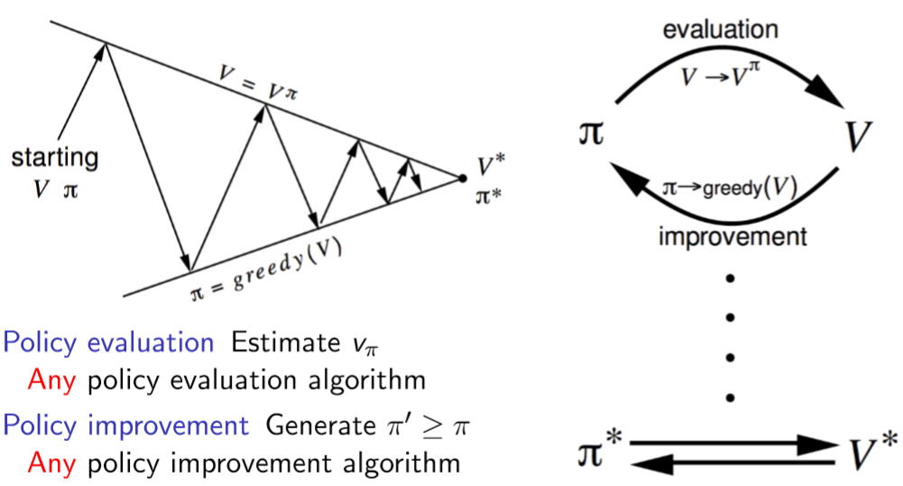
Generalised Policy Iteration

Slide 20
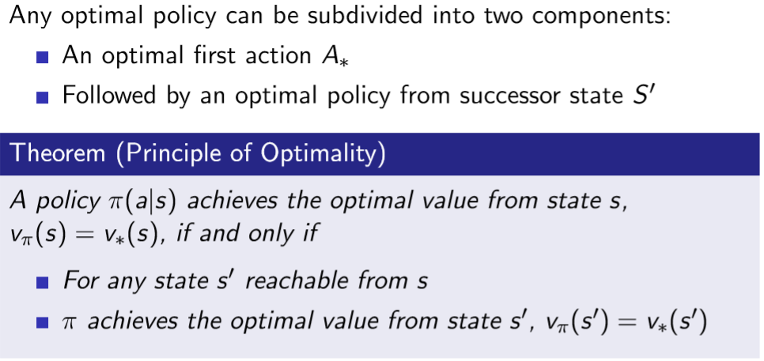
Principle of Optimality

Slide 21
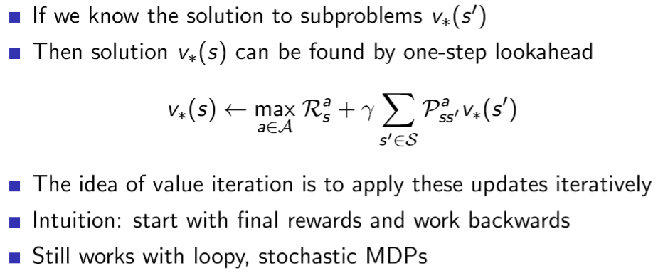
Deterministic Value Iteration

Slide 22
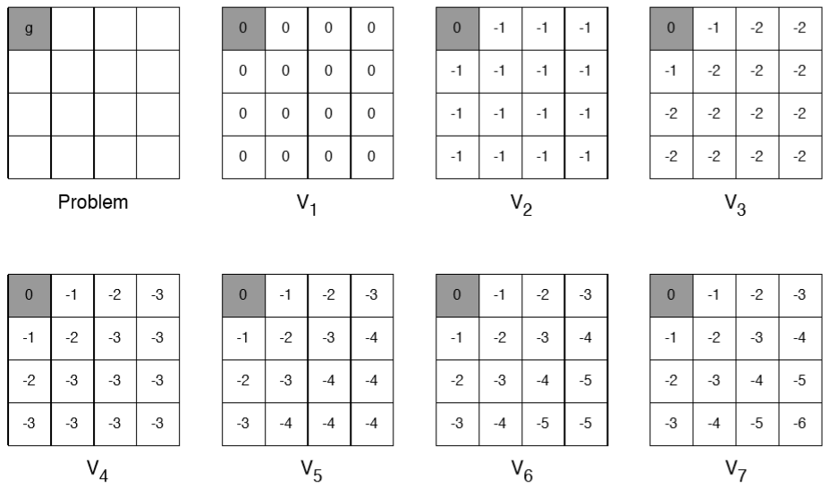
Example: Shortest Path

Slide 23
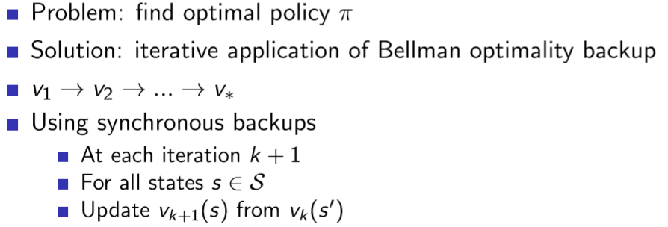
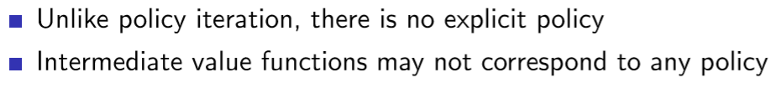
Value Iteration

Slide 24
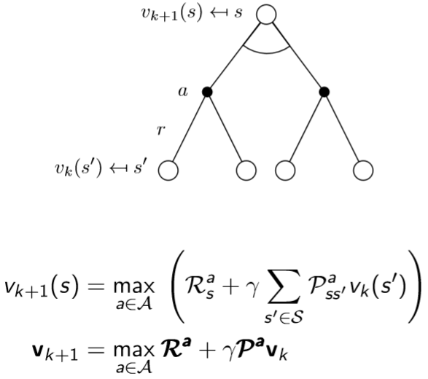
Value Iteration (2)

Slide 25
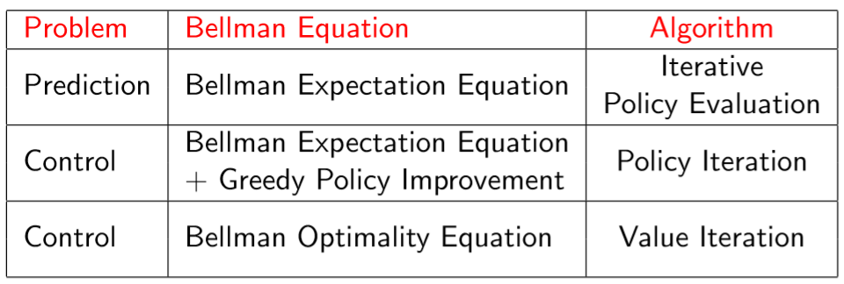
Synchronous Dynamic Programming Algorithms

