Slide 2
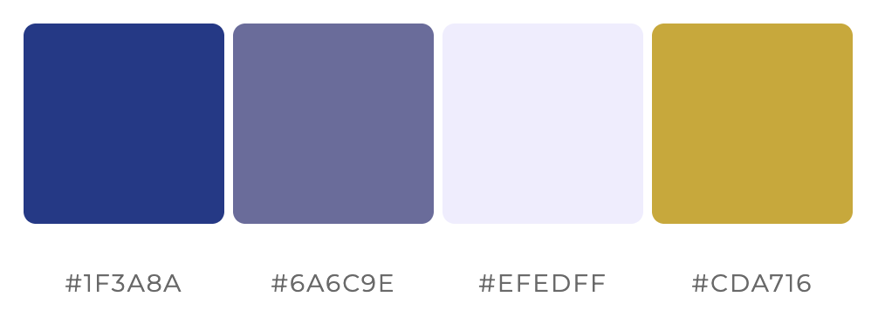

Slide 4




Upload
Auto-fill
Export

