Slide 2
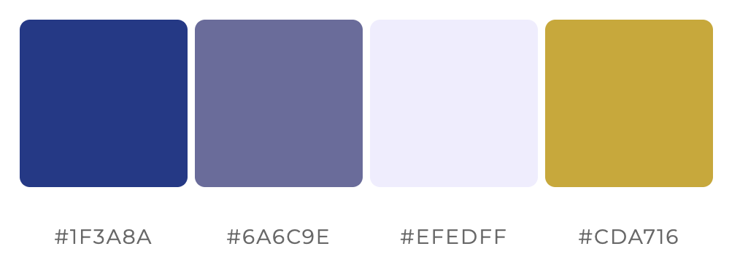

Slide 4




Upload
Auto-fill
Export

Slide 6





Input
Processing
Output
User
Upload
Parse Vars
Calc & Chart
Preview
Export

