Slide 1

SMSS Functionalities Values and Features
SMSS Introduction
Dev Team: Spring @TJU
Dev Partner: 张仁宇 zhangrenyutj@gmail.com
刘洪滨 liuhongbin2007@gmail.com
Notes:
联系方式
电话：400-658-5880 北京办事处：13691596001
邮件：support@cn9sky.net
地址：山东济南东关大街5号中泰大厦5楼

Slide 2
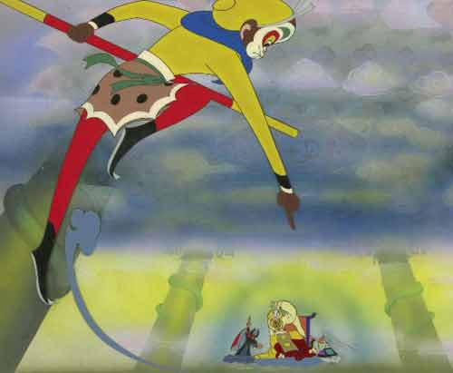
Origin of Idea
In classical Chinese fiction “Journey to the West”, Sun Wukong
always draw a circle, whose magic power
can resist everything, to protect his master,
while still robbed by monsters.
So why this happened ?
Spring analyzed and got two cues:
the protecting circle is unable to
alarm and inform Sun that
something is disturbing.
the protecting circle cannot move
when Sun`s master moves.

Slide 3
Functionalities of SMSS
Spring devise and develop SMSS, the Spring Mobile Security
System to help Sun, providing the following functions:
Convenient user IP Camera management
Basic real in time scene view
Easy security region selection and monitoring
Efficient selected region intrusion detection concerning occlusion
Efficient motion tracking focusing on selected objects
Real in time alarming and noticing

Slide 4
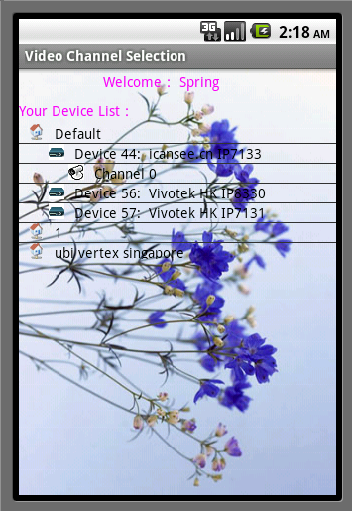
Functionalities of SMSS
tree style
IP Camera manager

Slide 5
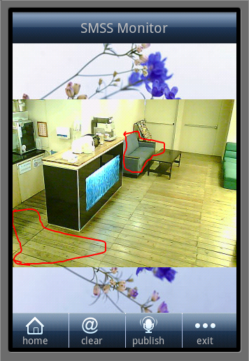
Functionalities of SMSS
scene view window
region selecting
and monitor
region intrusion detecting
motion tracking
security alarm
these three distributed among cloud.

Slide 6
Values of SMSS
SMSS bases on newly born 3G mobile platform and the cutting
edge IP Camera of KAI Square, integrates widely spread cloud
computing, providing mobile monitoring apps and cloud security
services, which far surpasses traditional video monitoring
systems.
SMSS leverages mobile devices` compact and portable
features to monitor and control in anytime, at anywhere, on
user selected objects, in user preferred manners.
SMSS takes advantage of cloud computing, including cloud
infrastructure and cloud platform, to provide various
customizable security services.

Slide 7
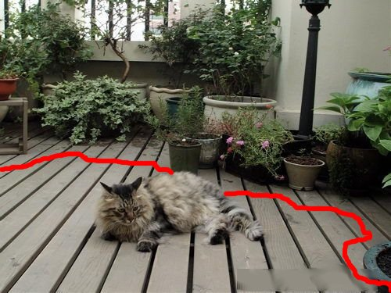
Values of SMSS
SMSS can be used in a wide variety of areas to complete
identified tasks, such as home care, goods watch, moving
objects tracking, entrance guarding, depends on where you
draw the protecting circle. In the following section we`ll
provide a few scenes to further describe the values of
SMSS.
Scene1: home care
keep pet away from
garden plants
alarming line

Slide 8
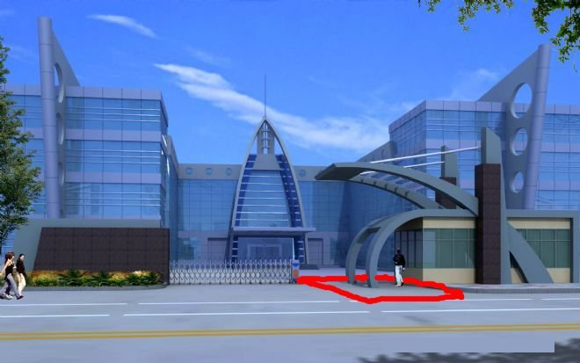
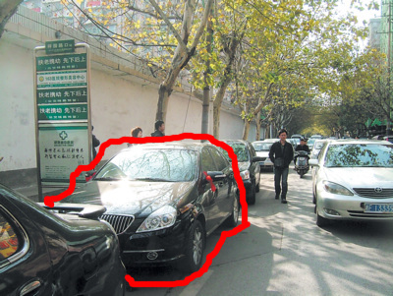
Values of SMSS
Scene2: Entrance Guarding
automatic noticing
new comers
Scene3: Goods Watch
car locking and tracking
pre-selected alarming region
user draw invisible lock

Slide 9
Future Development of SMSS
Spring will further strengthen the mobile client, purify user
interface, promote user experience and finally provide for
free.
Spring will definitely focus on the customizable cloud security
services and charge from them.
This time Spring used restricted Google Apps Engine, Google
Data Store and C2DM, some what unsatisfied. We look forward
to more free cloud infrastructure and platform in near future
provided by corporations as Google and KAI Square, so Spring
can provide more professional security services.
SMSS is not just a developed software, it is a fashion of
providing services.

Slide 10
Thank You!
We also thank …
KAI Square Pte Ltd.
Google Inc.
TJU Computer Vision Lib
TJU Free Software Foundation
Li Ming KAI Square Regional Manager (China)
白石 KAI Square
陈易凡 KAI Square
… … … …

