Slide 1
Daily Picture
By Xiao Luo

Slide 2
Introduction
Users will sign up to the application and get a “Picture of the Day” based on word or phrase. Then they will receive a notification when a new image is available. Users may also view a gallery of all images received so far.
Images will be obtained through search engines and may be unique between users. To manage questionable content images will be approved beforehand by an admin and users may also report images.

Slide 3
Components
REST API that retrieves images either through request or by schedule
An cross-platform application to receive notifications and view images received
Image server

Slide 4
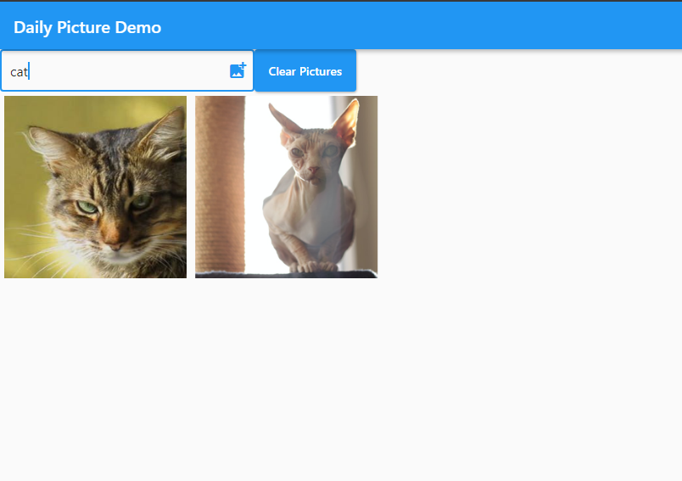
Demo

Slide 5
Why not just Google?
We download and host the images ourselves, allowing finer grained control
Compared to our final product:
- Google Images doesn’t support zip download and auto conversion
- No approval and reporting system

Slide 6
Compared to similar ideas
Subject may not be of interest to you
Everyone sees the same picture
Often no notification system
Content is more curated

Slide 7
Technical Overview

Slide 8
API Backend
Web Stack
- Postgresql (Database backend for Django)
- Django (Rest API Framework, celery beat models)
- Gunicorn (WSGI HTTP server)
- Nginx (Front facing server, also hosts application and static images)

Slide 9
API Functionality
Image search and downloads
Serve Image metadata
Image conversion/resizing
Scheduling tasks and changing schedules
User data and authentication
User Gallerys
Administration, including approval and report system

Slide 10
Task Queue
Celery
- Performs tasks passed to it from Django
Redis
- Message broker backend for Celery
Celery Beat Scheduler
- Schedules celery tasks
- Backed by Django Models so they can be managed through REST API

Slide 11
Image Server
Served as static content through Nginx
Plan to add modules to support zip downloads and auto image format conversion and resizing

Slide 12
Application
Flutter (UI Development Platform by Google)
- Cross-platform development
- Native performance
- Web support in beta
- Dart (Open source statically typed language optimized for UI)

Slide 13
Known Bugs
Backspace in Firefox moves back in history rather than deleting text in field
Spamming requests causes occasional errors

Slide 14
Planned Features
Using additional search engines and potentially our own web scrapers for a wider array of content
Reverse Image Search
Admin approval and user reporting systems
Download multiple images in zip folder
Auto conversion between formats and resizing of images
Notifications when new images are available

