Slide 1
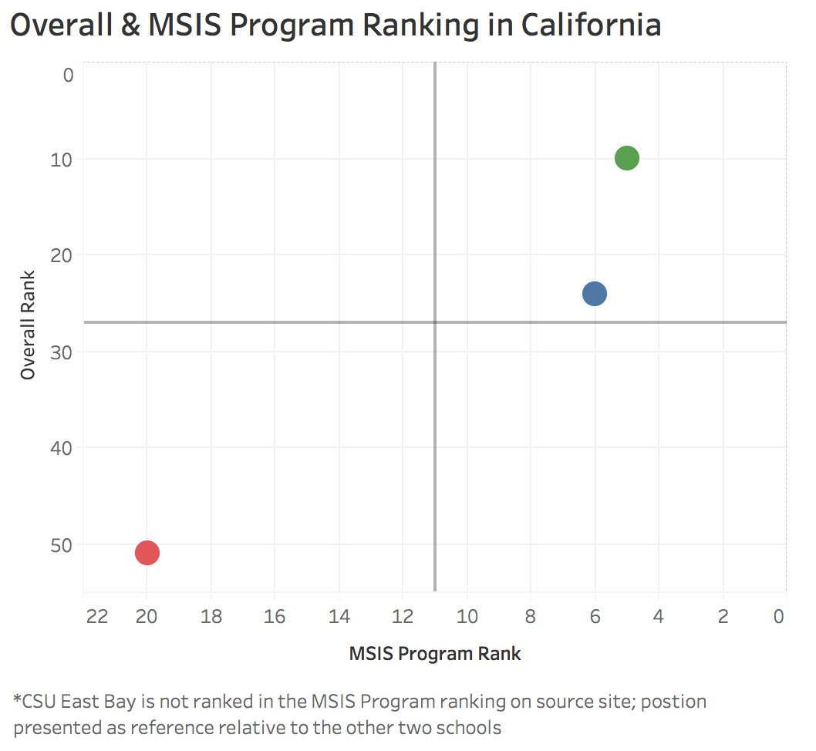
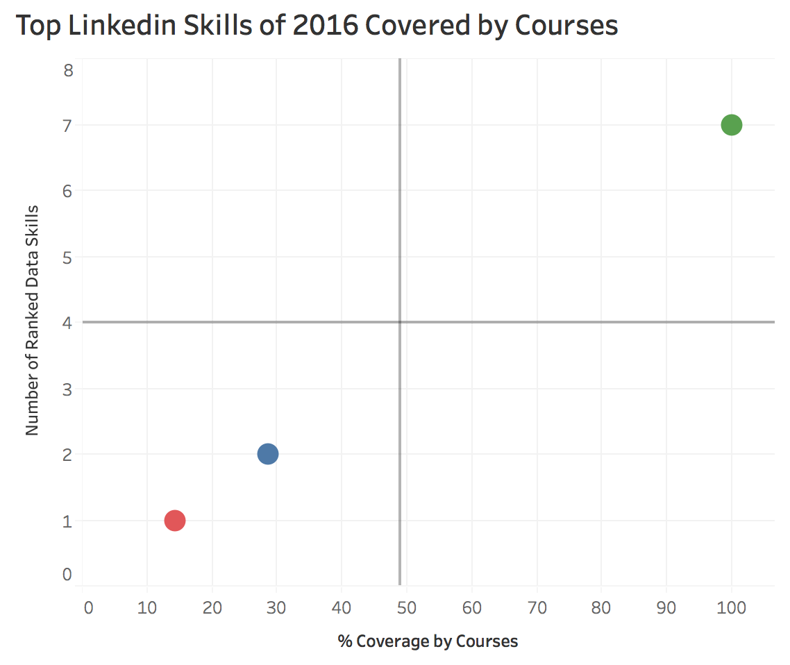
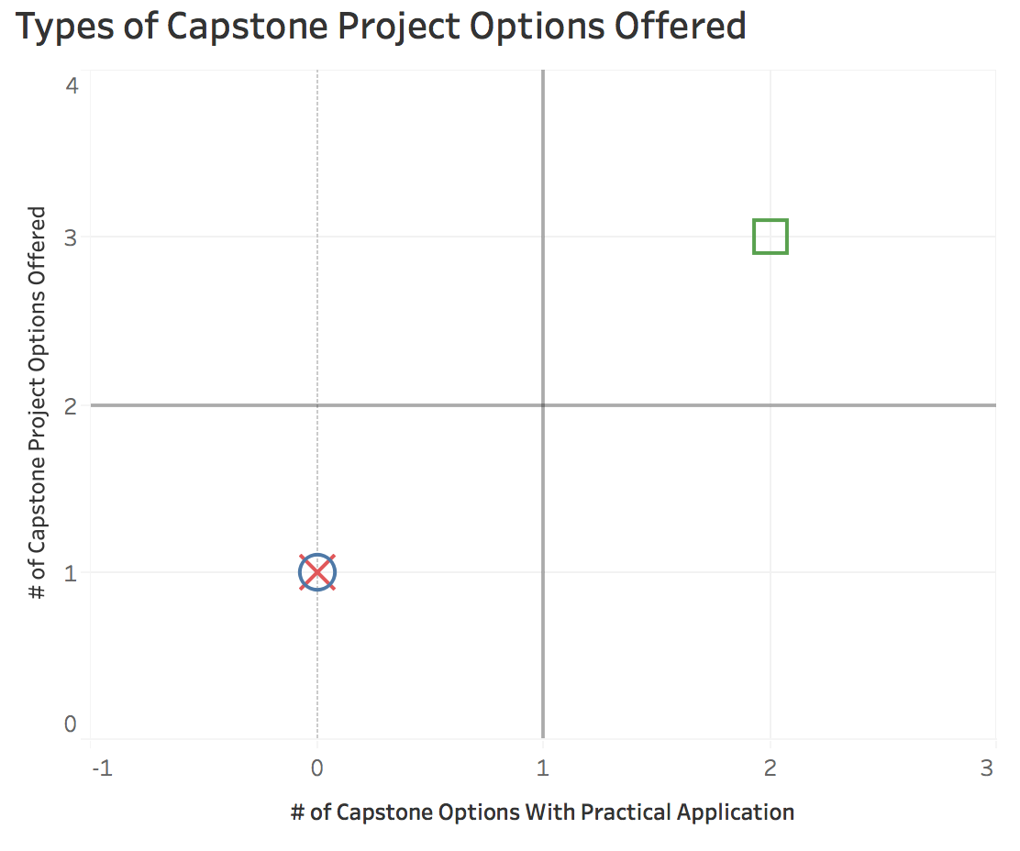
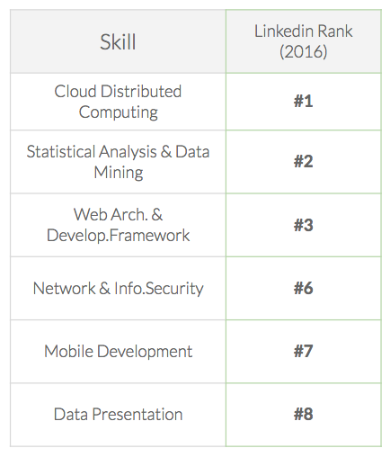
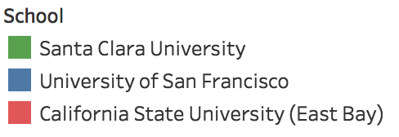
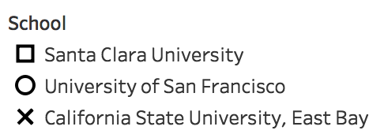
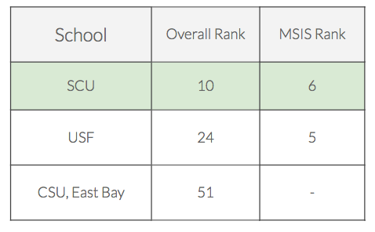
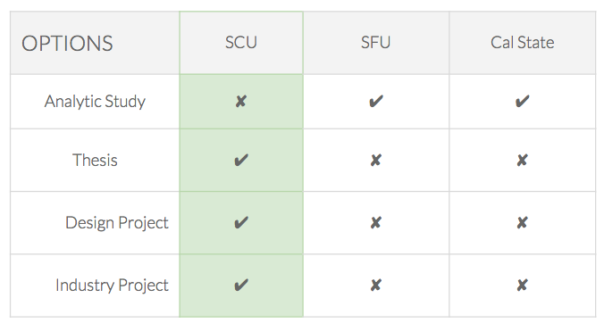
Santa Clara University MSIS Program

Slide 2
Sources
Big Data Salaries:
https://datajobs.com/big-data-salary
Top Linkedin Skills:
https://www.tableau.com/about/blog/2017/4/flex-your-data-skills-makeover-monday-68584
University of San Francisco MSIS Program Details:
https://www.usfca.edu/management/graduate-programs/information-systems/program-details
Cal State East Bay Business Analytics Option:
http://catalog.csueastbay.edu/preview_program.php?catoid=4&poid=1590
Best Colleges in California (Class Google Drive):
https://drive.google.com/open?id=0BzDtOOgjkAWUYzJzbGphc3JKNG8
Best Information Systems Colleges in California:
https://www.universities.com/find/california/best/computer-technology/information-systems

