Slide 1

Does Parental Out-migration Benefit Left-behind Children’s Schooling Outcomes? -- Evidence from Rural China
Xiaoman Luo
Department of Agricultural and Resource Economics,
University of California, Davis

Slide 2
Background
160 million migrate from rural to urban areas (NBS, 2013)
61 million children left behind, accounting for 37.7% of children in rural China, and 21.9% of children in China (NBS, 2010).

Slide 3
Research Question
Does parental out-migration have significant influence on left-behind children’s schooling outcomes?
What are the mechanisms of influence?
Parental accompaniment (direct)
Study time (indirect)
Education spending (indirect)

Slide 4
Contributions
Establish a theoretical framework (skipped)
Use Structural Equation Modeling (SEM) to study different mechanisms of influence
Propose a systematic identification strategy to deal with different sources of endogeneity

Slide 5
Data

Slide 6
Data
RUMiC Survey: 08 & 09 data released by the Institute of Labor Economics (IZA)
Survey Name | Panel Structure | Sampling Method
Rural household survey (RHS) | 8000 households, 0.4% attrition rate at individual level, 0.1% attrition rate at household level | Random samples based on permanent residential address
Urban household survey (UHS) | 5000 households, 5.8% attrition rate at individual level, 5.4% attrition rate at household level | Random samples based on permanent residential address
Migrant household survey (MHS) | 5000 households, 58.4% attrition rate at individual level, 63.6% attrition rate at household level | Random samples based on workplace

Slide 7
Data
Sample size: 2393 children in 1760 households
Origin: 81 cities in 9 Provinces
Destination: 176 cities in 31 Provinces

Slide 8
Outcome: Exam Scores
Different score scales: convert to 100 points in total.
Comparable scores:
7 out of 9 Provinces use the same textbook version, 2 Provinces use two other textbooks
All textbook versions and exams are designed closely following the Curriculum Standard designed by the Ministry of Education of China
Validity of scores:
Reported by guardians
Recorded on score reports handed to guardians from schools every semester

Slide 9
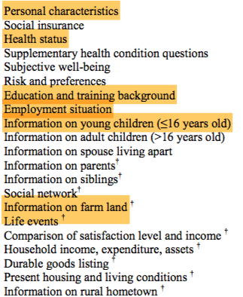
2009 RHS Data
Questionnaire modules:
Akgüç, Mehtap, Corrado Giulietti, and Klaus F. Zimmermann. "The RUMiC longitudinal survey: Fostering research on labor markets in China." IZA Journal of Labor & Development 3.1 (2014): 5.
Main variable list:
Outcome | Language score, math score
Migration | Dummy for parental migration, migration origin-destination-industry information
Child | Weekly study hours, gender, age, weight, height, birthweight
Parent | Age, education years
Household | Farm size, share of adult males

Slide 10
Empirical Framework

Slide 11
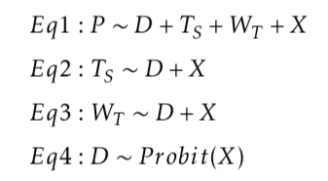
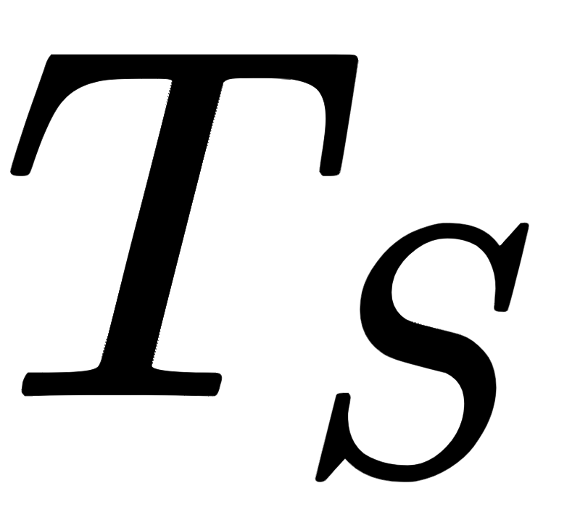



Regression Model: Structural Form
P | Exam scores of child
D | Measure of parent migration (dummy)
T_{S} | Hours spent studying per week
W_{T} | Spending on child education
X | The set of control variables

Slide 12





Effect Decomposition: Direct and Indirect Effects
Total effect decomposed into three channels:

Slide 13

Endogeneity

Slide 14



Instrumental Variables
: Bartik
: Adult male share
: Size of farmable land in household
Sufficient for identification of both direct and indirect effect (order condition)

Slide 15
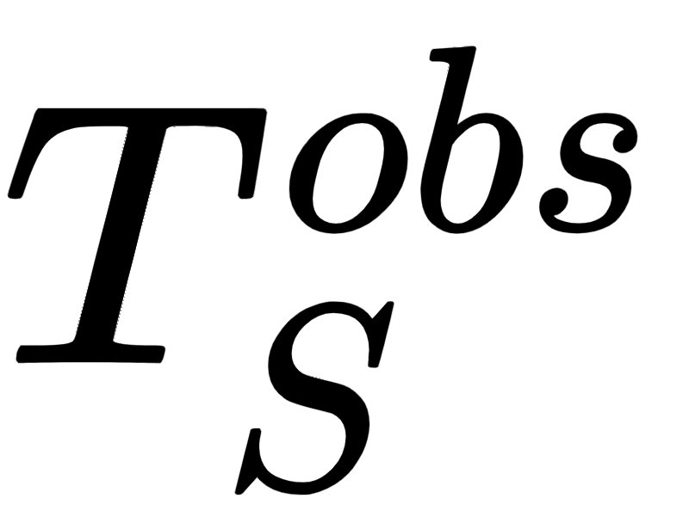

Another Source of Endogeneity: Nonrandom Missing
Children with missing values in study hour and education spending much more negatively affected
Ignoring the missing values will underestimate the effect
Heckman selection model reported when utility exceeds a certain threshold

Slide 16
Estimation (sketch)
Impute missing and by Heckman model
Fitting the SEM on imputed data via MLE (R Lavaan package)

Slide 17
Empirical Results

Slide 18
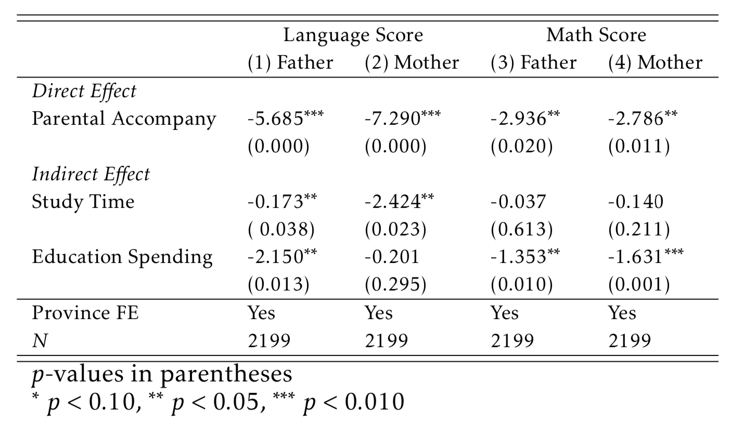
All Samples (Imputed)

Slide 19
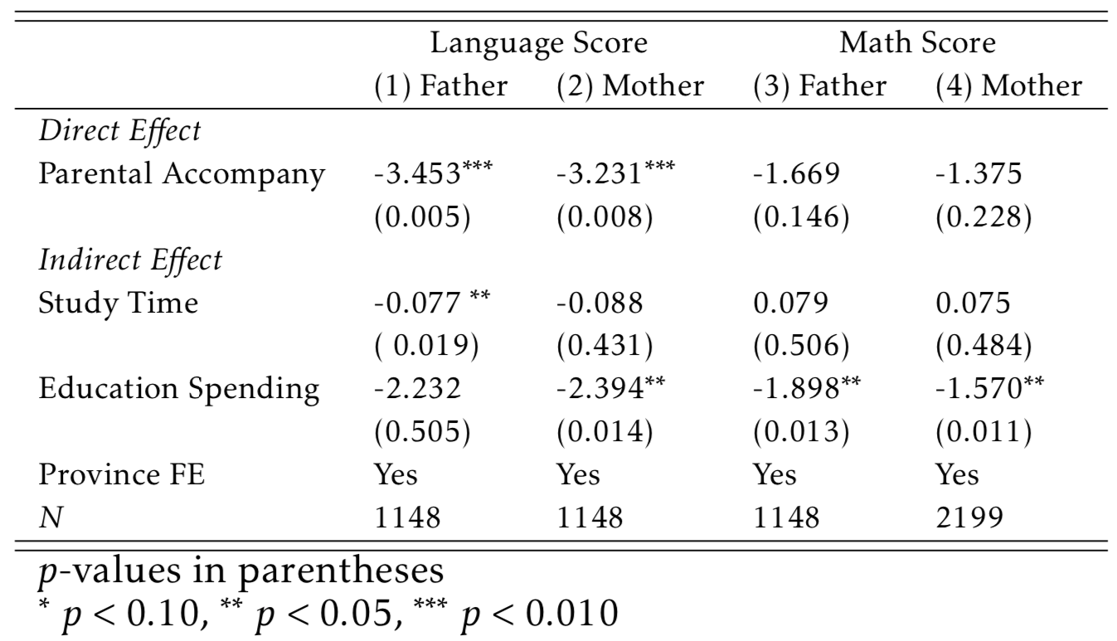
All Samples (Not Imputed)

Slide 20
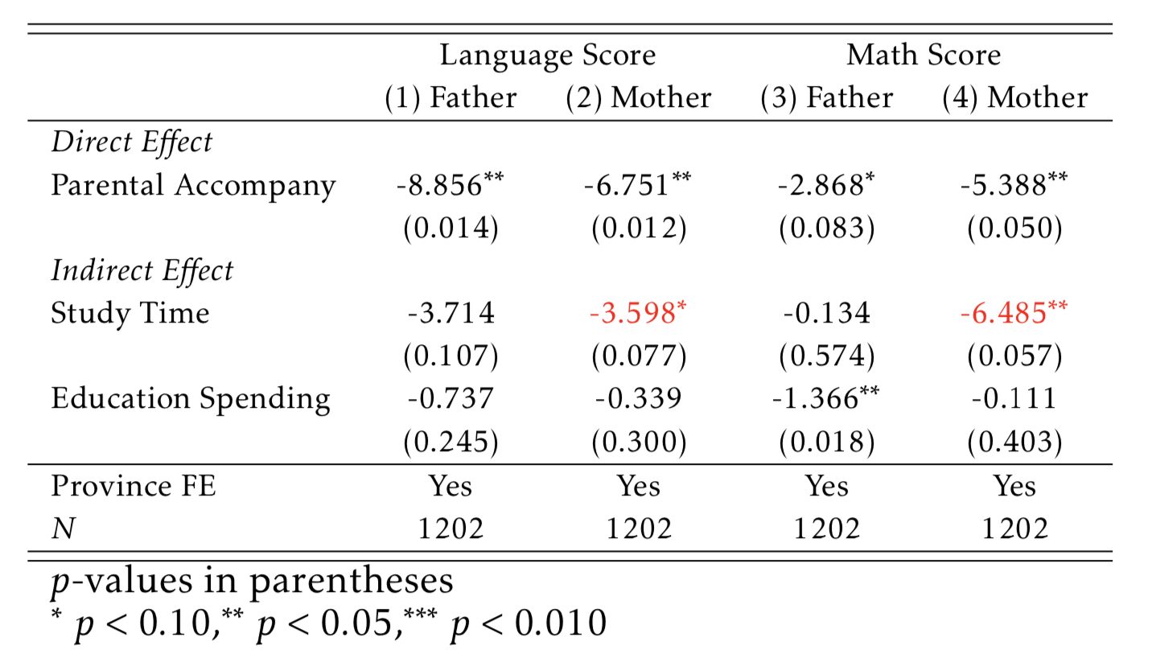
Subgroup of Boys

Slide 21
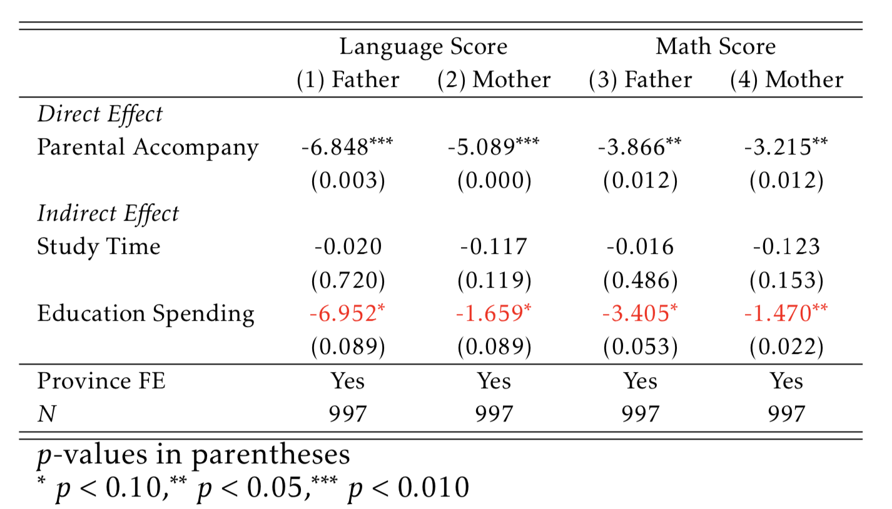
Subgroup of Girls

Slide 22
Summary
Significant negative direct effect of both father and mother migration on left-behind children’s language scores, but relatively smaller effect on these children’s math scores.
The empirical results confirm that structural models could further understand the mechanism of influence.
Should not simply remove NA’s when observations are missing non-randomly

Slide 23
Thanks!
https://xiaomanluo.github.io/

