Slide 1
GEICO Mini-Project
Service Payment Call Prediction
Xiaomu Liu

Slide 2
Outline
Objective
Overview of data
Modeling framework
Results
Summary

Slide 3
Problem Statement
Data provided
The scope of this study
Customers who have had a bill due in the next 5 days and whether they made a service payment call (130086 records 05/13/2014-05/20/2014).
Each record is associated with a set of variables that summarize the characteristics of the customer and his/her payment behaviors
Data preparation:
Sanity check
Exploratory analysis
Modeling
Model selection
Performance evaluation
Not included:
Sophisticated feature engineering
Statistical tests for model comparison
Model interpretation
Objective
Predict the likelihood that each policyholder will make a service payment call.

Slide 4
An Overview of Data
29 fields
Target variable: Call_Flag
Exclude the following variables for modeling:
DATE_FOR: assuming examples are time-independent
EVENT1_30_FLAG: all the values = 0
18 numerical variables and 8 categorical variables
130086 records of which
125322 records with Call_Flag=0
4764 records Call_Flag=1
Imbalanced ratio = 26 : 1
809 rows have missing values that correspond to the same fields.

Slide 5
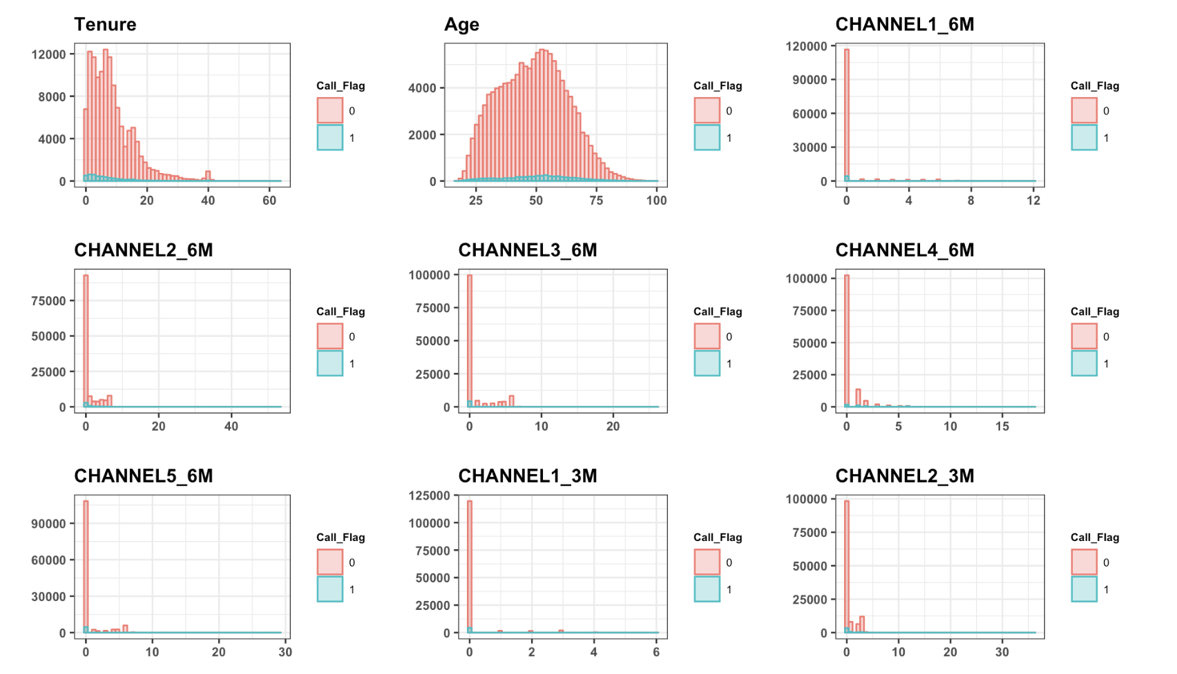
Exploratory Data Analysis: Distributions of Numerical Variables (1)

Slide 6
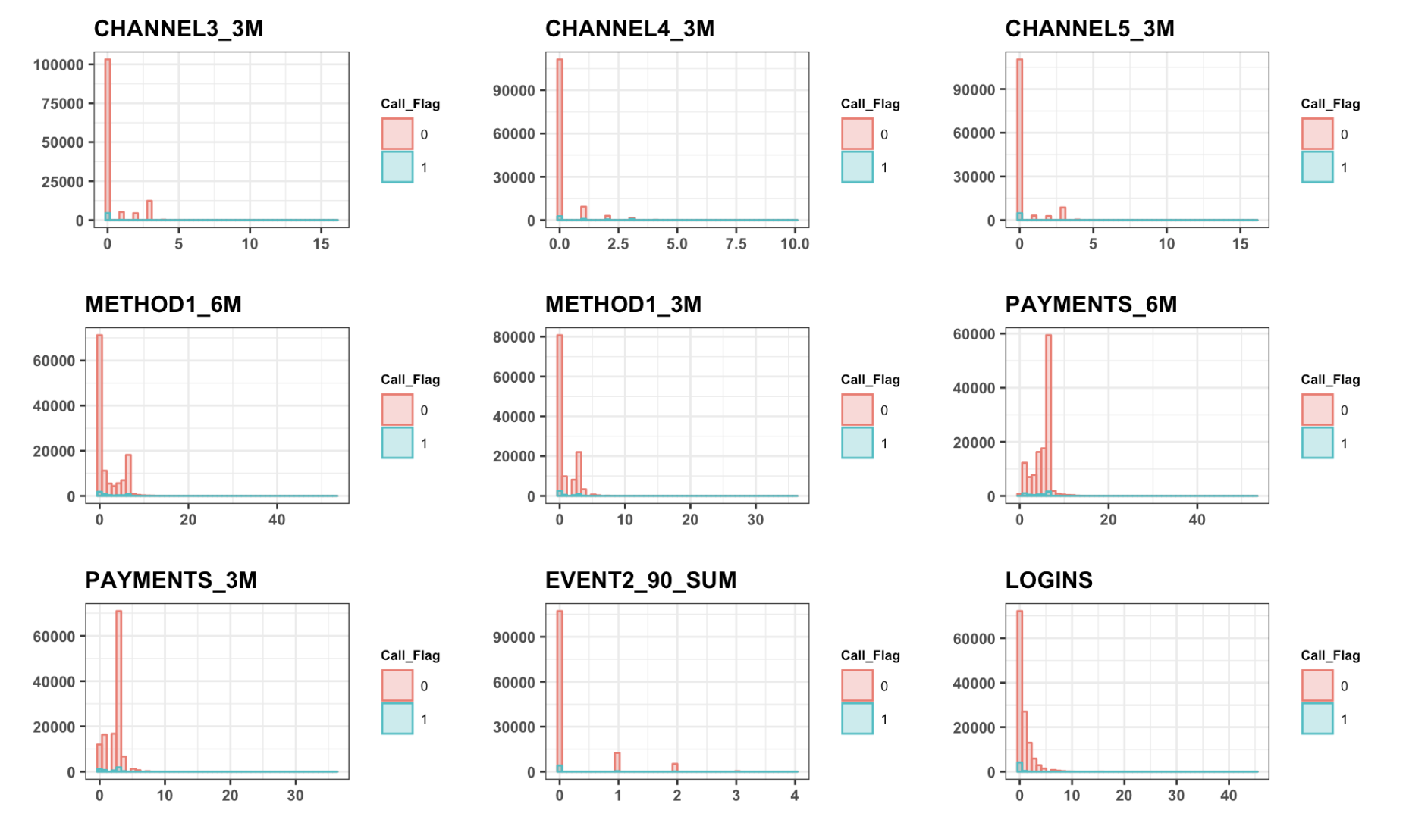
Exploratory Data Analysis: Distributions of Numerical Variables (2)

Slide 7
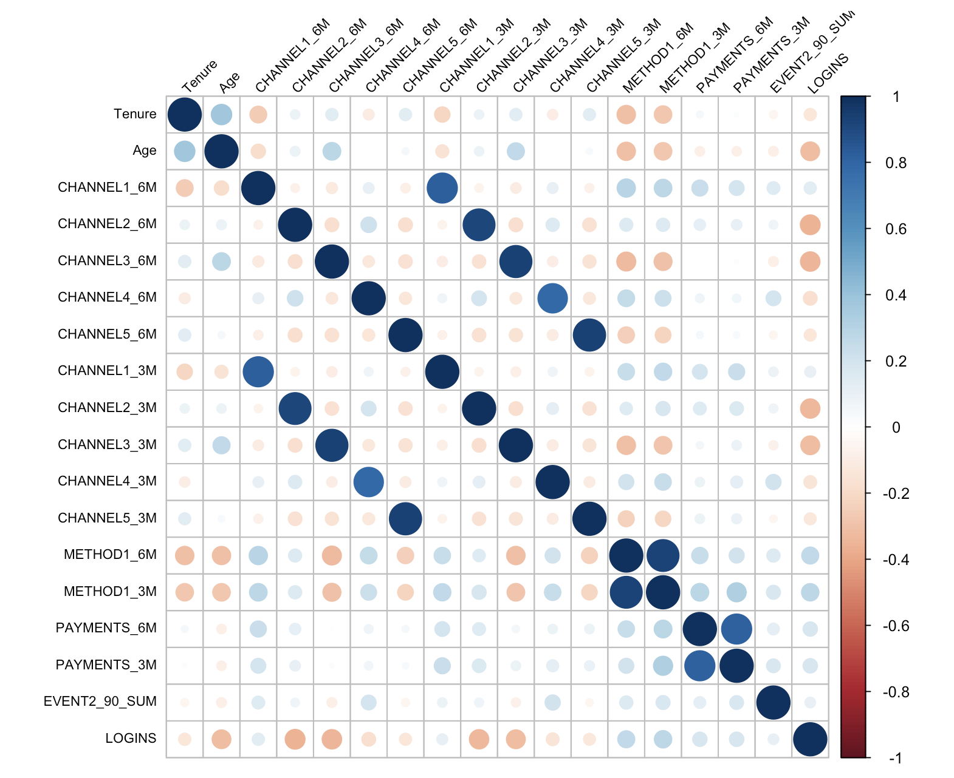
Exploratory Data Analysis: Correlation of Numerical Variables
As the definitions of many variables suggest, they may be correlated. E.g., CHANNEL1_6M and CHANNEL1_3M
Many numerical variables are count type or very skewed.
Spearman correlation is more appropriate for such cases when the assumptions for Pearson correlation are violated.
Skewed distributions may have an impact on some models using numerical methods for automatic variable selection.

Slide 8
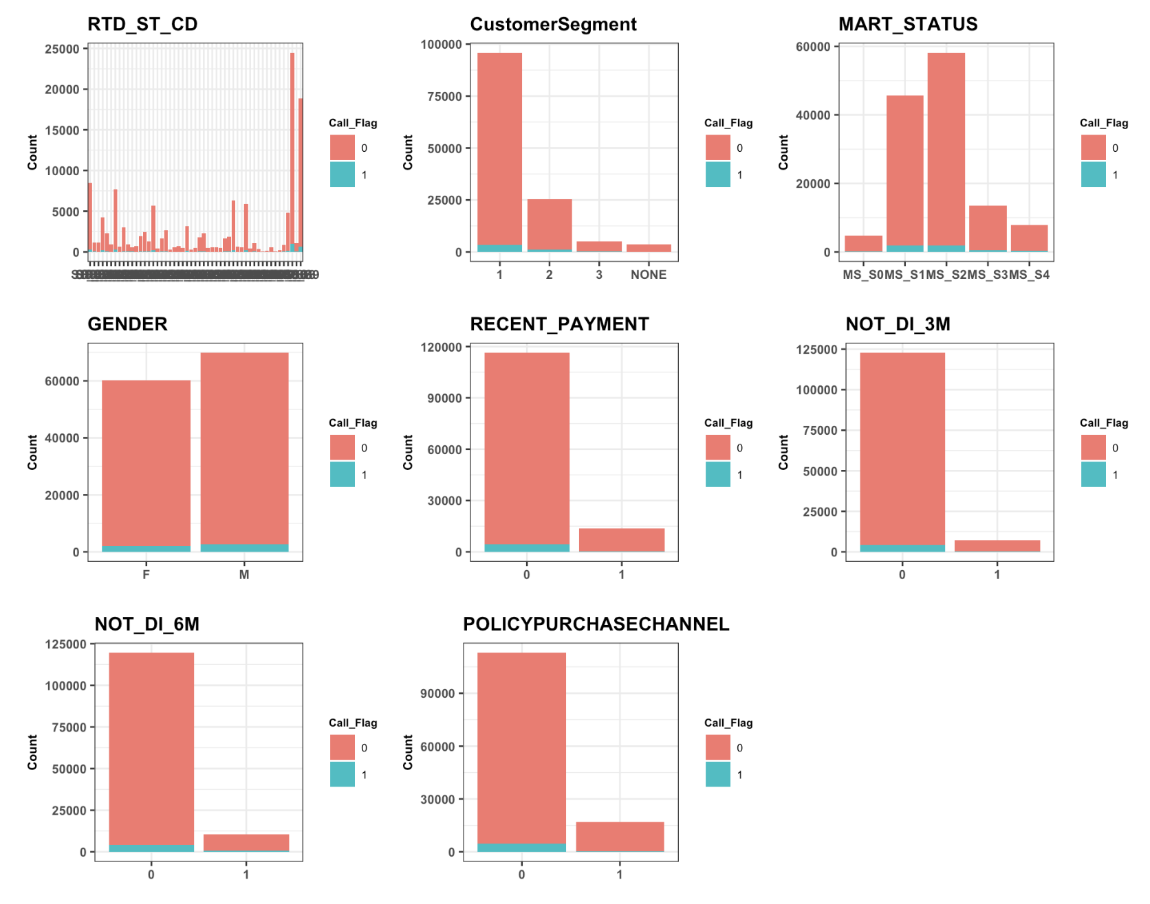
Exploratory Data Analysis: Categorical Variables
The impacts of variables with many levels on modeling:
Lasso: If one-hot encoding is applied, in order to force the dummy variables derived from the same original variable to be selected, grouped Lasso algorithm should be applied.
Tree-based models: the minimum number of examples on a leaf for the groups that have very few instances has to be carefully set.
Chi-squared test could be conducted for examining the proportions of the target variable with respect to a categorical variable.

Slide 9
Handling Missing Values
809 rows have missing values that correspond to the same fields.
The distributions of other variables for those 809 rows might suggest that they are not missing at random. E.g. The counts of the following variables
Gender: F: 299, M: 510. This ratio is significantly deviated from the one regarding the entire sample
NOT_DI_3M: ‘0’: 809, ‘1’: 0
NOT_DI_6M: ‘0’: 808, ‘1’: 1
Imputation: Given the definition of NOT_DI_xM (Had this customer been enrolled in automated payments in the last x months? 1/0), we assume the values for those missing values in the corresponding fields such as CHANNELx_6M are all 0s.

Slide 10
Modeling Workflow
Dataset
Training set
Test set
Tune model hyperparameters
Cross validation
Evaluate model performance
Estimate generalization performance
Training set
Train the model based on the best hyperparameters selected

Slide 11
Modeling Workflow
A 70-30 partition with stratified sampling
Dataset
Training set
Test set
Tune model hyperparameters
Cross validation
Evaluate model performance
Estimate generalization performance
Training set
Train the model based on the best hyperparameters selected
Notes:
Should split the data by date if records are time-dependent

Slide 12
Models
Models considered in this study
Logistic regression
A simple linear model to start with
Impose L1 penalty since many input variables are correlated.
Since prediction instead of the finding association is the focus of this study, we also consider two nonlinear tree-based models at the expense of losing some interpretability. Tree-based models are good at handling input variables with mixed types and capturing their interactions.
Gradient boosting trees (XGBoost)
Random Forest

Slide 13
Model Specifications
Model | Handling imbalanced class | Model selection /hyperparameter tuning | Interpretation | Caveats
Logistic regression with L1 regularization | Assigning weights | Lambda (automatic variable selection) | Model coefficients (effect size) | Standardization of count variables
Gradient boosting (XGBoost) | Stratified sampling PR- AUC as the metric for tuning hyperparameters | Number of trees (number of iterations) Maximum tree depth | Variable importance (Gain in accuracy brought by a feature) | Other hyperparameters also have influences
Random Forest | Stratified downsampling for bootstrap samples | Size of candidate subset for each split in tree growing | Variable importance (The mean decrease in Gini index brought by a feature) | Other hyperparameters also have influences
Notes:
# parameter list for XGboost:
# eta: learning rate
# min_child_weight: minimum number of instances needed for a leaf node
# max_depth: maximum depth of a tree
# subsample: subset ratio of the training instance
# eval_metric: evaluation metrics for validation dat
# scale_pos_weight: control the balance of positive and negative weights
# Use empirical parameter values for eta, min_child_weight,subsample
paramList <- list(booster="gbtree"
, eta=0.2
, min_child_weight=10
, subsample=0.8
, objective="binary:logistic"
, eval_metric="aucpr"
, scale_pos_weight=1/classRatio)
Random Forest:
numTrees <- 500
minLeafNodes <- 20
p <- ncol(trainDT)-1
numVars <- round(c(0.1,0.2,0.3,0.5)*p)
, mtry=numVars
, ntree=numTrees
, nodesize=minLeafNodes
, strata=as.factor(trainDT$Call_Flag[-testIdx])
, sampsize=c(2*n_minor.train,n_minor.train))

Slide 14
Modeling Workflow
Dataset
Training set
Test set
Tune model hyperparameters
Cross validation
Evaluate model performance
Estimate generalization performance
Training set
Train the model based on the best hyperparameters selected

Slide 15
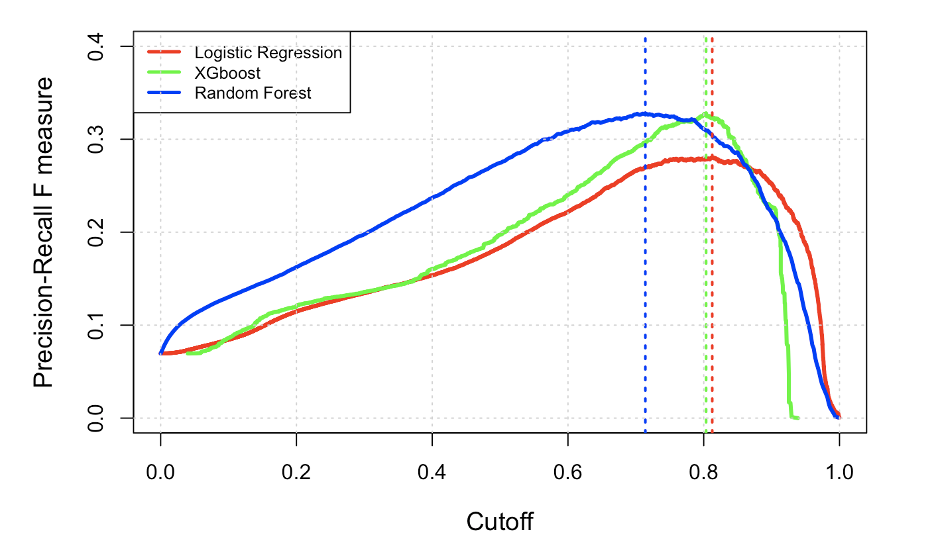
Threshold Selection
Select optimal cutoff for classifying probabilistic predictions
Precision = TP/(TP+FP)
Recall = TP/(TP+FN)
F1 score = 2 /(1/precision+1/recall)
Other F-beta scores can be resorted to depending on the cost of misclassification

Slide 16
Modeling Workflow
Dataset
Training set
Test set
Tune model hyperparameters
Cross validation
Evaluate model performance
Estimate generalization performance
Training set
Train the model based on the best hyperparameters selected

Slide 17
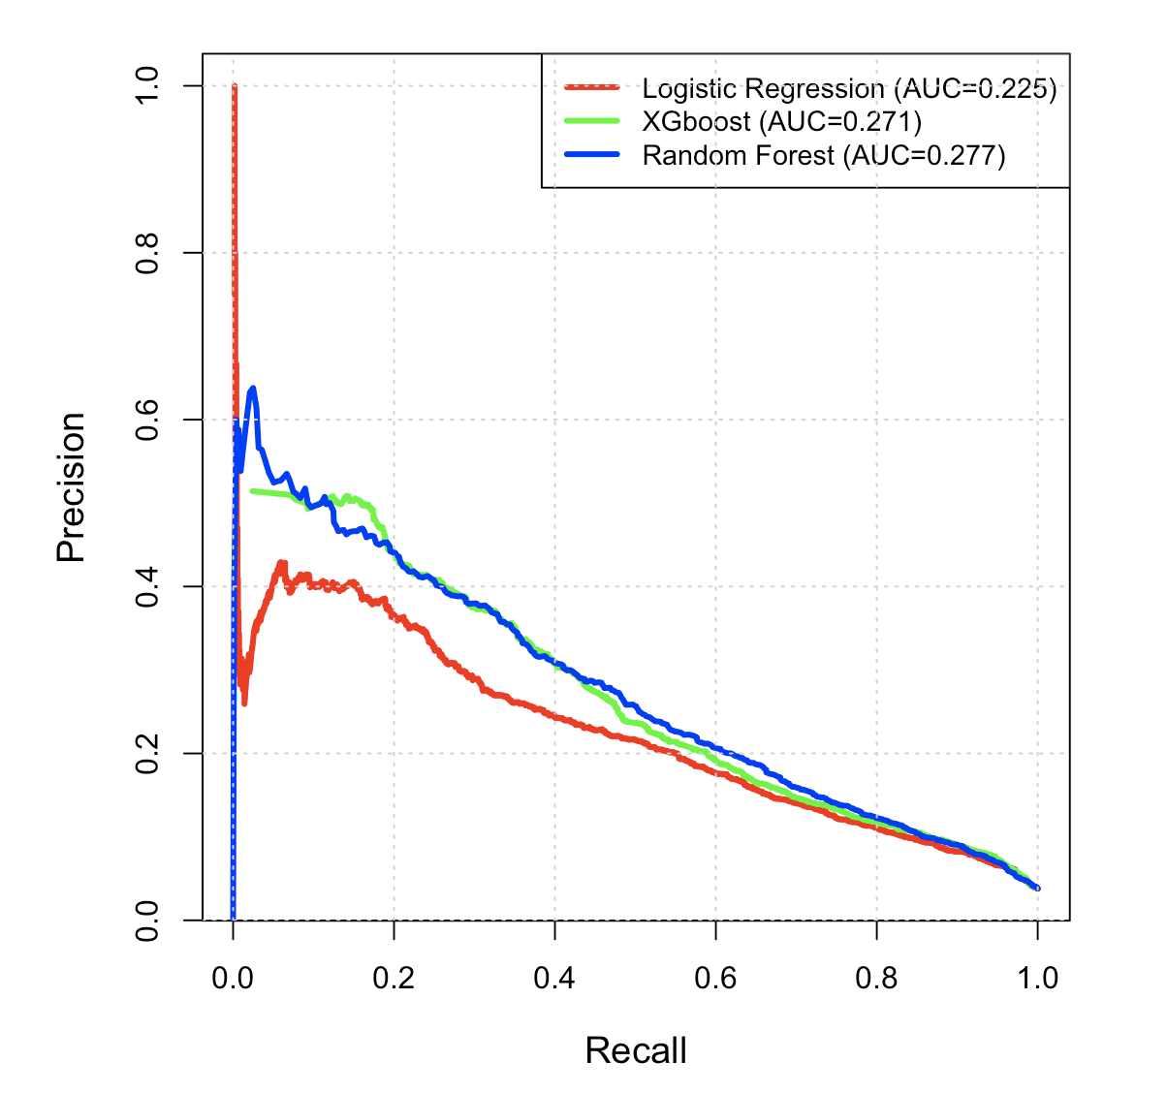
Model performance
The big picture: precision-recall curves for probabilistic output
In terms of area under curve (AUC), XGBoost and random forest outperform logistic regression.
Statistical significance tests were not performed. Therefore no conclusions are drawn here regarding their performance differences

Slide 18
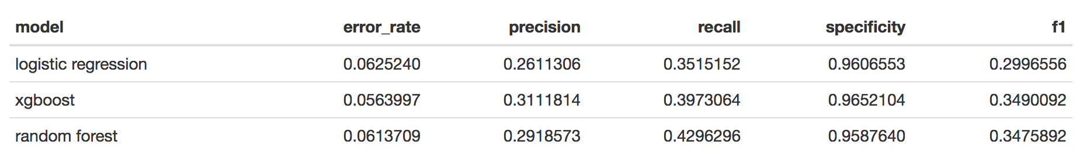
Model performance
Apply the optimal cutoffs to generate binary predictions for making decisions
precision = TP/(TP+FP)
recall = TP/(TP+FN)
specificity = TN/(TN+FP)
F1 score = 2/(1/precision+1/recall)

Slide 19
Variable Importance
Identify factors that affect/are associated with the chance of a customer making a service payment call.
Contribute to potential marketing changes
Systematic studies should be conducted if unveiling which variables are associated with the service payment calls is the primary goal. Here the findings only provide a guideline
Criteria:
Logistic regression: Model coefficients (effect size on log-odds)
XGBoost: Gain in accuracy brought by a feature
Random Forest: The mean decrease in Gini index brought by a feature

Slide 20
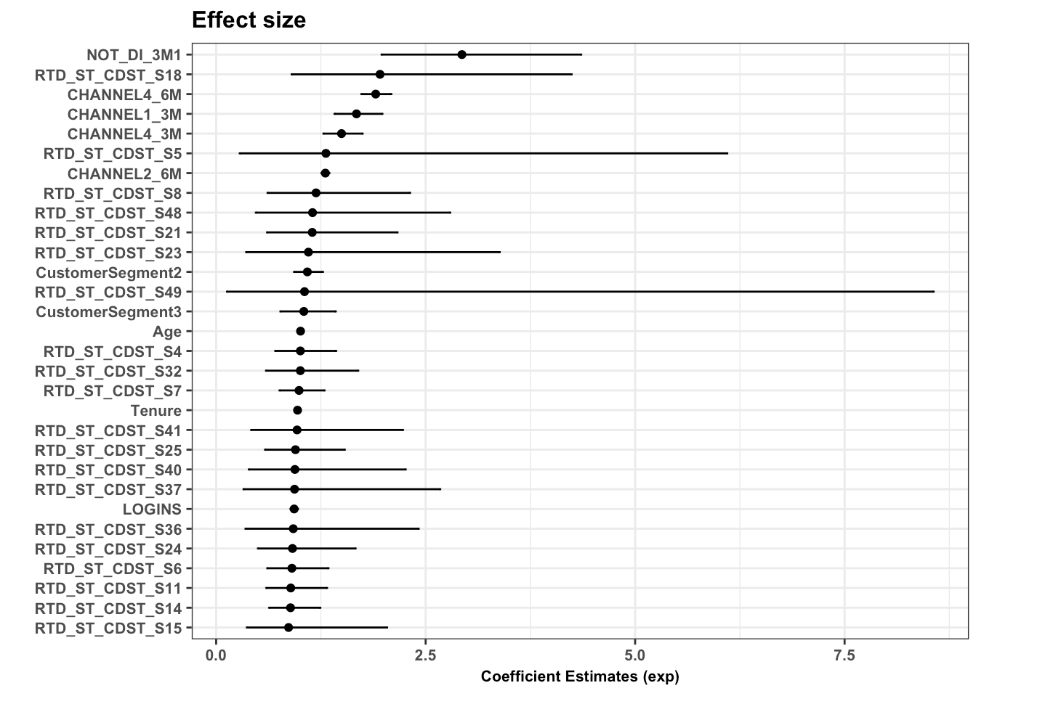
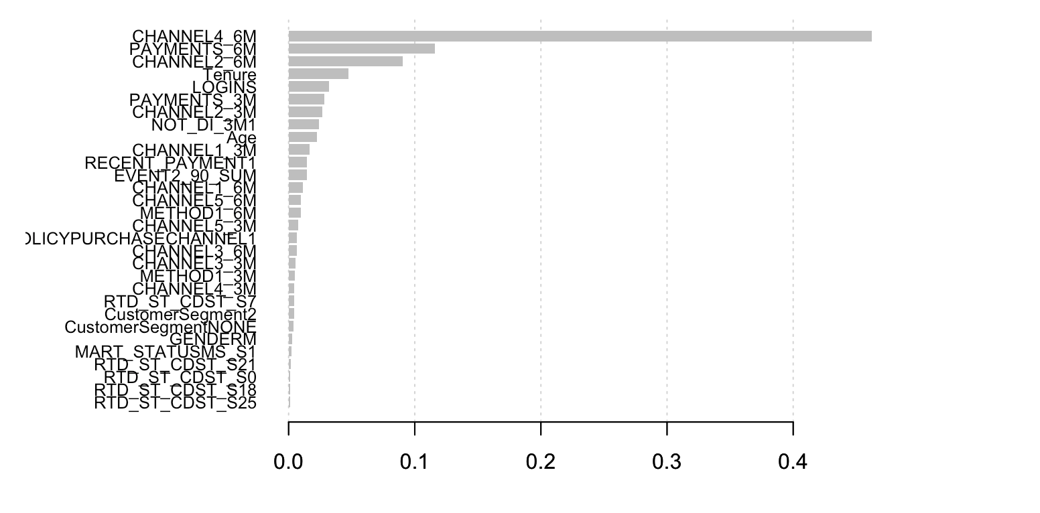
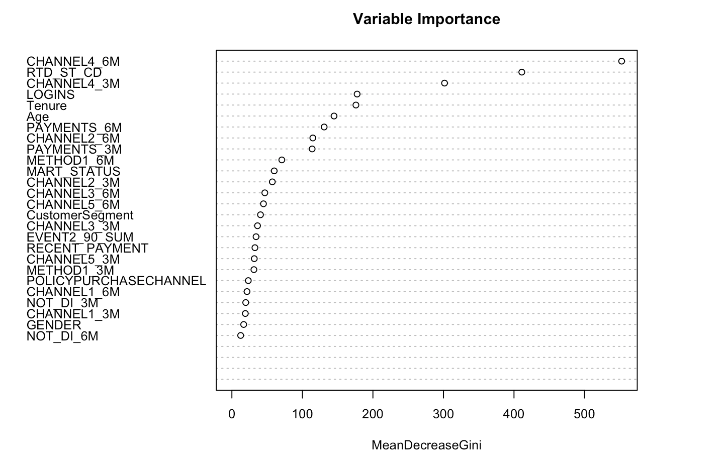
CHANNEL4_6M is identified by all the models as one of the most influential factors

