Slide 1
卡尔曼滤波

Slide 2
一、隐马尔科夫链假设及卡尔曼滤波原理
隐马尔科夫模型做了两个假设：
1、齐次马尔科夫假设：隐藏的马尔科夫链在任意时刻的状态只与前一时刻状态相关。
2、观测独立假设：任意时刻的观测只依赖于该时刻的马尔科夫链的状态。
卡尔曼滤波原理
假设我们利用传感器测量一个信号：
(1)有两个传感器，一个便宜，一个贵，并且知道其误差模型和方差，如何测量？加权平均，那又如何加权平均呢？利用方差就可以得到最优权重。
(2)若只有一个传感器，还有一个数学模型，可以算出一个不是很准的值，如何测量？把传感器的值和模型算出来的值利用方差加权平均。
(3)你的数学模型只能算出一个步长的值，让你结合传感器测出一系列的值，如何做？利用之前加权平均得到的值代入数学模型算出下一步的值，与传感器的值加权平均。

Slide 3

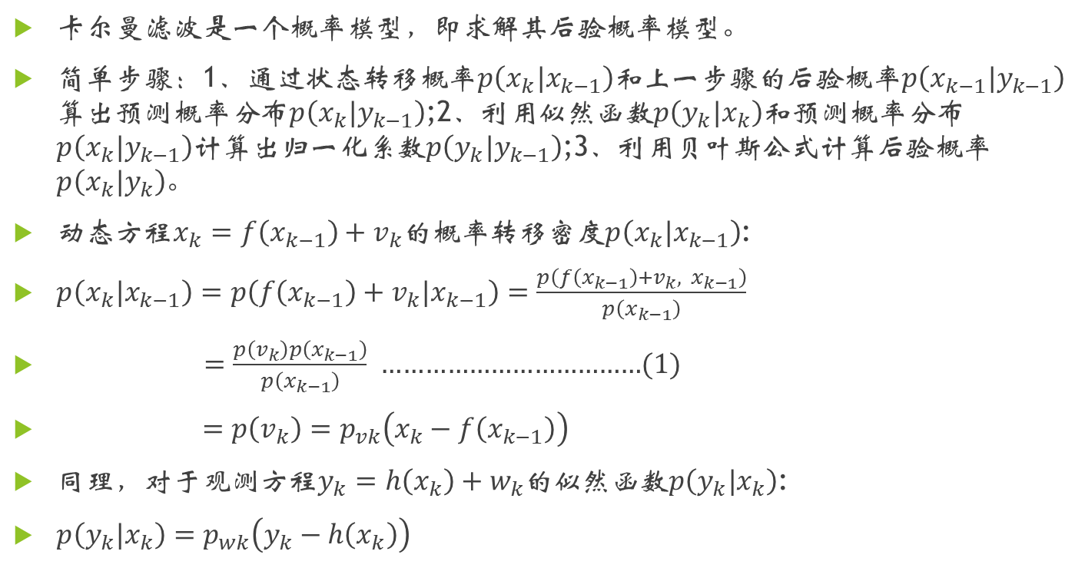
二、运动学问题的最优贝叶斯滤波
卡尔曼滤波是一个概率模型，即求解其后验概率模型。
简单步骤：1、通过状态转移概率$\left.p\right.\left(x_{k}|x_{k−1}\right)和$上一步骤的后验概率$p\left(x_{k−1}|y_{k−1}\right)$算出预测概率分布$p\left(x_{k}|y_{k−1}\right)$;2、利用似然函数$p\left(y_{k}|x_{k}\right)和$预测概率分布$p\left(x_{k}|y_{k−1}\right)$计算出归一化系数$p\left(y_{k}|y_{k−1}\right)$;3、利用贝叶斯公式计算后验概率$p\left(x_{k}|y_{k}\right)$。
动态方程$x_{k}=f\left(x_{k−1}\right)+v_{k}$的概率转移密度$p\left(x_{k}|x_{k−1}\right)$:
$p\left(x_{k}|x_{k−1}\right)=p\left(f\left(x_{k−1}\right)+v_{k}|x_{k−1}\right)=\frac{p\left(f\left(x_{k−1}\right)+v_{k}, x_{k−1}\right)}{p\left(x_{k−1}\right)}$
$=\frac{p\left(v_{k}\right)p\left(x_{k−1}\right)}{p\left(x_{k−1}\right)}$ ………………………………(1)
$=p\left(v_{k}\right)=p_{vk}\left(x_{k}−f\left(x_{k−1}\right)\right)$
同理，对于观测方程$y_{k}=h\left(x_{k}\right)+w_{k}$的似然函数$p\left(y_{k}|x_{k}\right)$:
$p\left(y_{k}|x_{k}\right)=p_{wk}\left(y_{k}−h\left(x_{k}\right)\right)$

Slide 4
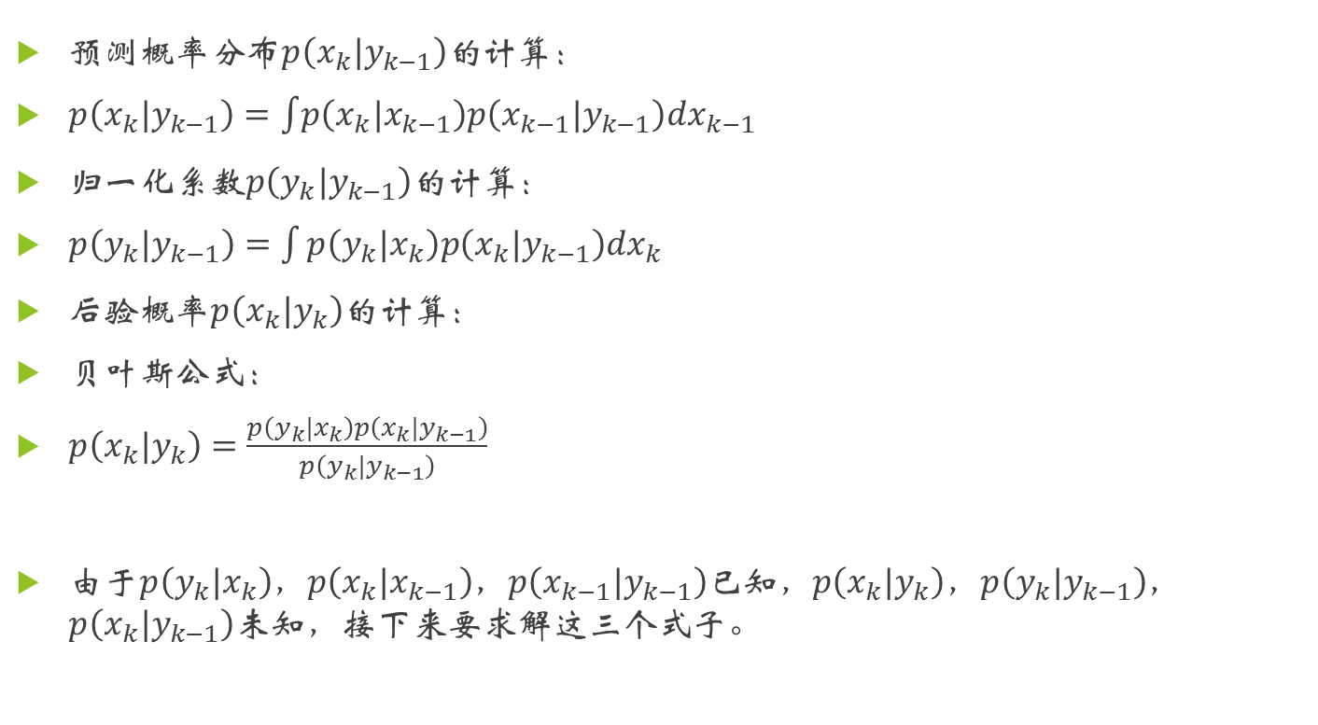
二、运动学问题的最优贝叶斯滤波
预测概率分布$p\left(x_{k}|y_{k−1}\right)的$计算：
$p\left(x_{k}|y_{k−1}\right)=\int{\left.p\right.\left(x_{k}|x_{k−1}\right)p\left(x_{k−1}|y_{k−1}\right)dx_{k−1}}$
归一化系数$p\left(y_{k}|y_{k−1}\right)的$计算：
$p\left(y_{k}|y_{k−1}\right)=\int{p\left(y_{k}|x_{k}\right)p\left(x_{k}|y_{k−1}\right)dx_{k}}$
后验概率$p\left(x_{k}|y_{k}\right)的计算$：
贝叶斯公式：
$p\left(x_{k}|y_{k}\right)=\frac{p\left(y_{k}|x_{k}\right)p\left(x_{k}|y_{k−1}\right)}{p\left(y_{k}|y_{k−1}\right)}$
由于$p\left(y_{k}|x_{k}\right)$，$p\left(x_{k}|x_{k−1}\right)$，$p\left(x_{k−1}|y_{k−1}\right)$已知，$p\left(x_{k}|y_{k}\right)$，$p\left(y_{k}|y_{k−1}\right)$，$p\left(x_{k}|y_{k−1}\right)$未知，接下来要求解这三个式子。

Slide 5
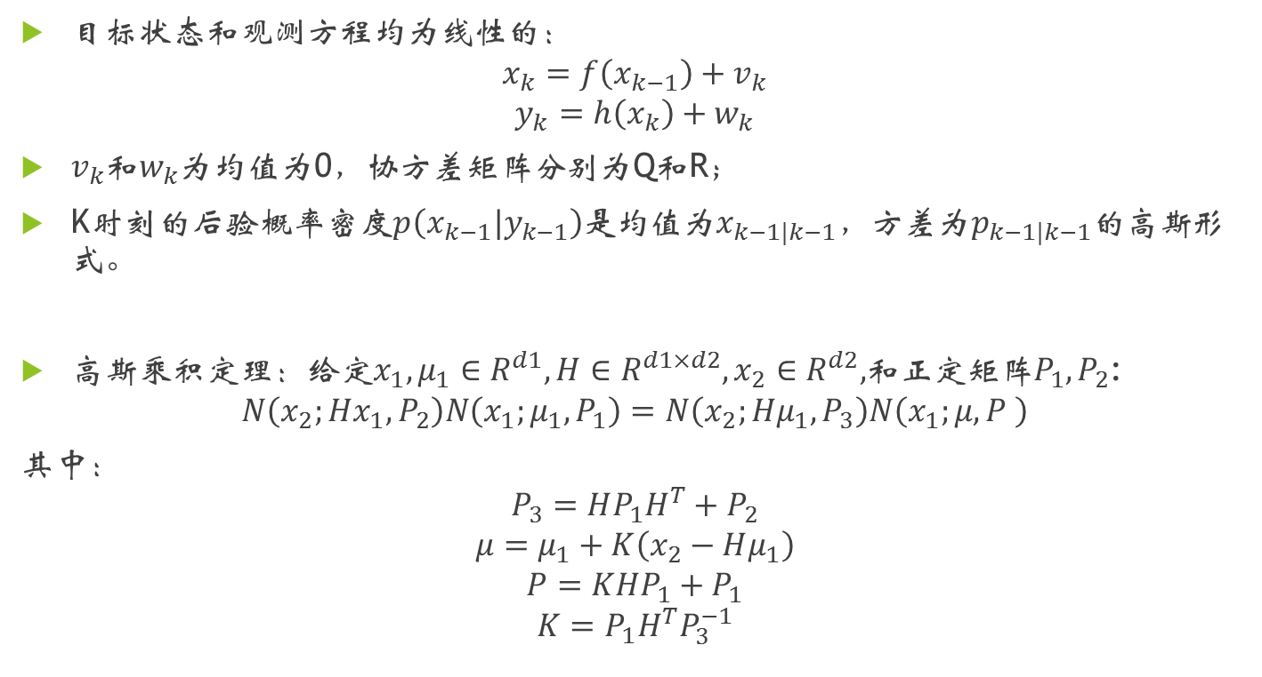
三、卡尔曼滤波
目标状态和观测方程均为线性的：
$$x_{k}=f\left(x_{k−1}\right)+v_{k}$$
$$y_{k}=h\left(x_{k}\right)+w_{k}$$
$v_{k}$和$w_{k}$为均值为0，协方差矩阵分别为Q和R；
K时刻的后验概率密度$p\left(x_{k−1}|y_{k−1}\right)$是均值为$x_{k−1|k−1}，$方差为$p_{k−1|k−1}$的高斯形式。
高斯乘积定理：给定$x_{1},μ_{1}∈R^{d1},H∈R^{d1×d2},x_{2}∈R^{d2},$和正定矩阵$P_{1},P_{2}$:
$$N\left(x_{2};Hx_{1},P_{2}\right)N\left(x_{1};μ_{1},P_{1}\right)=N\left(x_{2};Hμ_{1},P_{3}\right)N\left(x_{1};μ,P \right)$$
其中：
$$P_{3}=HP_{1}H^{T}+P_{2}$$
$$μ=μ_{1}+K\left(x_{2}−Hμ_{1}\right)$$
$$P=KHP_{1}+P_{1}$$
$$K=P_{1}H^{T}P_{3}^{−1}$$

Slide 6
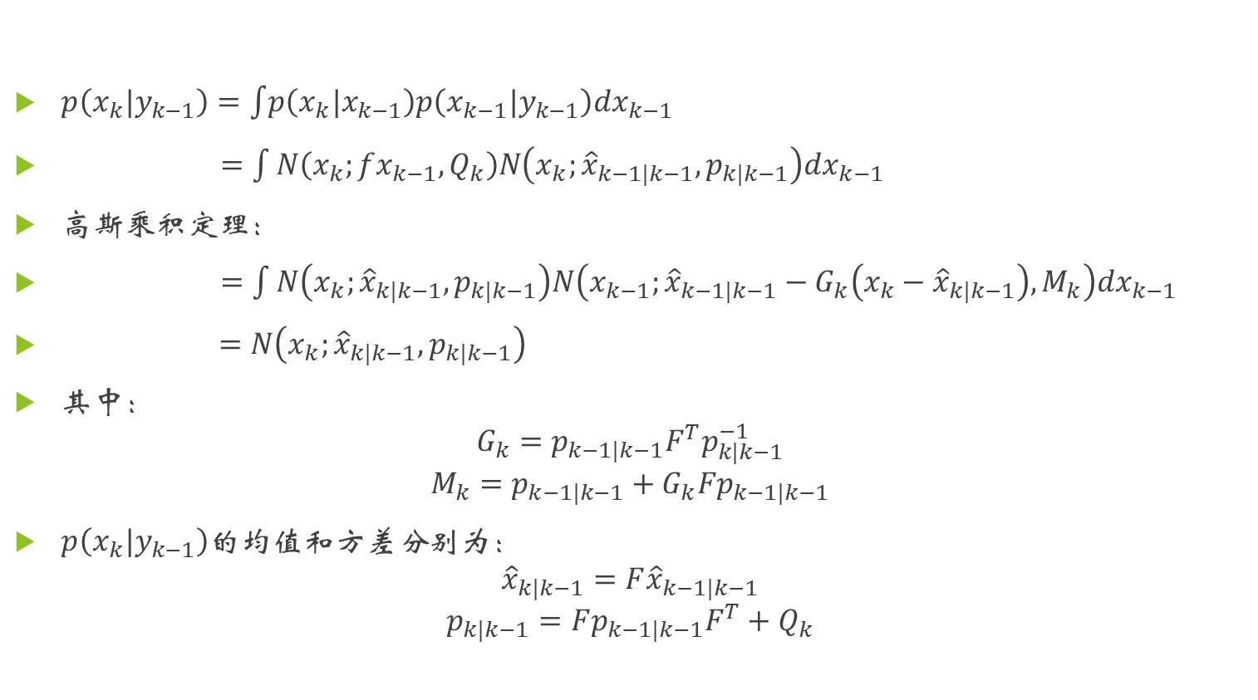
三、卡尔曼滤波
$p\left(x_{k}|y_{k−1}\right)=\int{\left.p\right.\left(x_{k}|x_{k−1}\right)p\left(x_{k−1}|y_{k−1}\right)dx_{k−1}}$
$=\int{N\left(x_{k};fx_{k−1},Q_{k}\right)N\left(x_{k};{\hat{x}}_{k−1|k−1},p_{k|k−1}\right)dx_{k−1}}$
高斯$乘积定理：$
$=\int{N\left(x_{k};{\hat{x}}_{k|k−1},p_{k|k−1}\right)N\left(x_{k−1};{\hat{x}}_{k−1|k−1}−G_{k}\left(x_{k}−{\hat{x}}_{k|k−1}\right),M_{k}\right)dx_{k−1}}$
$=N\left(x_{k};{\hat{x}}_{k|k−1},p_{k|k−1}\right)$
其中：
$$G_{k}=p_{k−1|k−1}F^{T}p_{k|k−1}^{−1}$$
$$M_{k}=p_{k−1|k−1}+G_{k}Fp_{k−1|k−1}$$
$p\left(x_{k}|y_{k−1}\right)$的均值和方差分别为：
$${\hat{x}}_{k|k−1}=F{\hat{x}}_{k−1|k−1}$$
$$p_{k|k−1}=Fp_{k−1|k−1}F^{T}+Q_{k}$$

Slide 7
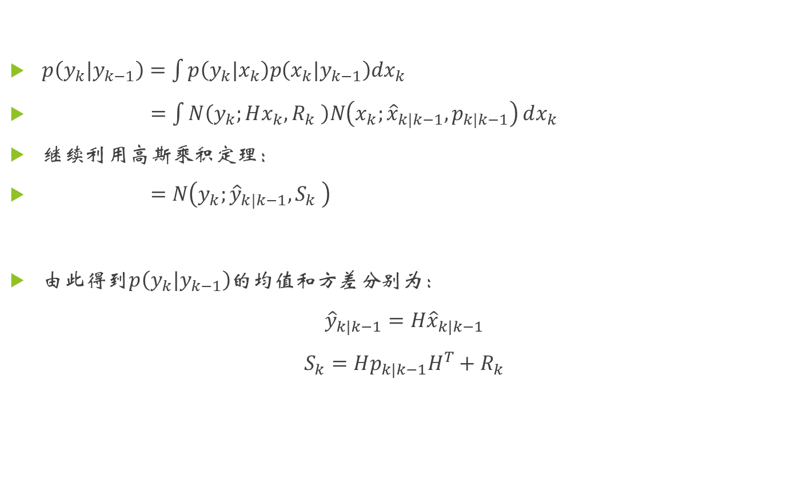
三、卡尔曼滤波
$p\left(y_{k}|y_{k−1}\right)=\int{p\left(y_{k}|x_{k}\right)p\left(x_{k}|y_{k−1}\right)dx_{k}}$
$=\int{N\left(y_{k};Hx_{k},R_{k} \right)N\left(x_{k};{\hat{x}}_{k|k−1},p_{k|k−1}\right)}dx_{k}$
继续利用高斯乘积定理：
$=N\left(y_{k};{\hat{y}}_{k|k−1},S_{k} \right)$
由此得到$p\left(y_{k}|y_{k−1}\right)$的均值和方差分别为：
$${\hat{y}}_{k|k−1}=H{\hat{x}}_{k|k−1}$$
$$S_{k}=Hp_{k|k−1}H^{T}+R_{k}$$

Slide 8
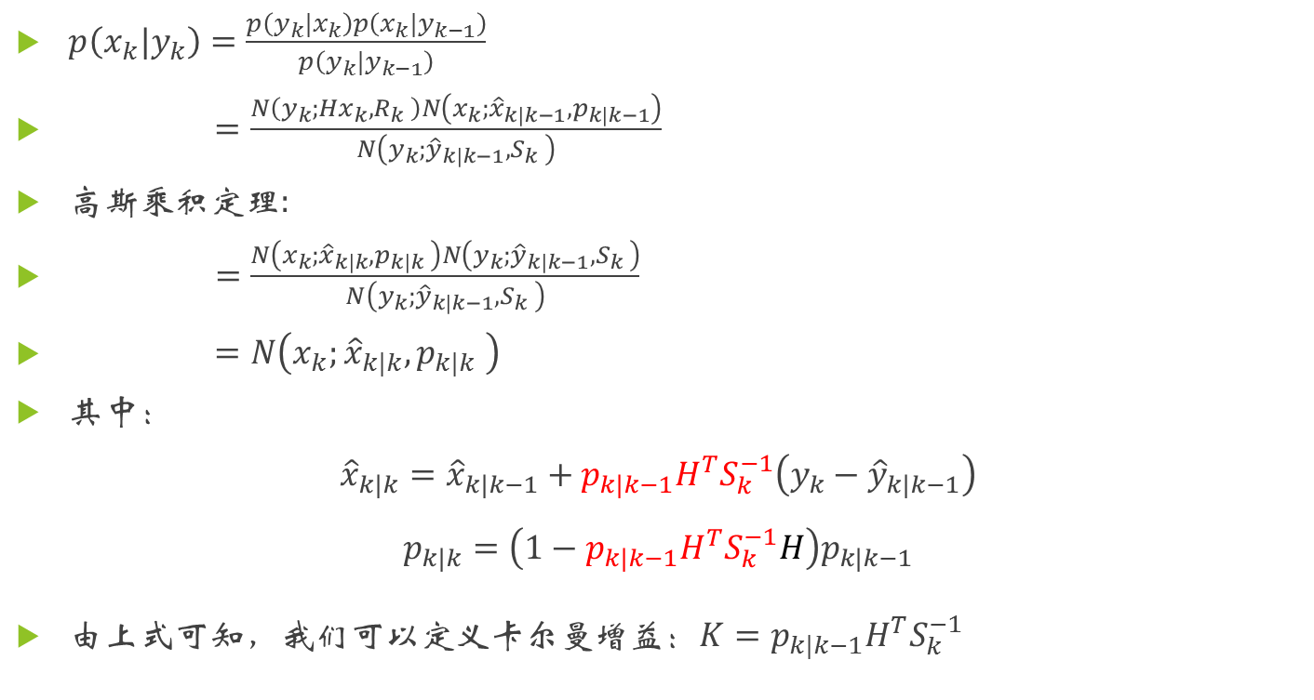
三、卡尔曼滤波
$p\left(x_{k}|y_{k}\right)=\frac{p\left(y_{k}|x_{k}\right)p\left(x_{k}|y_{k−1}\right)}{p\left(y_{k}|y_{k−1}\right)}$
$=\frac{N\left(y_{k};Hx_{k},R_{k} \right)N\left(x_{k};{\hat{x}}_{k|k−1},p_{k|k−1}\right)}{N\left(y_{k};{\hat{y}}_{k|k−1},S_{k} \right)}$
高斯乘积定理:
$=\frac{N\left(x_{k};{\hat{x}}_{k|k},p_{k|k} \right)N\left(y_{k};{\hat{y}}_{k|k−1},S_{k} \right)}{N\left(y_{k};{\hat{y}}_{k|k−1},S_{k} \right)}$
$=N\left(x_{k};{\hat{x}}_{k|k},p_{k|k} \right)$
其中：
$${\hat{x}}_{k|k}={\hat{x}}_{k|k−1}+p_{k|k−1}H^{T}S_{k}^{−1}\left(y_{k}−{\hat{y}}_{k|k−1}\right)$$
$$p_{k|k}=\left(1−p_{k|k−1}H^{T}S_{k}^{−1}H\right)p_{k|k−1}$$
由上式可知，我们可以定义卡尔曼增益：$K=p_{k|k−1}H^{T}S_{k}^{−1}$

Slide 9
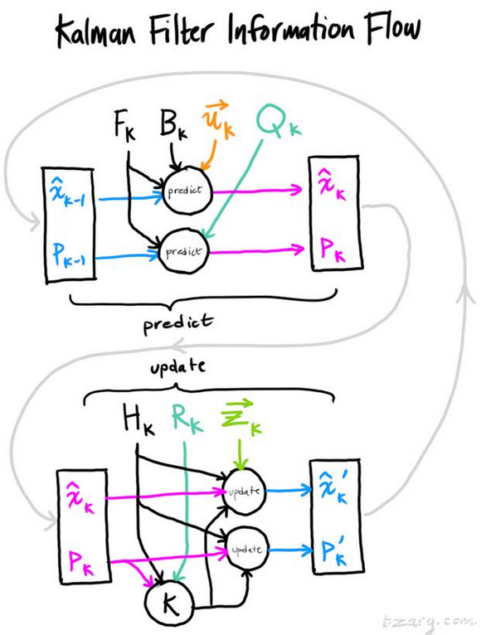
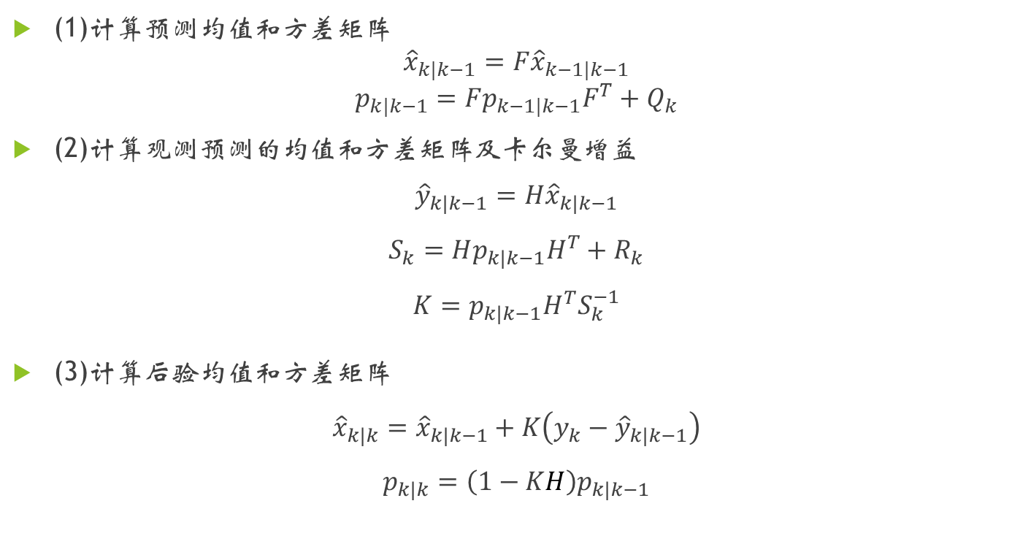
三、卡尔曼滤波
(1)计算预测均值和方差矩阵
$${\hat{x}}_{k|k−1}=F{\hat{x}}_{k−1|k−1}$$
$$p_{k|k−1}=Fp_{k−1|k−1}F^{T}+Q_{k}$$
(2)计算观测预测的均值和方差矩阵及卡尔曼增益
$${\hat{y}}_{k|k−1}=H{\hat{x}}_{k|k−1}$$
$$S_{k}=Hp_{k|k−1}H^{T}+R_{k}$$
$$K=p_{k|k−1}H^{T}S_{k}^{−1}$$
(3)计算后验均值和方差矩阵
$${\hat{x}}_{k|k}={\hat{x}}_{k|k−1}+K\left(y_{k}−{\hat{y}}_{k|k−1}\right)$$
$$p_{k|k}=\left(1−KH\right)p_{k|k−1}$$

Slide 10
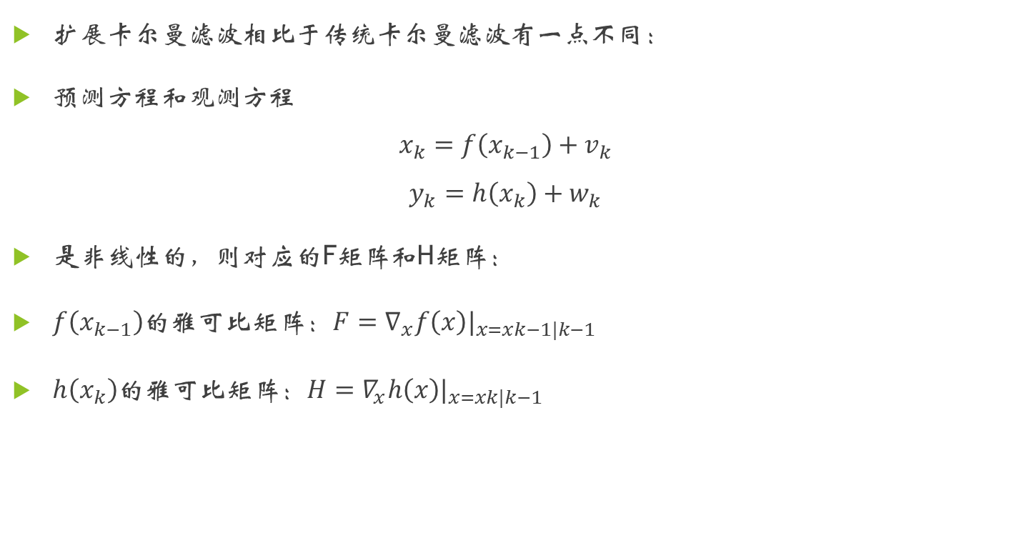
四、扩展卡尔曼滤波
扩展卡尔曼滤波相比于传统卡尔曼滤波有一点不同：
预测方程和观测方程
$$x_{k}=f\left(x_{k−1}\right)+v_{k}$$
$$y_{k}=h\left(x_{k}\right)+w_{k}$$
是非线性的，则对应的F矩阵和H矩阵：
$f\left(x_{k−1}\right)$的雅可比矩阵：$F=∇_{x}f\left(x\right)|_{x=xk−1|k−1}$
$h\left(x_{k}\right)$的雅可比矩阵：$H=∇_{x}h\left(x\right)|_{x=xk|k−1}$

Slide 11
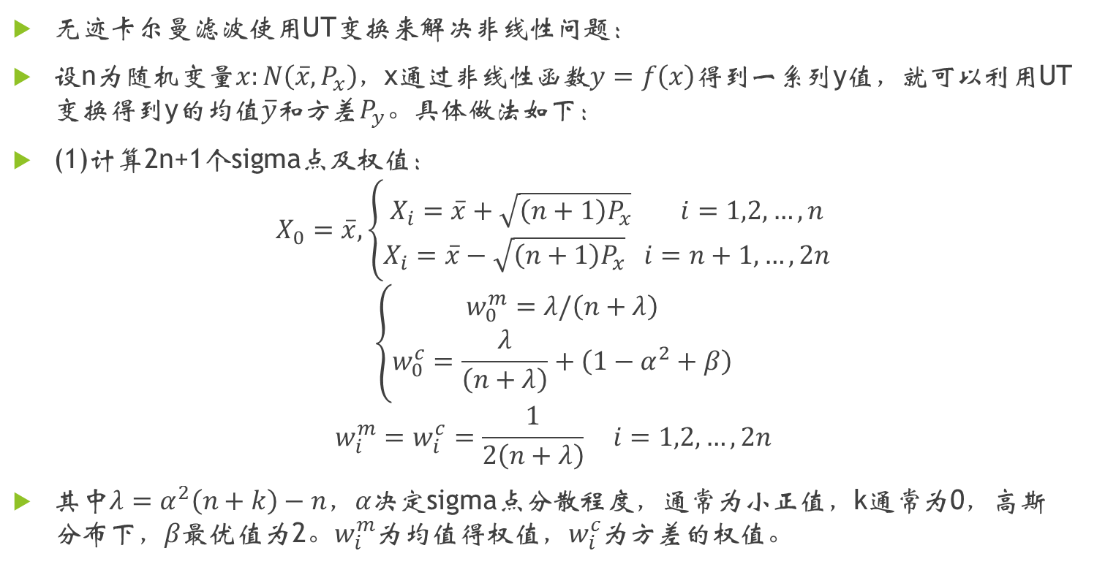
五、无迹卡尔曼滤波
无迹卡尔曼滤波使用UT变换来解决非线性问题：
设n为随机变量$x:N\left(\overline{x},P_{x}\right)$，x通过非线性函数$y=f\left(x\right)$得到一系列y值，就可以利用UT变换得到y的均值$\overline{y}和$方差$P_{y}。$具体做法如下：
(1)计算2n+1个sigma点及权值：
$$X_{0}=\overline{x},\left\{\begin{aligned}X_{i}=\overline{x}+\sqrt{\left(n+1\right)P_{x}} i=1,2,…,n \\ X_{i}=\overline{x}−\sqrt{\left(n+1\right)P_{x}} i=n+1,…,2n\end{aligned}\right.$$
$$\left\{\begin{aligned}w_{0}^{m}=λ/\left(n+λ\right) \\ w_{0}^{c}=\frac{λ}{\left(n+λ\right)}+\left(1−α^{2}+β\right)\end{aligned}\right.$$
$$w_{i}^{m}=w_{i}^{c}=\frac{1}{2\left(n+λ\right)} i=1,2,…,2n$$
其中$λ=α^{2}\left(n+k\right)−n，α$决定sigma点分散程度，通常为小正值，k通常为0，高斯$分布下，β$最优值为2。$w_{i}^{m}$为均值得权值，$w_{i}^{c}$为方差的权值。

Slide 12
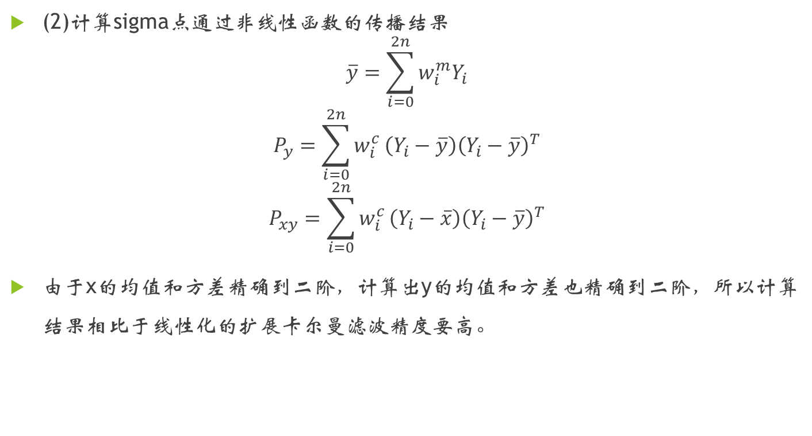
五、无迹卡尔曼滤波
(2)计算sigma点通过非线性函数的传播结果
$$\overline{y}=\sum_{i=0}^{2n}{w_{i}^{m}Y_{i}}$$
$$P_{y}=\sum_{i=0}^{2n}{w_{i}^{c}}\left(Y_{i}−\overline{y}\right){\left(Y_{i}−\overline{y}\right)}^{T}$$
$$P_{xy}=\sum_{i=0}^{2n}{w_{i}^{c}}\left(Y_{i}−\overline{x}\right){\left(Y_{i}−\overline{y}\right)}^{T}$$
由于x的均值和方差精确到二阶，计算出y的均值和方差也精确到二阶，所以计算结果相比于线性化的扩展卡尔曼滤波精度要高。

Slide 13

五、无迹卡尔曼滤波
于是可以得到：
状态预测的均值方差：
$${\hat{x}}_{k|k−1}=\sum{w_{i}x_{k}^{i}}, x_{k}^{i}=f\left(x_{k−1}^{i}\right)$$
$$p_{k|k−1}=\sum{w_{i}\left(x_{k}^{i}−x_{k|k−1}\right){\left(x_{k}^{i}−x_{k|k−1}\right)}^{T}}+Q_{k}$$
观测预测的均值方差：
$${\hat{y}}_{k|k−1}=\sum{w_{i}y_{k}^{i}}, y_{k}^{i}=h\left(x_{k}^{i}\right)$$
$$S_{k}=\sum{w_{i}\left(y_{k}^{i}−y_{k|k−1}\right){\left(y_{k}^{i}−y_{k|k−1}\right)}^{T}}+R_{k}$$
后验均值方差：
$${\hat{x}}_{k|k}={\hat{x}}_{k|k−1}+ψ_{k}S_{k}^{−1}\left(y_{k}−{\hat{y}}_{k|k−1}\right)$$
$$p_{k|k}=p_{k|k−1}−ψ_{k}S_{k}^{−1}ψ_{k}^{−1} ,ψ_{k}=\sum{w_{i}\left(x_{k}^{i}−x_{k|k−1}\right){\left(y_{k}^{i}−y_{k|k−1}\right)}^{T}}$$

Slide 14
THANKS

