Slide 1



Slide 2
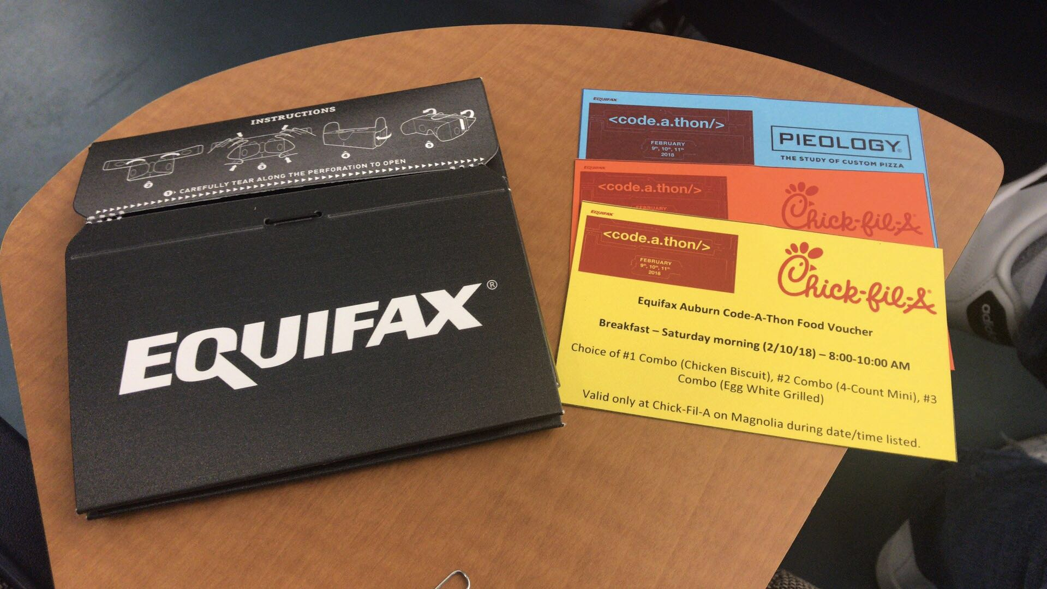
Topic: A web app for weather forecast and History, daily, hourly, minutely
Little gift and free foods
6:00 PM Friday 2/9 -- 8:00AM Sunday 2/11

Slide 3
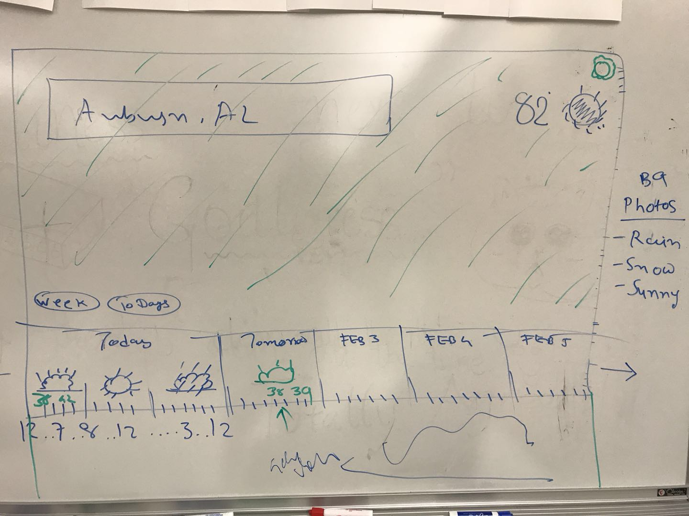
Initial Design Needs: HTML5, CSS, JavaScript

Slide 4



Final Tools

Slide 5
Demo
https://weathermap.shinyapps.io/weathermap/
https://www.youtube.com/watch?v=rZcj8Bn3K4M

