Slide 1
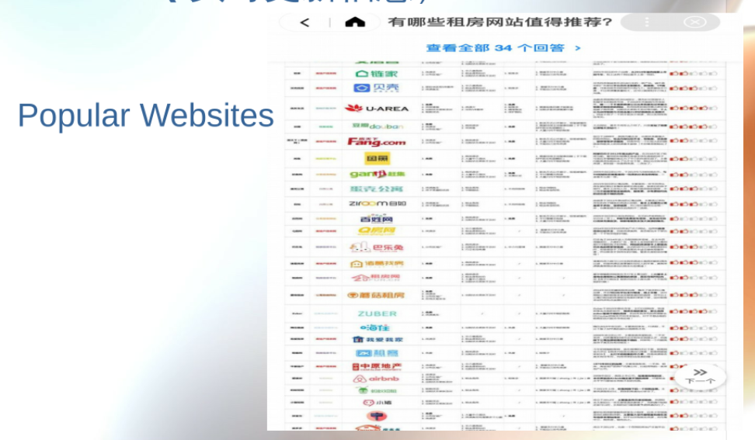
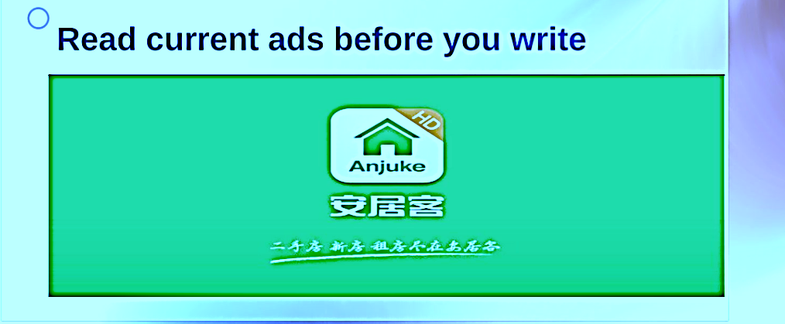
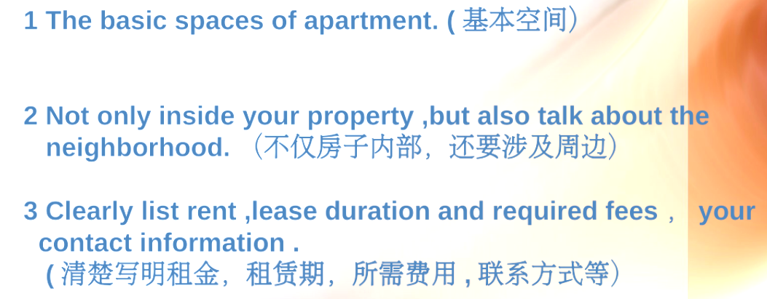
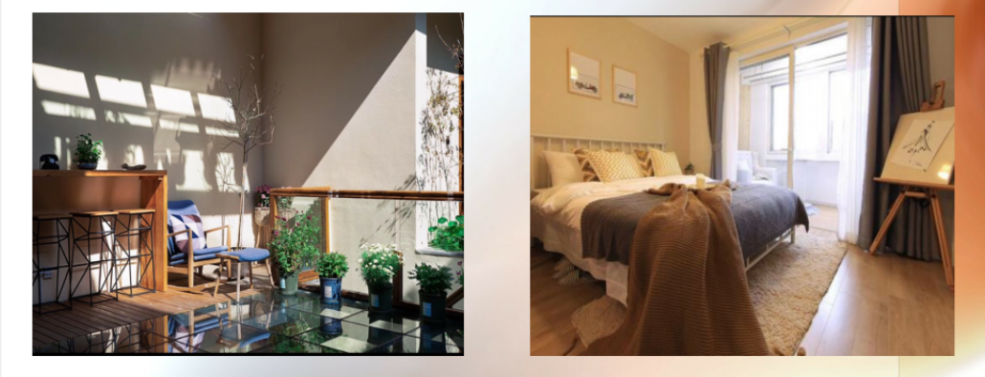

E
D
part5 keep your ad up to date
part1 Preparing to Write Rental Advertisements
part4 Writing rental ads
part2 Photos
How to Write Rental Advertisements
part3 Create an eye-catching headline
Create a detailed rental property description
C
----A good front page photo and nice photo of the house
如何撰写租赁广告
B
A

Slide 2
E
D
part5 keep your ad up to date
part1 Preparing to Write Rental Advertisements
part4 Writing rental ads
part2 Photos
How to Write Rental Advertisements
part3 Create an eye-catching headline
Create a detailed rental property description
C
----A good front page photo and nice photo of the house
如何撰写租赁广告
B
A

Slide 3
E
D
part5 keep your ad up to date
part1 Preparing to Write Rental Advertisements
part4 Writing rental ads
part2 Photos
part3 Create an eye-catching headline
How to Write Rental Advertisements
Create a detailed rental property description
C
----A good front page photo and nice photo of the house
如何撰写租赁广告
B
A

Slide 4
E
D
part5 keep your ad up to date
part1 Preparing to Write Rental Advertisements
part4 Writing rental ads
part2 Photos
part3 Create an eye-catching headline
How to Write Rental Advertisements
Create a detailed rental property description
----A good front page photo and nice photo of the house
C
如何撰写租赁广告
B
A

Slide 5
E
D
part5 keep your ad up to date
part4 Writing rental ads
part1 Preparing to Write Rental Advertisements
part2 Photos
part3 Create an eye-catching headline
How to Write Rental Advertisements
Create a detailed rental property description
C
----A good front page photo and nice photo of the house
如何撰写租赁广告
B
A

Slide 6
E
D
part5 keep your ad up to date
part1 Preparing to Write Rental Advertisements
part4 Writing rental ads
part2 Photos
part3 Create an eye-catching headline
How to Write Rental Advertisements
Create a detailed rental property description
C
----A good front page photo and nice photo of the house
如何撰写租赁广告
B
A

