Slide 1

Online Sushi
https://github.com/dongguowu/map07-group03-test.git
Olga Ersov
Xiaowei Chen
Dongguo Wu

Slide 2
Main Tasks
User Login - Olga
Sushi List - Xiaowei
Sushi Manage - Dongguo

Slide 3
List-Page(xiaowei):
What I have done:
1, generated dynamic cards and fetch data from data file to rendering on the cards.
2, responsive page
3, sort the cards by price
4, search item based on the title
5, plus and minus button
6, shopping cart icon to show order numbers
7, displaying current weather on the navbar with API
What problem I need to fix:
1, the item card elements displaying not in the correct position after searching
2, the order numbers counting has little logic problem there, need to fix
3, because of the time limited, I have not moved the data to database yet

Slide 4
Main Technologies
User Requirements Research
Mobile-first & Responsive Layout
Search and Sort
Git GitHub
Upload and Download Image

Slide 5
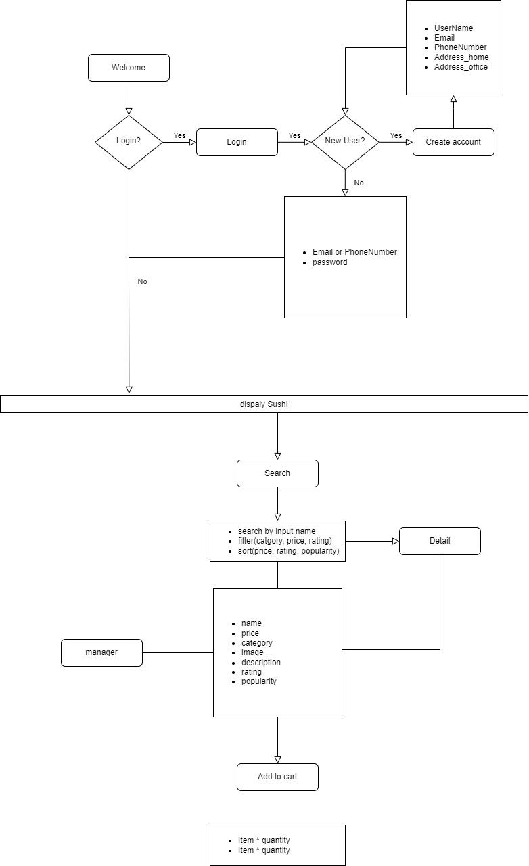
User Requirements Research

Slide 6
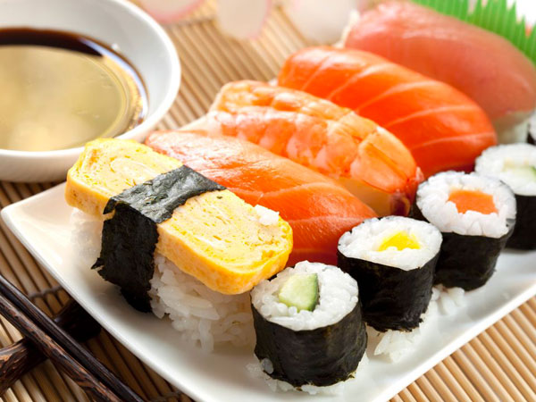

Mobile-first & responsive layout

Slide 7
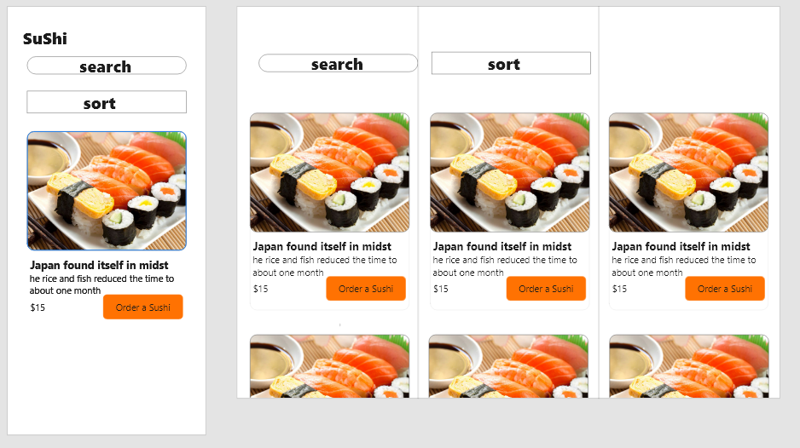
Mobile-first & responsive layout

Slide 8
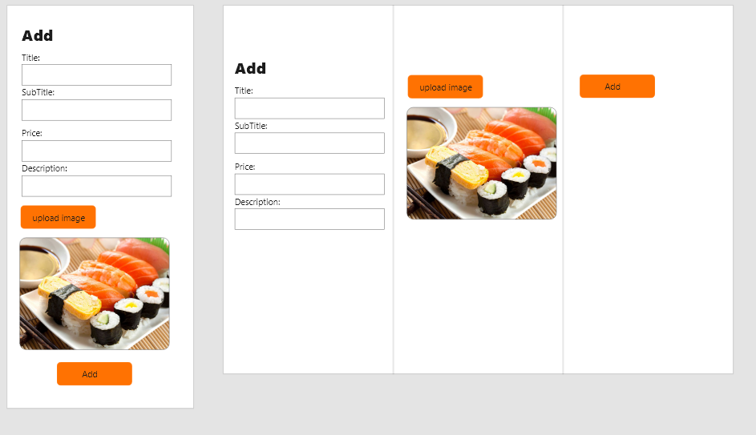
Mobile-first & responsive layout

Slide 9
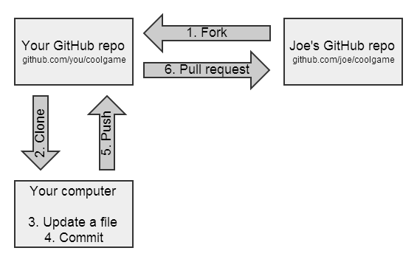
GitHub
7. Git Merge Main Branch
8. Git Merge Main Branch
9. Git Merge Main Branch

Slide 10
Future plans and potential improvements
Personalization: Enhance the user experience by providing personalized recommendations based on their browsing and purchase history.

