Slide 1


Chapter 7
Network Flow
Slides by Kevin Wayne.
Copyright © 2005 Pearson-Addison Wesley.
All rights reserved.

Slide 2
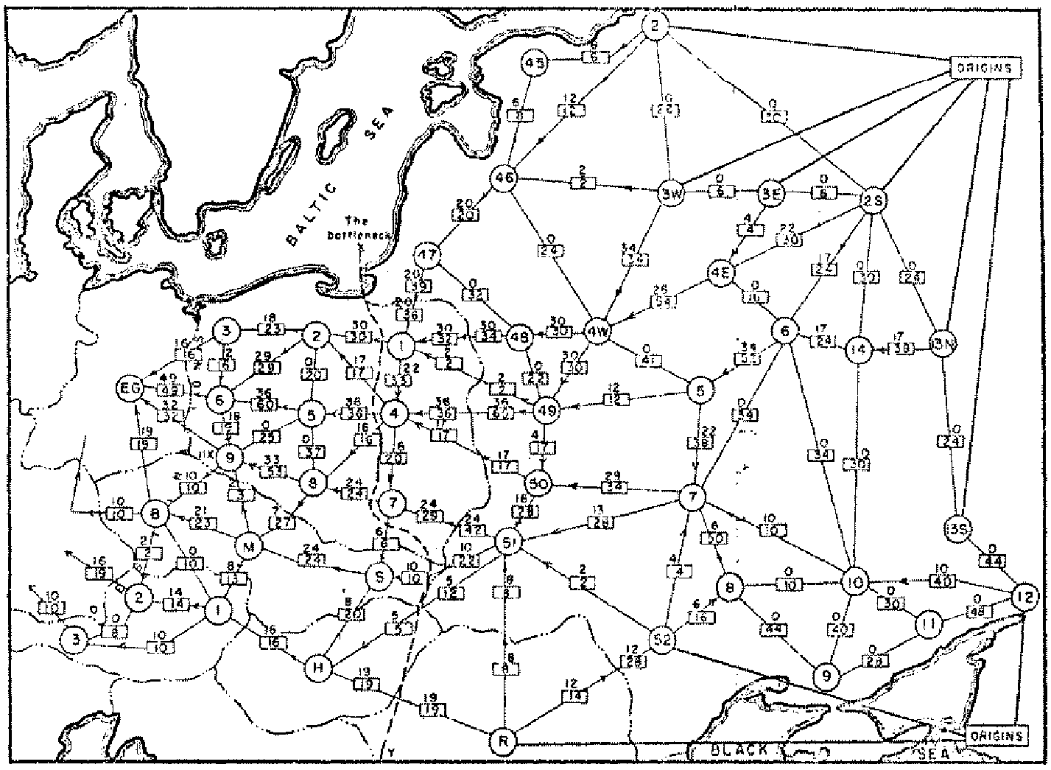
Soviet Rail Network, 1955
Reference: On the history of the transportation and maximum flow problems.
Alexander Schrijver in Math Programming, 91: 3, 2002.
Notes:
Russian scientist A. N. Tolstoi investigated soviet rail network. Wanted to optimize amount of cargo that could be shipped from origins in Soviet Union (right) to destination satellite counties (Poland, Czechoslovakia, Austria, Eastern Germany) (left). American scientists Harris and Ross were also interested in Soviet rail system but from a different perspective. In a secret report (declassified at Schrijver's request in 1999), Harris and Ross calculated a "minimum interdiction" of 163,000 tons.
after aggregation, 44 vertices, 105 edges

Slide 3
Maximum Flow and Minimum Cut
Max flow and min cut.
  Two very rich algorithmic problems.
  Cornerstone problems in combinatorial optimization.
  Beautiful mathematical duality.
Nontrivial applications / reductions.
  Data mining.
  Project selection.
  Airline scheduling.
  Bipartite matching.
  Image segmentation.
  Network connectivity.
  Network reliability.
  Distributed computing.
  Security of statistical data.
  Network intrusion detection.
  Multi-camera scene reconstruction.
  Many many more . . .
Notes:
Network intrusion detection: http://www.ieee-infocom.org/2003/papers/46_02.PDF

Slide 4
Minimum Cut Problem
Flow network.
  Abstraction for material flowing through the edges.
  G = (V, E) = directed graph, no parallel edges.
  Two distinguished nodes: s = source, t = sink.
  c(e) = capacity of edge e.
2
9
5
10
4
15
15
10
source
s
5
3
8
6
10
t
sink
4
6
15
10
capacity
15
4
30
7
Notes:
source = where material originates, sink = where material goes.
We use cut to mean s-t cut.

Slide 5

Cuts
Def. An s-t cut is a partition (A, B) of V with s ∈ A and t ∈ B.
Def. The capacity of a cut (A, B) is:
Capacity = 10 + 5 + 15
= 30
2
9
5
10
4
15
15
10
s
5
3
8
6
10
t
A
4
6
15
10
15
4
30
7
B

Slide 6
Cuts
Def. An s-t cut is a partition (A, B) of V with s ∈ A and t ∈ B.
Def. The capacity of a cut (A, B) is:
Capacity = 9 + 15 + 8 + 30
= 62
2
9
5
B
10
4
15
15
10
s
5
3
8
6
10
t
A
4
15
15
6
10
4
30
7
Notes:
7->3 not counted

Slide 7
Minimum Cut Problem
Min s-t cut problem. Find an s-t cut of minimum capacity.
Capacity = 10 + 8 + 10
= 28
2
9
5
10
4
15
15
10
B
s
5
3
8
6
10
t
A
4
15
15
6
10
4
30
7

Slide 8



Flows
Def. An s-t flow is a function that satisfies:
  For each e ∈ E: (capacity)
  For each v ∈ V – {s, t}: (conservation)
Def. The value of a flow f is:
0
2
9
5
4
0
0
10
4
4
15
15
0
10
0
4
4
s
5
3
8
6
10
t
0
0
capacity
4
0
6
15
0
10
15
flow
0
0
Value = 4
4
30
7
Notes:
source = where material originates, sink = where material goes
flow conservation = otherwise warehouse overfills or oil pipe bursts
flow conservation is analogous to Kirchoff's law
* flow: abstract entity generated at source, transmitted across edges, absorbed at sink
* assume no arcs enter s or leave t (makes a little cleaner, no loss of generality)

Slide 9
Flows
Def. An s-t flow is a function that satisfies:
  For each e ∈ E: (capacity)
  For each v ∈ V – {s, t}: (conservation)
Def. The value of a flow f is:
9
2
9
5
10
1
9
10
4
0
15
15
0
10
4
8
9
s
5
3
8
6
10
t
4
10
capacity
4
0
6
15
0
10
15
flow
14
14
Value = 28
4
30
7

Slide 10

Flows and Cuts
Flow value lemma. Let f be any flow, and let (A, B) be any s-t cut. Then, the net flow sent across the cut is equal to the amount leaving s.
6
2
9
5
10
0
6
10
4
4
15
15
0
10
3
8
8
s
5
3
8
6
10
t
A
1
10
4
0
6
15
0
10
15
11
11
Value = 24
4
30
7

Slide 11
Flows and Cuts
Flow value lemma. Let f be any flow, and let (A, B) be any s-t cut. Then, the net flow sent across the cut is equal to the amount leaving s.
6
2
9
5
10
0
6
10
4
4
15
15
0
10
3
8
8
s
5
3
8
6
10
t
A
1
10
4
0
6
15
0
10
15
11
11
Value = 6 + 0 + 8 - 1 + 11
= 24
4
30
7
Notes:
total amount of flow that leaves S minus amount flow that "swirls" back

Slide 12
Flows and Cuts
Flow value lemma. Let f be any flow, and let (A, B) be any s-t cut. Then, the net flow sent across the cut is equal to the amount leaving s.
6
2
9
5
10
0
6
10
4
4
15
15
0
10
3
8
8
s
5
3
8
6
10
t
A
1
10
4
0
6
15
0
10
15
11
11
Value = 10 - 4 + 8 - 0 + 10
= 24
4
30
7

Slide 13

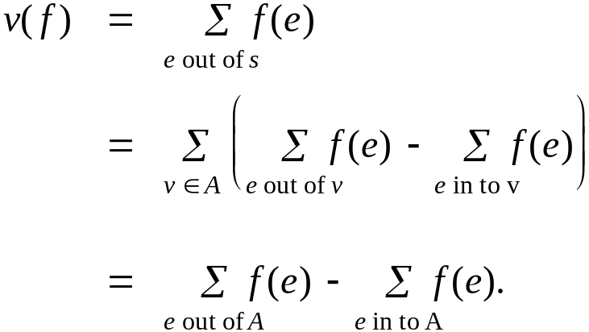
Flows and Cuts
Flow value lemma. Let f be any flow, and let (A, B) be any s-t cut. Then
Pf.
by flow conservation, all terms
except v = s are 0

Slide 14
Flows and Cuts
Weak duality. Let f be any flow, and let (A, B) be any s-t cut. Then the value of the flow is at most the capacity of the cut.
Cut capacity = 30 ⇒ Flow value ≤ 30
2
9
5
10
4
15
15
10
s
5
3
8
6
10
t
A
4
6
15
10
15
Capacity = 30
4
30
7

Slide 15
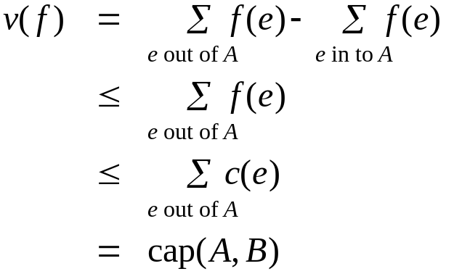
Flows and Cuts
Weak duality. Let f be any flow. Then, for any s-t cut (A, B) we have
v(f) ≤ cap(A, B).
Pf.
▪
A
B
4
8
t
s
7
6

Slide 16
Certificate of Optimality
Corollary. Let f be any flow, and let (A, B) be any cut.
If v(f) = cap(A, B), then f is a max flow and (A, B) is a min cut.
Value of flow = 28
Cut capacity = 28 ⇒ Flow value ≤ 28
9
2
9
5
10
1
9
10
4
0
15
15
0
10
4
8
9
s
5
3
8
6
10
t
4
10
A
4
0
6
15
0
10
15
14
14
4
30
7

Slide 17
Towards a Max Flow Algorithm
Greedy algorithm.
  Start with f(e) = 0 for all edge e ∈ E.
  Find an s-t path P where each edge has f(e) < c(e).
  Augment flow along path P.
  Repeat until you get stuck.
1
0
0
20
10
s
30
0
t
10
20
0
0
Flow value = 0
2

Slide 18
Towards a Max Flow Algorithm
Greedy algorithm.
  Start with f(e) = 0 for all edge e ∈ E.
  Find an s-t path P where each edge has f(e) < c(e).
  Augment flow along path P.
  Repeat until you get stuck.
1
20
0
0
X
20
10
30
0
20
t
s
X
10
20
0
0
20
Flow value = 20
X
2

Slide 19
Towards a Max Flow Algorithm
Greedy algorithm.
  Start with f(e) = 0 for all edge e ∈ E.
  Find an s-t path P where each edge has f(e) < c(e).
  Augment flow along path P.
  Repeat until you get stuck.
locally optimality ⇒ global optimality
1
1
20
0
20
10
20
10
20
10
s
30
20
t
s
30
10
t
10
20
10
20
0
20
10
20
greedy = 20
2
opt = 30
2

Slide 20
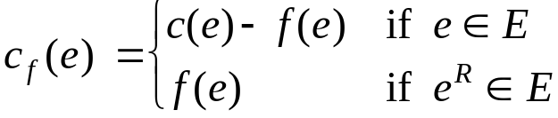
Residual Graph
Original edge: e = (u, v) ∈ E.
  Flow f(e), capacity c(e).
Residual edge.
  "Undo" flow sent.
  e = (u, v) and e^{R} = (v, u).
  Residual capacity:
Residual graph: G_{f} = (V, E_{f} ).
  Residual edges with positive residual capacity.
  E_{f} = {e : f(e) < c(e)} ∪ {e^{R} : c(e) > 0}.
capacity
u
17
v
6
flow
residual capacity
u
11
v
6
residual capacity

Slide 21
Ford-Fulkerson Algorithm
2
4
4
capacity
G:
10
2
8
6
10
s
10
3
9
5
10
t

Slide 22
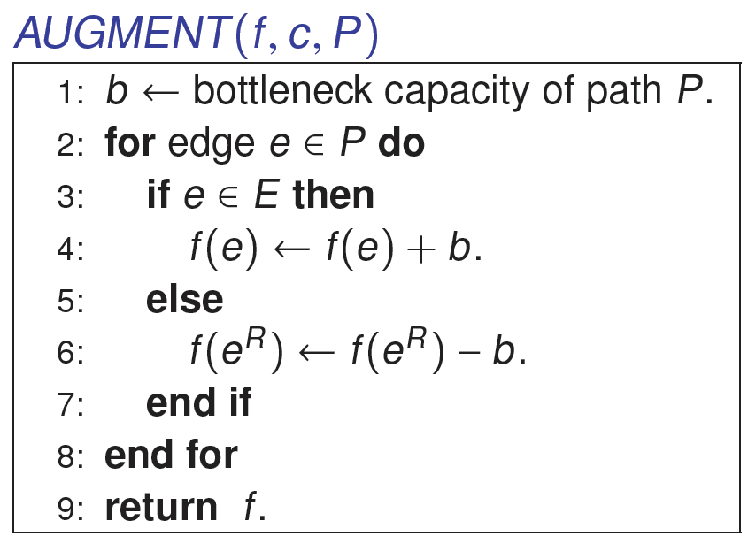
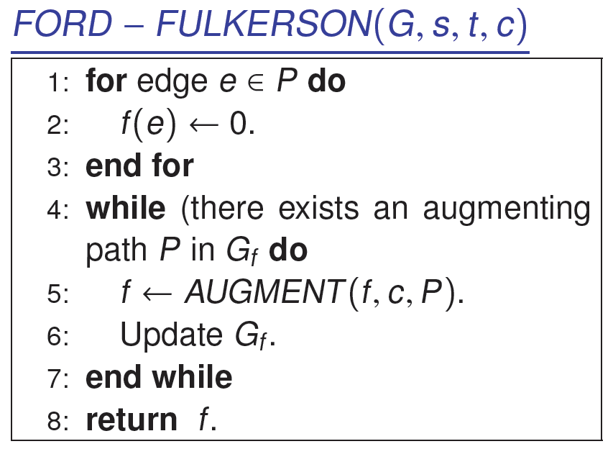
Augmenting Path Algorithm
forward edge
reverse edge

Slide 23
Max-Flow Min-Cut Theorem
Augmenting path theorem. Flow f is a max flow iff there are no augmenting paths.
Max-flow min-cut theorem. [Ford-Fulkerson 1956] The value of the max flow is equal to the value of the min cut.
Proof strategy. We prove both simultaneously by showing :
  (i) There exists a cut (A, B) such that v(f) = cap(A, B).
  (ii) Flow f is a max flow.
  (iii) There is no augmenting path relative to f.
(i) ⇒ (ii) This was the corollary to weak duality lemma.
(ii) ⇒ (iii) We show contrapositive.
  Let f be a flow. If there exists an augmenting path, then we can improve f by sending flow along path.

Slide 24
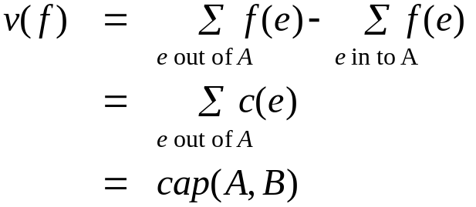
Proof of Max-Flow Min-Cut Theorem
(iii) ⇒ (i)
  Let f be a flow with no augmenting paths.
  Let A be set of vertices reachable from s in residual graph.
  By definition of A, s ∈ A.
  By definition of f, t ∉ A.
A
B
t
s
original network

Slide 25
Running Time
Assumption. All capacities are integers between 1 and C.
Invariant. Every flow value f(e) and every residual capacities c_{f} (e) remains an integer throughout the algorithm.
Theorem. The algorithm terminates in at most v(f*) ≤ nC iterations.
Pf. Each augmentation increase value by at least 1. ▪
Corollary. If C = 1, Ford-Fulkerson runs in O(mn) time.
Integrality theorem. If all capacities are integers, then there exists a max flow f for which every flow value f(e) is an integer.
Pf. Since algorithm terminates, theorem follows from invariant. ▪

Slide 26
7.3 Choosing Good Augmenting Paths

Slide 27
Ford-Fulkerson: Exponential Number of Augmentations
Q. Is generic Ford-Fulkerson algorithm polynomial in input size?
A. No. If max capacity is C, then algorithm can take C iterations.
m, n, and log C
1
1
1
0
0
1
0
0
X
X
X
1
C
C
C
C
1
0
t
1
0
1
0
t
s
X
1
s
X
X
C
C
C
C
0
0
1
0
0
1
X
1
X
X
2
2

Slide 28
Choosing Good Augmenting Paths
Use care when selecting augmenting paths.
  Some choices lead to exponential algorithms.
  Clever choices lead to polynomial algorithms.
  If capacities are irrational, algorithm not guaranteed to terminate!
Goal: choose augmenting paths so that:
  Can find augmenting paths efficiently.
  Few iterations.
Choose augmenting paths with: [Edmonds-Karp 1972, Dinitz 1970]
  Max bottleneck capacity.
  Sufficiently large bottleneck capacity.
  Fewest number of edges.

Slide 29
Capacity Scaling
Intuition. Choosing path with highest bottleneck capacity increases flow by max possible amount.
  Don't worry about finding exact highest bottleneck path.
  Maintain scaling parameter Δ.
  Let G_{f} (Δ) be the subgraph of the residual graph consisting of only arcs with capacity at least Δ.
4
4
110
102
110
102
s
1
t
s
t
122
170
122
170
2
2
G_{f}
G_{f} (100)

Slide 30
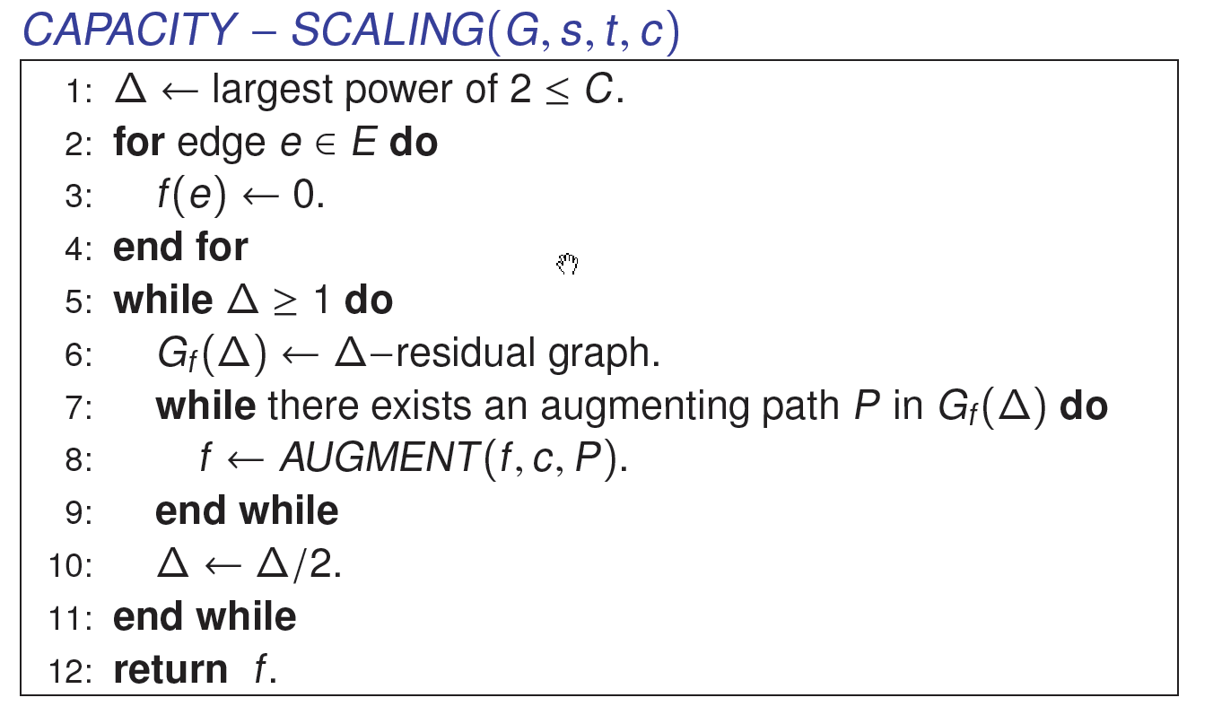
Capacity Scaling

Slide 31
Capacity Scaling: Correctness
Assumption. All edge capacities are integers between 1 and C.
Integrality invariant. All flow and residual capacity values are integral.
Correctness. If the algorithm terminates, then f is a max flow.
Pf.
  By integrality invariant, when Δ = 1 ⇒ G_{f}(Δ) = G_{f}.
  Upon termination of Δ = 1 phase, there are no augmenting paths. ▪

Slide 32
Capacity Scaling: Running Time
Lemma 1. The outer while loop repeats 1 + ⎡log₂ C⎤ times.
Pf. Initially C ≤ Δ < 2C. Δ decreases by a factor of 2 each iteration. ▪
Lemma 2. Let f be the flow at the end of a Δ-scaling phase. Then the value of the maximum flow is at most v(f) + m Δ.
Lemma 3. There are at most 2m augmentations per scaling phase.
  Let f be the flow at the end of the previous scaling phase.
  L2 ⇒ v(f*) ≤ v(f) + m (2Δ).
  Each augmentation in a Δ-phase increases v(f) by at least Δ. ▪
Theorem. The scaling max-flow algorithm finds a max flow in O(m log C) augmentations. It can be implemented to run in O(m² log C) time. ▪
proof on next slide

Slide 33
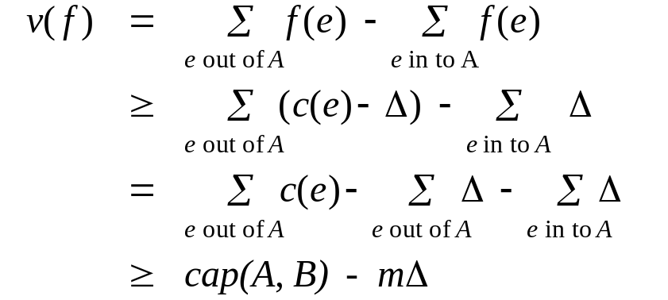
Capacity Scaling: Running Time
Lemma 2. Let f be the flow at the end of a Δ-scaling phase. Then value of the maximum flow is at most v(f) + m Δ.
Pf. (almost identical to proof of max-flow min-cut theorem)
  We show that at the end of a Δ-phase, there exists a cut (A, B) such that cap(A, B) ≤ v(f) + m Δ.
  Choose A to be the set of nodes reachable from s in G_{f}(Δ).
  By definition of A, s ∈ A.
  By definition of f, t ∉ A.
A
B
t
s
original network
Notes:
intuition: f is max flow in G_{f}(Δ). Adding back arc with capacity less than Δ can only increase capacity of cut by at most mΔ.

Slide 34
7.5 Bipartite Matching

Slide 35
Matching
Matching.
  Input: undirected graph G = (V, E).
  M ⊆ E is a matching if each node appears in at most edge in M.
  Max matching: find a max cardinality matching.

Slide 36
Bipartite Matching
Bipartite matching.
  Input: undirected, bipartite graph G = (L ∪ R, E).
  M ⊆ E is a matching if each node appears in at most edge in M.
  Max matching: find a max cardinality matching.
1
1'
2
2'
matching
1-2', 3-1', 4-5'
3
3'
4
4'
L
5
5'
R

Slide 37
Bipartite Matching
Bipartite matching.
  Input: undirected, bipartite graph G = (L ∪ R, E).
  M ⊆ E is a matching if each node appears in at most edge in M.
  Max matching: find a max cardinality matching.
1
1'
2
2'
max matching
1-1', 2-2', 3-3' 4-4'
3
3'
4
4'
L
5
5'
R

Slide 38
Bipartite Matching
Max flow formulation.
  Create digraph G' = (L ∪ R ∪ {s, t}, E' ).
  Direct all edges from L to R, and assign infinite (or unit) capacity.
  Add source s, and unit capacity edges from s to each node in L.
  Add sink t, and unit capacity edges from each node in R to t.
G'
1
1
1'
1
2
2'
1
s
3
3'
t
4
4'
L
5
5'
R

Slide 39
Bipartite Matching: Proof of Correctness
Theorem. Max cardinality matching in G = value of max flow in G'.
Pf. ≤
  Given max matching M of cardinality k.
  Consider flow f that sends 1 unit along each of k paths.
  f is a flow, and has cardinality k. ▪
1
1'
1
1
1'
2
2'
1
2
2'
1
3
3'
s
3
3'
t
4
4'
4
4'
G
G'
5
5'
5
5'

Slide 40
Bipartite Matching: Proof of Correctness
Theorem. Max cardinality matching in G = value of max flow in G'.
Pf. ≥
  Let f be a max flow in G' of value k.
  Integrality theorem ⇒ k is integral and can assume f is 0-1.
  Consider M = set of edges from L to R with f(e) = 1.
    each node in L and R participates in at most one edge in M
    |M| = k: consider cut (L ∪ s, R ∪ t) ▪
1
1
1'
1
1'
1
2
2'
1
2
2'
s
3
3'
t
3
3'
4
4'
4
4'
G'
G
5
5'
5
5'
Notes:
flow across cut (L ∪ s, R ∪ t) = flow entering t = k

Slide 41
Bipartite Matching: Running Time
Which max flow algorithm to use for bipartite matching?
  Generic augmenting path: O(m val(f*) ) = O(mn).
  Capacity scaling: O(m² log C ) = O(m²).
  Shortest augmenting path: O(m n^{1/2}).
Non-bipartite matching.
  Structure of non-bipartite graphs is more complicated, but
  well-understood. [Tutte-Berge, Edmonds-Galai]
  Blossom algorithm: O(n⁴). [Edmonds 1965]
  Best known: O(m n^{1/2}). [Micali-Vazirani 1980]

