Slide 1
Using Java1A
Online Judge
SA: Zhirui Lu 11712709

Slide 2
Access
Inside Campus Only
http://10.20.64.171

Slide 3
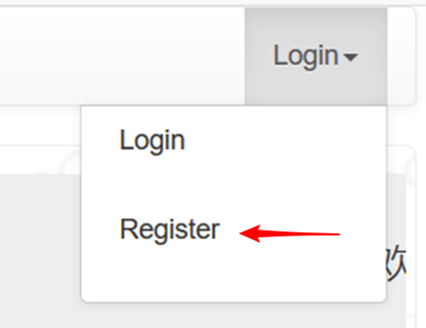
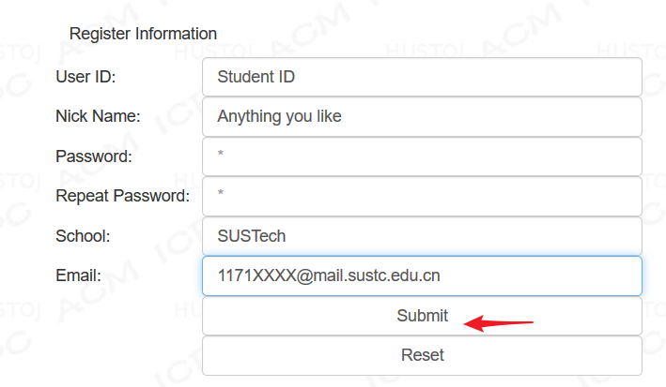
Register

Slide 4
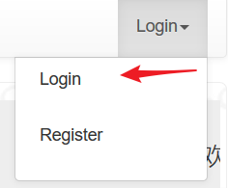
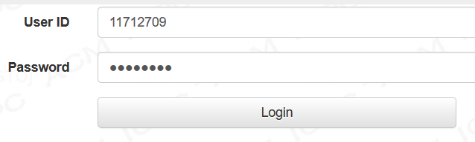
Login
WARNING: “Lost Password” won’t work
Remember your password!

Slide 5
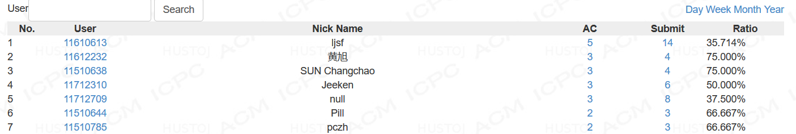
Wandering around
F.A.Q: compile arguments, meaning of status…
Status: real-time results of all people
Ranklist: rank of all people (you can click on userid to know more)
Contest: The place where your homework and exercise is!
Wish your name could be here!

Slide 6
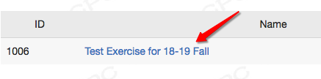
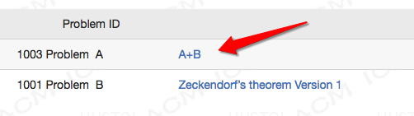
Getting Started
Contest – Test Exercise (1002) – A+B (1003)

Slide 7
Understanding Problems
Description (What I’m trying to solve/calculate?)
Input (Range, separation)
Output (Space, Decimal points, New line or not…)
Sample Input
Sample Output
Hint (Perhaps this will save your life)
Only start after you’re sure that
you’ve understood everything!

Slide 8
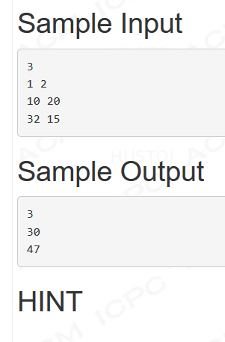
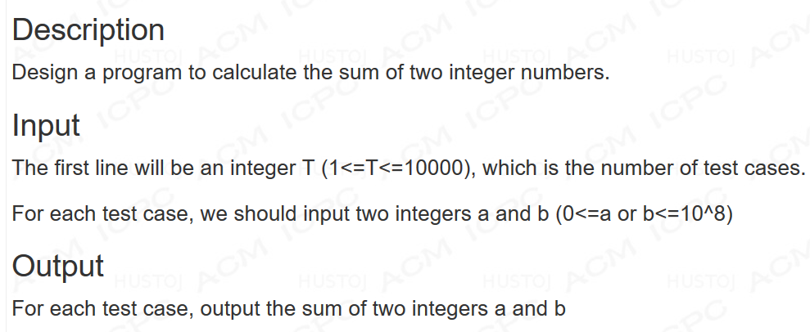
An Example
Source: http://10.20.64.171/problem.php?cid=1006&pid=0
Range? 0<=a,b<=10^8, int should be enough, no need to worry overflow
Output format? A number a line, no space at the end of a line

Slide 9
Writing codes
import java.util.Scanner;
public class MyFirstOJ {
public static void main(String[] args) {
Scanner input = new Scanner(System.in);
int a = input.nextInt();
int b = input.nextInt();
int sum = a + b;
System.out.println(sum);
}
}
Seems ok?

Slide 10
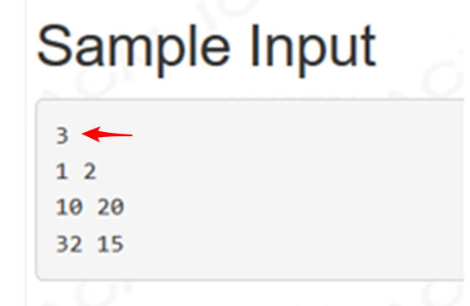
Writing code (Cont.)
3: Number of test cases
public static void main(String[] args) {
Scanner input = new Scanner(System.in);
int total = input.nextInt(); // number of test cases
// way1
while(total-->0) {
// your code goes here
}
// way2
for(int i=0;i<total;i++) {
// your code goes here
}
}

Slide 11
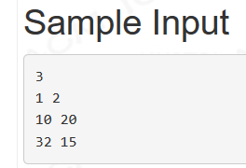
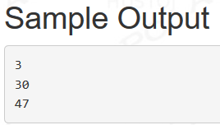
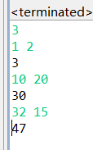
Writing Code And Test
import java.util.Scanner;
public class MyFirstOJ {
public static void main(String[] args) {
Scanner input = new Scanner(System.in);
int total = input.nextInt();
while(total-->0) {
int a = input.nextInt();
int b = input.nextInt();
int sum = a + b;
System.out.println(sum);
}
}
}
Tips: You can output the result one by one, or output them altogether after input ends.

Slide 12

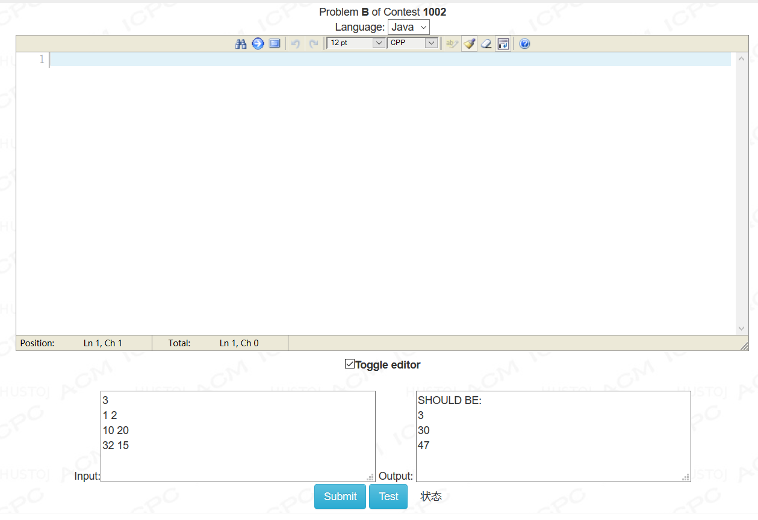
Upload Your Code to OJ

Slide 13
Upload Your Code to OJ (cont.)
1
//package mypackage
import java.util.Scanner;
public class Main {
public static void main(String[] args) {
Scanner input = new Scanner(System.in);
int total = input.nextInt();
while(total-->0) {
int a = input.nextInt();
int b = input.nextInt();
int sum = a + b;
System.out.println(sum);
}
}
}
2
Paste your code
Do some modification
  Delete package
  Change class name to main

Slide 14
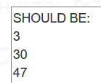

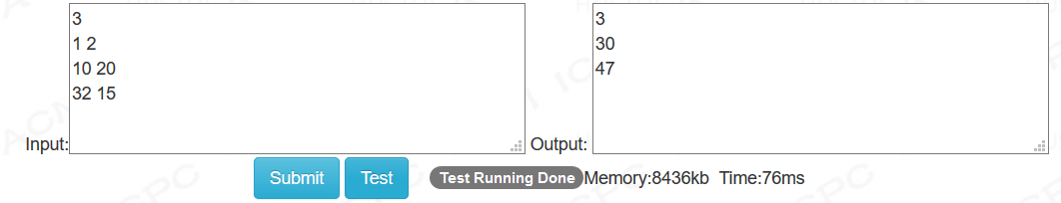

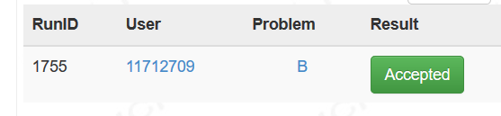
Upload Your Code to OJ (cont.)
3. Test
4. Submit

Slide 15






Common Status
Well done! Congratulations!
Check output format (hidden space? Decimal place?)
Check your algorithm (special cases?
Something not considered?)
Why my program is right at local, but get WA in OJ?: check weird cases
Answer is right, but format is incorrect.
Check space, blank lines, etc.
Package not deleted? Forget to change class name?
Null pointer? Array out of bound? Click to get more info.
Algorithm too slow. (Bruteforce? Too many iterations?)
Find a more efficient one.
Read more: http://10.20.64.171/faqs.php
红橙作伴

Slide 16
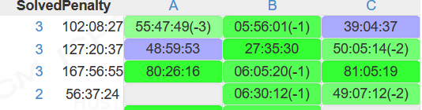
Few Other Things
Ranklist and Penalty
Penalty: The sum of time you used to solve the problems (First time of )
+ additional time for your incorrect submits
( , , ,etc )

Slide 17
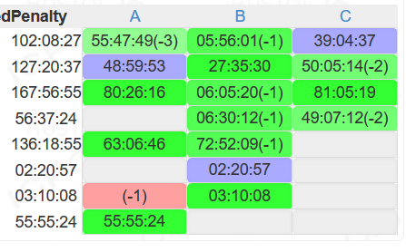
Few Other Things
Meaning of colors and numbers
Green: AC
Red: Not AC
Purple: First one to AC
Negative Number: Retry count before AC

Slide 18
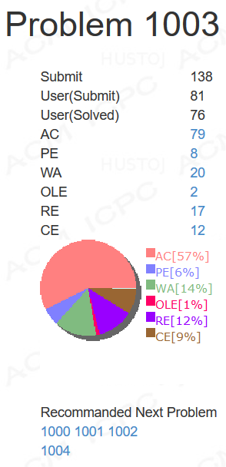
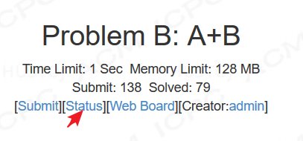
Few Other Things
Problem Status
Statistic about the problem

Slide 19
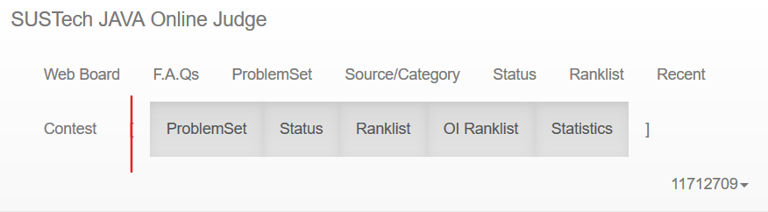
Few Other Things
Global and Problem Set
Above is global (in the whole website)
Behind is only in this problem set

Slide 20
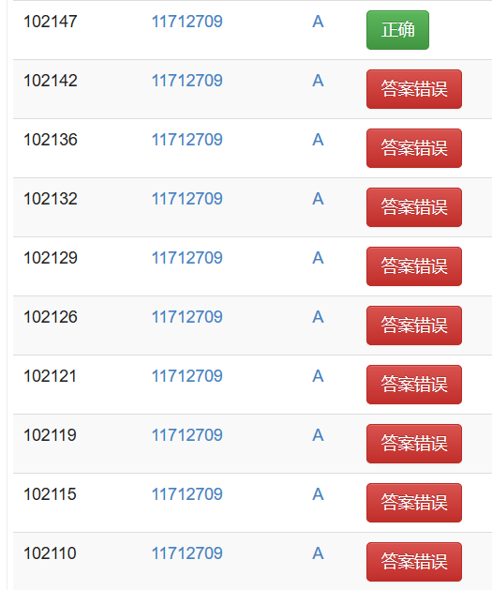
Final Words
Everyone makes mistakes
Do BELIEVE in yourself!

Slide 21
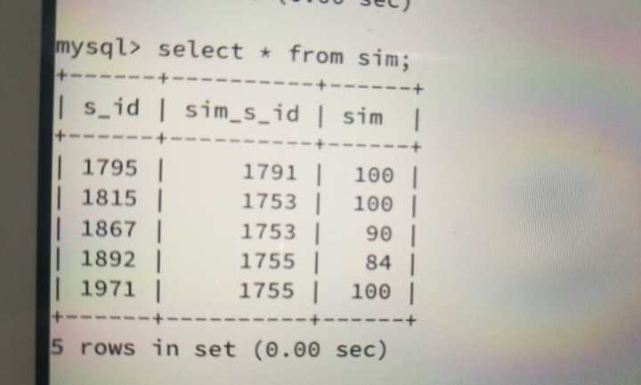
Final Words
DO NOT PLAGIARIZE!
We can and will catch!

Slide 22
Thanks!
Your time now!
Write Code, Have Fun

