Slide 1

Unmanned Auto Driving Vehicle
Xiaoran Li(35058463)
Zhilai Shen(443344)
Ningfeng Zhang(70692885)
Yishan Ma(0948702)
Mentor: Glenn Healey

Slide 2
Outline
1. Introduction
2. Overview
3. Ultrasonic
4. Pixy Camera
5. Reference

Slide 3
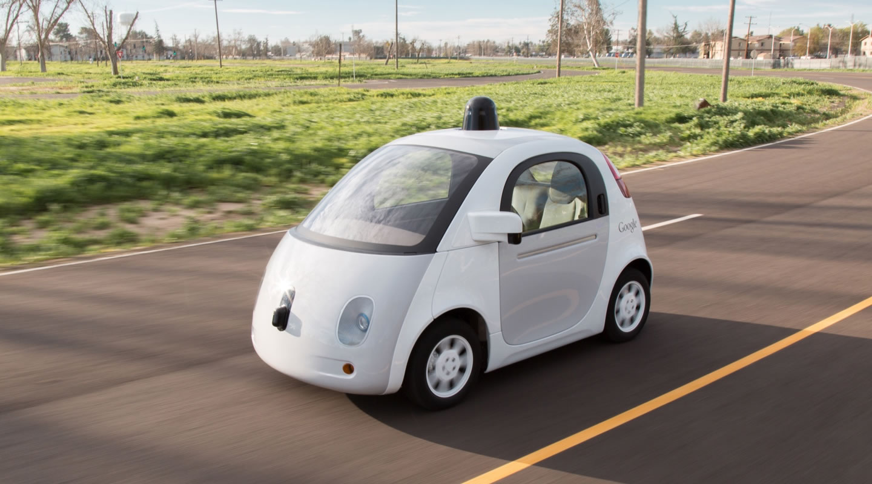
Background
Vehicle that drives from one point to another point without human interaction.
Implement number of well placed sensors that detect different things such as other vehicles, people, traffic lights, and movement of other vehicles

Slide 4
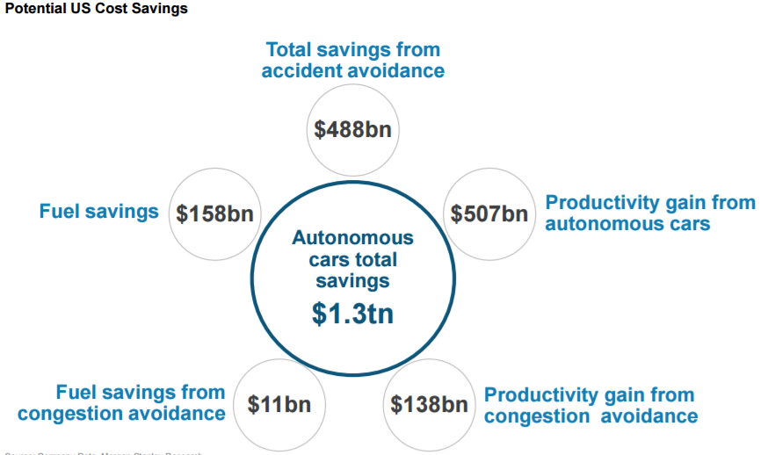
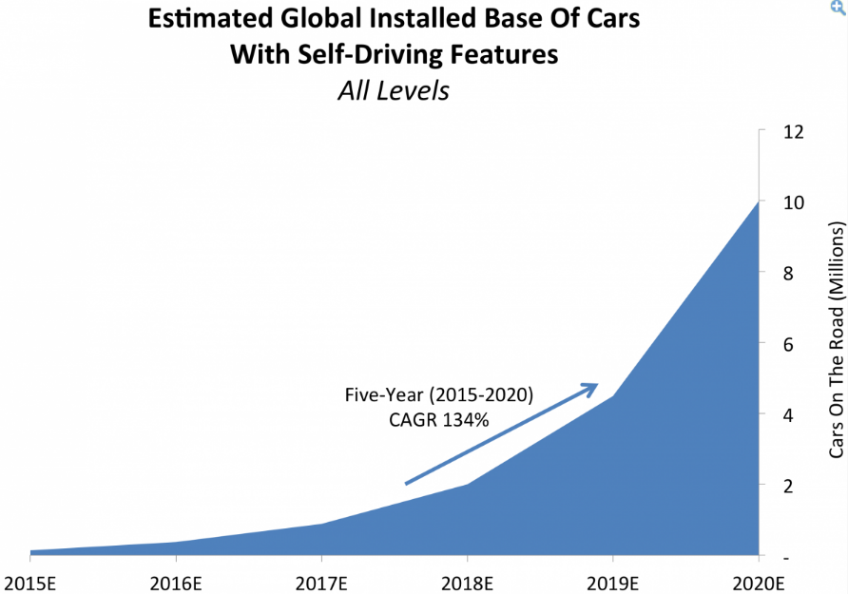
Introduction
1.2 Statistics
Nearly 10 million cars with self-driving features in 2020
$1.3 trillion in annual savings to the US economy alone, with global savings estimated at over $5.6 trillion.

Slide 5
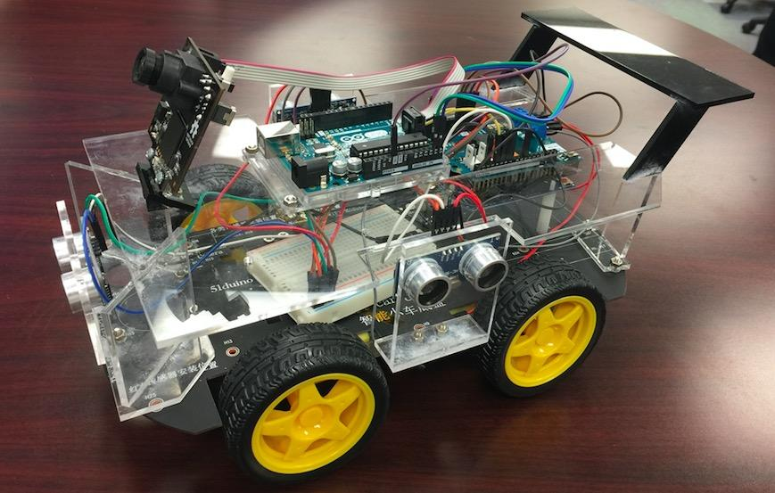
Introduction
1.3 Goals
Distance Detection
[ultrasonic sensor]
Signal Light Recognition
[pixy camera]

Slide 6
Outline
1. Introduction
2. Overview
3. Ultrasonic
4. Pixy Camera
5. Reference

Slide 7
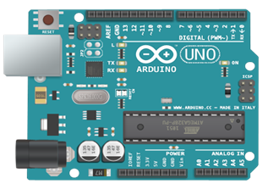
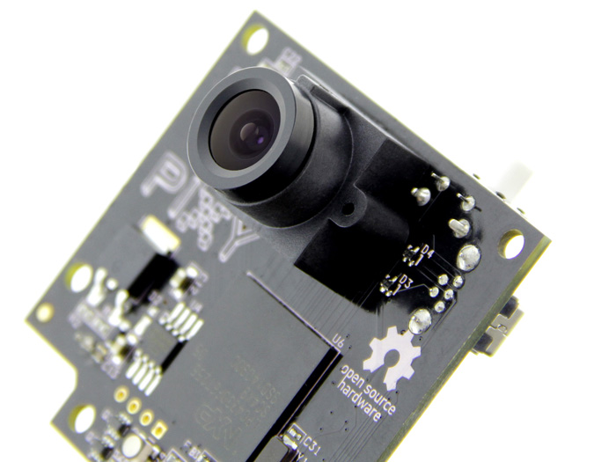
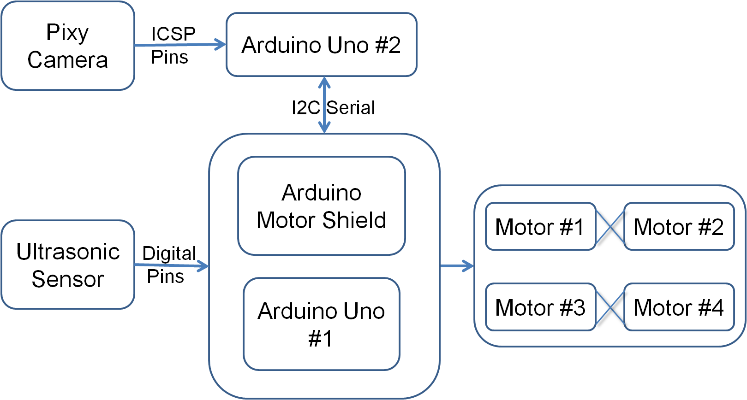
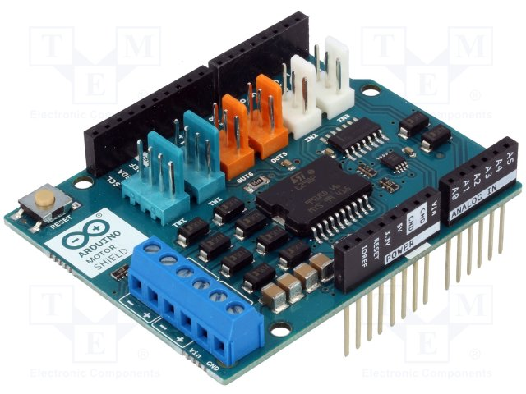
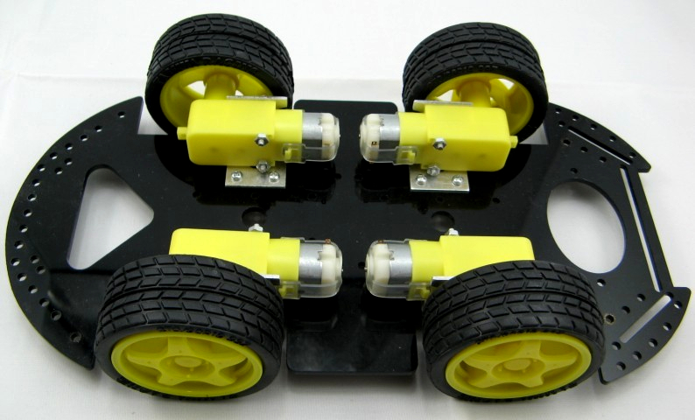
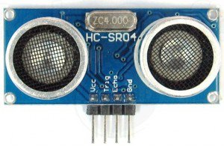
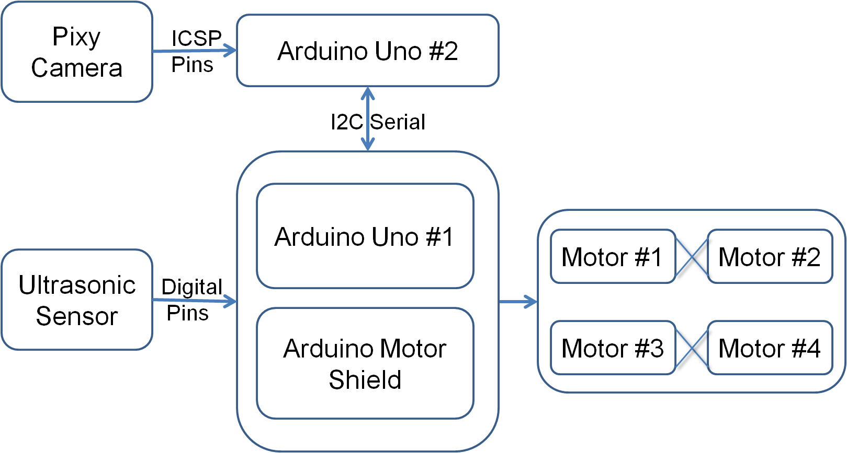
2. Overview

Slide 8
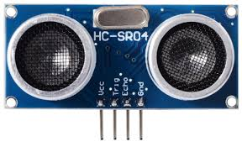
Outline
1. Introduction
2. Overview
3. Ultrasonic
4. Pixy Camera
5. Reference

Slide 9
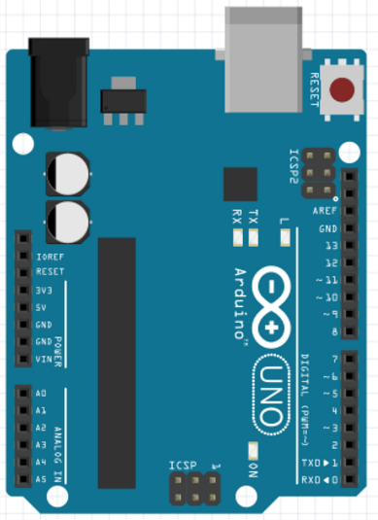
Configuration

Slide 10
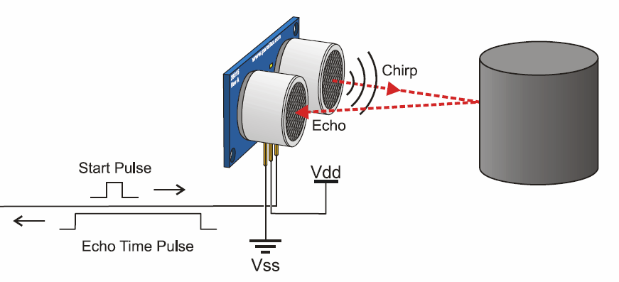
Implementation
Chirp Port: send ultrasonic wave for 10 μs
Echo Port: detect reflected ultrasonic wave
Board: calculate distances through differences in time

Slide 11
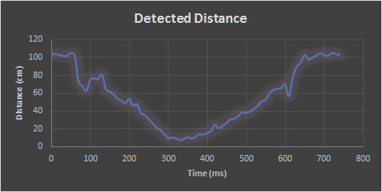
Data Analysis
Data sent back to the board are distances between sensors and objects
Whenever the distance below the red line (20 cm):
Front Sensor: Require Stop
Left Sensor: Require Right Turn
Right Sensor: Require Left Turn
Distance detected in centimeters vs time in microsecond

Slide 12
Outline
1. Introduction
2. Overview
3. Ultrasonic
4. Pixy Camera
5. Reference

Slide 13
The Selection of Camera
Principle: resolution, data analysis, price, image recognition
Selection：
 | Resolution | Image recognition | Data Analysis | Price
Web Cam | 640x480 | Yes | No | Low
Pixy Cam | 640x400 | Yes | Yes | High

Slide 14
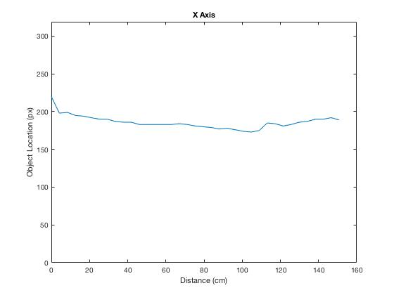
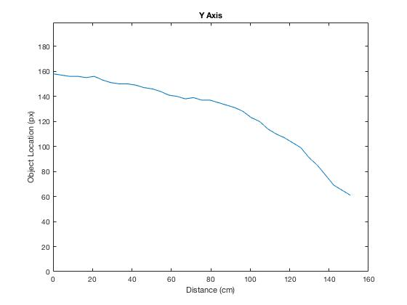
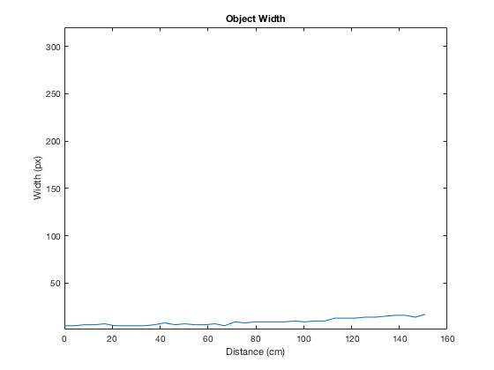
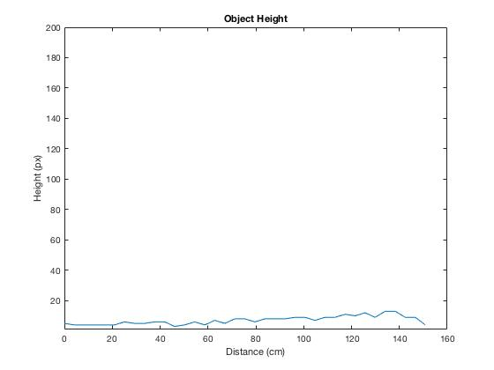




Implementation
Y $∈[0,199]$
X $∈[0,319]$
✔️
Width $∈[1,120]$
Width $∈[1,320]$

Slide 15
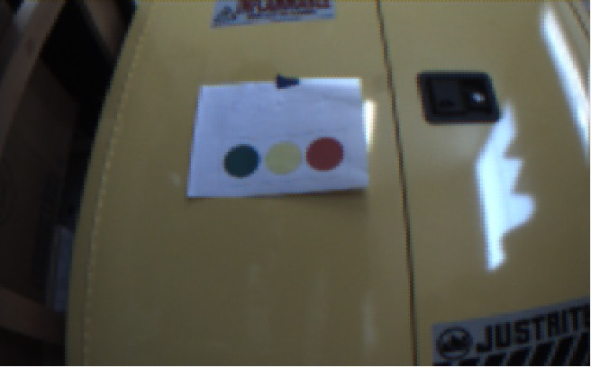
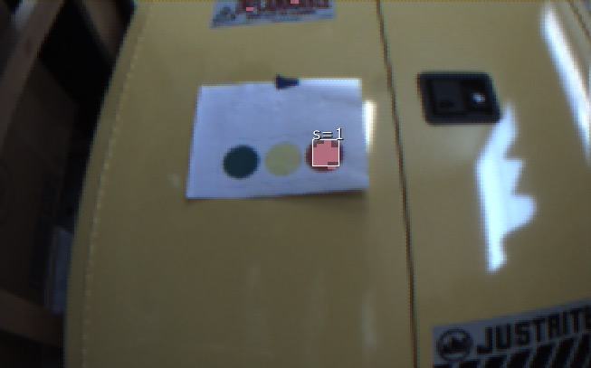
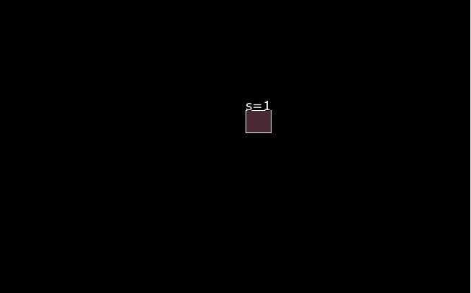
Implementation
Set signature color
STOP!

Slide 16
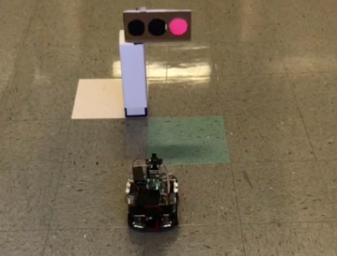
Implementation
blocks=pixy.getBlocks();
value=0; if(blocks){ for(j=0;j<blocks;j++){ Serial.println(pixy.blocks[j].y);
if(pixy.blocks[j].y>value) value=pixy.blocks[j].y;
}
}

Slide 17
Reference
http://www.hobbyist.co.nz/?q=batdrive-robotic-chassis
http://droidecomunidad.com/portfolio-item/curso-de-proyectos-con-arduino/
http://www.tme.eu/en/details/a000079/development-kits-accessories/arduino/arduino-motor-shield-rev3/
https://electrosome.com/hc-sr04-ultrasonic-sensor-pic/
[3] Gantt, Charles. “Using an ultrasonic distance sensor to illuminate NeoPixels.” The makers Workbench. 4 June 2015. Web. 26 Feb. 2017.

Slide 18
Q&A

