Slide 1

A non-parametric method for joint association analysis of sequencing and imaging data
Xiaoran Tong
Department of Epidemiology and Biostatistics
Michigan State University

Slide 2
Background
While statistical methods have been proposed to evaluate the effect of genetic variants or imaging measures on disease outcomes, there is a lack of methods for testing their joint effect
The challenges of genetic and imaging data include high-dimensionality and complex data structures, and deep-learning has been found to be promising for dimensionality reduction and high order feature extraction
Notes:
Our research is motivated by the lack of method capable of testing the joint association among genetic marker, image measure and disease outcome
The challenge come from the curse of dimensionality. We see that deep learning is capable in dimension reduction and high order feature extraction, and would like to apply it to image

Slide 3
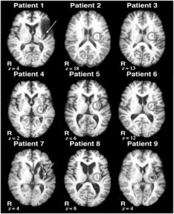
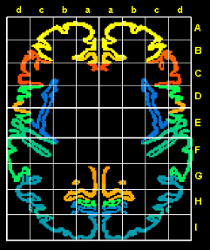
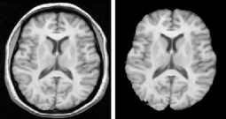
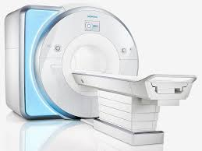
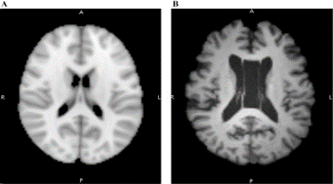
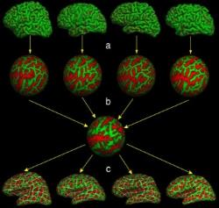
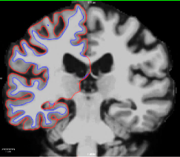
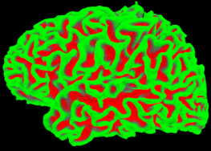
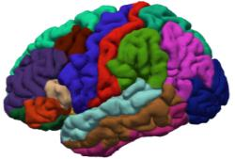
Neural Image Preprocessing
Surface features at vertices
Figure generated by freesurfer group, Harvard University
Notes:
Start with MRI slices ➔ Align to atlas ➔ Skull striping and intensity normalization ➔
vertex feature calculation ⬅ Register to average brain ⬅ 3D surface reconstruction ⬅ boundary search
anatomical partition ⬅
Talairach coordinates, also known as Talairach space, is a 3-dimensional coordinate system (known as an 'atlas') of the human brain, which is used to map the location of brain structures independent from individual differences in the size and overall shape of the brain.
The processing is mostly done by FreeSurfer software package

Slide 4
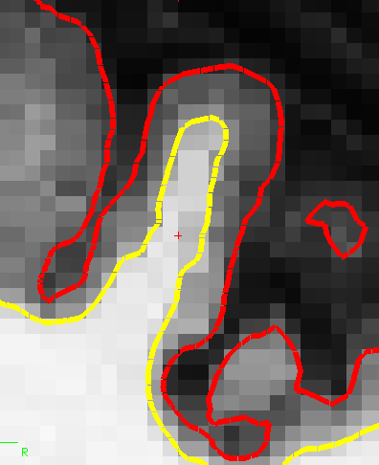
Surface Features on Vertices
A total of 32,768 vertices in each brain surface, across 67 anatomical regions;
Each region has few hundreds to ten thousands of vertices
Figure generated by freesurfer group, Harvard University
Notes:
A cross section of pial / WM boundary of the reconstructed brain surface 3D model, overplayed on original MRI voxels
L: GM thickness
R: WM curvature
The purpose of collecting these data, is to test the hypothesis that GM shrinkage is related to AZ progression.
There are 16,384 vertices per hemisphere pre 3D brain surface model
Dimension is high:
A total of 32,768 vertices in each brain surface, across 68 anatomical region;
One region has few hundreds to ten thousands of vertices
This number may grow with advancing image technology

Slide 5

Encode Vertices by Deep Learning
x_{r-1}'
s(b_{r}' + (.)w_{r}')
x_{r}
A_{r}
s(b_{r} + (.)w_{r})
x_{r-1}
s(b_{r-1}' + (.)w_{r-1}')
x_{r-2}’
A_{r-1}
s(b_{r-1} + (.)w_{r-1})
x₂'
… …
x_{r-2}
s(b₃ + (.)w₃)
x₂
s(b₂' + (.)w₂')
x₁’
A₂
s(b₂ + (.)w₂)
x₀’
s(b'₁ + (.)w'₁)
x₁
A₁
$$L\left(x_{0}^{′},x_{0};θ\right)$$
s(b₁ + (.)w₁)
x₀

Slide 6
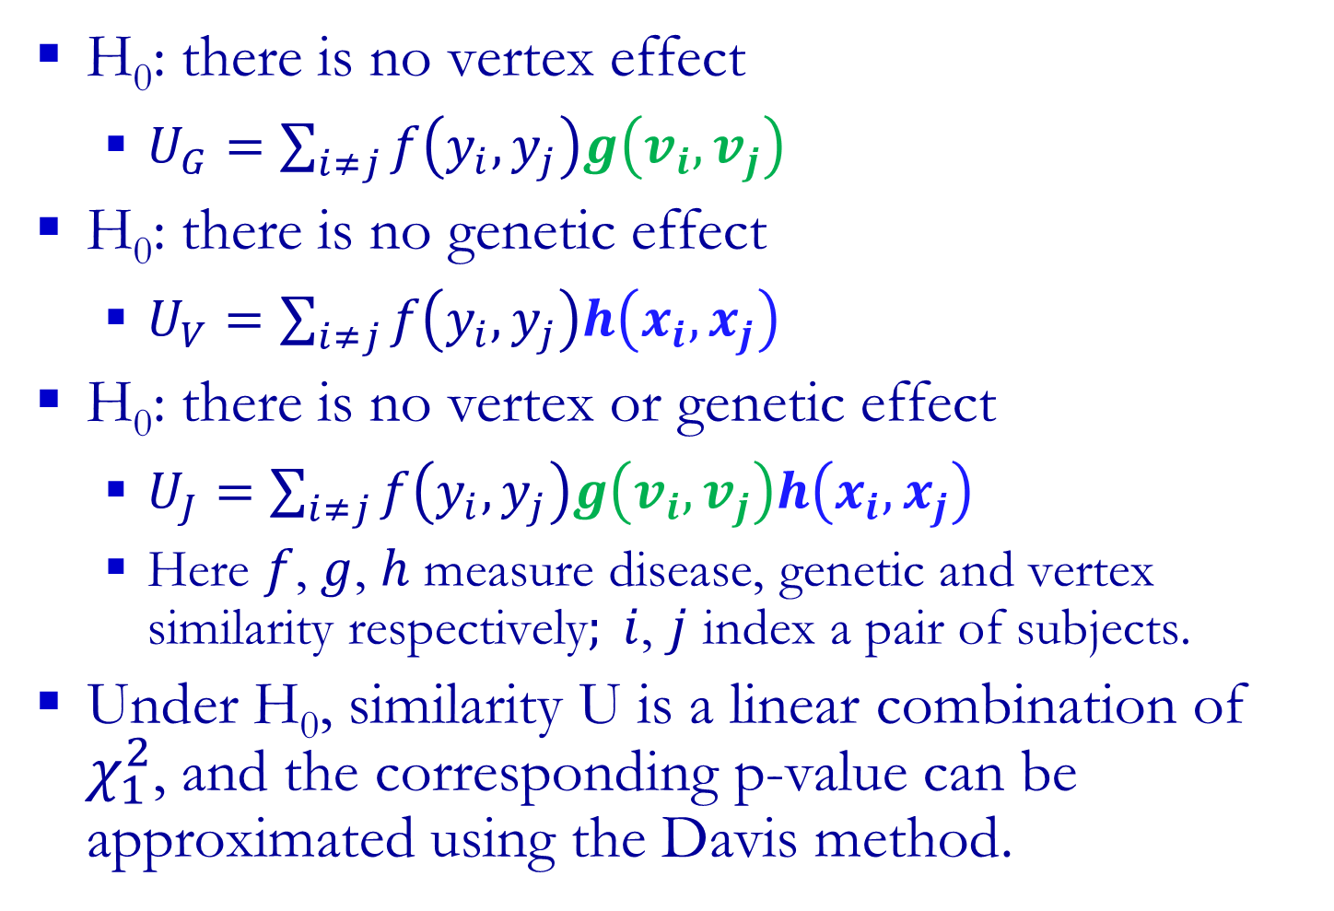
Similarity U Tests
H₀: there is no vertex effect
$U_{G}=\sum_{i≠j}{f\left(y_{i},y_{j}\right)g\left(v_{i},v_{j}\right)}$
H₀: there is no genetic effect
$U_{V}=\sum_{i≠j}{f\left(y_{i},y_{j}\right)h\left(x_{i},x_{j}\right)}$
H₀: there is no vertex or genetic effect
$U_{J}=\sum_{i≠j}{f\left(y_{i},y_{j}\right)g\left(v_{i},v_{j}\right)h\left(x_{i},x_{j}\right)}$
Here $f$, $g$, $h$ measure disease, genetic and vertex similarity respectively$; i$, $j$ index a pair of subjects.
Under H₀, similarity U is a linear combination of $χ_{1}^{2}$, and the corresponding p-value can be approximated using the Davis method.
Notes:
Under H0, inter-subject similarity in disease has nothing to do with the similarity in Brain or Genetics.
U should be close to 0, if f, g, and h are uncorrelated, because the similarity in genome, brain, and clinical profile is uncorrelated and symmetric
Here the genetic similarity is implemented by IBS kernel, vertex similarity is inversed Gaussian distance, which is based on the Euclidian distance
Disease similarity is a product kernel
Kernels may change to suit the type of data, and weights can be assigned to variants within the test unit.

Slide 7
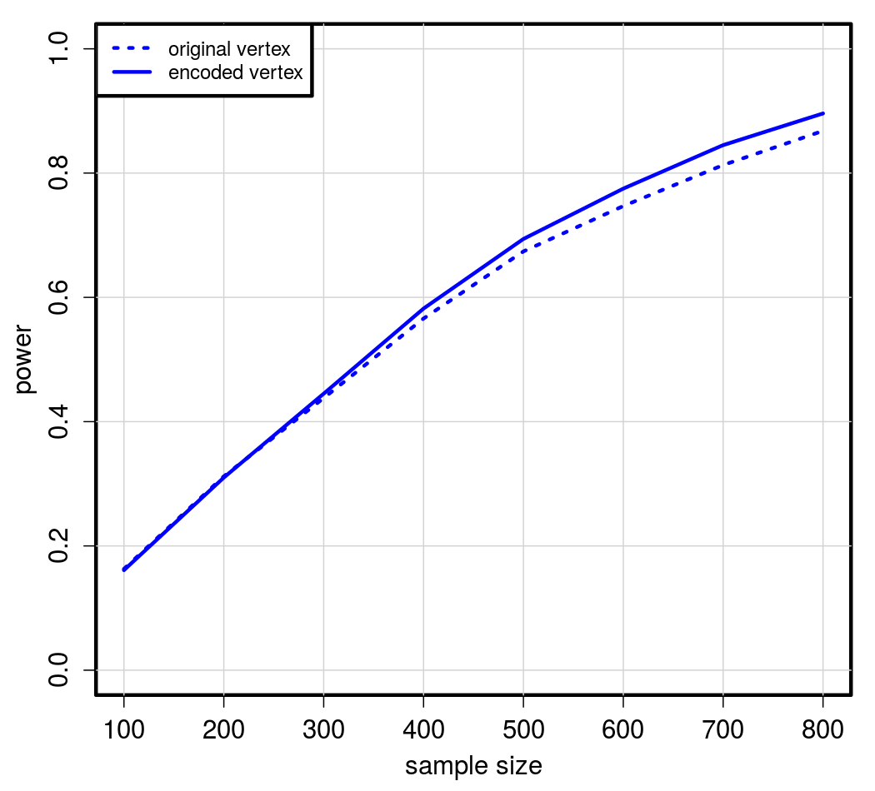
Vertex-only Effect
Original vertices vs. Encoded vertices
N | Original | Encoded
100 | 0.163 | 0.161
200 | 0.312 | 0.310
300 | 0.438 | 0.445
400 | 0.566 | 0.582
500 | 0.674 | 0.694
600 | 0.747 | 0.775
700 | 0.813 | 0.845
800 | 0.868 | 0.896
Notes:
Randomly draw genetic and image data from 807 ADNI participants with available WGS and MRI image data.
Create pure genetic, pure vertex and additive effect scenario.
Compare power across sample sizes strata
$U_{V}$ built upon original vertex vs. encoded vertex
$U_{G}$, $U_{V}$ and $U_{G}$
We compare the performance of vertex similarity U statistic built upon original and encoded vertices.
The encoded vertices offer higher power, even though their dimensionality is lower, and the risk effect was actually simulated from the original vertices.
In the subsequence analysis, we will measure vertex similarity with encoded vertex exclusively.

Slide 8
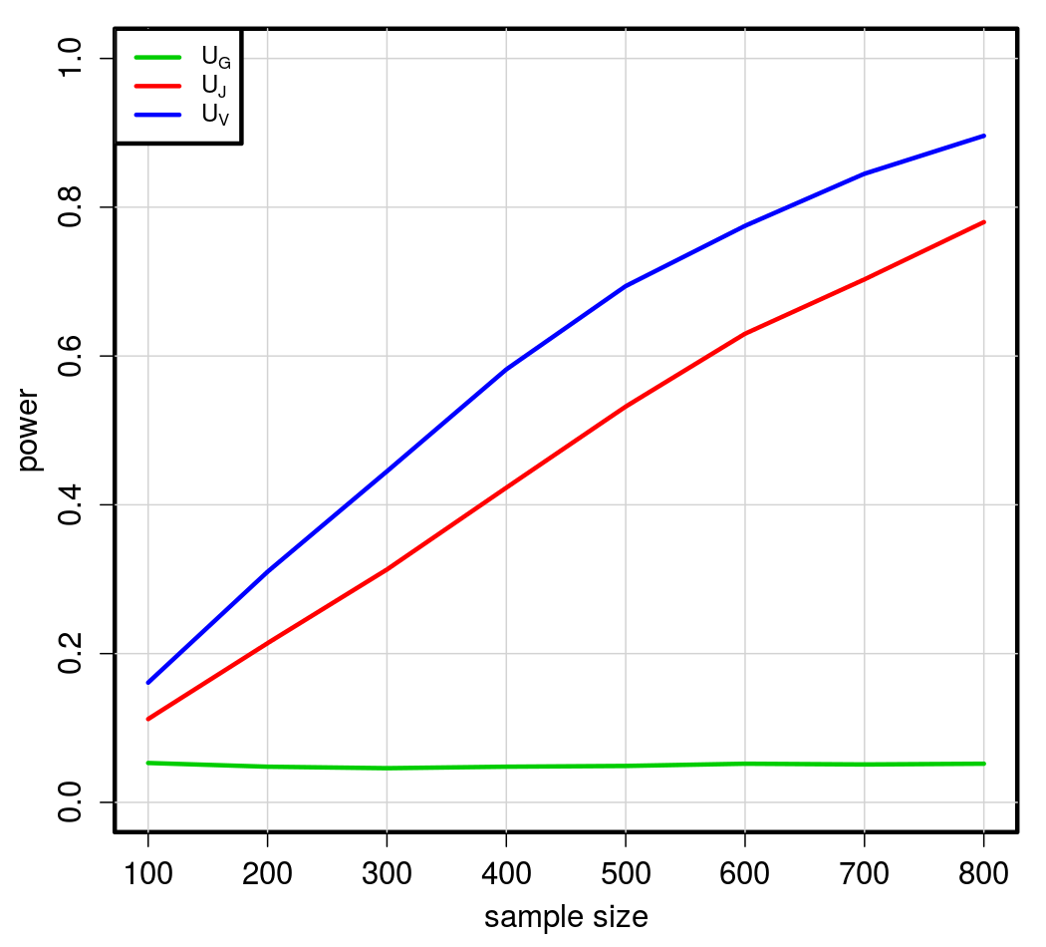
Vertex-only Effect
Power performance of vertex-only, genetic-only, and joint similarity U when there are only vertex effects
N | U_{G} | U_{J} | U_{V}
100 | 0.053 | 0.112 | 0.161
200 | 0.048 | 0.214 | 0.310
300 | 0.046 | 0.313 | 0.445
400 | 0.048 | 0.423 | 0.582
500 | 0.049 | 0.532 | 0.694
600 | 0.052 | 0.630 | 0.775
700 | 0.051 | 0.703 | 0.845
800 | 0.052 | 0.780 | 0.896
Notes:
Same scenario, but try out three type of similarity kernels: vertex, genetic, and joint kernel.
Vertex kernel performs the best because of correct specification – effect is pure vertex based.
Joint kernel performs fairly well
Genetic kernel offers no power due to complete miss-specification.

Slide 9
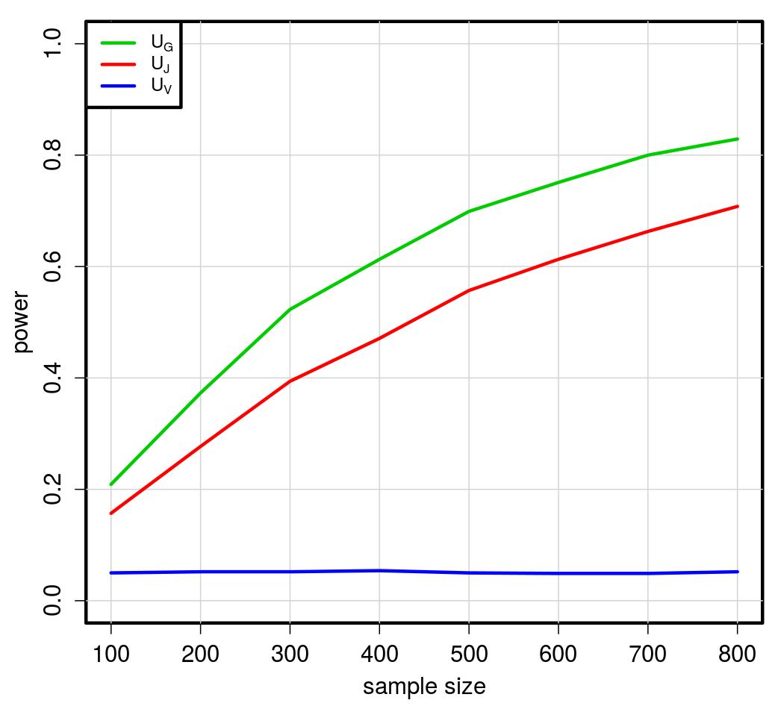
Genetic-only Effect
Power performance of three U tests when there are only genetic effects
N | U_{G} | U_{J} | U_{V}
100 | 0.209 | 0.157 | 0.050
200 | 0.373 | 0.277 | 0.052
300 | 0.523 | 0.394 | 0.052
400 | 0.613 | 0.471 | 0.054
500 | 0.699 | 0.557 | 0.050
600 | 0.751 | 0.613 | 0.049
700 | 0.800 | 0.663 | 0.049
800 | 0.829 | 0.708 | 0.052
Notes:
We change the scenario to drew effect exclusively from genetic variants.
As expected, the genetic kernel best other kernels this time, while vertex kernel offers now power sine the effect was purely genetic.
The joint kernel still performs fairly well

Slide 10
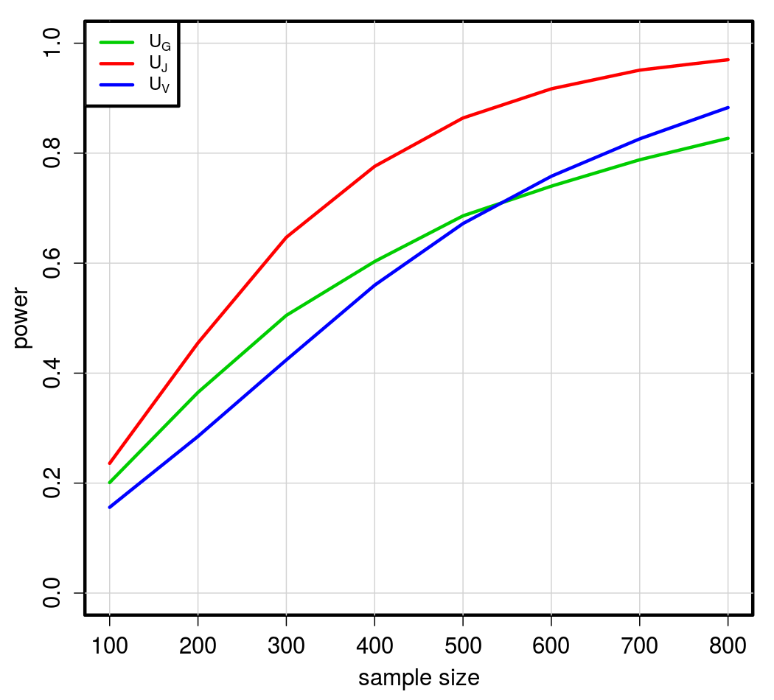
Genetic Effect + Vertex Effect
Power performance of three U tests when there are both genetic and vertex effects
N | U_{G} | U_{J} | U_{V}
100 | 0.201 | 0.236 | 0.156
200 | 0.365 | 0.455 | 0.285
300 | 0.505 | 0.647 | 0.424
400 | 0.603 | 0.776 | 0.560
500 | 0.686 | 0.864 | 0.672
600 | 0.740 | 0.917 | 0.758
700 | 0.788 | 0.951 | 0.826
800 | 0.827 | 0.970 | 0.883
Notes:
Now the effect is an additive result from both genetic variant and vertices.
All kernels perform well, while the joint kernel is optimal under this setting, a mixed kernel shows highest detection power when the effect is also a mixture.

Slide 11
Real Data Application
ADNI Dataset
Samples: 47 Alzheimer cases and 280 controls with both WGS and MRI image data. Covariates: age, sex, education, race, ethnicity, marriage status and APOE4
Brain region # of vertices |  | Gene #of variants |  | P-value
 |  |  |  | U_{G} | U_{P} | U_{V}
L superiortemporal | 7271 | IGLV1-44 | 174 | 3.51E-04 | 2.77E-13 | 1.68E-11
L superiortemporal | 7271 | NBEAP2 | 238 | 1.19E-04 | 4.74E-13
L superiortemporal | 7271 | RPL21P89 | 90 | 6.36E-04 | 5.14E-13
L superiortemporal | 7271 | LOC102724504 | 59 | 1.41E-03 | 5.56E-13
L superiortemporal | 7271 | CNTNAP3P8 | 40 | 1.08E-03 | 6.17E-13
L superiortemporal | 7271 | CDH4 | 9464 | 4.64E-03 | 6.96E-13
L superiortemporal | 7271 | HNRNPA1P19 | 17 | 8.88E-04 | 7.80E-13
L superiortemporal | 7271 | FAM72C | 174 | 9.28E-06 | 7.82E-13
L superiortemporal | 7271 | RP11-638L3.1 | 4067 | 1.41E-01 | 9.49E-13
Notes:
67 anatomical regions, 40095 genes
2686700 region & gene combination
P value for vertex and join test are significant even after bonfroni correction,
But not for genes
Top 10 statistical significance
We applied the joint similarity U test to Alzheimer’s disease case control study data from ADNI.
Here we listed the top 10 most significant gene-brain joint association.
We tested the genes and the brain region with genetic and vertex similarity U respectively. Turns out the joint test borrowed information from both type of data, mostly from vertices
of Left superiortemporal, whose association with AZ is heavily supported by post mortem anatomical studies.

Slide 12
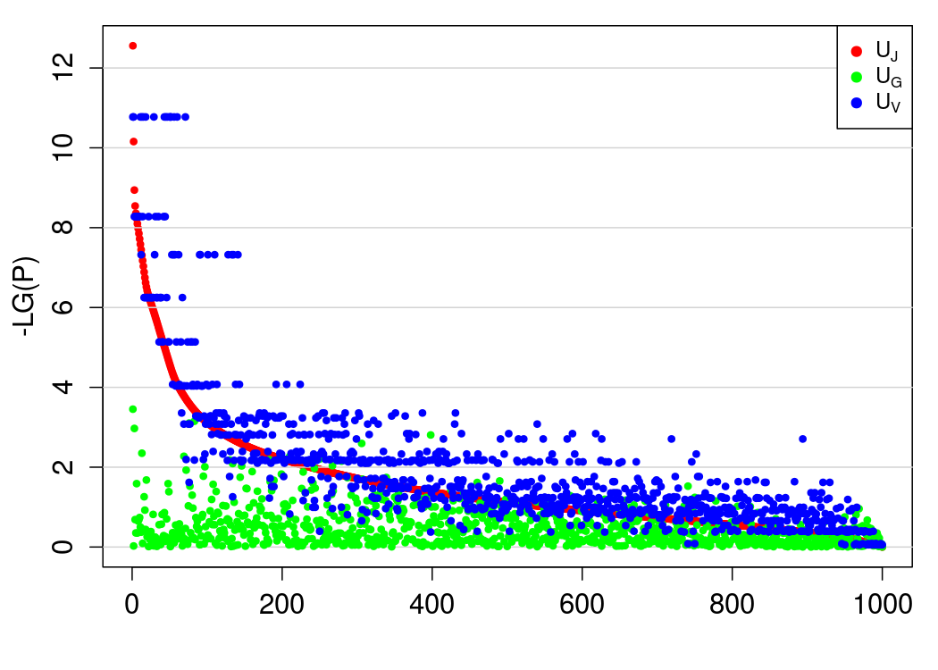
Real Data Application
Results from the analysis of whole genome sequencing data and 67 anatomical regions by using the three U tests
Notes:
67 anatomical regions, 40095 genes
2686700 region & gene combination
P value for vertex and join test are significant even after bonfroni correction,
But not for genes
Top 10 statistical significance
We applied the joint similarity U test to Alzheimer’s disease case control study data from ADNI.
Here we listed the top 10 most significant gene-brain joint association.
We tested the genes and the brain region with genetic and vertex similarity U respectively. Turns out the joint test borrowed information from both type of data, mostly from vertices
of Left superiortemporal, whose association with AZ is heavily supported by post mortem anatomical studies.

Slide 13
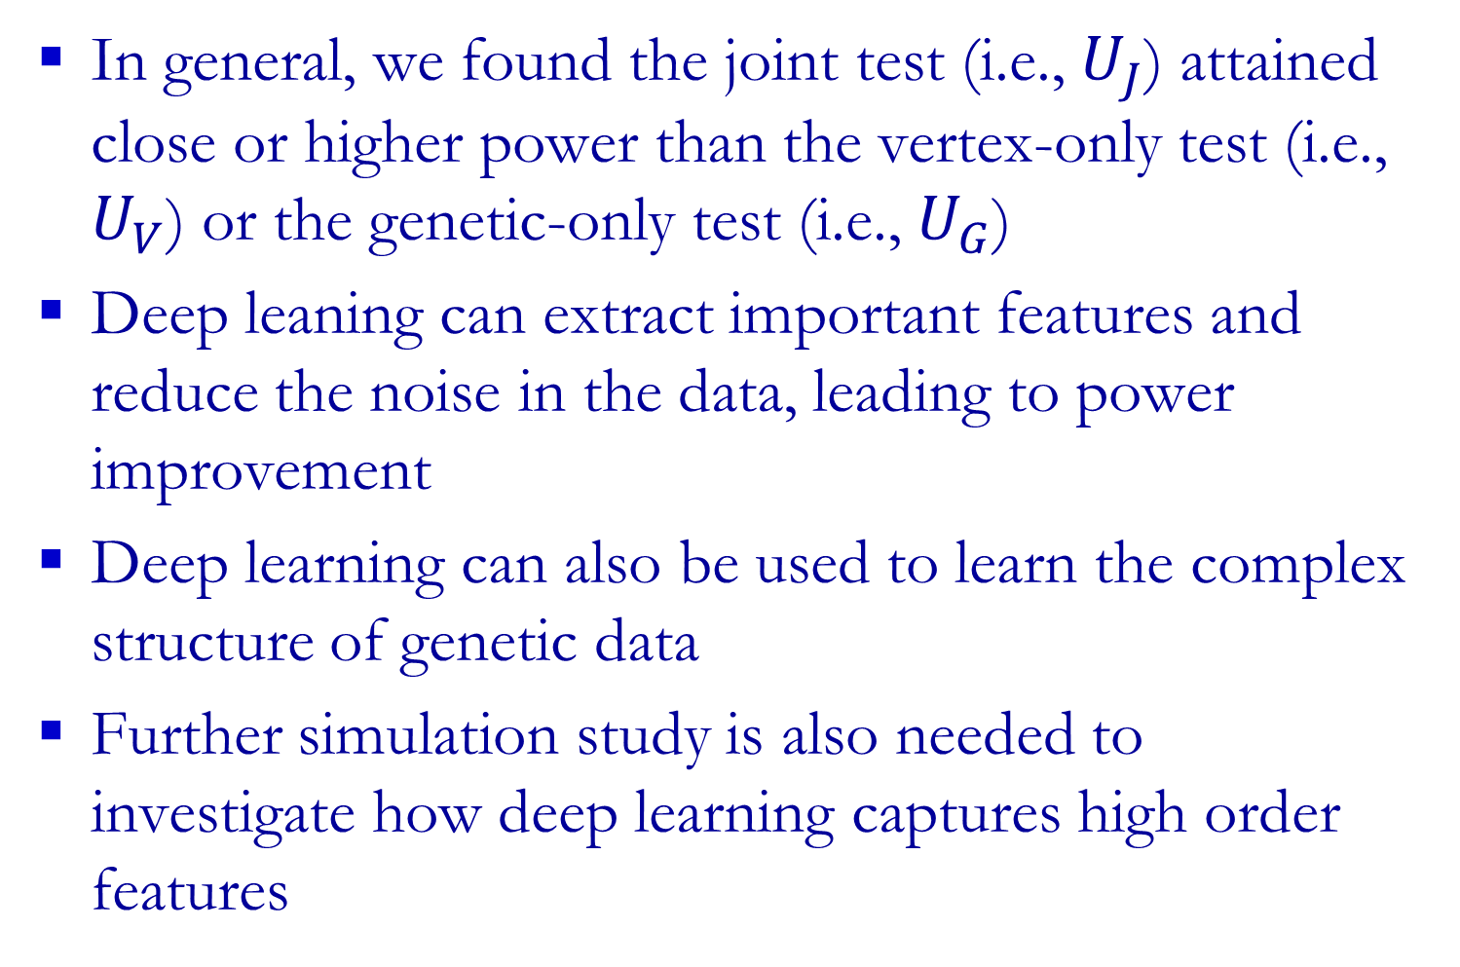
Discussion
In general, we found the joint test (i.e., $U_{J}$) attained close or higher power than the vertex-only test (i.e., $U_{V}$) or the genetic-only test (i.e., $U_{G}$)
Deep leaning can extract important features and reduce the noise in the data, leading to power improvement
Deep learning can also be used to learn the complex structure of genetic data
Further simulation study is also needed to investigate how deep learning captures high order features
Notes:
Joint test is a safe choice when effect composition is unknown
Vertex encoding is helpful in general. except the testing model is severely miss-specified.
Dimension reduction and noise ratio reduction is achieved by deep learning
Testing large unit may overlook significant single variant – poor Coherence with GWAS meta-analysis.

Slide 14
Thank You!

Slide 15
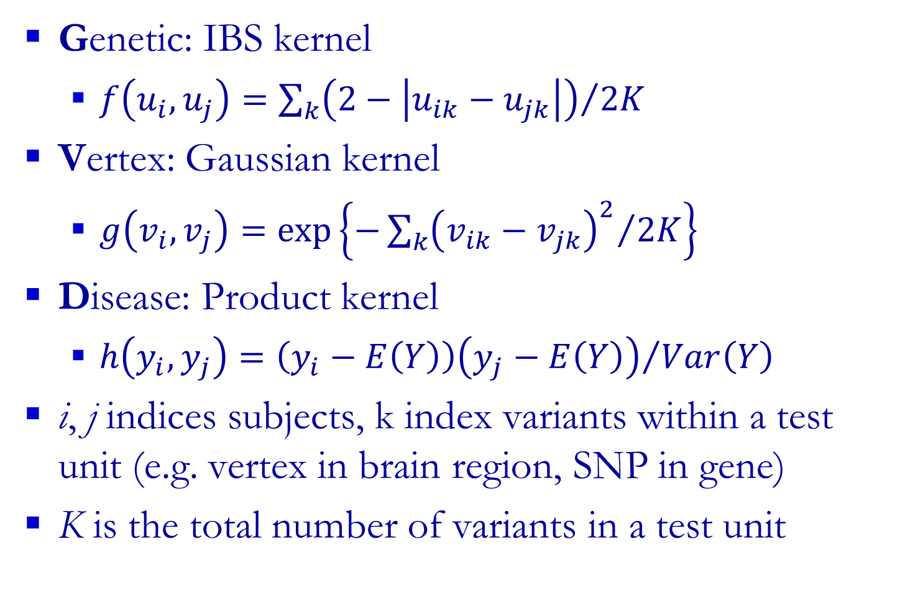
Subject pairwise similarity measure
Genetic: IBS kernel
$f\left(u_{i},u_{j}\right)={\sum_{k}{\left(2−\left|u_{ik}−u_{jk}\right|\right)}}/{2K}$
Vertex: Gaussian kernel
$g\left(v_{i},v_{j}\right)=exp\left\{{−\sum_{k}{{\left(v_{ik}−v_{jk}\right)}^{2}}}/{2K}\right\}$
Disease: Product kernel
$h\left(y_{i},y_{j}\right)={\left(y_{i}−E\left(Y\right)\right)\left(y_{j}−E\left(Y\right)\right)}/{Var\left(Y\right)}$
i, j indices subjects, k index variants within a test unit (e.g. vertex in brain region, SNP in gene)
K is the total number of variants in a test unit

Slide 16
Top 10 significant vertex test
Data retrieved from ADNI:
280 controls, 47 AZ cases at baseline, with available WGS and image data.
Controlling on: age, sex, education, race, ethnicity, marriage and APOE4
Hemisphere & region |  | #vertex | p-value | BN-adjust
L | superiortemporal | 7271 | 2.49E-11 | 1.67E-09
L | entorhinal | 1102 | 5.28E-09 | 3.53E-07
R | superiortemporal | 6868 | 4.75E-08 | 3.18E-06
R | entorhinal | 902 | 5.62E-07 | 3.77E-05
L | cuneus | 1630 | 7.27E-06 | 4.87E-04
L | fusiform | 4714 | 8.43E-05 | 5.65E-03
L | temporalpole | 839 | 9.20E-05 | 6.16E-03
L | middletemporal | 4452 | 4.38E-04 | 2.93E-02
R | pericalcarine | 1823 | 5.22E-04 | 3.50E-02
L | pericalcarine | 1912 | 6.74E-04 | 4.52E-02
Notes:
Vertex kernel against 67 anatomical region
All statistical significance after bonfroni correction

Slide 17
Top significant genetic test
Data retrieved from ADNI:
280 controls, 47 AZ cases at baseline, with available WGS and image data.
Controlling on: age, sex, education, race, ethnicity, marriage and APOE4
Gene | #variant | P value | BN-adjust
FAM72C | 174 | 9.28E-06 | 3.72E-01
HSPD1P13 | 86 | 1.69E-05 | 6.77E-01
ZNF749 | 321 | 2.67E-05 | 1
SNAR-B2 | 94 | 4.56E-05
SNAR-D | 86 | 4.64E-05
MIR1972-1 | 56 | 4.67E-05
EIF4A1P6 | 76 | 7.10E-05
LINC01212 | 224 | 7.95E-05
LINC00378 | 269 | 9.53E-05
NBEAP2 | 238 | 1.19E-04

Slide 18
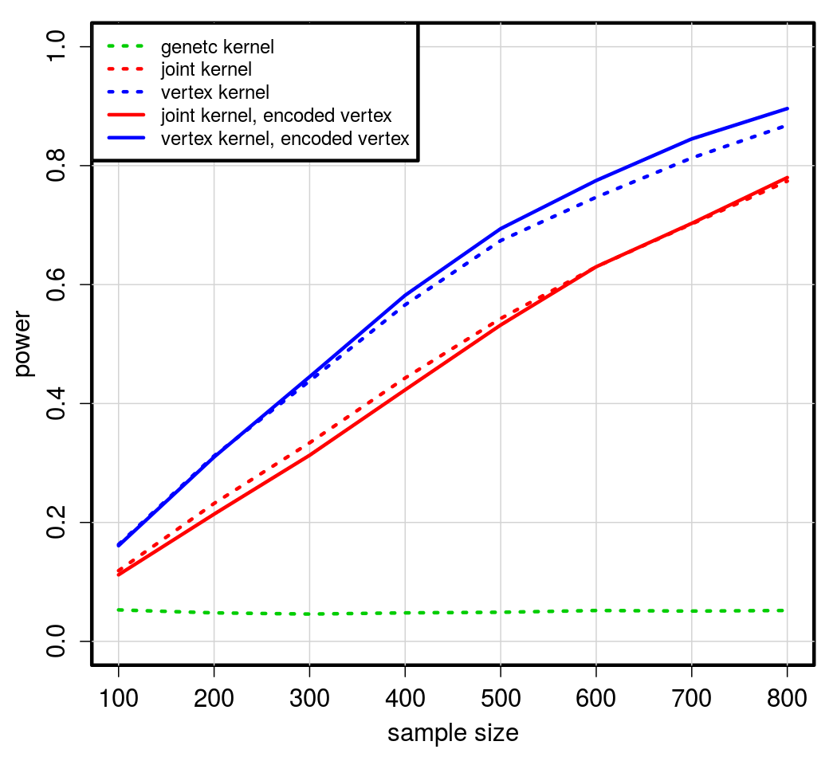
Raw vertex vs. Encoding, vertex effect

Slide 19
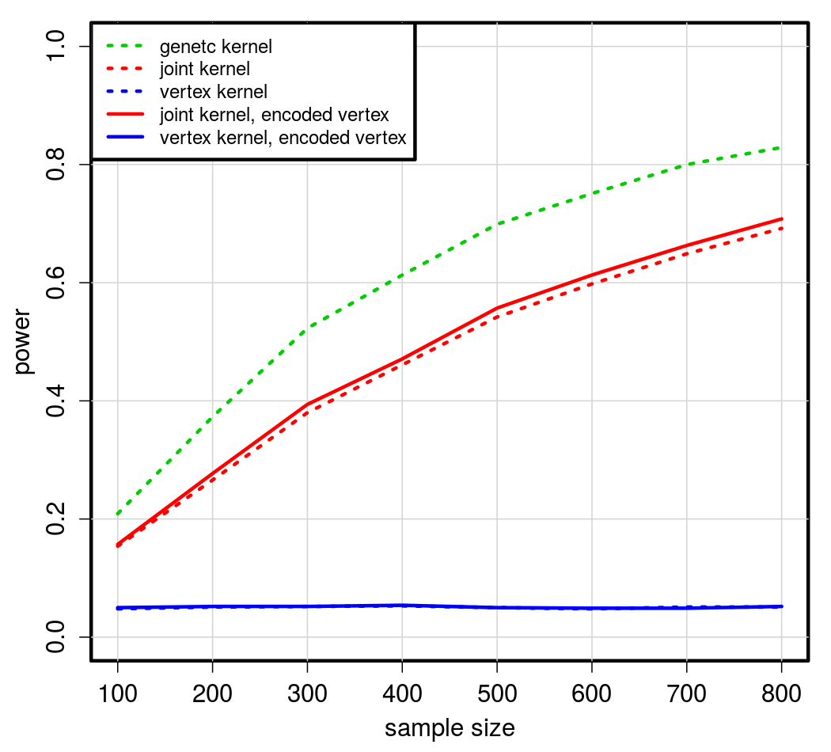
Raw vertex vs. Encoding, genetic effect

Slide 20
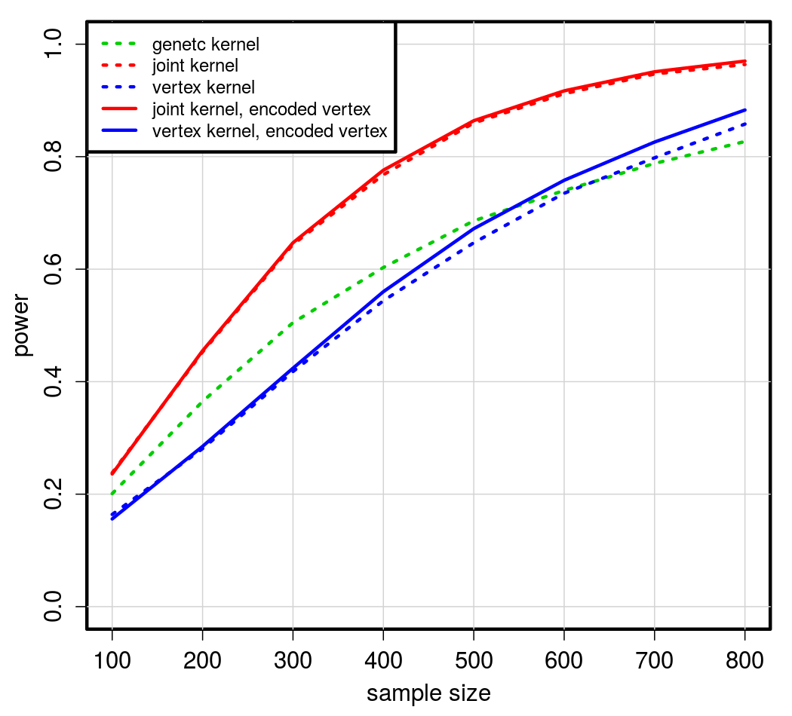
Raw vertex vs. Encoding, additive effect

Slide 21
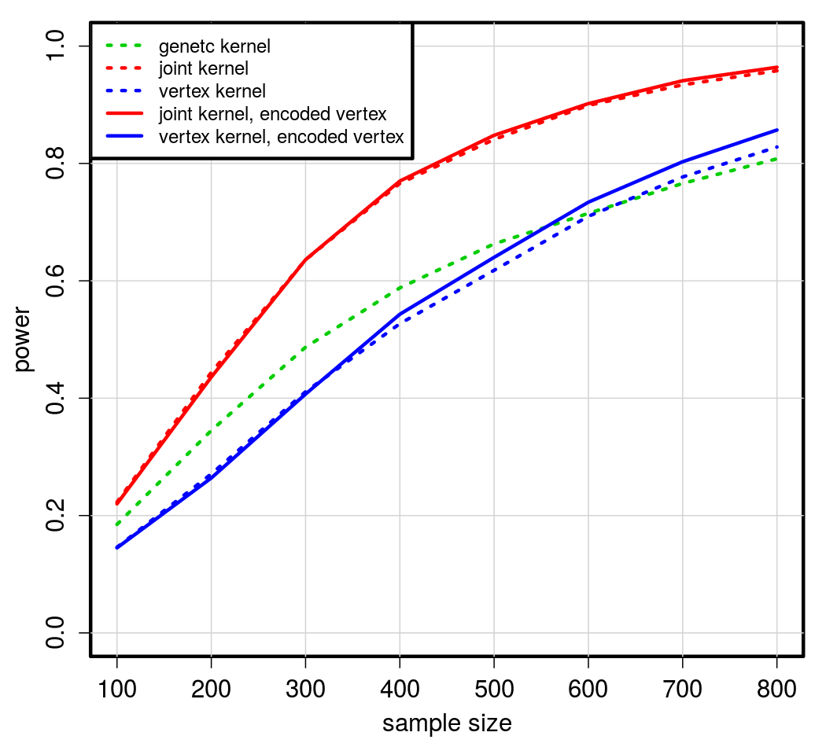
Raw vertex vs. Encoding, effect modification

Slide 22
single layer coder
x_{p}’
x_{p}’
Decoder
s(.)
s(b'_{p} + (.)_{q}w'_{q×p})
b'_{p} + (.)_{q}w'_{q×p}
y_{q}
y_{q}
Encoder
s(.)
s(b_{q} + (.)_{p}w_{p×q})
b_{q} + (.)_{p}w_{p×q}
x_{p}
x_{p}

