Slide 1
Vertex and genetic joint test

Slide 2
Background & Motivation
The Alzheimer’s disease(AZ) is a neurodegenerative chronic disease threatening the late life quality.
AZ is generally irreversible once onset, it is difficult to early diagnose.
Informative biomarkers is in need for prevention and etiological study of AZ.
We aim to develop method capable of picking predictive genetic and brain biomarkers
Notes:
Data sources
genome sequencing
MRI imaging and variants

Slide 3
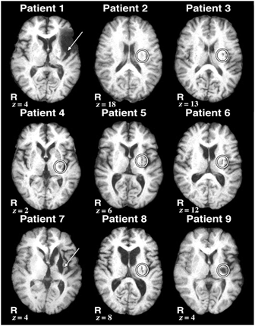
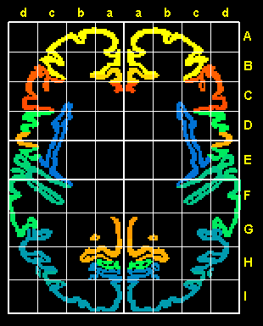
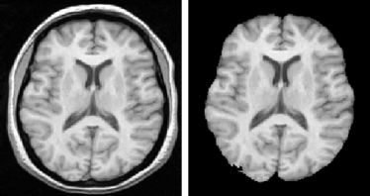
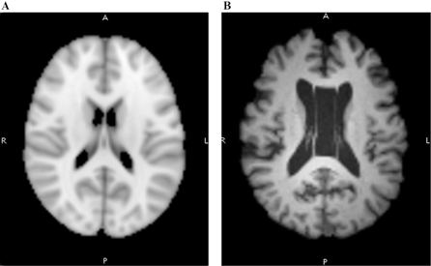
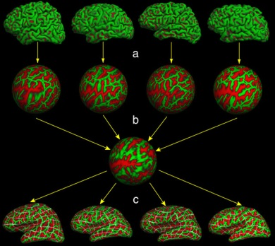
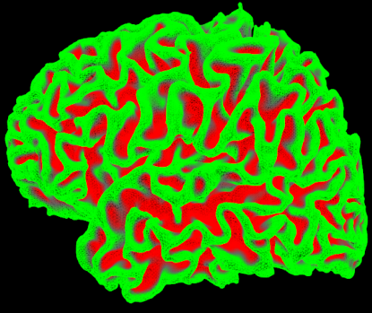
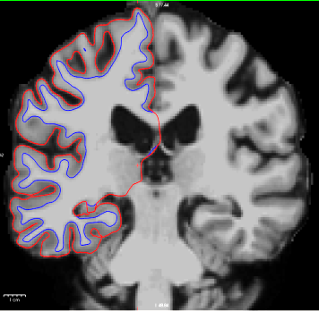
Brain image processing
Grey Matter features at vertices
Notes:
Talairach coordinates, also known as Talairach space, is a 3-dimensional coordinate system (known as an 'atlas') of the human brain, which is used to map the location of brain structures independent from individual differences in the size and overall shape of the brain.
Start with MRI slices
Align to reference brain 1
Skull striping and intensity (brightness) normalization → intensity / voxel based analysis
Intensity guided Pial and white matter boundary search
3D surface model construction
Align to reference brain 2
Calculate grey matter (between pial and white matter boundaries) features at each vertices

Slide 4
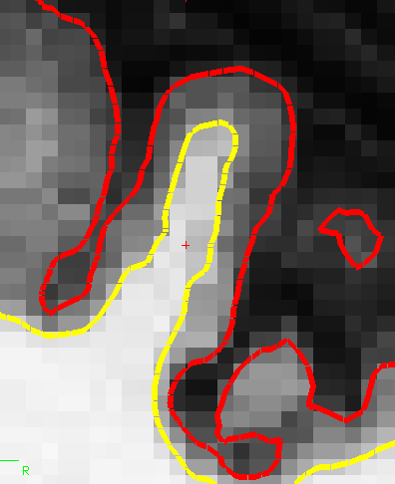
Gray Matter features at some vertices

Slide 5
dimensionality Issue
Small test unit: multiple testing, low heterogeneity
Large test unit: high noise ratio within unit
Model both genetic and brain markers
Performance
test biological unit: genes, brain anatomy
Reduce dimension and noise with Deep Learning
A joint U test of both marker types against disease
Parallel computation
Notes:
They all chew on statistical power:
1.1Multiple testing for small units, because the number of test increases
1.2Low heterogeneity for small units, remember rare variant problem
2. High noise ratio for large testing unit:
3. Model both genetic and brain (if one decided to do so)
normally not a big deal in epidemiology, but the h-dim in both type of marks complicate our test
Difficult to model both genome and brain
Performance
36 brain anatomy region for both hemispheres

Slide 6
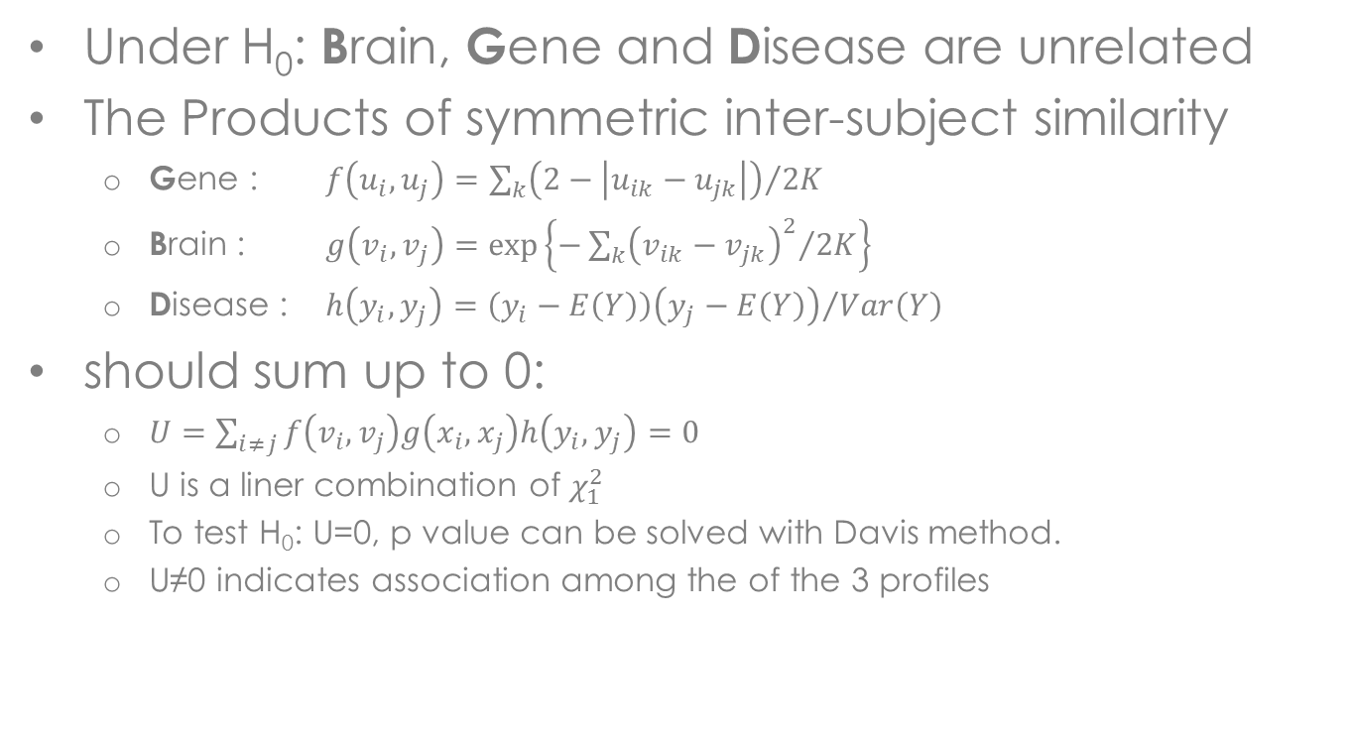
U test for joint effect
Under H₀: Brain, Gene and Disease are unrelated
The Products of symmetric inter-subject similarity
Gene : $f\left(u_{i},u_{j}\right)={\sum_{k}{\left(2−\left|u_{ik}−u_{jk}\right|\right)}}/{2K}$
Brain : $g\left(v_{i},v_{j}\right)=exp\left\{{−\sum_{k}{{\left(v_{ik}−v_{jk}\right)}^{2}}}/{2K}\right\}$
Disease : $h\left(y_{i},y_{j}\right)={\left(y_{i}−E\left(Y\right)\right)\left(y_{j}−E\left(Y\right)\right)}/{Var\left(Y\right)}$
should sum up to 0:
$U=\sum_{i≠j}{f\left(v_{i},v_{j}\right)g\left(x_{i},x_{j}\right)h\left(y_{i},y_{j}\right)}=0$
U is a liner combination of $χ_{1}^{2}$
To test H₀: U=0, p value can be solved with Davis method.
U≠0 indicates association among the of the 3 profiles
Notes:
Under H0, inter-subject similarity in disease has nothing to do with the similarity in Brain or Genetics.
U should be close to 0, if f, g, and h are uncorrelated, because the similarity in genome, brain, and clinical profile is uncorrelated.

