Slide 1
Dimensionality Reduction and Its Application in Data Mining
16 Nov 2017
CS5234 Mini Project
Yang Ruizhi, Chen Shaozhuang, Li Yuanda

Slide 2
Agenda
Introduction to Dimensionality Reduction
Experiments with Dimensionality Reduction
Text
Image
Experiments with K-Means and K-NN
Text
Image
Conclusion

Slide 3
Motivation for Dimensionality Reduction
Many data mining/machine learning applications deal with high dimensional data
E.g. text, image, etc.
Project high dimensional data to lower dimensional space is desirable
R^{d} → R^{k}, where k << d

Slide 4
Dimensionality Reduction Techniques
We consider 3 DR techniques
Principle Component Analysis
(Gaussian) Random Projection
Sparse Random Projection

Slide 5

Principle Component Analysis (PCA)
Let X_{d⨯N} be the original data set, which contains N data points of dimension d. PCA requires eigenvalue decomposition of the data covariance matrix:
The N k-dimensional data matrix after PCA is:
Where E_{k} contains k eigenvectors corresponding to the k largest eigenvalues in 𝚲.
Time Complexity: O(d²N + d³)

Slide 6
(Gaussian) Random Projection
Random projection is performed by simply multiply the original data matrix by a random matrix:
where the random matrix R is obtained by sampling each of entry from a Gaussian distribution N(0, 1/k).
Time Complexity: O(dkN)

Slide 7

Sparse Random Projection
Similar to Gaussian random projection, sparse random projection is done by simply multiply the original data matrix by a random matrix:
where the random matrix R is obtained by sampling each of entry using:
Time Complexity: O(dkN). But sparsity can be exploited.

Slide 8
Johnson-Lindenstrauss Lemma (J-L Lemma)
There are various proofs and interpretations. Our way to interpret J-L Lemma:
For a given error bound 𝜖 and a given size of data set N, as long as k is suitably big, we can always find a random projection, such that the pairwise distance after projection is 𝜖-approximation of the original pairwise distance.
In human language:
Pairwise distance between data points is nearly preserved.
Performance guarantee for random projection.

Slide 9
Summary
Random Projection (RP) | X_{RP}=RX X: original data matrix R: projection matrix, Gaussian-sampled.
Sparse Random Projection (SRP) | r_{ij} sampled from: r_{ij} = √3 w.p. ⅙ r_{ij} = 0 w.p. ⅔ r_{ij} = -√3 w.p. ⅙
Principle Component Analysis (PCA) | X_{PCA}=E_{K}^{T} X X: original data matrix E_{k}: contains k eigenvectores

Slide 10
Agenda
Introduction to Dimensionality Reduction
Experiments with Dimensionality Reduction
Text
Image
Experiments with K-Means and K-NN
Text
Image
Conclusion

Slide 11
Experimental Settings
Objective: Justify the ability of different dimensionality reduction methods for preserving pairwise distance.
Datasets (high-dimensional)
Text Data: 20 newsgroups dataset (10⁴ dimension)
Image Data: Olivetti faces dataset (10³ dimension)
Notes:
20 newsgroups dataset, from 130107 -> 2000
400 images, from 64*64 -> 500.

Slide 12
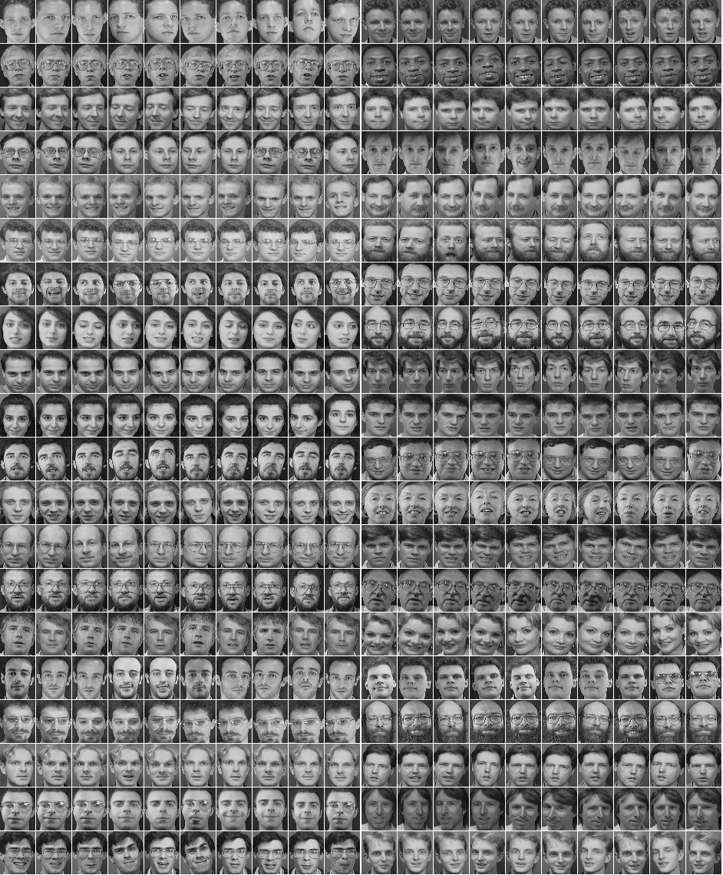
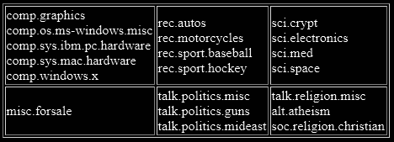

Slide 13
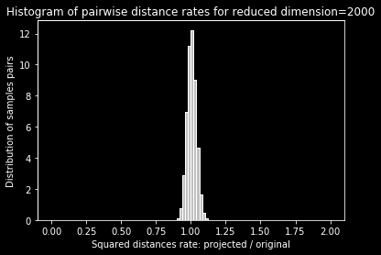
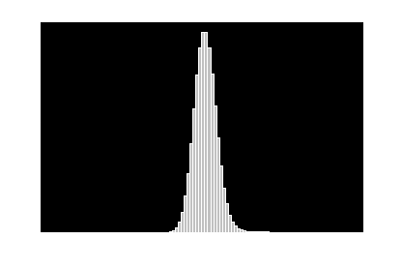
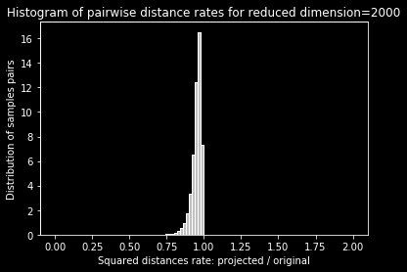
Histogram for RP, SPR, PCA on Text Data
RP SRP PCA

Slide 14
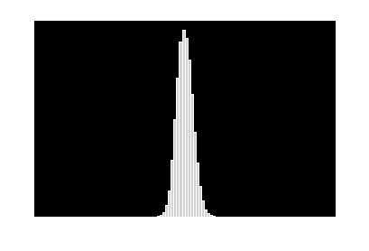
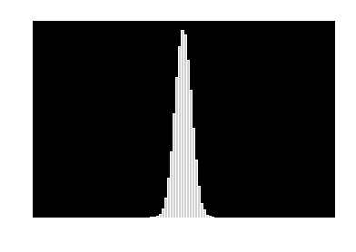

Histogram for RP, SPR, PCA on Image Data
RP SRP PCA

Slide 15
Agenda
Introduction to Dimensionality Reduction
Experiments with Dimensionality Reduction
Text
Image
Experiments with K-Means and K-NN
Text
Image
Conclusion

Slide 16
Experimental Settings
We are particularly interested in data mining/machine learning algorithms that make heavy use of pairwise distance among data points:
K-nearest neighbors (classification, supervised learning)
K-means (clustering, unsupervised learning)
Number of categories:
Text dataset: 5 categories considered.
Image dataset: 10 categories considered.

Slide 17
Performance Metrics
Training/test data division for kNN:
Hold-out, 6 : 4. Stratified sampling.
Metrics:
K-NN:
Precision, recall, f1-score
Higher means better.
K-Means:
Homogeneity, completeness, v-measure.
Higher means better.
Each experiment is performed 20 times. Mean is taken for evaluation.

Slide 18
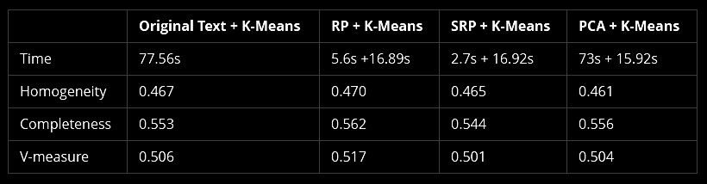
K-Means on Text Data
Notes:
RP performs better than original data. SRP fastest PCA DR takes long time

Slide 19
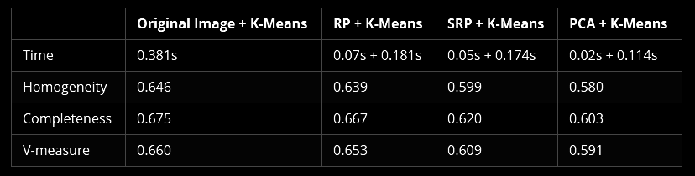
K-Means on Image Data
Notes:
RP performs best. PCA has best time efficiency.

Slide 20
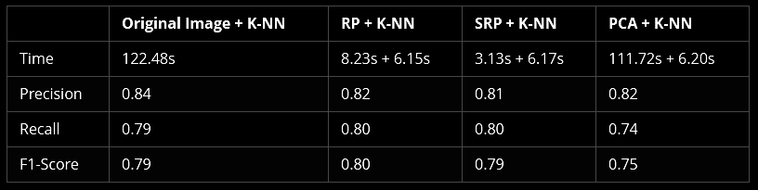
K-NN on Text Data

Slide 21
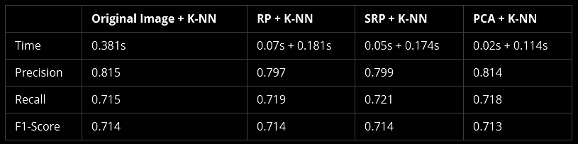
K-NN on Image Data

Slide 22
Agenda
Introduction to Dimensionality Reduction
Experiments with Dimensionality Reduction
Text
Image
Experiments with K-Means and K-NN
Text
Image
Conclusion

Slide 23
Conclusion
Our results show:
All three DR techniques perform well on our datasets and applications.
Gaussian RP outperforms others in most of our experiments.
PCA is inefficient on large dataset with large dimensionality.
We conclude:
RP and SRP are good alternatives to PCA, when pairwise distance is important, dimension is big, and time complexity is a concern.

Slide 24
References
[1] Johnson, W. B., & Lindenstrauss, J. (1984). Extensions of Lipschitz mappings into a Hilbert space. Contemporary mathematics, 26(189-206), 1.
[2] Achlioptas, D. (2001, May). Database-friendly random projections. In Proceedings of the twentieth ACM SIGMOD-SIGACT-SIGART symposium on Principles of database systems (pp. 274-281). ACM.
[3] Dasgupta, S., & Gupta, A. (2003). An elementary proof of a theorem of Johnson and Lindenstrauss. Random Structures & Algorithms, 22(1), 60-65.

