Slide 1

UL217认证测试项目介绍
KAI WANG
X-Sense Innovations Co., Ltd.

Slide 2
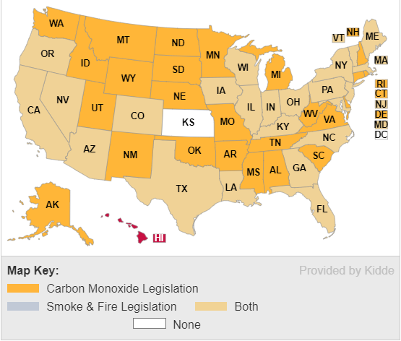
Fire Safety Laws & Legislation

Slide 3
UL 217
Release Date
Sixth Edition – August, 2006
Seventh Edition – June, 2015(未正式生效)
Eighth Edition – October, 2015
Ninth Edition – January, 2020
Information from ETL via e-mail
The Effective Date for either the 8th edition or the 9th edition is June 30, 2024. We do not have a separate date for the 9th edition only.
The 10th edition has not been released yet but I expect it to be approved sometime within the next year.

Slide 4
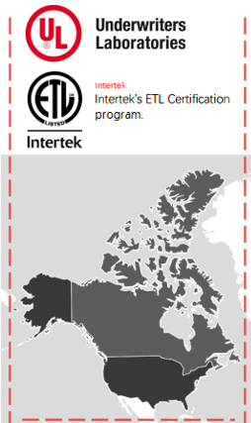
认证机构
UL
ETL

Slide 5
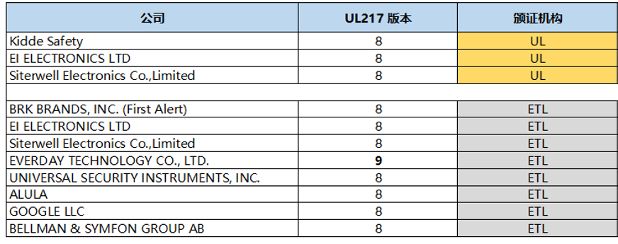
新版标准竞品获证情况

Slide 6
测试项目介绍

Slide 7
测试环境
The smoke alarm shall be installed in an environment so as to permit accurate monitoring of the conditions in (a) – (e). Unless otherwise specified, the following conditions shall be established and maintained throughout the test: a) Ambient temperature at 23 ±3°C (73.4 ±5°F) or a higher temperature if specified by the manufacturer, b) Relative humidity at 50 ±20 percent, c) Oxygen concentration at 20.9 ±1 percent, d) Barometric pressure of 101 ±4 kPa of mercury (760 ±30 mm), and e) Supply voltage, if applicable, adjusted to 100 percent of rated input voltage.

Slide 8
测试结果判断
During or immediately after performance tests, the sensitivity of the detectors shall not vary more than ±1 percent per foot obscuration from the value recorded prior to the test.
And the alarm shall emit neither a fault signal nor an alarm signal during the test.

Slide 9
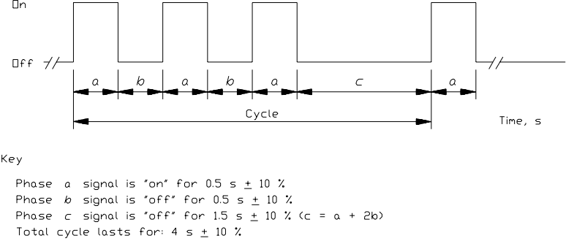
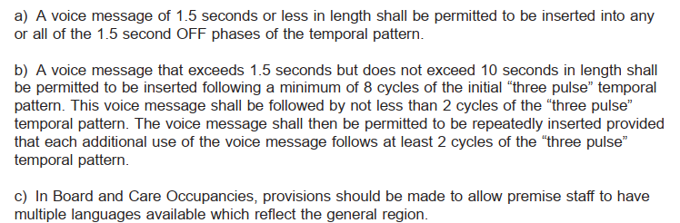
Normal Operation Test
产品的正常功能检查，包含报警优先级、故障指示、静音功能、语音模式、报警发音模式以及其他各项功能检查确认。

Slide 10
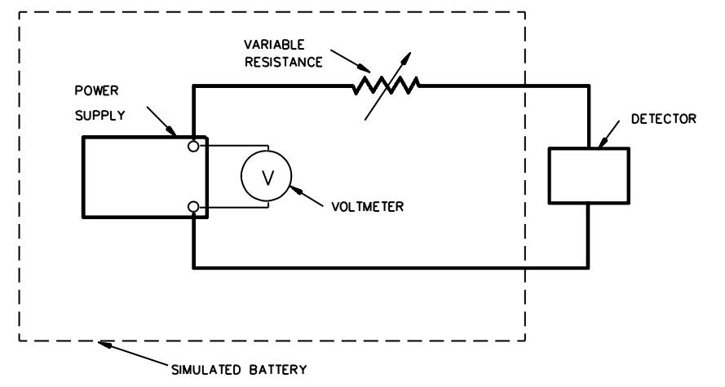
Battery trouble voltage determination
确认烟雾警报器低电压值。

Slide 11
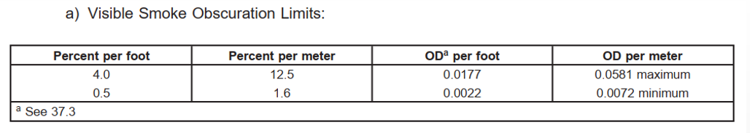
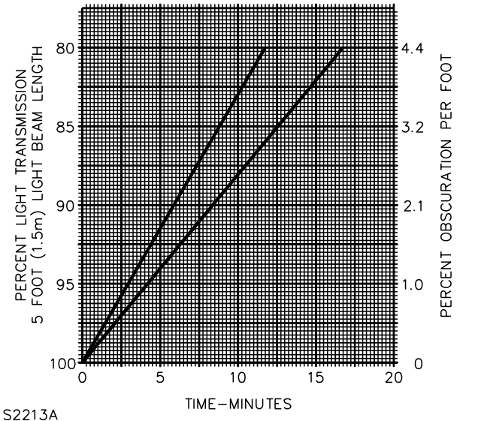
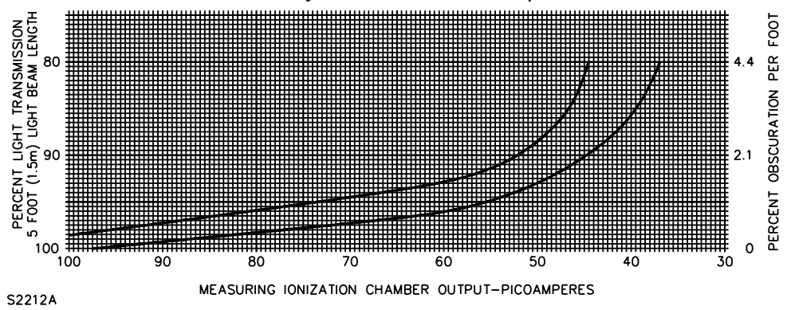
Sensitivity Test

Slide 12
Velocity-Sensitivity Test
Air velocity 32 fpm(0.16 m/s)
Air velocity 150 fpm( 0.76 m/s)
Directionality Test
确认最高最低灵敏度方向

Slide 13
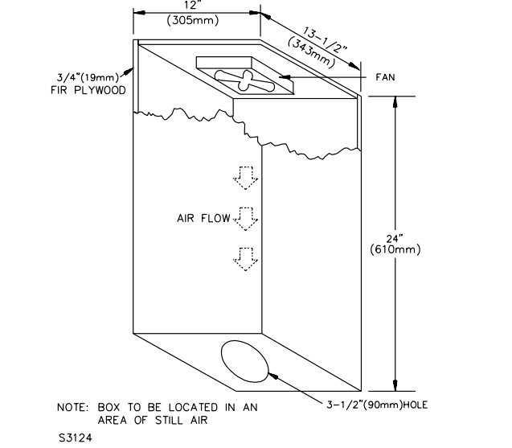
Smoke Entry (Stack Effect) Test
Air Flow 300英尺/分钟风速

Slide 14
Lamp Interchangeability Test (Photoelectric)
The sensitivity of an alarm employing a replaceable light source shall vary not more than 1obs.
And shall comply with the requirements of the Sensitivity Test, when tested with the intended replacement lamps.

Slide 15
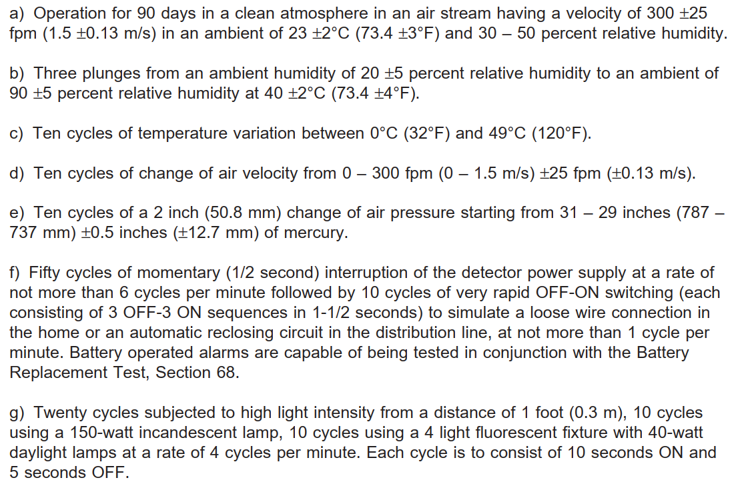
Stability Tests

Slide 16
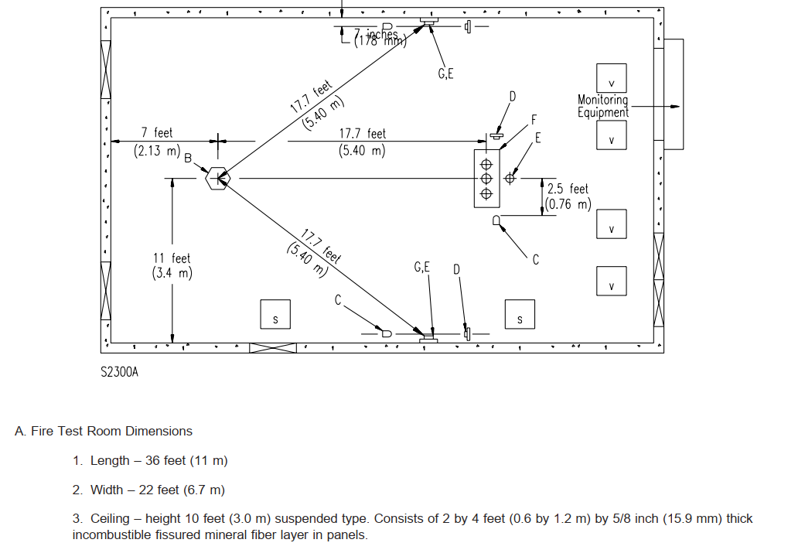
Fire Tests

Slide 17
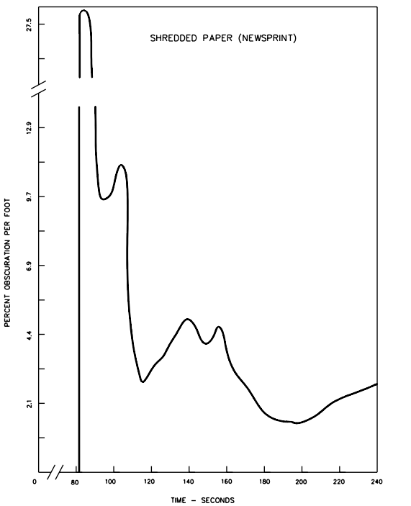
Fire Tests
纸火--4分钟内报警

Slide 18
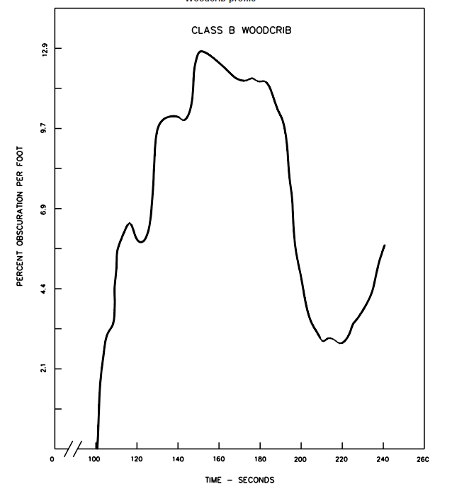
Fire Tests
木材--4分钟内报警

Slide 19
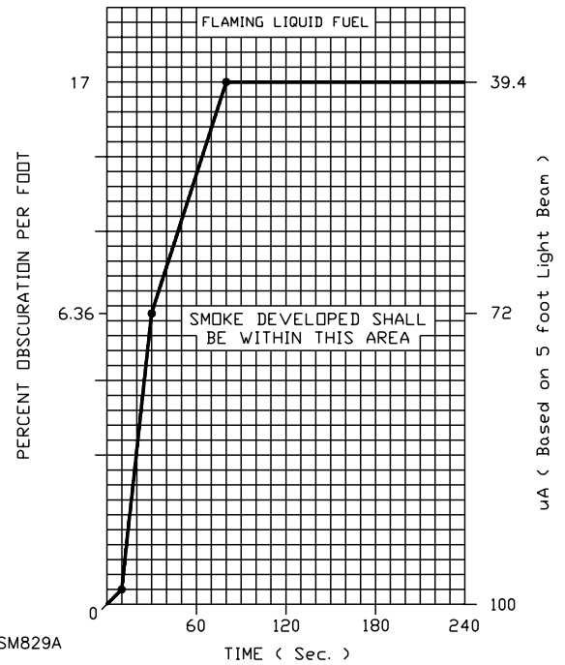
Fire Tests
可燃液体--4分钟内报警

Slide 20
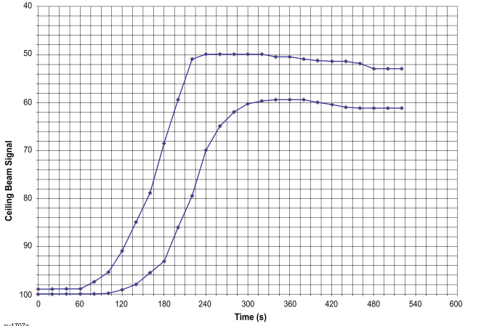
Fire Tests
聚氨酯泡沫-- --<5obs内报警（第8版）

Slide 21
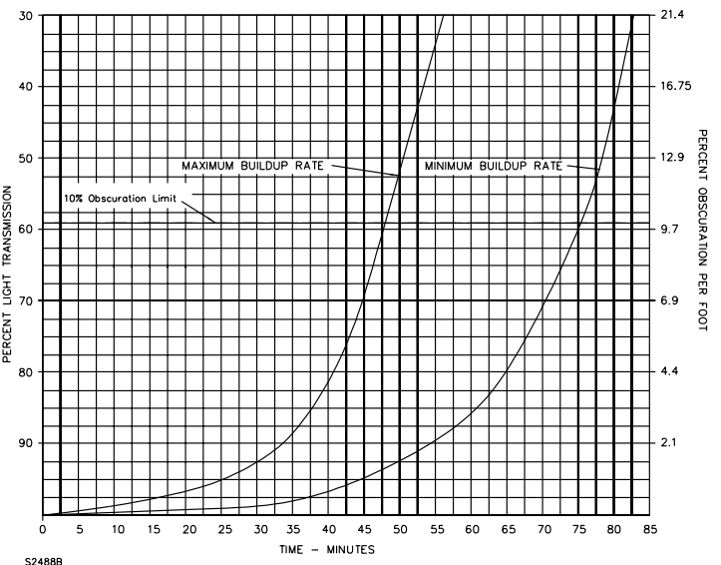
Smoldering Smoke Test
木材-- --<12obs内报警

Slide 22
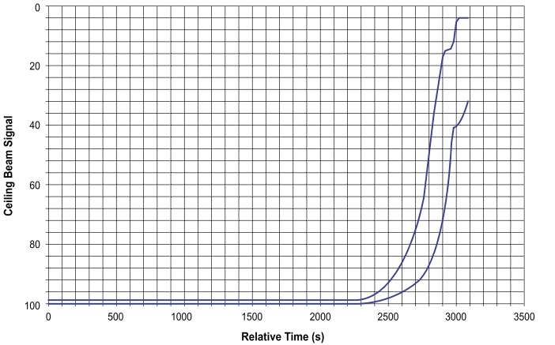
Smoldering Smoke Test (第8版)
聚氨酯泡沫-- --<12obs内报警

Slide 23
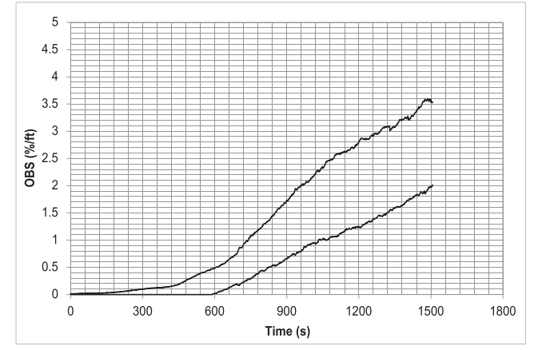
Cooking Nuisance Smoke Test (第8版)
煎牛排油烟-- --1.5obs前不可报警

Slide 24
Go/No Go Flaming Polyurethane Foam Test (第9版)
煎牛排油烟-- --1.5obs前不可报警（到达1.5obs烟雾浓度后需10秒内停止煎牛排）
聚氨酯泡沫-- --<5obs内报警

Slide 25
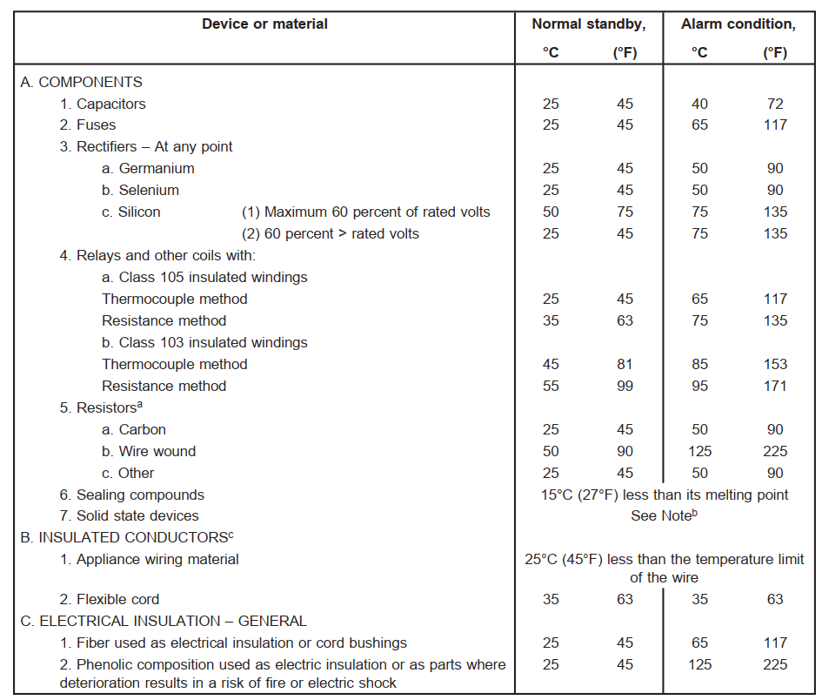
Temperature Test
在任何操作条件下，报警器中使用的材料或部件的温升不得超过表47.1中所示的温升

Slide 26
Overload Test
AC机型.
1.15倍额定电压供电
6次报警/分钟，50个循环
Endurance Test
5秒报警，1分钟10次，共6000个循环

Slide 27
Variable Ambient Temperature Test
Operation in high and low ambient
0度低温灵敏度
49度高温灵敏度
Effect of shipping and storage
a temperature of 70°C for a period of 24 hours, let to cool to room temperature for at least 1 hour
a temperature of -30°C for at least 3 hours, and then permitted to warm up to room temperature for at least 3 hours

Slide 28
Leakage Current Test
The leakage current of an alarm not operating from a primary battery shall not exceed 0.5 milliampere
Transient Tests
浪涌雷击/抗干扰等方面的测试

Slide 29
Abnormal Operation Test
烟雾报警器应在异常(故障)条件下连续工作，不产生火灾危险。
烟雾报警器应在使用过程中在电路异常故障情况下运行，同时连接到表所规定的电源上。不得有火焰、熔化的金属或者其他火灾的表现。

Slide 30
Overvoltage and Undervoltage Tests
1.1 VR
0.85 VR
BAT VLB
Static Discharge Test
10,000 volts DC for at least 2 seconds

Slide 31
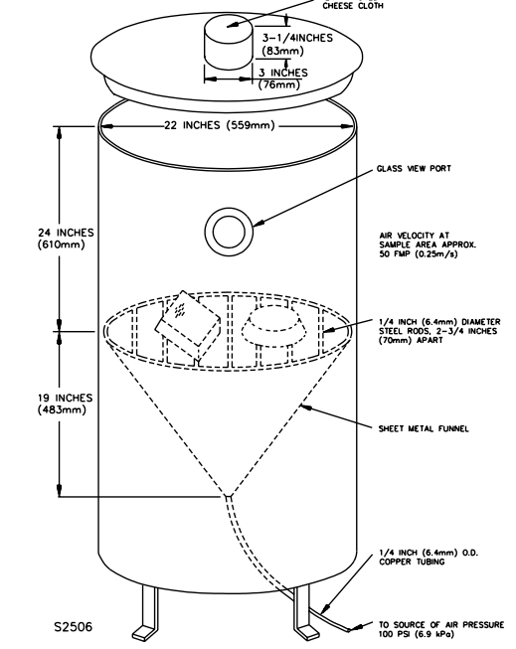
Dust Test
测试时间 15分钟
测试过程中报警、故障提示 or 测试前后灵敏度差异不超过1obs.

Slide 32
Humidity Test
168小时
湿度 93+/-2RH%
温度 40摄氏度
Vibration Test / Jarring Test
验证产品结构的可靠性

Slide 33
Corrosion Test
temperature of 23 ±2°C , maintained at 93+/2 percent relative humidity
硫化氢1000±50 PPM 10天
二氧化碳10 000±500 PPM &二氧化硫5000±250 PPM 10天
Alternate Corrosion Test (21-Day): temperature of 30 ±2°C (86 ±3°F) and the relative humidity at 70 ±2 percent，100±10 (ppb) (H2S) ；20 ±5 ppb (Cl2)；200 ±50 ppb (NO2) (第8版)

Slide 34
Battery Tests
a) Room Ambient – 23 ±3°C (73.4 ±5°F), 30 – 50 percent relative humidity, 760 mm Hg. b) High Temperature – 45°C (113°F). c) Low Temperature – 0°C (32°F). d) Humidity – 30 ±2°C (86 ±3°F), 85 ±5 percent relative humidity.
可更换-测试时间1年
不可更换-测试时间10年
低电状态后，a minimum of 4 minutes of alarm, followed by 7 days of trouble signal

Slide 35
Audibility Test
DB>85, 3.05m
Survivability Test
temperature of 121°C (250°F) for a period of 4 minutes
DB>85
灵敏度变化<1obs

Slide 36
Tests of Thermoplastic Materials
高温老化—7天90度，或28天70度，相对湿度0~10%RH
Flame test—确认壳料阻燃等级是否满足要求

Slide 37
Battery Replacement Test
50 cycles of battery removal and replacement, at a rate not to exceed 6 cycles per minute, without any reduction in contact or mounting integrity.
验证电池接触装置可靠性
Polarity Reversal Test
证实烟雾警报器即使在电池极性连接错误后，仍能恢复正常工作。

Slide 38
Electric Shock Current Test
验证产品维护时的电气安全性是否满足要求
Power Supply Tests
当产品使用独立电源时，验证此电源的是否满足要求

Slide 39
Fire Test (Heat Detector)
A heat detector, provided as part of a single station smoke alarm assembly, shall comply with the Standard for Heat Detectors for UL 521
Accelerated Aging Test
14 days，66 °C , 0 – 10 percent relative humidity
10 cycles of change of air velocity from 0 to 1.5 m/s.

Slide 40
Drop Test
警报器应能承受从7英尺（2.1米）高度跌落到混凝土地板上，五次
该测试不适用于固定安装的报警器（ This test is to be conducted only on smoke alarms intended for transient use, such as a travel alarm, and is not to be conducted on alarms intended for stationary installation.）
Conformal Coatings on Printed-Wiring Boards
验证保护涂层是否满足要求，高温/高湿/老化/加高电压，涂层材料不得因处理而剥落或其他劣化现象，以及不得有电介质击穿的迹象。

Slide 41
附加项--适用于房车、船的烟雾警报器补充测试项
Variable Ambient Temperature and Humidity Test
Corrosion (Salt Spray) Test
Vibration Test
……

Slide 42
THANKS

