Slide 1

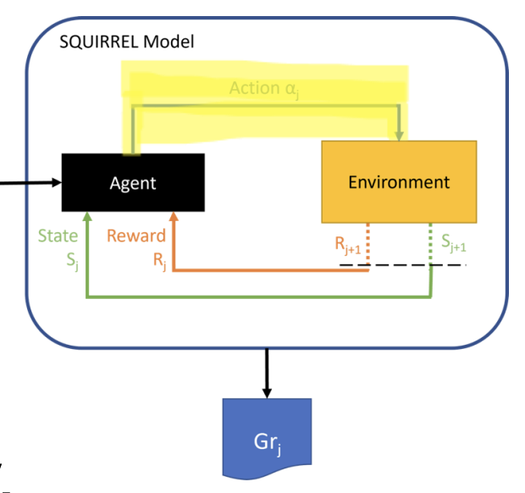
SDAA Sequential Group Recommendations
Satisfaction and Disagreement Aware Aggregation
Students: Oskari Perikangas, Xiaosi Huang
Course: DATA.ML.360-2025-2026-1 Recommender Systems
Date: November 10, 2025

Slide 2
From Static to Dynamic Group Recommendations
The Limitations of User-Based Collaborative Filtering and Group Recommendations
Example: Movie 1276 predictions
• System predicts User 1 would rate it: 5.00
• System predicts User 2 would rate it: 3.76
• Disagreement : 1.24
Challenges:
• Average method and Least misery methods don't learn from previous recommendations
• Some users stay unhappy over multiple rounds
• No adaptation to group dynamics
Solution: SDAA framework
• Recommends movies over multiple rounds
• Adjusts strategy based on user satisfaction
• Balances group happiness and individual fairness

Slide 3
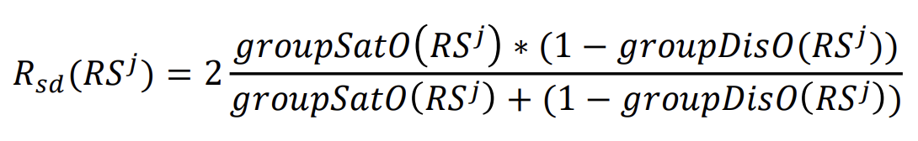
SDAA Implementation
1st satisfaction scores: Decides which movies to recommend to the group
2nd Alpha Adaptation : Measures how unfair the previous round was
3rd Reward Evaluation: Balances group satisfaction and fairness

Slide 4
How Alpha adapts strategy :
Small αⱼ (users equally satisfied) → More weight on Average method
Large αⱼ (satisfaction differences) → More weight on Least Misery
Project result:
Round 1: α = 0.2765 → 72% Average, 28% Least Misery
Round 2: α = 0.4216 → 58% Average, 42% Least Misery
Round 3: α = 0.4415 → 56% Average, 44% Least Misery

Slide 5
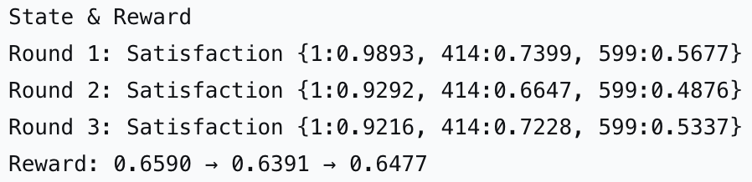
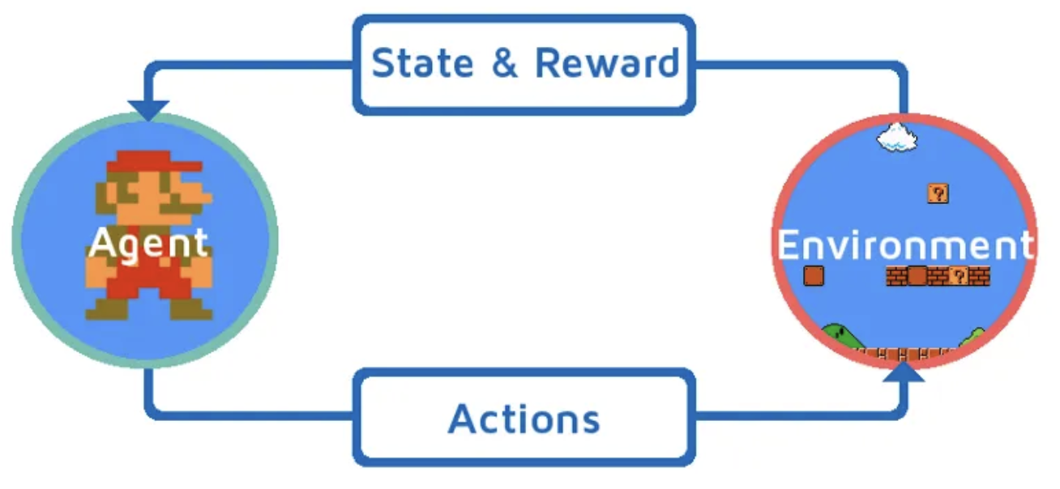
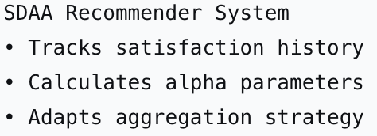
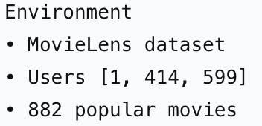
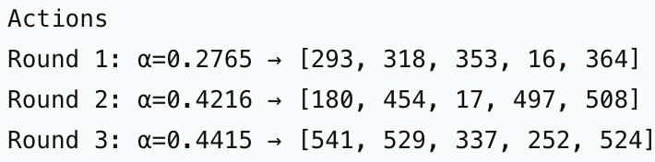
SQUIRREL Reinforcement Learning Framework
Learning Cycle:
State → Agent → Actions → New State → Reward
(Continuous adaptation across 3 rounds)

Slide 6
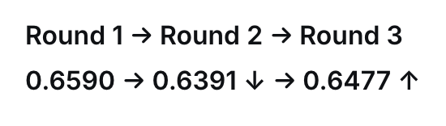
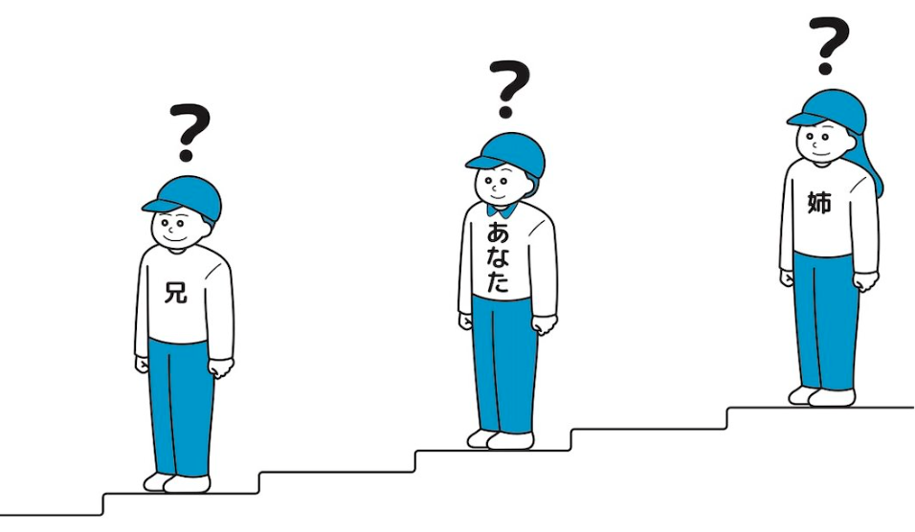
Reward changes reveal system intelligence:
The temporary drop shows smart balancing,
not system failure,
keeps all users engaged long-term,
not just maximizes a number.

