Slide 1

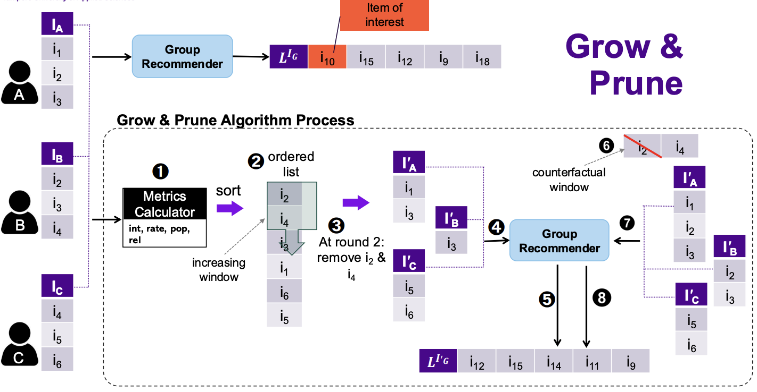
Part IV: Counterfactual Explanations for Group Recommendations
Students: Oskari Perikangas, Xiaosi Huang
Course: DATA.ML.360-2025-2026-1
Date: November 28, 2025

Slide 2

Problem Statement: 🤔
"If the group had NOT watched items A,
then item B would NOT be recommended"
Challenge:
Ensure fairness - no single-user blame in group explanations
Technical Stack:
Grow & Prune Algorithm
Pareto Filtering (Multi-objective optimization)
Item-based KNN Recommender
4 metrics (recognition, rating, influence, explanatory power)
+ fairness constraint ≥0.67

Slide 3
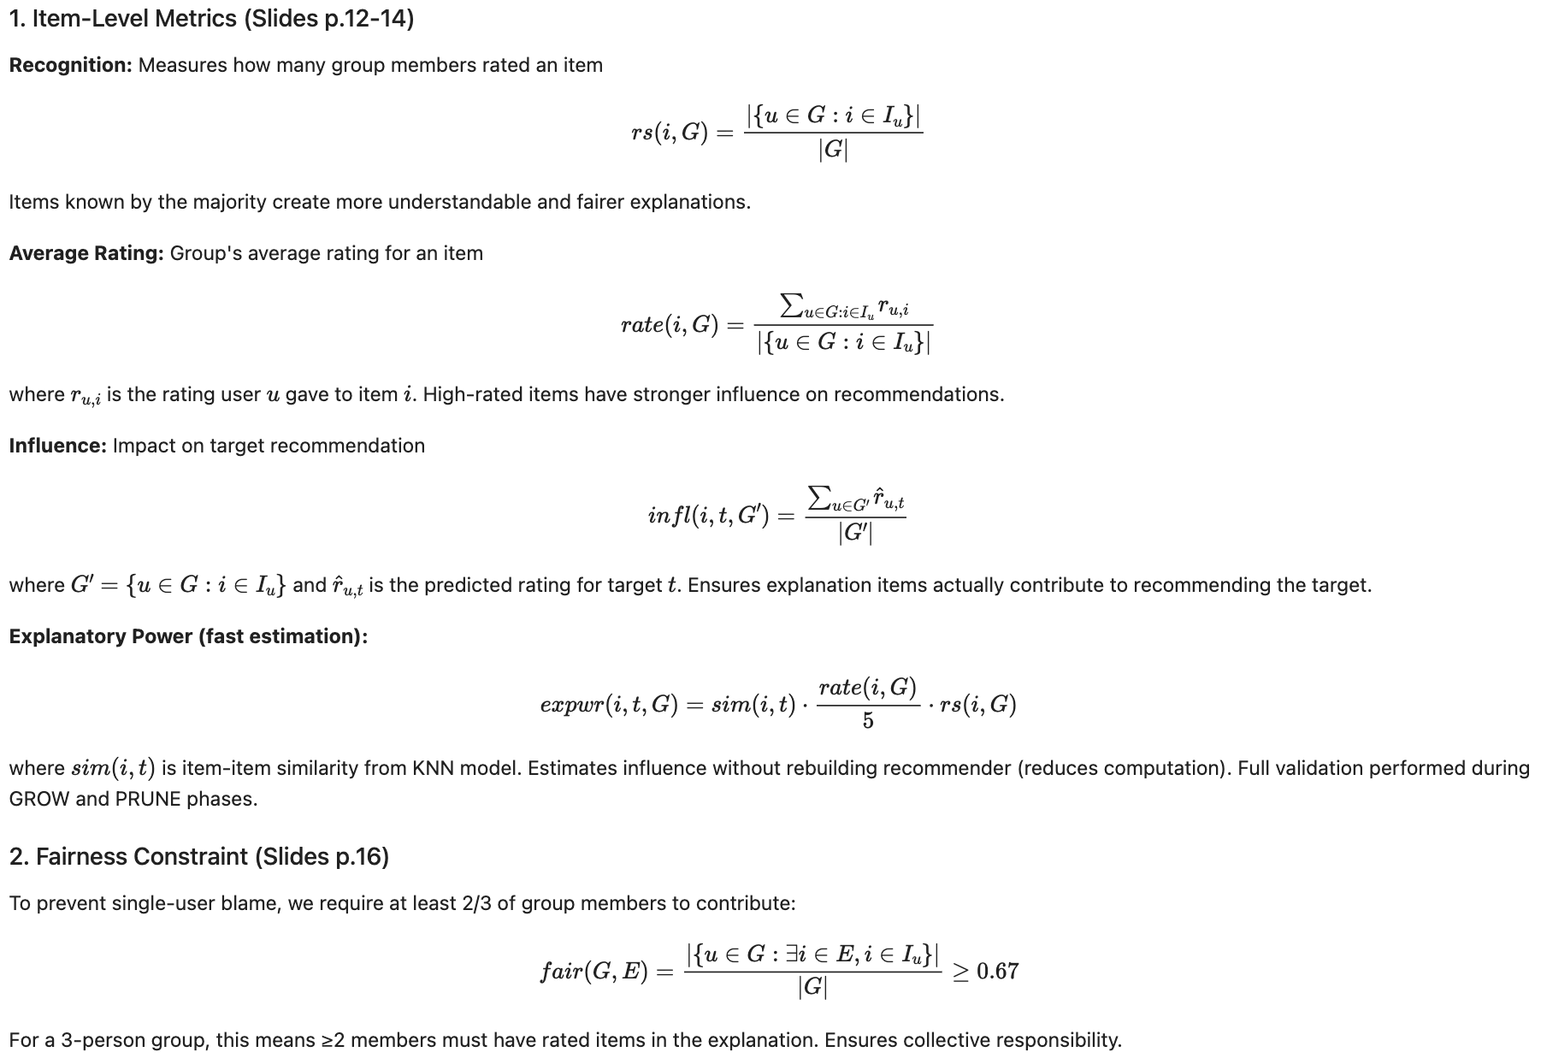
Metrics
&
Functions

Slide 4
Solution Flow _ Input: Group G, Target t, Top-N list L
1. Get Candidates (~1275 movies)
→ Collect all movies rated ≥3.5 by any group member → Remove target item from candidates
2. Pareto Filtering (Reduce 1275 movies → 3-5 items)
─ Pre-filter: rs≥0.5, rate≥3.5 → 345 items
─ Top-50 by rating
─ Compute 4 metrics
└─ Keep non-dominated → 3-5 items
3. GROW Phase (Build explanation)
─ Add items iteratively
─ Rebuild recommender
└─ Stop when target disappears
4. PRUNE Phase (Remove redundancy)
─ Try removing each item
└─ Keep only if necessary ( Drop fairness below 0.67 )
5. Output: Minimal fair explanation
Example: "If group had NOT watched Full Metal Jacket,
then Like Water for Chocolate would NOT be recommended"

Slide 5
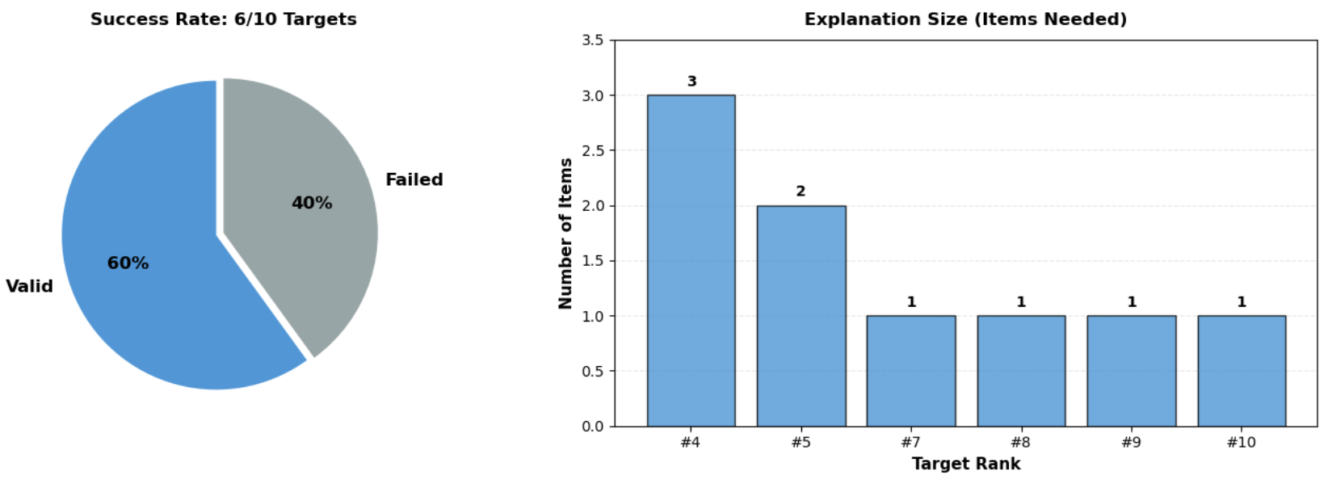
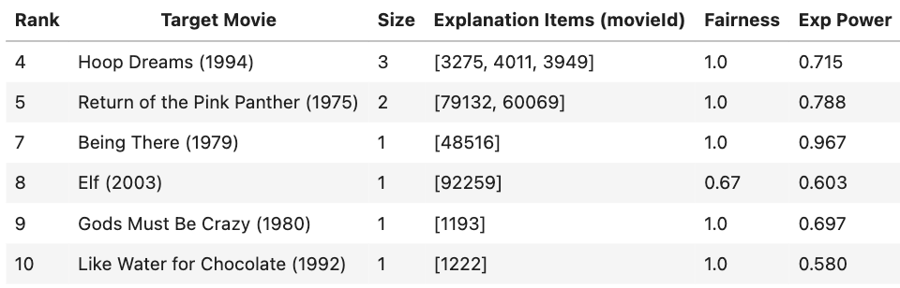
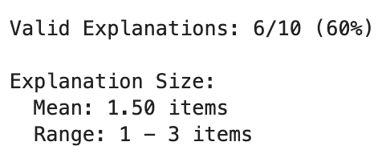
Results - Success & Size
60% success rate (6/10 targets)
Mean size: 1.50 items (highly concise)

Slide 6
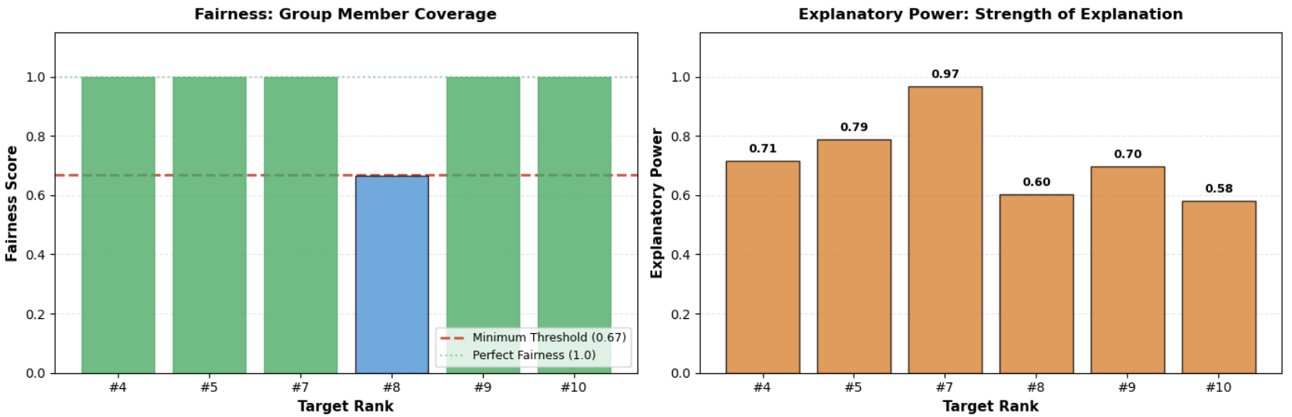
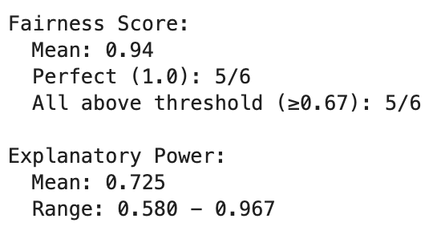
Results - Quality Metrics

