Slide 1

User-Based Collaborative Filtering for Group Recommendations
Students: Oskari Perikangas, Xiaosi Huang
Course: DATA.ML.360-2025-2026-1 Recommender Systems
Date: November 4, 2025

Slide 2
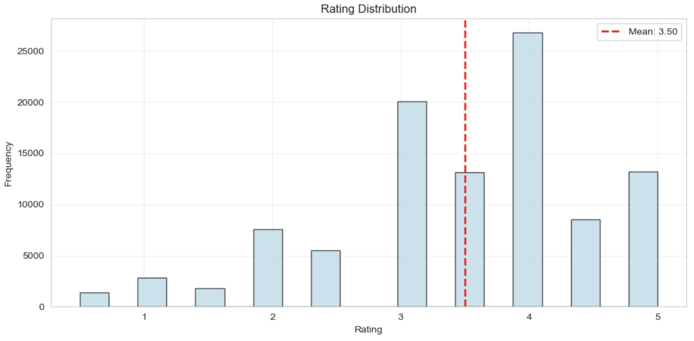
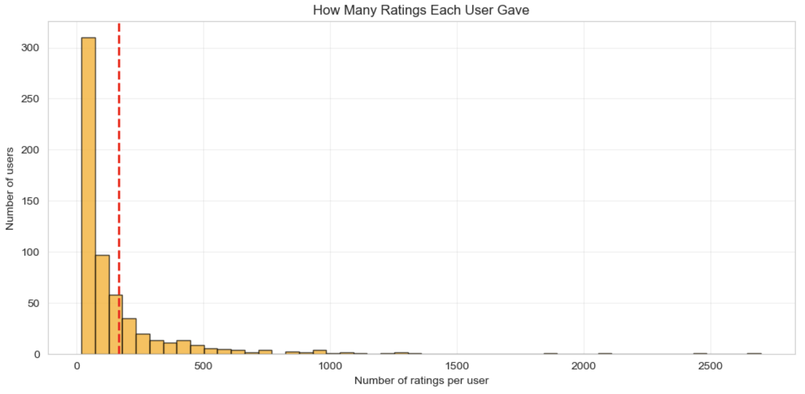
Dataset & Challenges Identified
MovieLens 100K - 100836 ratings from 610 users – Containing 9724 different movies - Ratings on a 0.5 to 5 star 🌟
Challenge 1: Rating Bias
The average is 3.50, more high ratings than low ratings.
Most ratings cluster at 4 and 5 stars.
Users tend to rate movies they LIKE and skip movies they DISLIKE.
The data is skewed, it doesn't represent the true quality.
This bias affects the recommendation predictions
Challenge 2: Data Sparsity
Almost 10,000 movies in total, more users only rate 100-200 movies.
There are 4744 out of 9724 (48.8%) have 2 or fewer ratings.
Data Sparsity makes collaborative filtering very difficult.
Users don't overlap enough to find reliable similarities.

Slide 3
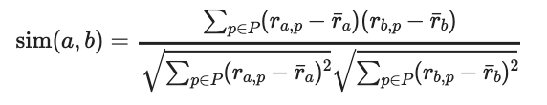

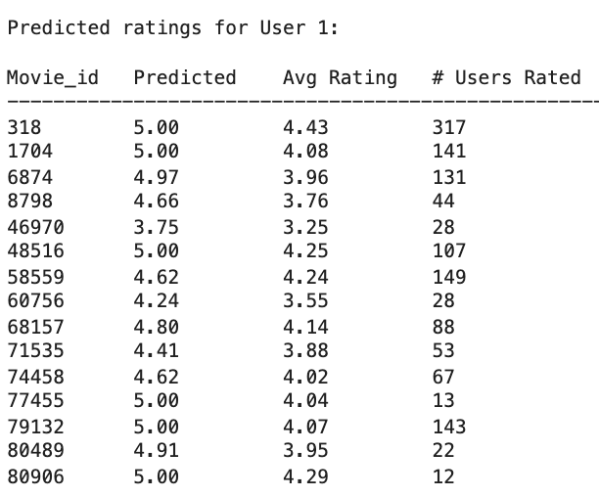
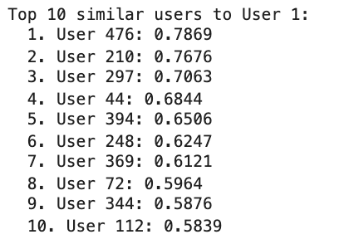
Finding Similar Users & Predicting Ratings
⭐️ Taking user 1 as an example
Similarity Formula (Pearson Correlation): Prediction Formula (from class slides):

Slide 4
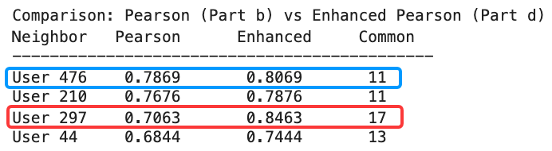
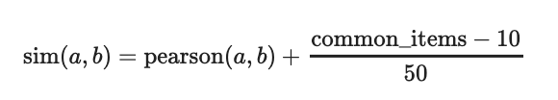
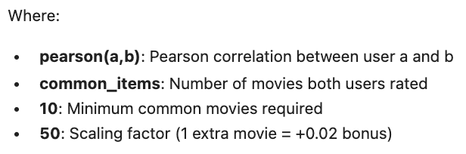
Enhanced Pearson Similarity
Question: If User 476 has rated 11 movies in common with User 1, and User 297 has rated 17 movies in common, who should we trust MORE?
Reward users with MORE data overlap
Example ( User 297) :
For every extra movie beyond 10,
we add 0.02 to the similarity score.
If User 297 has 17 common movies:
17 minus 10 equals 7 extra movies
7 divided by 50 equals 0.14 bonus
We add 0.14 to their Pearson score

Slide 5


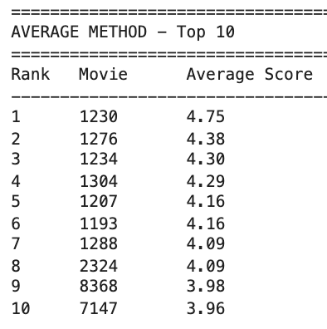
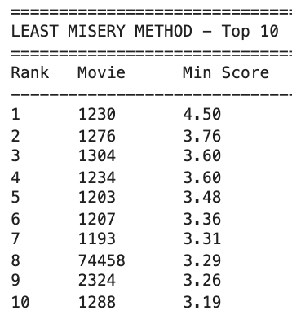
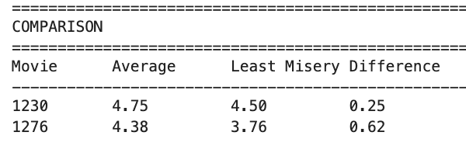

Group Recommendations
New challenge : How to Combine 3 Different Users' Preferences?
Example: Group User [1, 414, 599 ]
Steps: Find unrated popular movies and predict score
Find common movies , Aggregate using methods as below,
Method 1: Average aggregation Method 2: Least misery aggregation
What if we could have BOTH ?
High satisfaction for the group
Low disagreement between members

Slide 6

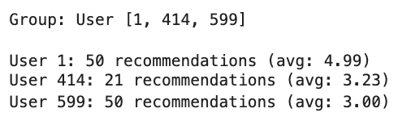
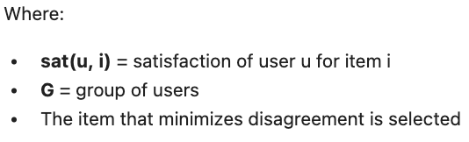
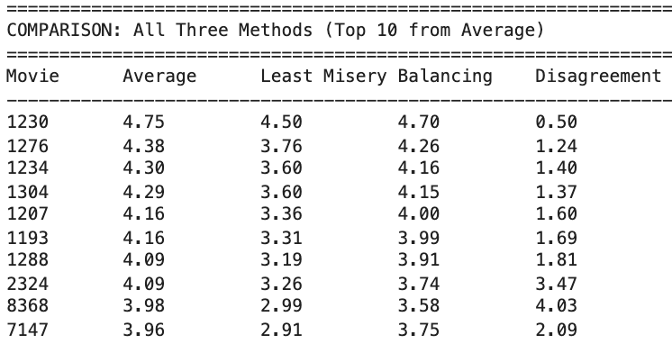
Group Recommendations
Method 3: Balancing Strategy Minimize satisfaction differences between users
Formular: Balancing Strategy (Masthoff 2004)

