Slide 1

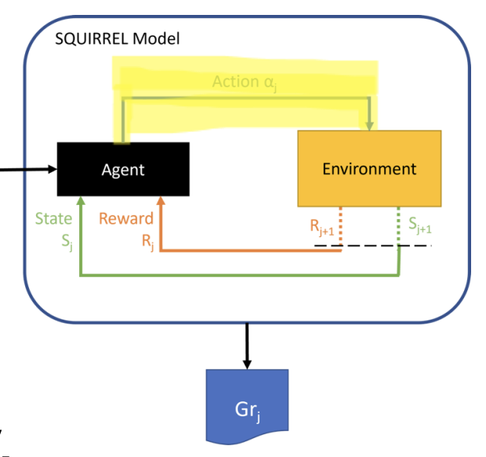
Sequential Group Recommendation
PFA: Proportional Fairness Aggregation (NEW METHOD)
Students: Oskari Perikangas, Xiaosi Huang
Course: DATA.ML.360-2025-2026-1 Recommender Systems
Date: December 5th, 2025

Slide 2
PFA Theory
Proportional Fairness Aggregation (PFA)
Core Innovation: Geometric Mean Aggregation
SDAA: score = (w₁·p₁ + w₂·p₂ + w₃·p₃) / Σw [Arithmetic]
aggregate preferences in a way that overlooks individual dissatisfaction.
PFA: score = (p₁^w₁ × p₂^w₂ × p₃^w₃)^(1/Σw) [Geometric]
more sensitive to low values, reveal and address unfairness across group members.
Why Geometric Mean?
- Automatically penalizes imbalanced predictions
- Example: predictions [2.0, 5.0, 4.0]
- Arithmetic: 3.67 (hides imbalance)
- Geometric: 3.42 (lower score reflects unfairness)
Two-Phase Design:
1. Phase 1: Average aggregation filters top candidates (quality)
2. Phase 2: Geometric mean selects final items (fairness)
Dynamic Weights:
Gap-based adjustment: users below average get higher weights
Self-correcting over rounds : prevents cumulative unfairness

Slide 3
PFA Implementation : Sequential Workflow
Proportional Fairness Aggregation (PFA)
Round 1: Initialize
✓ All users start with equal weights [1.0, 1.0, 1.0]
✓ Predict ratings for all candidate movies. Recommend top-k items using PFA
Each Round (2-10): Four-Step Process
Step 1: Calculate Dynamic Weights
→ Check each user's cumulative satisfaction
→ Users below average → higher weights (e.g., 1.4)
→ Users above average → lower weights (e.g., 0.8)
Example: Round 2 weights = [0.43, 0.17, 0.40]. User 39 had highest satisfaction → lowest weight
Step 2: Phase 1 - Quality Filter
→ Use simple average: score = (p₁ + p₂ + p₃) / 3
→ Select top k×3 candidates (e.g., 15 movies). Ensures we only consider good items
Step 3: Phase 2 - Fairness Optimization
→ Use weighted geometric mean: (p₁^w₁ × p₂^w₂ × p₃^w₃)^(1/Σw)
→ Pick final k items (e.g., 5 movies)
→ Naturally prefers balanced items
Step 4: Update Satisfaction
→ Users watch recommended movies
→ Update cumulative satisfaction for next round.System self-corrects over time

Slide 4
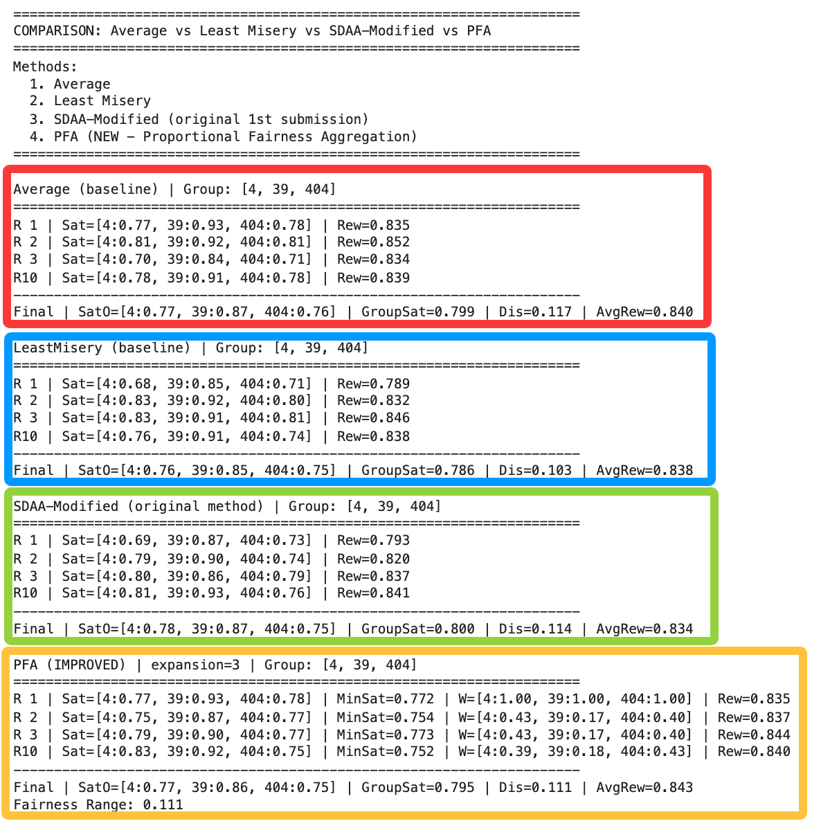
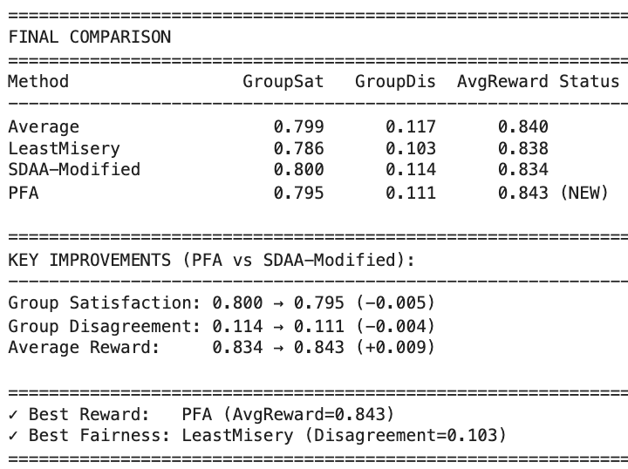
Comparison results:
Test Group users: [4, 39, 404] - 10 Rounds
Average
Least Misery
SDAA
PFA

Slide 5
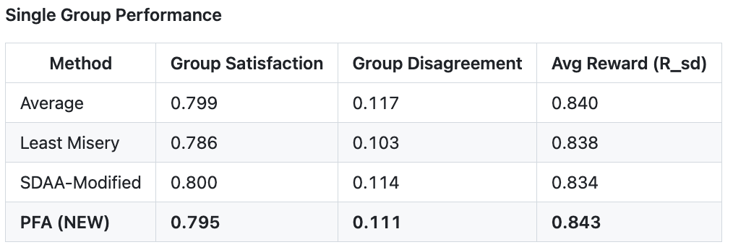
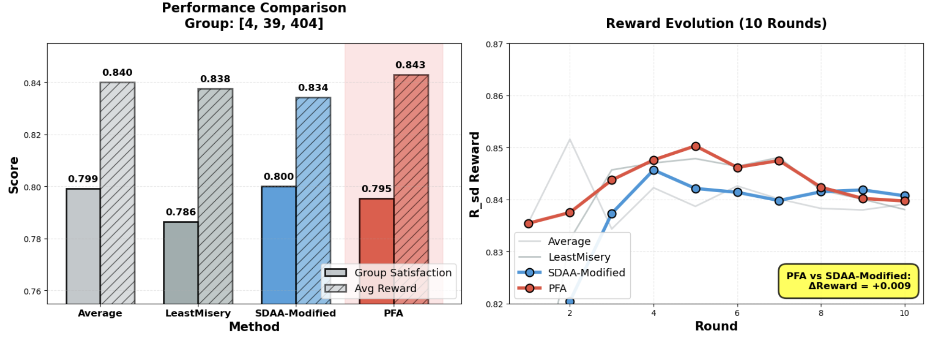
Results 1 - Single Group Test _ Visualization
Test Group users: [4, 39, 404] - 10 Rounds

Slide 6
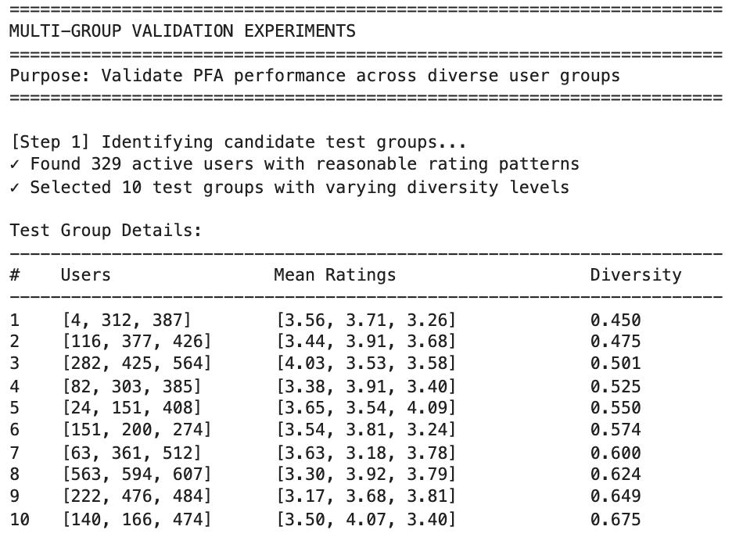
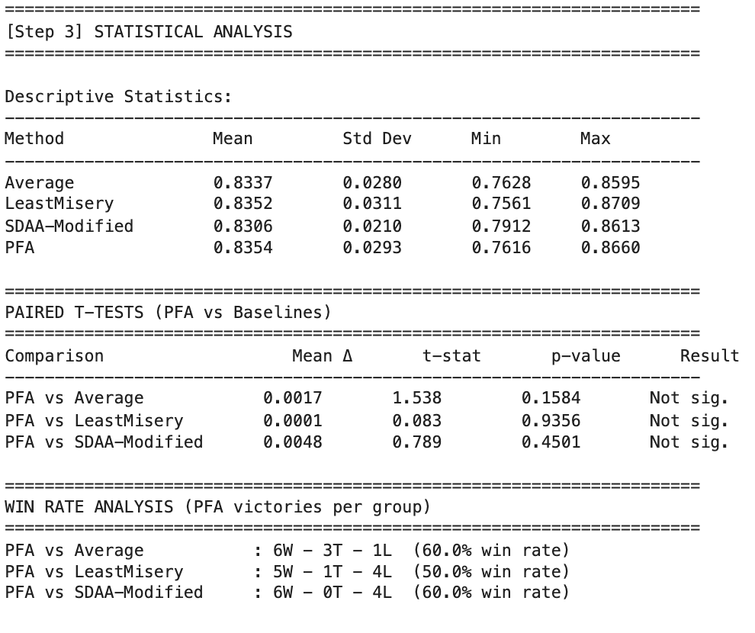
Results 2 - Multi-Group Validation
Testing Across Diverse 10 Groups – also 10 Rounds
Robust performance: PFA outperforms baseline in 6 out of 10 diverse groups with +0.6% average improvement

Slide 7
Why It Works & Conclusion
1. Mathematical Innovation
• SDAA uses arithmetic mean (addition) → averages hide problems
• PFA uses geometric mean (multiplication) → naturally detects imbalance
2. Sequential Intelligence
• SDAA: Fixed alpha parameter throughout all rounds
• PFA: Dynamic gap-based weights that adapt each round
• Unhappy users automatically get higher influence next round
• System self-corrects → prevents cumulative unfairness
3. Quality-First Architecture
• SDAA: Direct aggregation may sacrifice quality for fairness
• PFA: Two-phase design ensures both objectives
- Phase 1 filters high-quality candidates
- Phase 2 selects fairest from quality pool
• Result: Best reward AND better fairness

