Slide 1

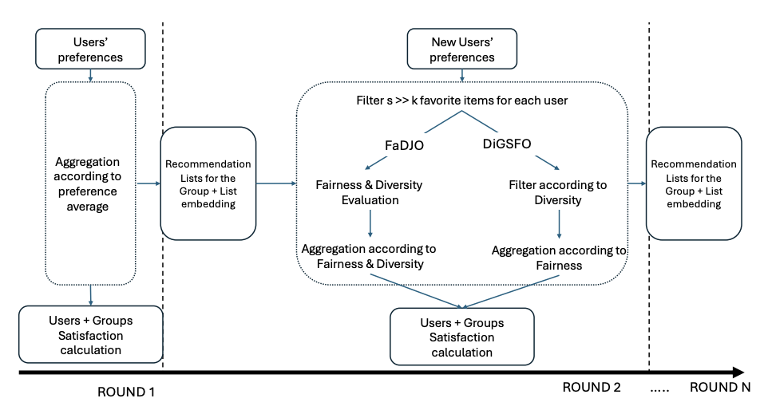
Diverse Sequential Group Recommendation
Diversity-Guided Selection with Fairness Optimization (DiGSFO)
Students: Oskari Perikangas, Xiaosi Huang
Course: DATA.ML.360-2025-2026-1
Date: November 19, 2025

Slide 2
Sequential Group Recommendations
Challenges:
- Filter bubble: Repeatedly suggesting similar genres
- Unfairness: Minority preferences get ignored
- Users only see content matching past behavior
Solution: DiGSFO
(Diversity-Guided Selection with Fairness Optimization)
Core idea:
- Filter by diversity (genre distance)
- Optimize by fairness (weighted satisfaction)
- List-level evaluation (coherent recommendations_more rounds)

Slide 3
DiGSFO Algorithm Flow
Round 1: Average aggregation (no history to compare)
Round 2 onwards:
Step 1: Generate candidates
- Each user: top-100 items
- Create 50 candidate lists (sliding window)
Step 2: Filter by diversity
- Calculate genre distance to history
- Keep only lists with distance ≥ δ
Step 3: Score by fairness
- Weighted fairness (considers history)
- Select most fair list
Innovation: Combines diversity + fairness

Slide 4
Tested users example:
- Group: 3 users (User 1, 414, 599)
- Rounds: 10 sequential recommendation rounds
- Recommendations per round: 5 movies (one list)
- Rating scale: 0.5 to 5.0 (MovieLens dataset)
Process:
- Round 1: Average aggregation selects top-5 movies
- Round 2-10: Generate 50 candidate lists (5 movies each),
select the most fair and diverse list
Total: 50 movies recommended across 10 rounds

Slide 5
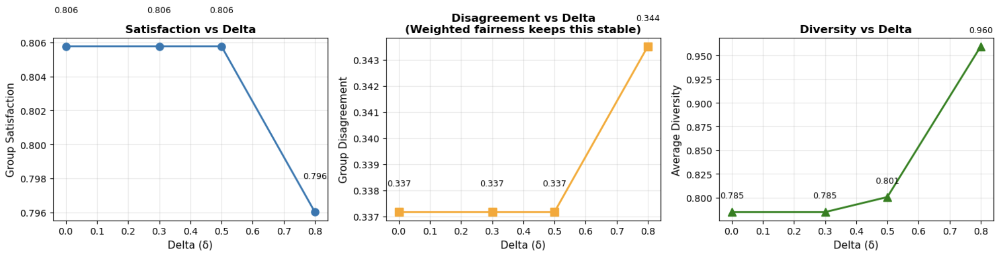
Results: Delta Parameter Testing
- Satisfaction: Stable at 0.806 (delta 0.0-0.5)
- Disagreement: Stable at 0.337 (weighted fairness works)
- Diversity: Increases with delta
- 0.785 (no filter) → 0.801 (delta=0.5) → 0.960 (delta=0.8)
Best configuration: Delta = 0.5
→ Balances diversity gain with satisfaction maintenance

Slide 6
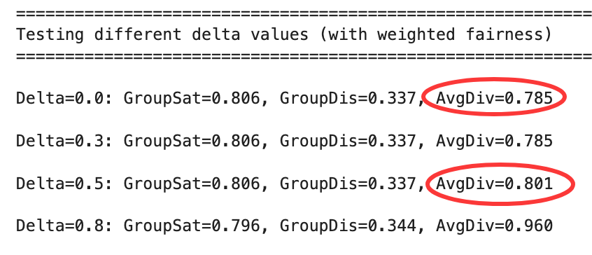
Why DiGSFO Works Well
1. Prevents repetitive content
Genre-based distance filtering
→ Diversity +2% (0.785 → 0.801)
2. Maintains group fairness
Weighted fairness mechanism
→ Disagreement stable at 0.337
3. List-level optimization
Evaluates 5-movie sets as whole
→ Coherent recommendations
Tested on group [User 1, 414, 599] over 10 rounds
Successfully balanced diversity and fairness

