Slide 1

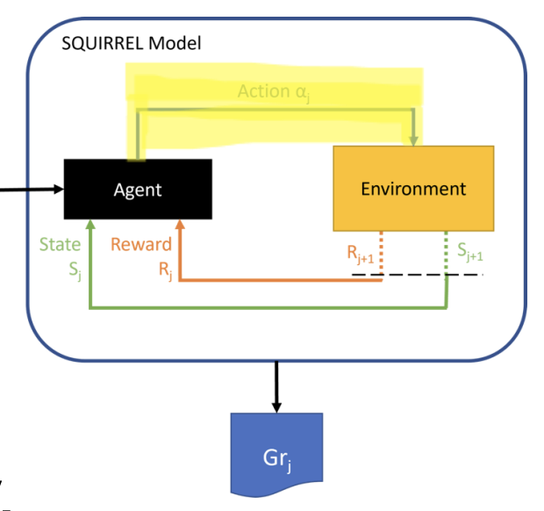
Sequential Group Recommendation with SDAA
Method: Satisfaction and Disagreement Aware Aggregation
Students: Oskari Perikangas, Xiaosi Huang
Course: DATA.ML.360-2025-2026-1 Recommender Systems
Date: November 10, 2025

Slide 2

From Static to Dynamic Group Recommendations
Problems?
- Average: Treats all users equally every round
→ Minority users consistently unsatisfied
- Least Misery: Always focuses on least satisfied user
→ Lower overall group satisfaction
New challenge:
How to ensure fairness across MULTIPLE rounds without sacrificing quality?

Slide 3


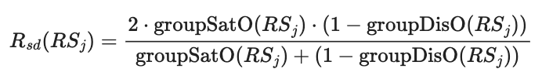
SDAA Method Design (from SQUIRREL Framework)
Track cumulative satisfaction for each user
Calculate fairness weights
3. Blend Average and Least Misery
4. Adapt dynamically each round with Reward Function
Lower satisfaction → Higher weight
Here α = satisfaction disparity

Slide 4
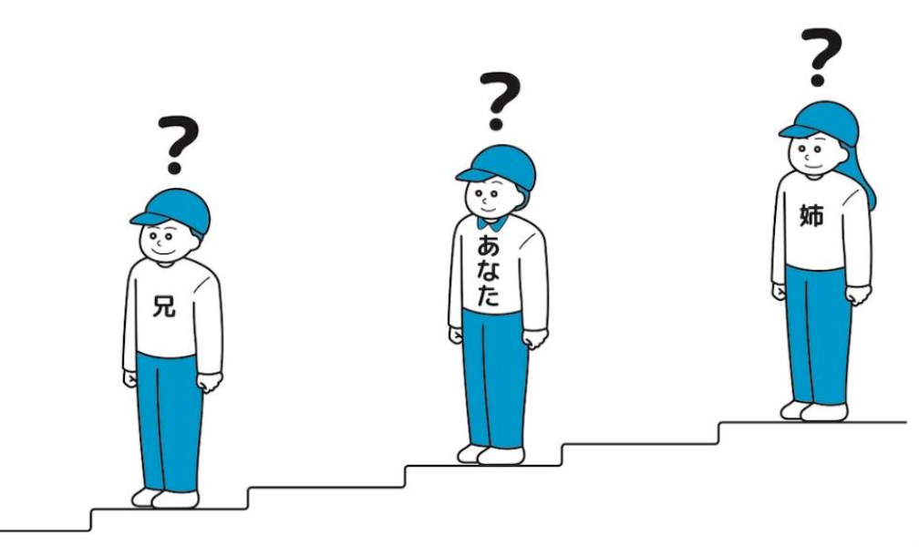
Testing users [1, 414, 599]
Round 1 Results:
User 1: Satisfaction = 1.00 (very satisfied)
User 414: Satisfaction = 0.84
User 599: Satisfaction = 0.70 (least satisfied)
Round 2 - SDAA Response:
Adjusted Weights: {1: 0.00, 414: 0.35, 599: 0.65}
→ User 599 gets 65% influence on recommendations
Round 2 Results:
User 599: Satisfaction improved to 0.68 ↑
Interesting workflow:
SDAA remembers who was dissatisfied and gives them priority in future rounds,
ensuring long-term fairness.

Slide 5
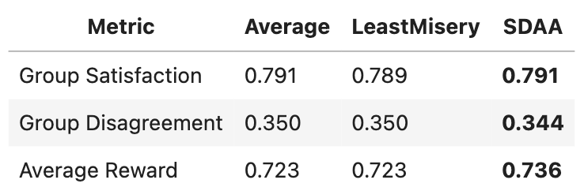
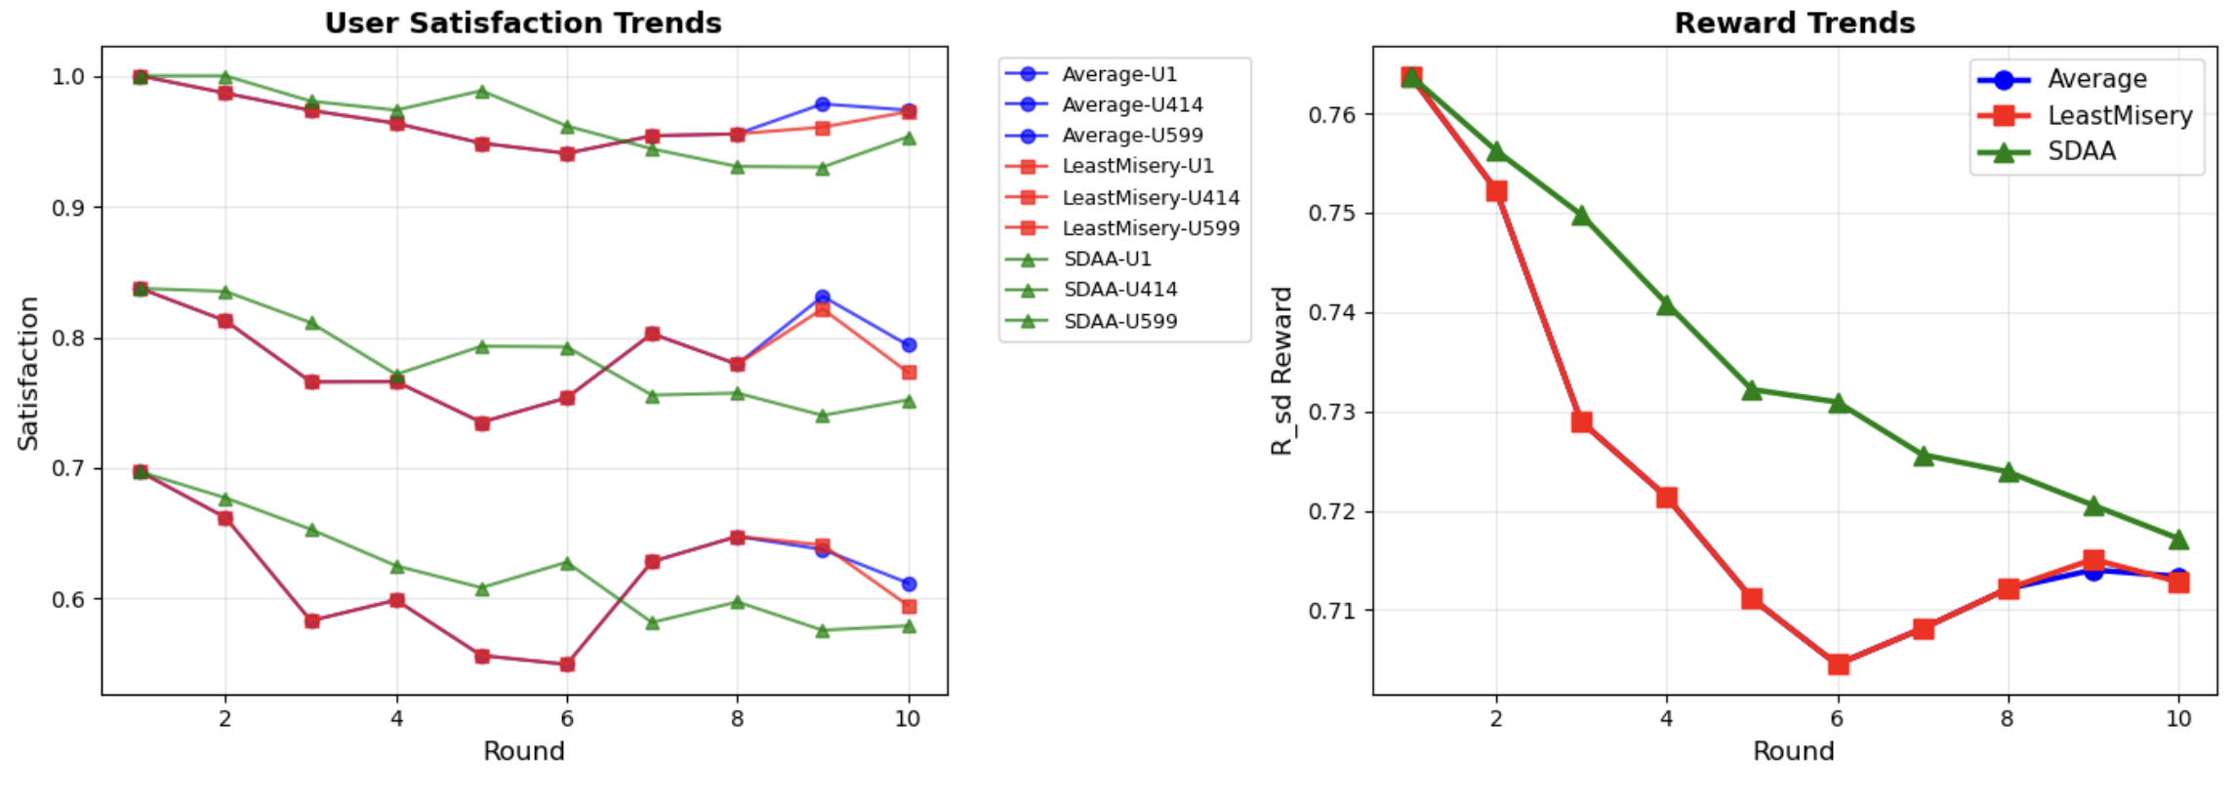
Comparison
Three Methods from SQUIRREL

Slide 6

Why SDAA good?
Results Summary:
Same satisfaction as Average (0.791)
Lower disagreement (-1.7%)
Highest reward (+1.8%)
Among the three SQUIRREL methods we implemented:
⭐️ SDAA achieves best balance
- Memory: Tracks cumulative satisfaction
- Adaptive: Dynamic weight adjustment
- Balanced: Fairness + Quality
SDAA outperforms both Average and Least Misery in terms of reward and disagreement reduction.

