Slide 1
DCS 2026 Spring Lab 3 - Sequential Circuit 2
TA : 陳孟頡 Advisor : Tian-Sheuan Chang
Date : 2026.03.19

Slide 2
Lab03
Run the command below to get files for this lab.
tar -xvf ~dcsTA01/Lab03.tar

Slide 3
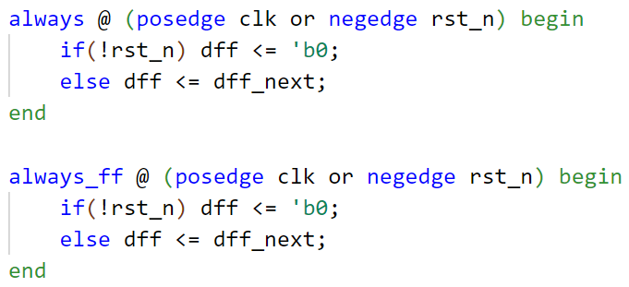
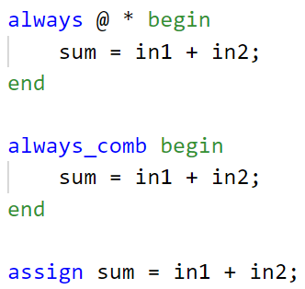
Sequential v.s. Combinational in Verilog
 | Sequential Circuit (D Flip-Flop) | Combinational Circuit
Verilog Code
Block Diagram
dff_next
D
Q
dff
in1
Adder
z=a+b
a
z
sum
clk
in2
b
reset
rst_n

Slide 4
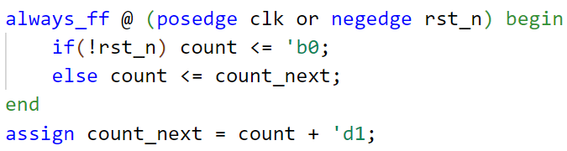
Example Counter
Combinational
Adder
z=a+b
b
‘d1
z
a
count_next
count
D
Q
clk
reset
rst_n
Sequential

Slide 5
Example Counter
Cycle 0:
Adder
z=a+b
b
‘d1
z
a
count_next
count
1
0 (reset)
D
Q
clk
reset
rst_n

Slide 6
Example Counter
Cycle 1:
Adder
z=a+b
b
‘d1
z
a
count_next
count
2
1
D
Q
clk
reset
rst_n

Slide 7
Example Counter
Cycle 2:
Adder
z=a+b
b
‘d1
z
a
count_next
count
3
2
D
Q
clk
reset
rst_n

Slide 8
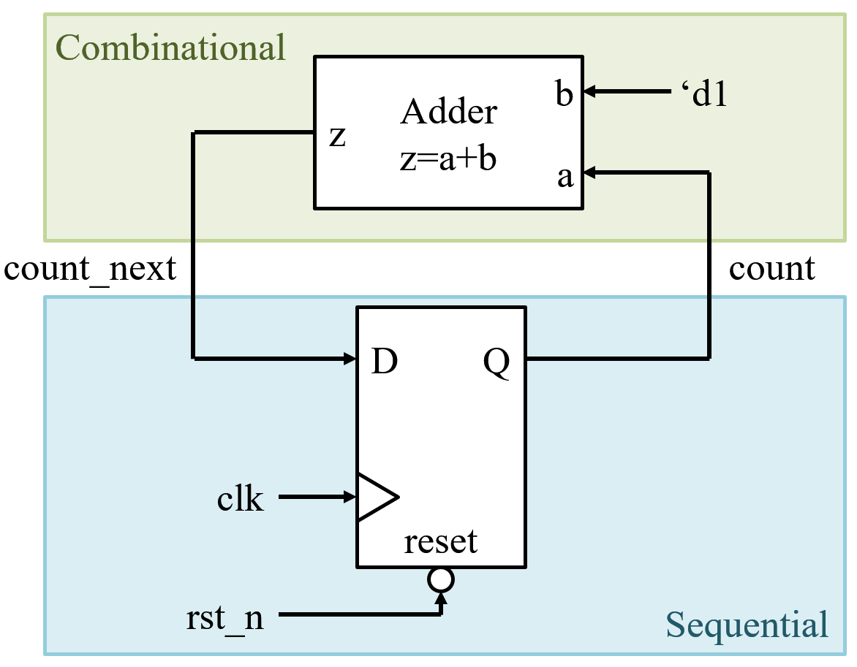
Reminder
Reset all DFFs so you don’t start with unknown value.
Separate combinational and sequential part in your Verilog code.
Avoid multiple-driven net.

Slide 9
Lab03: Sequential Sorting Network
Sorting Network:
Sort N numbers using Compare-and-Swap units.
Best for small N and ultra-low latency, parallel data.
in_data[0]
CMP
CMP
CMP
in_data[1]
CMP
CMP
in_data[2]
CMP
CMP
CMP
in_data[3]
CMP
CMP
in_data[4]

Slide 10
Lab03: Sequential Sorting Network
Sorting Network:
Sort N numbers using Compare-and-Swap units.
Best for small N and ultra-low latency, parallel data.
Ex:
45
45
45
45
45
in_data[0]
CMP
CMP
CMP
45
0
44
44
44
0
in_data[1]
CMP
CMP
44
44
0
33
33
44
in_data[2]
CMP
CMP
CMP
33
24
33
0
24
24
in_data[3]
CMP
CMP
24
33
24
24
0
33
in_data[4]
0

Slide 11
Lab03: Sequential Sorting Network
Input:
5 unsigned 6-bit integer in serial.
Output:
Consecutive 5 sorting results.

Slide 12
SeqSort.sv
Input Signal | Bit Width | Definition
clk | 1 | Clock signal.
rst_n | 1 | Asynchronous active-low reset.
in_valid | 1 | High when in_data is valid.
in_data | 6 | Five Input data need to sort given in serial.
Output Signal | Bit Width | Definition
out_valid | 1 | Pull high when out_data is valid. Should be reset when rst_n is low.
out_data | 6 | The five sorting result in serial. Should be reset when rst_n is low.

Slide 13
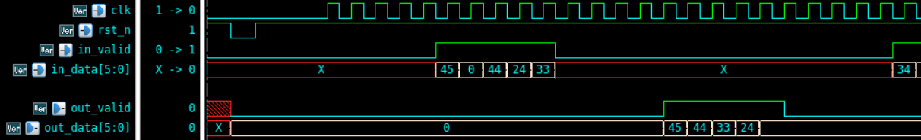
SeqSort.sv
Five input data provided in serial.
Five output sorting results (descending) in serial.

Slide 14
SeqSort.sv
out_valid should not overlap with in_valid.
out_valid should pull high in 100 cycles after in_valid pull low.
Outputs should be reset when rst_n is low.
Five outputs must be consecutive.
out_data should be 0 when out_valid is low

Slide 15
Grading Policy
1st demo – 100% for following requirements:
Pass the RTL simulation
Pass Synthesis (No Error, Timing Report Slack met, no Latch)
Pass Gate-level simulation
2nd demo – 60%

Slide 16
Upload
cd ../09_UPLOAD/
./01_upload (upload code)
./02_download [argument]
[argument] = demo1 or demo2
Note:
Make sure to upload the correct file successfully.
Deadline:
1st demo: 3/19 17:40
2nd demo: 3/19 23:59
Good Luck !

