Slide 1
Lab 6 Pattern
林群凱

Slide 2
Purpose
Learn how to write a pattern to test your design.

Slide 3
Lab06
Run the command below to get files for this lab.
$ tar -xvf ~es26dcsTA01/Lab06.tar

Slide 4
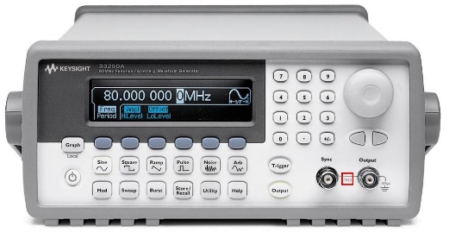
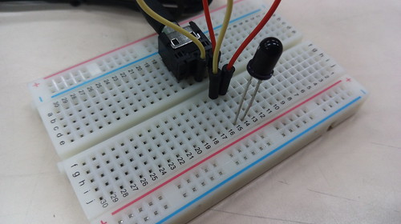

Design vs Testbench vs Pattern
Testbench
Design
Connection
Pattern
Input
Output
Output
Input
RTL description of your design
Must be synthesizable
Composed of always blocks and assignments
Generate input stimuli for the design
Capture and check the correctness of the design outputs
Not synthesizable
Usually composed of initial blocks

Slide 5
LOCK.sv from Lab05 (TA has written.)
THIS IS NOT WHAT YOU SHOULD DO FOR THIS LAB!!!

Slide 6
PATTERN.sv (under 00_TESTBED/)
Input Signal | Bit Width | Definition
state | 3 | State for the password lock FSM 000: LOCKED 001: IN_D1 010: IN_D2 011: IN_D3 100: IN_D4 101: UNLOCKED 110: CHANGE 111: ALARM
unlocked | 1 | Raised when unlocked
alarm | 1 | Raise when triggering alarm state
Output Signal | Bit Width | Definition
clk | 1 | Clock signal
rst_n | 1 | Asynchronous active-low reset signal
in_valid | 1 | Asserted when any one of the below 4 input signals is valid
in_digit | 4 | Input digit ranged from 0 to 9
enter | 1 | “Enter” key for user confirmation
change | 1 | Asserted to initiate password change mode
lock_reset | 1 | Asserted to reset the lock status

Slide 7
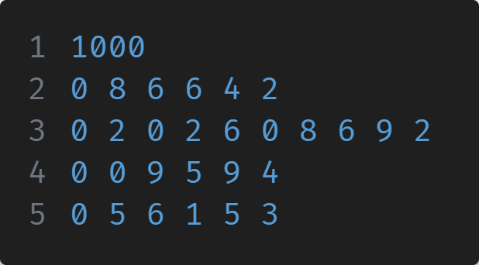
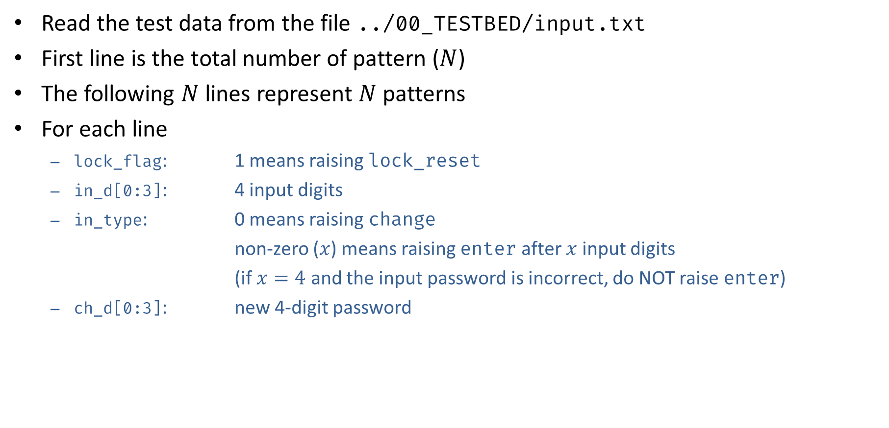
PATTERN.sv
Read the test data from the file ../00_TESTBED/input.txt
First line is the total number of pattern ($N$)
The following $N$ lines represent $N$ patterns
For each line
lock_flag: 1 means raising lock_reset
in_d[0:3]: 4 input digits
in_type: 0 means raising change
non-zero ($x$) means raising enter after $x$ input digits
(if $x=4$ and the input password is incorrect, do NOT raise enter)
ch_d[0:3]: new 4-digit password
in_d[0:3]
ch_d[0:3]
lock_flag
in_type

Slide 8
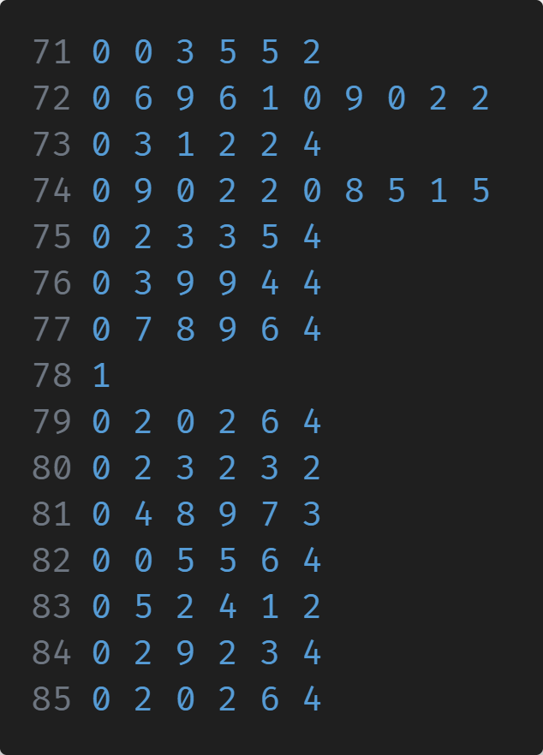
PATTERN.sv (input.txt example)
$$0→3→enter$$
$$6→9→6→1→change→9→0→2→2$$
$$2→3→3→5→enter (if correct passwd)$$
$$lock_reset$$
$$4→8→9→enter$$

Slide 9
PATTERN.sv

Slide 10
Specifications
Check # | Description
0 | Output must be 0 after reset.
1 | State should be LOCKED after early enter.
2 | UNLOCKED mode not set after correct passwd.
3 | State should be LOCKED after a wrong attempt. (within 2 wrong attempts)
4 | ALARM mode not set after 3 wrong attempts or early release before lock_reset.

Slide 11
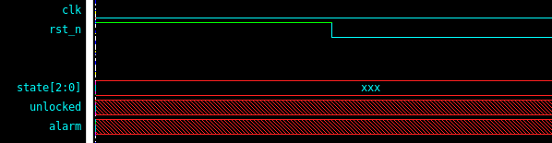
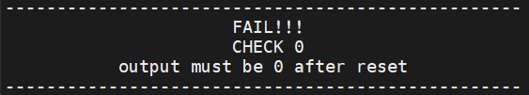
Check 0
Report this error if any output is not 0 after reset.

Slide 12
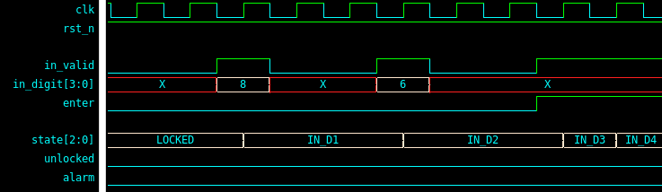
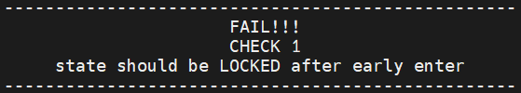
Check 1
Report this error if state is not LOCKED with an enter asserted early.

Slide 13
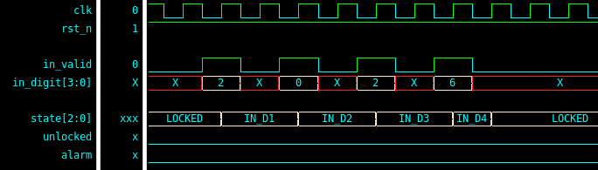
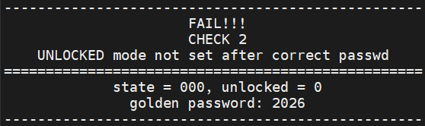
Check 2
Report this error if the system is not unlocked after a correct password.

Slide 14
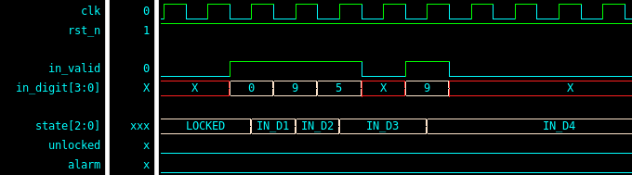
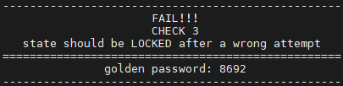
Check 3
Report this error if the system is not LOCKED within 2 wrong attempts.

Slide 15
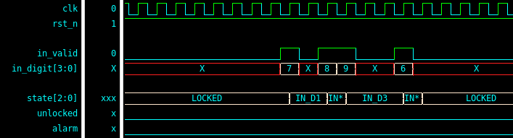
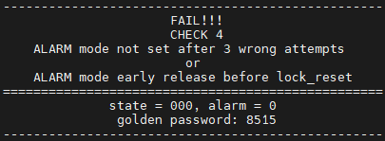
Check 4
Report this error if ALARM mode is not set or hold after 3 wrong attempts and before lock reset is asserted.

Slide 16
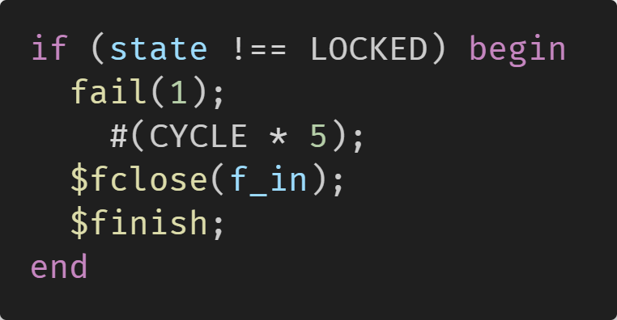
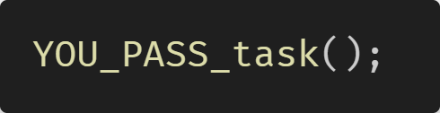
Rules for Pattern
You should reset the design before testing patterns. You should call the task “fail(check_code);” provided by TA when you detect an error and call the task “YOU_PASS_task;” if the design has no error.
Only one check failure message can be printed at a time, and the simulation should be terminated afterwards.
It is acceptable to have any number of clock cycle stalling between outputs.
After giving 4 in_digit, stall for ≥1 cycle(s) since IN_D4 needs 1 cycle to evaluate the input.

Slide 17
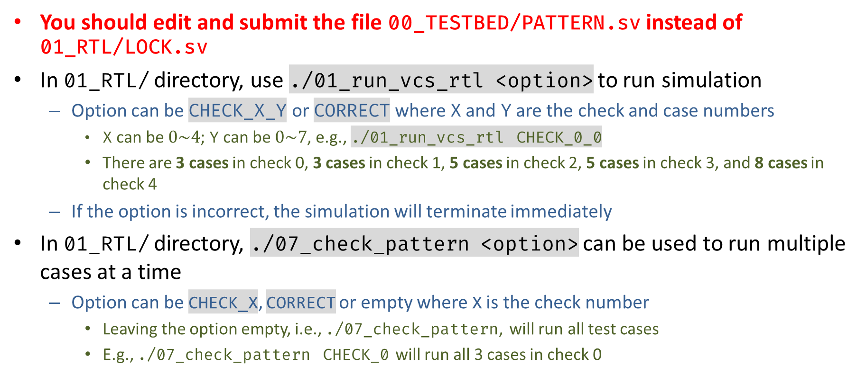
File Usage
You should edit and submit the file 00_TESTBED/PATTERN.sv instead of 01_RTL/LOCK.sv
In 01_RTL/ directory, use ./01_run_vcs_rtl <option> to run simulation
Option can be CHECK_X_Y or CORRECT where X and Y are the check and case numbers
X can be $0\sim 4$; Y can be $0\sim 7$, e.g., ./01_run_vcs_rtl CHECK_0_0
There are 3 cases in check 0, 3 cases in check 1, 5 cases in check 2, 5 cases in check 3, and 8 cases in check 4
If the option is incorrect, the simulation will terminate immediately
In 01_RTL/ directory, ./07_check_pattern <option> can be used to run multiple cases at a time
Option can be CHECK_X, CORRECT or empty where X is the check number
Leaving the option empty, i.e., ./07_check_pattern, will run all test cases
E.g., ./07_check_pattern CHECK_0 will run all 3 cases in check 0

Slide 18
Grading Policy
Successfully distinguish correct design and every faulty design (print the message on terminal): 100%
40% off for demo 2

Slide 19
Upload
cd ../09_UPLOAD/
./01_upload (upload code)
./02_download [argument] (download uploaded file)
[argument] = demo1 or demo2
Checks whether upload successfully & correctly
Demo 1: 4/23 17:40, Demo 2: 4/23 23:59

Slide 20
Debug Helper
The pattern numbers where the check cases fail
CHECK_1
CHECK_2
CHECK_3
CHECK_4
CEHCK_1_0: No.0 | CEHCK_1_1: No.0 | CEHCK_1_2: No.3
CEHCK_2_0: No.1 | CEHCK_2_1: No.1 | CEHCK_2_2: No.77
CEHCK_2_3: No.23 | CEHCK_2_4: No.19
CEHCK_3_0: No.2 | CEHCK_3_1: No.2 | CEHCK_3_2: No.2
CEHCK_3_3: No.16 | CEHCK_3_4: No.9
CEHCK_4_0: No.75 | CEHCK_4_1: No.75 | CEHCK_4_2: No.175 | CEHCK_4_3: No.143
CEHCK_4_4: No.143 | CEHCK_4_5: No.142 | CEHCK_4_6: No.145 | CEHCK_4_7: No.75

Slide 21
Appendix
Testbench Programming Review

Slide 22
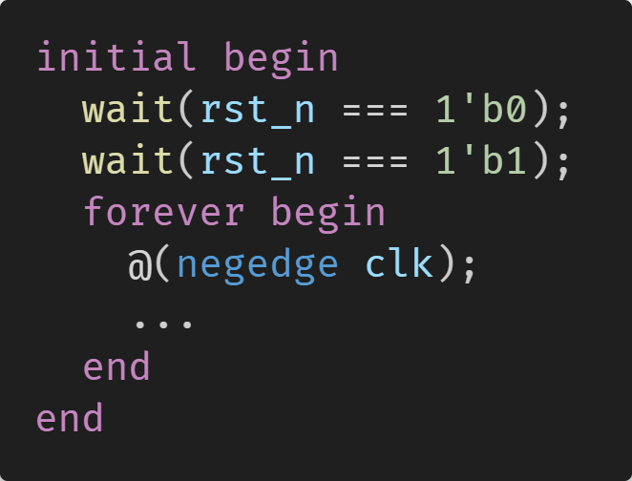
Control Flow
Construct the testbench in a sequential way like software language
Simulation time would not advance unless a timing control statement is executed
repeat(N) ...
Repeatedly executes a statement for N times
while(condition) / for(init; condition; increment)
Loops until the condition fails
foreach(array[index])
Iterates through all elements of array
forever
Infinite loop

Slide 23
Timing Control & Events
The data should be sent and check in negative edge of clock to avoid race condition
#(delay);
Delays for certain time with unit and precision specified by `timescale
@(signal); / @(edge signal);
Suspends execution until the signal changes
Edge: posedge / negedge
wait(expression);
Blocks until the expression is true

Slide 24
File I/O
C-style functions for specified files
fd = $fopen("file_path", "type");
Returns a 32-bit descriptor for a file
Type: "r" for read, "w" for write (overwrite if exist), "a" for append
E.g., f_in = $fopen("../00_TESTBED/input.txt", "r");
$fclose(fd);
Closes the file for the descriptor
status = $fscanf(fd, format, args...);
Reads data based on the format
Returns the number of arguments that are read successfully
E.g., status = $fscanf(f_in, "%d%d%d%d", in_d[0], in_d[1], in_d[2], in_d[3]);

Slide 25
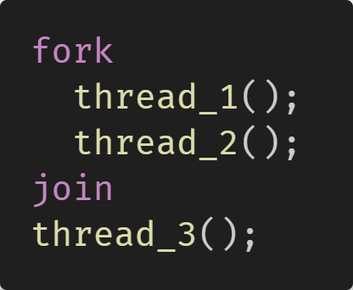
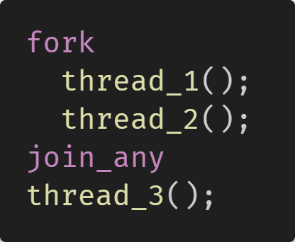
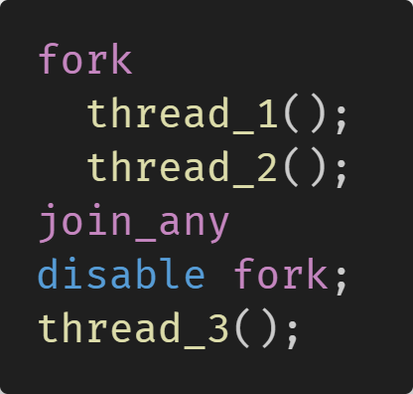
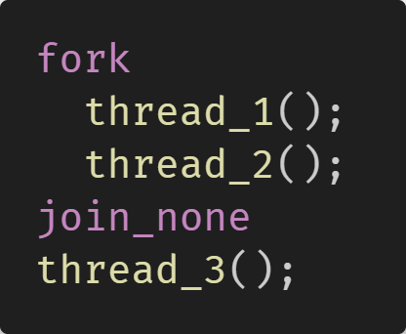
fork-join / fork-join_any / fork-join_none
A thread can be a single-line statement, a begin-end block, or a task
fork-join
Spawns parallel processes and waits for all to complete
fork-join_none
Spawns parallel processes but continues immediately without waiting
fork-join_any
Waits for any one of the parallel processes to complete
disable fork;
Kills all threads that are spawned by fork

