Slide 1
Lab08 Long Division
李品辰

Slide 2
Outline
Pipeline
Generate
Long Division (Lab08)
LongDiv.sv
SPEC
Hint
Grading Policy

Slide 3
Outline
Pipeline
Generate
Long Division (Lab08)
LongDiv.sv
SPEC
Hint
Grading Policy

Slide 4
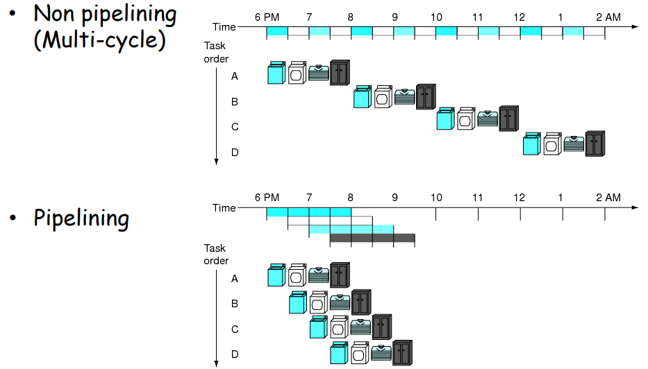
Pipeline

Slide 5
Outline
Pipeline
Generate
Long Division (Lab08)
LongDiv.sv
SPEC
Hint
Grading Policy

Slide 6
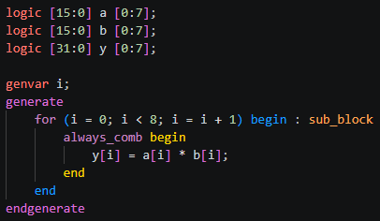
Generate
在合成前就編譯完成，相較for迴圈較不易出錯
可以將assign、always block、submodule放在generate裡宣告
generate是將一份電路複製多份，for則是在編譯時unrolling
在nWave裡可以看到sub-block顯示，較好debug

Slide 7
Outline
Pipeline
Generate
Long Division (Lab08)
LongDiv.sv
SPEC
Hint
Grading Policy

Slide 8
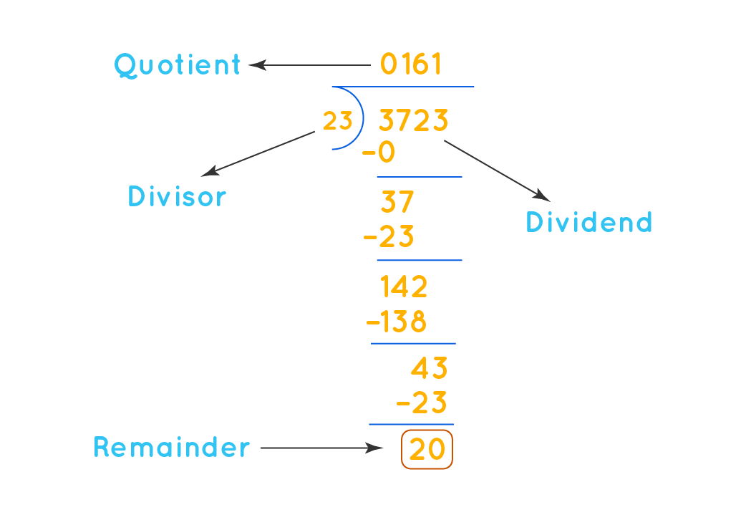
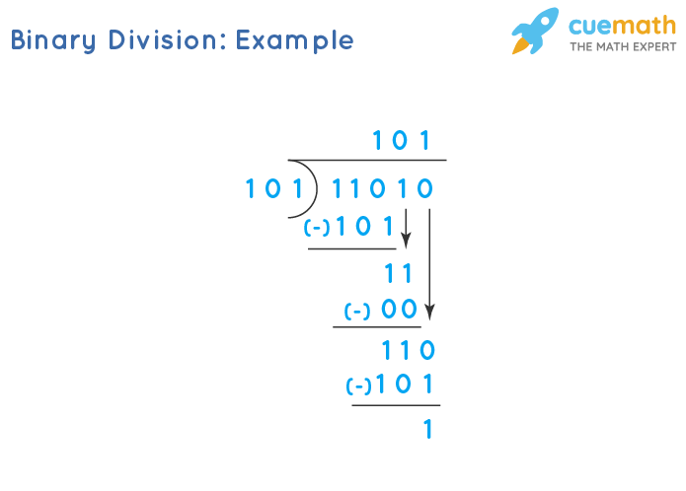
Long Division (Lab08)
LongDiv.sv
長除法可以將龐大的除法器運算化簡為一連串的移位與減法操作

Slide 9
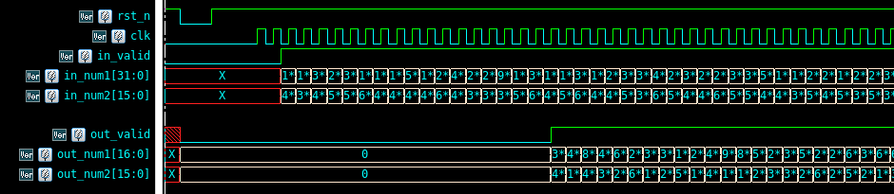
Long Division (Lab08)
LongDiv.sv
本次 Lab 將實作大數除法器 (in_num1[31:0] / in_num2[15:0])
Cycle time 極短，無法直接使用 “/” 和 “%” 進行運算 (timing violation!)
輸入為連續 (in_valid 持續為 1)
輸出也必須為連續 (out_valid 持續為 1)
“in_num2[15]” 必為 leading 1 (pipeline 級數固定)

Slide 10
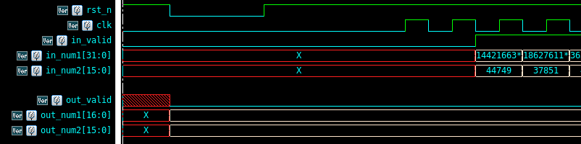
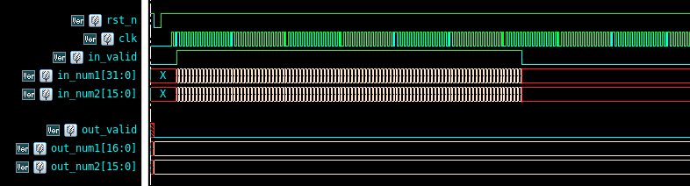
Long Division (Lab08)
LongDiv.sv
Output should be reset after “rst_n”
“out_valid” should be asserted within 100 cycles after “in_valid”.

Slide 11
Long Division (Lab08)
SPEC
Input Signal | Bit Width | Definition
rst_n | 1 | Asynchronous active-low reset
clk | 1 | Global clock
in_valid | 1 | Set to 1 when the input is ready
in_num1 | 32 | Dividend
in_num2 | 16 | Divisor (in_num2[15] == 1’b1)
Output Signal | Bit Width | Definition
out_valid | 1 | Set to 1 when the output is ready
out_num1 | 17 | Quotient
out_num2 | 16 | Remainder

Slide 12
Long Division (Lab08)
Hint
使用 generate 語法來設計重複性值高的 pipeline 電路
Pipeline 補充影片: https://www.youtube.com/watch?v=jOzW7kfr2p4

