Slide 1
DCS 2026 Spring Lab 9 – CDC
TA : 陳孟頡 Advisor : Tian-Sheuan Chang
Date : 2026.05.14

Slide 2
Lab09
Run the command below to get files for this lab.
tar -xvf ~es26dcsTA01/Lab09.tar

Slide 3
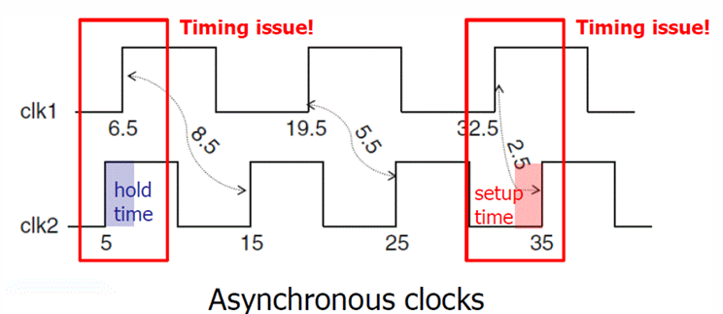
Clock Domain Crossing (CDC)
CDC: When the data launched and captured by different (asynchronous) clock domain, this case is called Clock Domain Crossing.
Consider two clocks, clk1 and clk2, with periods 13 and 10, respectively.

Slide 4
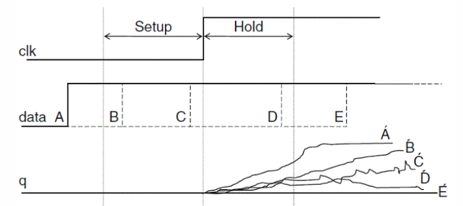
Metastability
The unstable status due to non-ideal data transition is called metastability.
To avoid this phenomenon, we must ensure that data should be stable during setup/hold timing check.
However, CDC designs will inevitably face this problem.

Slide 5
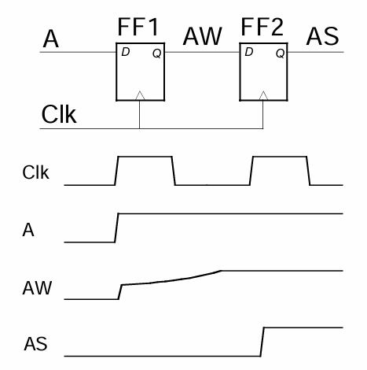
Solution: A Brute-Force Synchronizer
For more details, please reference to Lecture 12 - Metastability

Slide 6
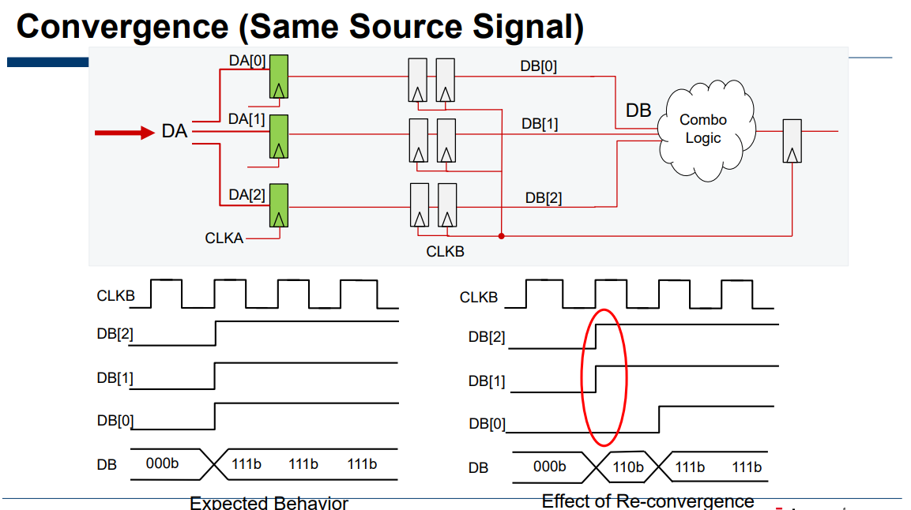
Convergence Issue
When transmitting multi-bit data, there is no guarantee that every bit will arrive at the same time
Reference: 2023 Fall iclab Lec07 (Jasper_CDC_introduction_lhlai)

Slide 7
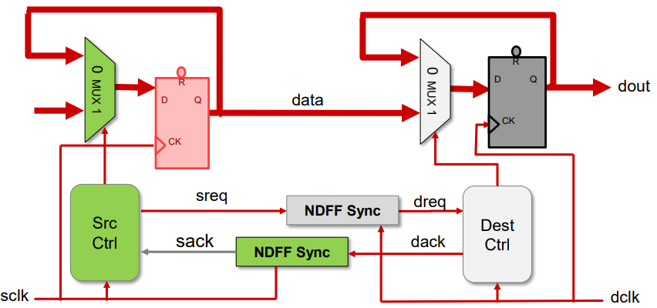
Solution 1: Handshake Synchronizer
Request-acknowledge protocol
High latency
Reference: 2023 Fall iclab Lec07 (Jasper_CDC_introduction_lhlai)

Slide 8
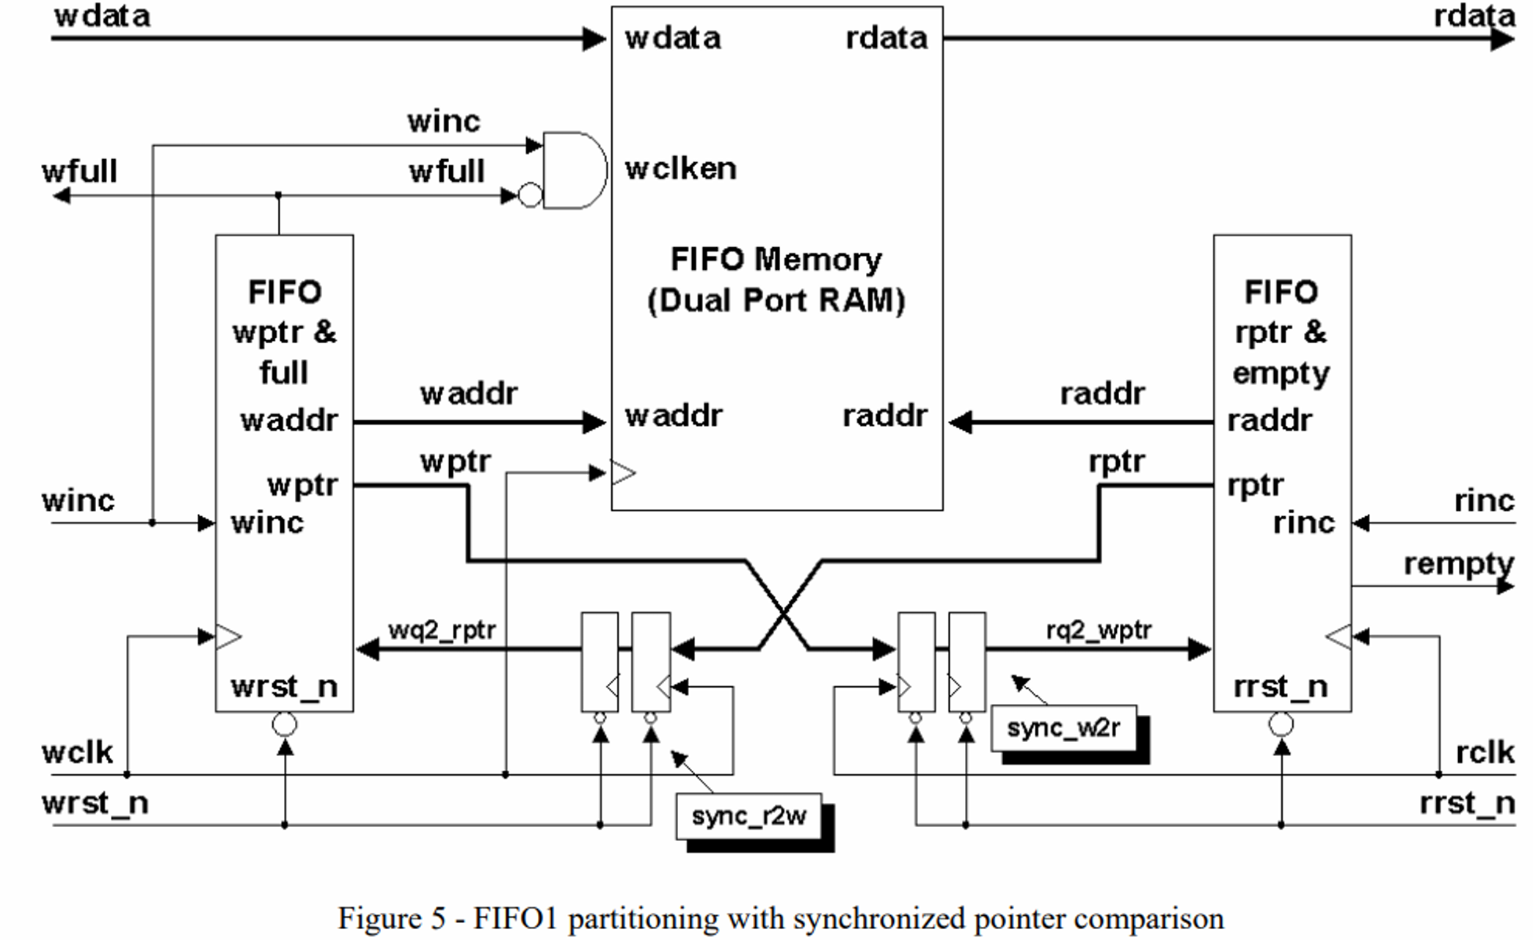
Solution 2: FIFO Synchronizers (Asynchronous FIFO)
Read/Write data in different clock domain with a dual-port RAM.
Use gray-coded pointers to generate full and empty status flags.
High throughput with hardware overhead.
Reference: 2024 Fall iclab Lec07 (IC設計簡介 - Clock Domain Crossing(CDC))

Slide 9
Asynchronous FIFO : Bit Number of Pointers
Address | Data
7
6
5
4
3
2
1
0
Write Pointer
Read Pointer
waddr[2:0] = 3’b000
raddr[2:0] = 3'b000
waddr[3:0]
Dual-port RAM
raddr[3:0]

Slide 10
Asynchronous FIFO : Bit Number of Pointers
Address | Data
7
6
5
4
3
2
1
0
Data 0
waddr[2:0] = 3’b000
raddr[2:0] = 3'b000
Dual-port RAM

Slide 11
Asynchronous FIFO : Bit Number of Pointers
Address | Data
7
6
5
4
3
2
1
0
Data 1
waddr[2:0] = 3’b001
Data 0
raddr[2:0] = 3'b000
Dual-port RAM

Slide 12
Asynchronous FIFO : Bit Number of Pointers
Address | Data
7
6
5
4
3
2
1
0
waddr[2:0] = 3’b010
Data 1
Data 0
raddr[2:0] = 3'b000
Dual-port RAM

Slide 13
Asynchronous FIFO : Bit Number of Pointers
Address | Data
7
6
5
4
3
2
1
0
Data 7
waddr[2:0] = 3’b111
Data 6
Data 5
Data 4
Data 3
Data 2
Data 1
Data 0
raddr[2:0] = 3'b000
Dual-port RAM

Slide 14
Asynchronous FIFO : Bit Number of Pointers
Address | Data
7
6
5
4
3
2
1
0
Data 7
Data 6
Data 5
Data 4
Data 3
Data 2
Data 1
waddr[2:0] = 3’b000
Data 0
raddr[2:0] = 3'b000
Dual-port RAM
Empty? Full?

Slide 15
Asynchronous FIFO : Bit Number of Pointers
Address | Data
7
6
5
4
3
2
1
0
Data 0
waddr[3:0] = 4’b0000
raddr[3:0] = 4'b0000
Dual-port RAM

Slide 16
Asynchronous FIFO : Bit Number of Pointers
Address | Data
7
6
5
4
3
2
1
0
waddr[3:0] = 4’b0001
Data 0
raddr[3:0] = 4'b0000
Dual-port RAM

Slide 17
Asynchronous FIFO : Bit Number of Pointers
Address | Data
7
6
5
4
3
2
1
0
Data 7
waddr[3:0] = 4’b0111
Data 6
Data 5
Data 4
Data 3
Data 2
Data 1
Data 0
raddr[3:0] = 4'b0000
Dual-port RAM

Slide 18
Asynchronous FIFO : Bit Number of Pointers
Address | Data
7
6
5
4
3
2
1
0
Data 7
Data 6
EMPTY
if (waddr == raddr)
Data 5
Data 4
FULL
if (waddr == {~raddr[3], raddr[2:0]})
Data 3
Data 2
Data 1
waddr[3:0] = 4’b1000
Data 0
raddr[3:0] = 4'b0000
Dual-port RAM

Slide 19
Asynchronous FIFO : Gray-Coded Pointers
Address | Data
7
6
5
4
3
2
1
0
Convergence Issue
waddr[3:0] = 4’b0010
Data 1
waddr[3:0] = 4’b0001
Data 0
raddr[3:0] = 4'b0000
Dual-port RAM

Slide 20
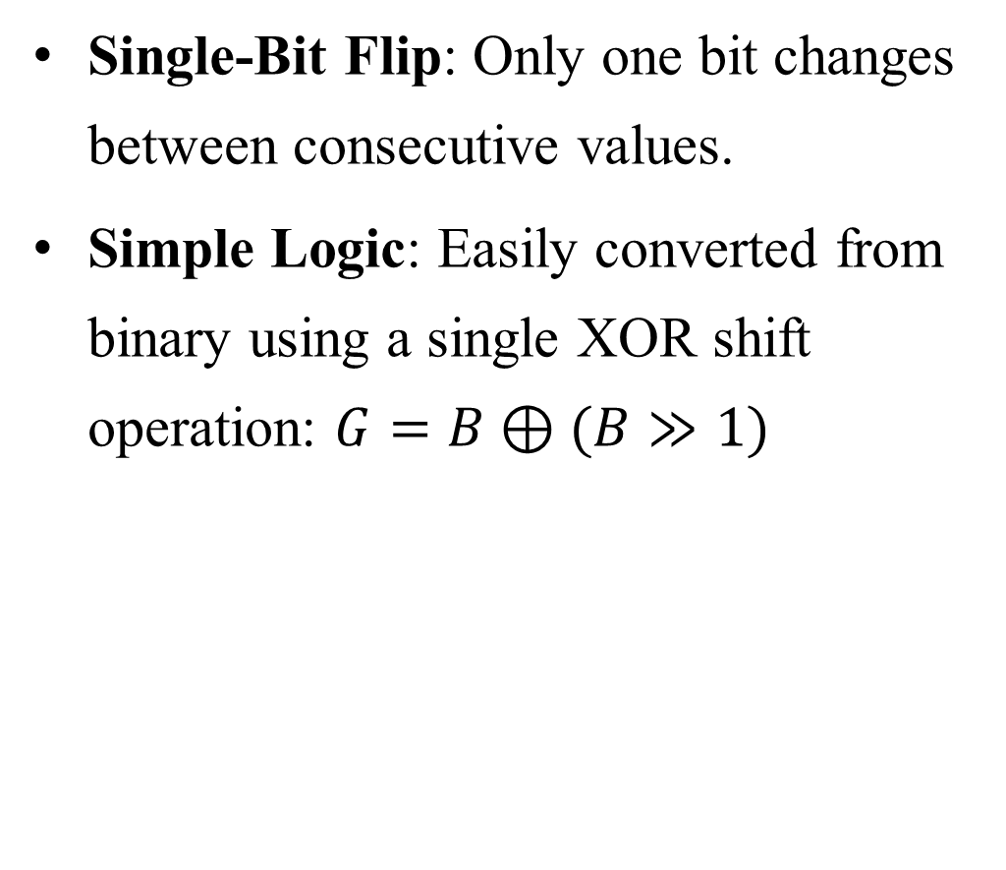
Asynchronous FIFO : Gray-Coded Pointers
Single-Bit Flip: Only one bit changes between consecutive values.
Simple Logic: Easily converted from binary using a single XOR shift operation: $G=B⊕(B≫1)$
Decimal | Binary | Gray Code
0 | 000 | 000
1 | 001 | 001
2 | 010 | 011
3 | 011 | 010
4 | 100 | 110
5 | 101 | 111
6 | 110 | 101
7 | 111 | 100
How to determine full condition if using gray-coded pointer instead of binary?
For more details, please reference to Lecture 12 - Metastability

Slide 21
Lab09 : Asynchronous FIFO
tx_clk = 2.5ns, rx_clk = 14.1ns
Write data into the FIFO in TX domain.
Read data from FIFO in RX domain.
Fill the blanks in AsyncFIFO.sv to complete the Asynchronous FIFO.

Slide 22
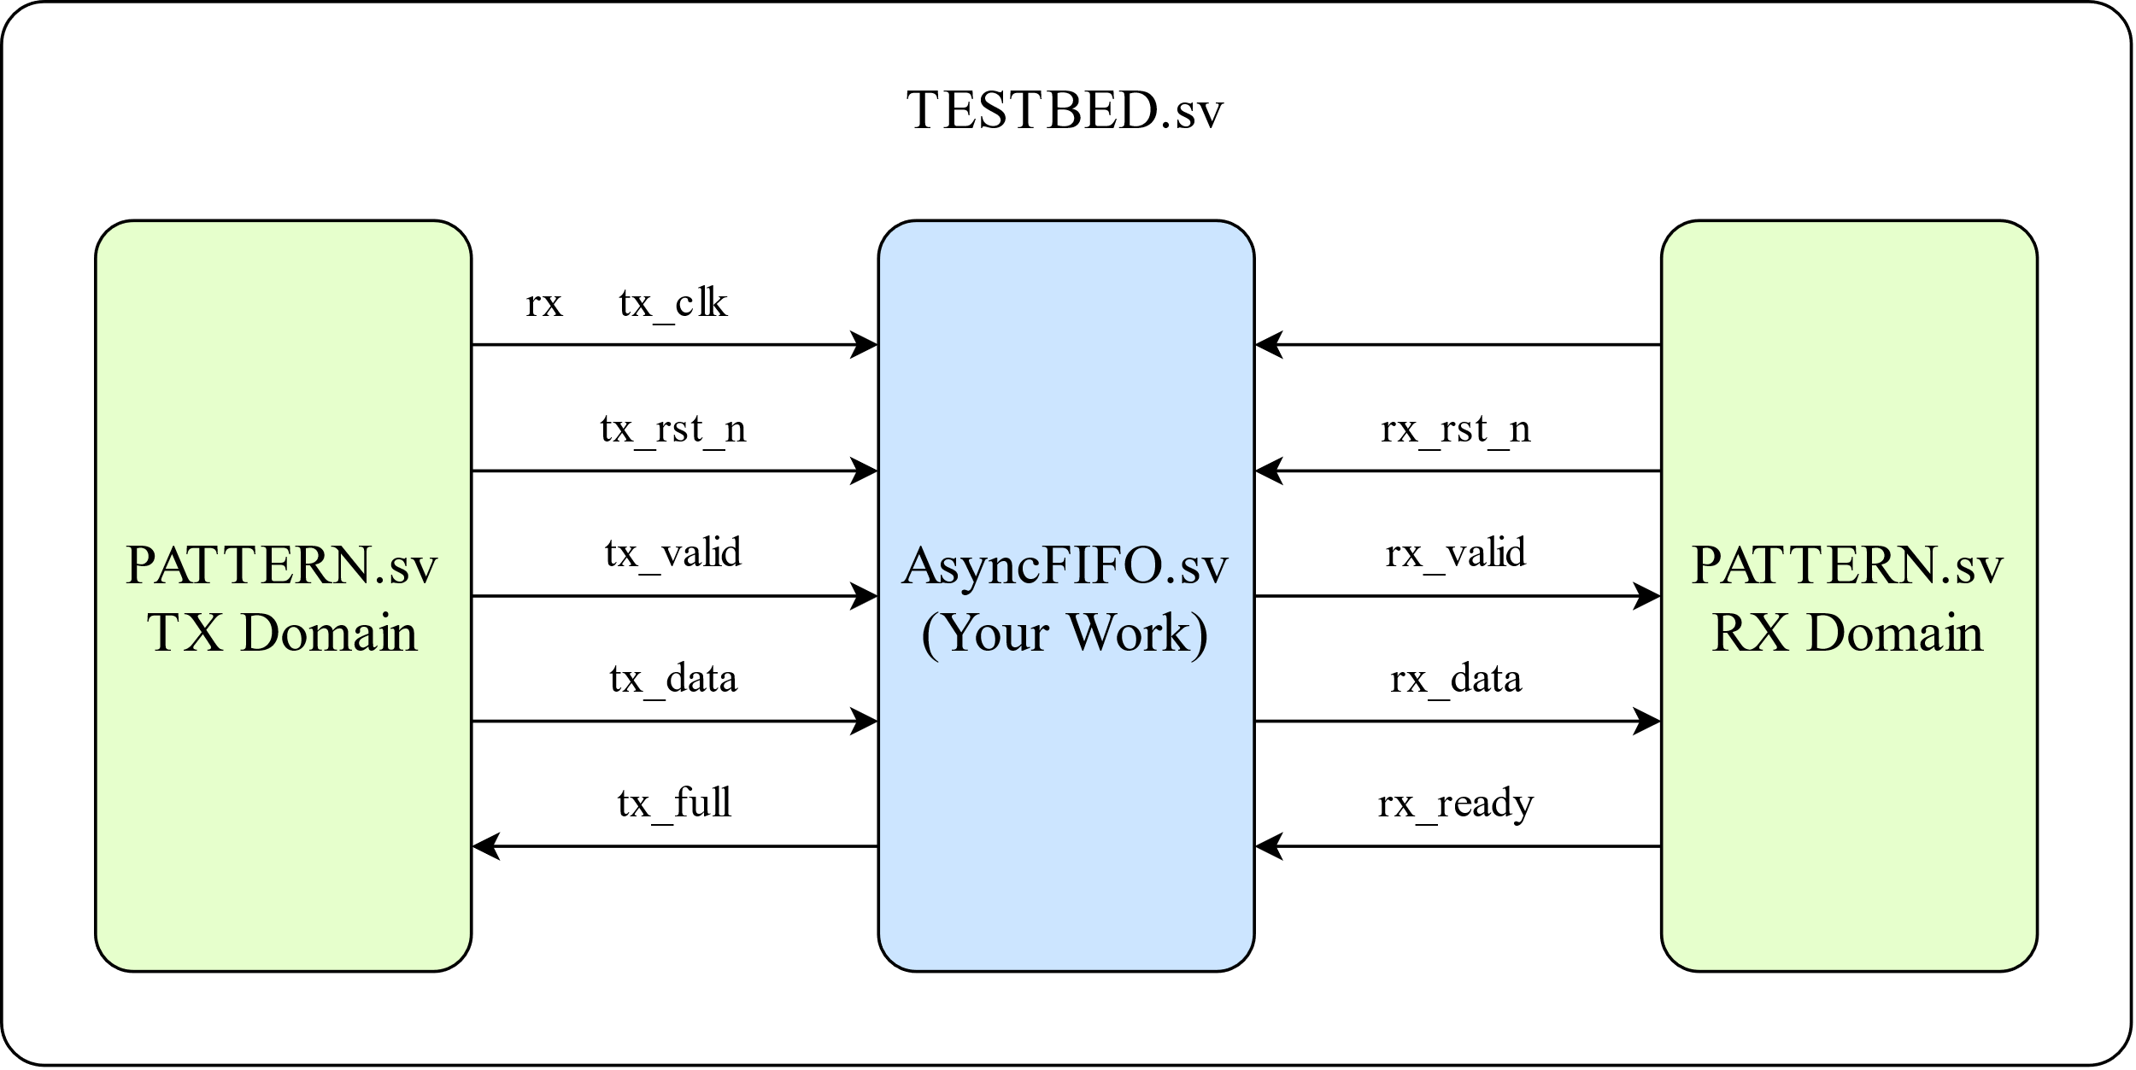
Lab09 : Block diagram

Slide 23
AsyncFIFO.sv
TX Domain Signals:
Signal | I/O | Bit Width | Definition
tx_clk | input | 1 | Write domain clock signal.
tx_rst_n | input | 1 | Write domain asynchronous active-low reset.
tx_valid | input | 1 | High when tx_data is valid.
tx_data | input | 8 | Data need to write into FIFO.
tx_full | output | 1 | High when FIFO is full.

Slide 24
AsyncFIFO.sv
RX Domain Signals:
Signal | I/O | Bit Width | Definition
rx_clk | input | 1 | Read domain clock signal.
rx_rst_n | input | 1 | Read domain asynchronous active-low reset.
rx_valid | output | 1 | High when rx_data is valid.
rx_data | output | 8 | Data read from FIFO.
rx_ready | input | 1 | High when PATTERN.sv is ready to read data.

Slide 25
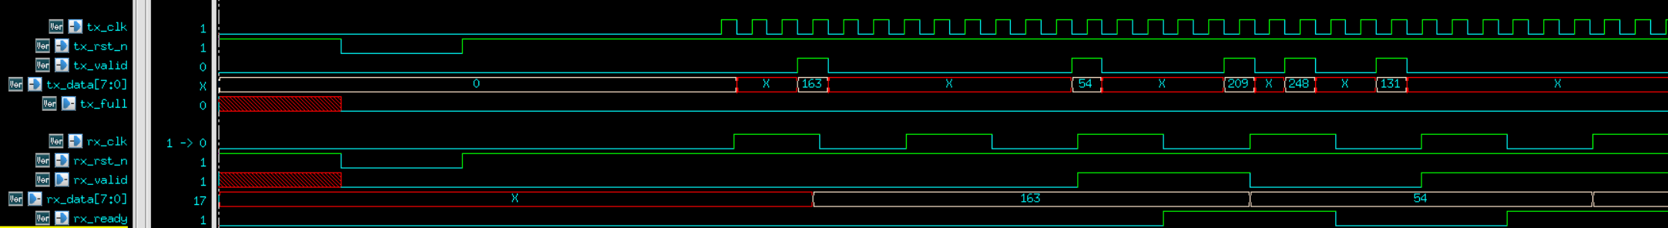
Waveform
TX domain randomly send write data
rx_valid should be high when rx_data is valid
RX domain randomly set ready signal

Slide 26
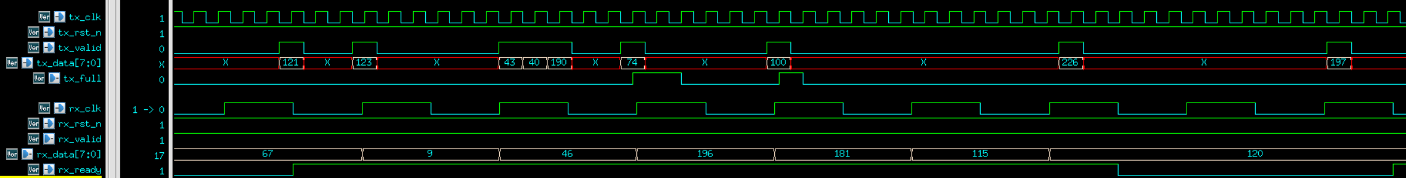
Waveform
tx_full should pull high when FIFO full

Slide 27
Reminders
Using the TA's provided framework is strongly advised.
All needed signals are already defined, but feel free to add your own.

Slide 28
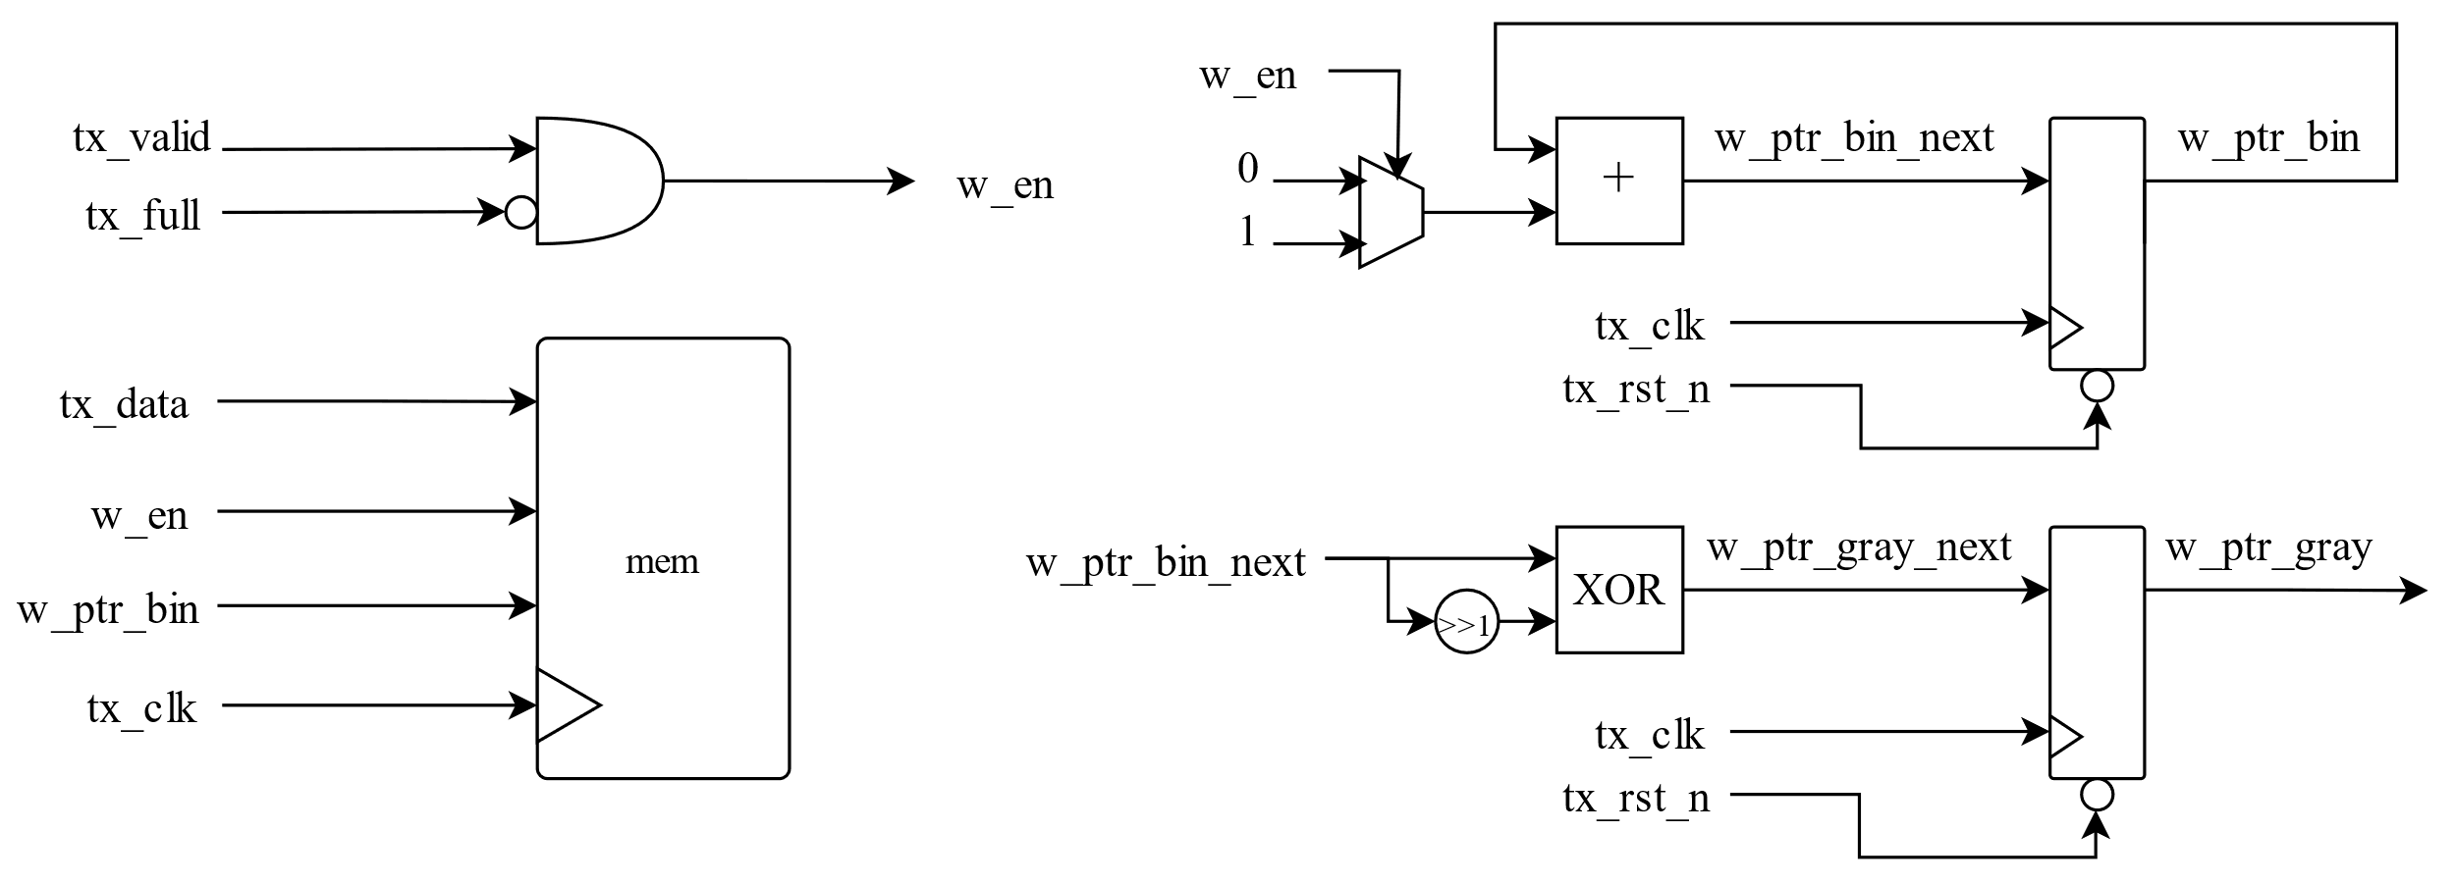
Hint : TX Domain Architecture

Slide 29
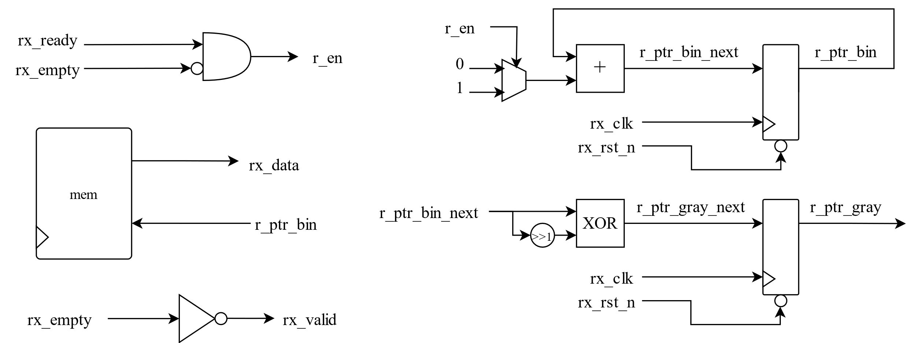
Hint : RX Domain Architecture

Slide 30
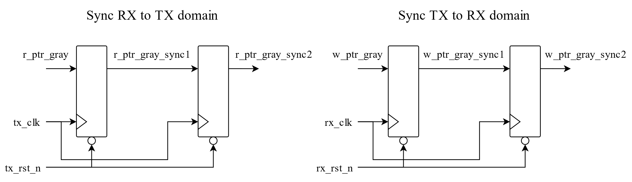
Hint : Synchronization

Slide 31
Hint : FIFO Full/Empty
TX domain full
Compare tx gray-coded pointer to rx gray-coded sync pointer.
RX domain empty
Compare rx gray-coded pointer to tx gray-coded sync pointer.
tx_full
rx_empty

Slide 32
Grading Policy
1st demo – 100% for following requirements:
Pass the RTL simulation
Pass Synthesis (No Error, Timing Report Slack met, no Latch)
Pass Gate-level simulation
2nd demo – 60%

Slide 33
Upload
cd ../09_UPLOAD/
./01_upload (upload code)
./02_download [argument]
[argument] = demo1 or demo2
Note:
Make sure to upload the correct file successfully.
Deadline:
1st demo: 5/14 17:20
2nd demo: 5/14 23:59

