Slide 1
Lab01 Combinational Circuit
張皓庭

Slide 2
Combinational Circuit
The system takes four input numbers: in_num0 ~ in_num3
Perform the specified bitwise operations based on the block diagram:
A = in_num0 XNOR in_num1
B = in_num1 AND in_num3
C = in_num0 XOR in_num2
D = in_num2 OR in_num3
Then, group and calculate the sum
E = max(A, B) + min(C, D)
F = min(A, B) + max(C, D)
Convert E into its Gray code representation, the outputs are the Gray-coded E and F

Slide 3
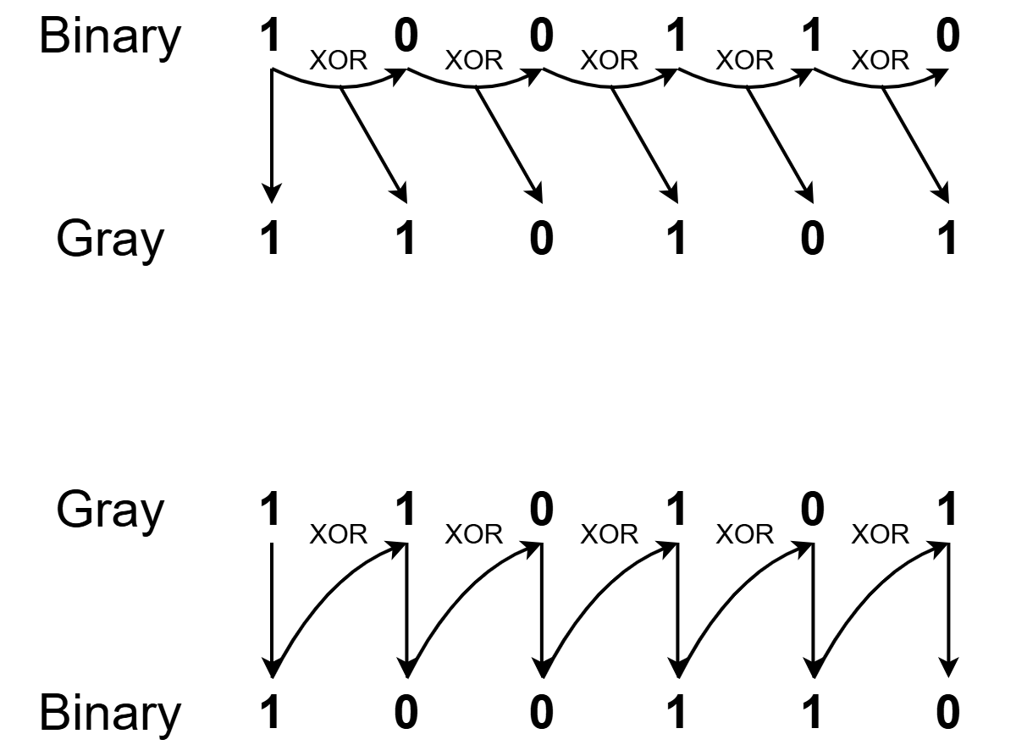
Combinational Circuit
Gray code representation:
A Gray code has a property that the codes for successive decimal digits differ in exactly one bit
Binary to Gray conversion:
Gray to binary conversion:
Decimal | Binary | Gray
0 | 000 | 000
1 | 001 | 001
2 | 010 | 011
3 | 011 | 010
4 | 100 | 110
5 | 101 | 111
6 | 110 | 101
7 | 111 | 100

Slide 4
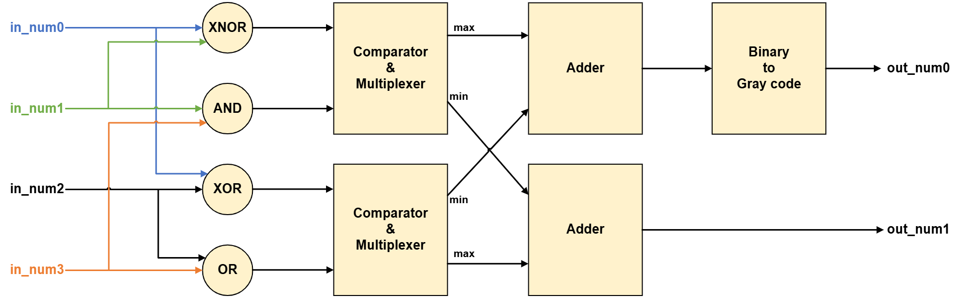
Block Diagram

Slide 5
Block Diagram (Example)
21
71
71
143
200
45
33
33
93
72
72
160
35
127
127

Slide 6
Block Diagram (Example)
0010101
1000111
1000111
10001111
11001000
0100001
0101101
0100001
1011101
1001000
1001000
10100000
0100011
1111111
1111111

Slide 7
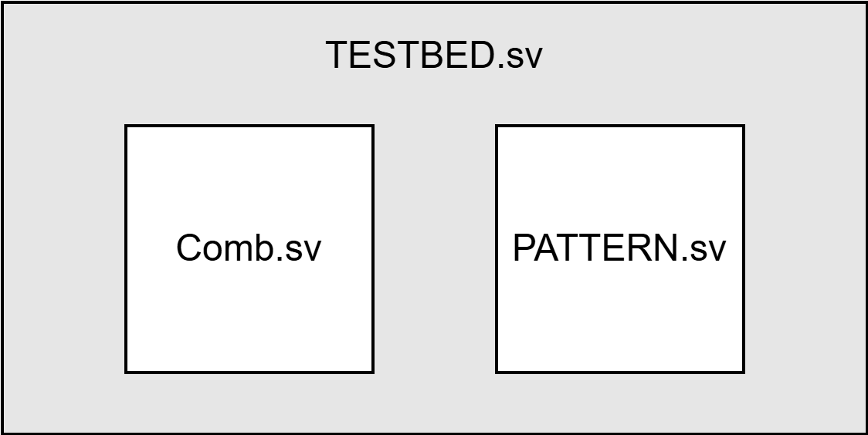
Block Diagram

Slide 8
Specification
Comb.sv
Input Signal | Bit Width | Definition
in_num0 | 7 | Random 7-bit unsigned numbers
in_num1 | 7
in_num2 | 7
in_num3 | 7
Output Signal | Bit Width | Definition
out_num0 | 8 | The gray code of max(A, B) + min(C, D)
out_num1 | 8 | min(A, B) + max(C, D)

Slide 9
Directory
tar -xvf ~es26dcsTA01/Lab01.tar
00_TESTBED
TESTBED.sv
PATTERN.sv
01_RTL
01_run_vcs_rtl
09_clean_up
Comb.sv
02_SYN
01_run_dc
09_clean_up
03_GATE
01_run_vcs_gate
09_clean_up

Slide 10
Command
cd Lab01/01_RTL/
vim Comb.sv (text editor)
i (輸入模式)
[Esc] (退回普通模式)
:w (儲存)
:q (結束)
gedit Comb.sv (text editor)
view → Highlight Mode → Sources → Verilog
If you use Windows/MacOS, you can use VSCode/Notepad++, or any editors you are used to using.

Slide 11
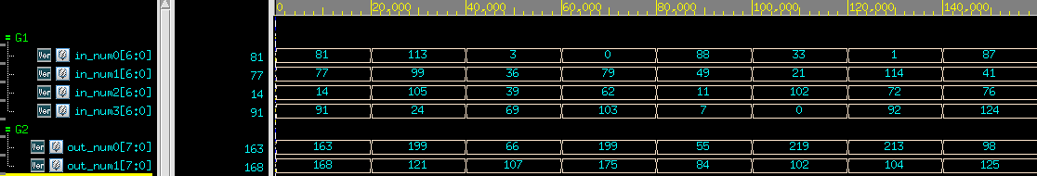
RTL Simulation
cd Lab01/01_RTL/
./01_run_vcs_rtl (電路模擬)
./09_clean_up (清除波型檔)
./05_nWave (看波型)
範例波型

Slide 12
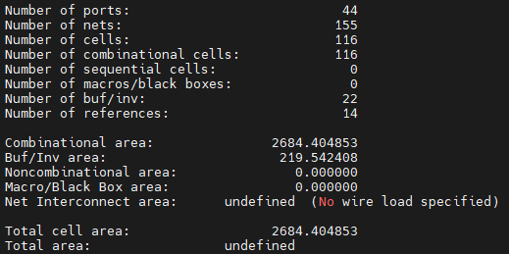
Synthesis
cd ../02_SYN/
./01_run_dc (電路合成)
./09_clean_up (清除合成結果)
合成結果: (不能有Error、要有Area report、Timing report slack met、不能有Latch)

Slide 13
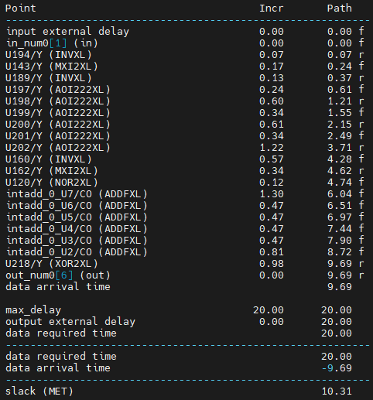
Synthesis
合成的timing report中的slack必須≧0 (MET)
如果出現timing violation → Demo Fail ! (slack < 0)

Slide 14

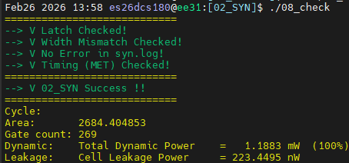
Synthesis
記得檢查是否合成出Latch和error
可以在 syn.log 用 ctrl+F 尋找關鍵字Latch、error
如果出現 Latch、error → Demo Fail
可在 /02_SYN/ 中使用 ./08_check
檢查 “latch”, “error”, “timing”, “area”

Slide 15
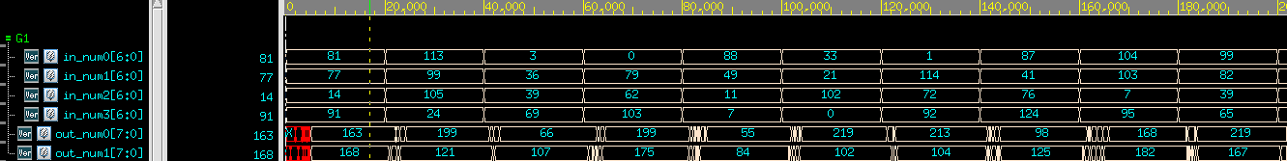
Gate-Level Simulation
cd ../03_GATE/
./01_run_vcs_gate (電路模擬)
./09_clean_up (清除波型檔)
./05_nWave (看波型)
範例波形

Slide 16
Grading Policy
Pass the RTL & Synthesis & Gate-level simulation: 100%
合成結果: (不能有Error、Timing report slack met、不能有Latch)
Demo2 打 6 折

Slide 17
Upload
cd ../09_UPLOAD/
./01_upload (上傳 code)
./02_download [argument] (下載上傳結果)
[argument] = demo1 or demo2
檢查是否上傳成功 & 正確
Demo1: 2026/03/11 17:30:00
Demo2: 2026/03/11 23:59:59

