Slide 1

The Panama Papers
Massive Offshore Leaks Data Analysis

Slide 2



Structure of Offshore Companies
Officers
Edges
Entities
Intermediaries
Edges

Slide 3
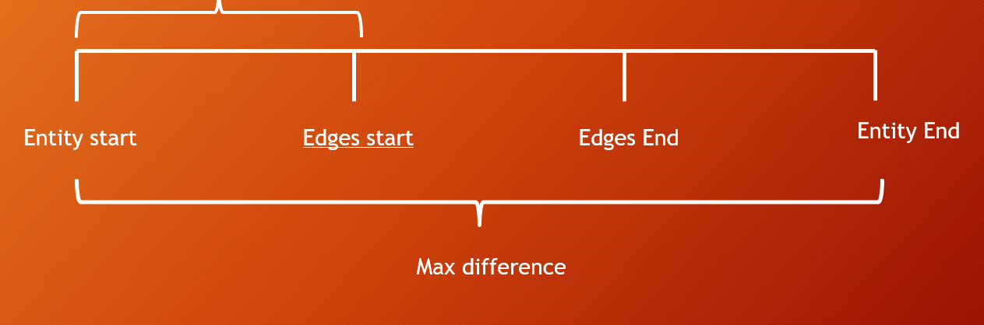
Deal with missing data
Difference

Slide 4
Visualization

Slide 5
Need plots…

Slide 6
Cluster countries by year based on the characteristics of domestic officers
Research
Goal:

Slide 7
High Dimensional Clustering

Slide 8
Methodology
Parameter selection
Dimension reduction
Random forest cluster

Slide 9
Parameter Selection
•Our goal is to summarize network structure in each country and its variability throughout time.
•By network structure we mean the degree distribution of its officers i.e. how many entities are linked to this officer.
•
•To efficiently describe the distribution, we focused on three perspectives: location, spread and frequency

Slide 10
Change of officers’ degree
Distribution of degree of global officers from 1970 to 2015

Slide 11
•Location: mean degree, proportion of one-degree node.
•
•Spread: standard deviation, 75% percentile( max is extremely sensitive to officers in large clusters)
•
•Frequency: Number of degree-two nodes, one proportion
•
•Variability via time: alpha( small alpha means more centralized country, and an expansion of new officers)

Slide 12
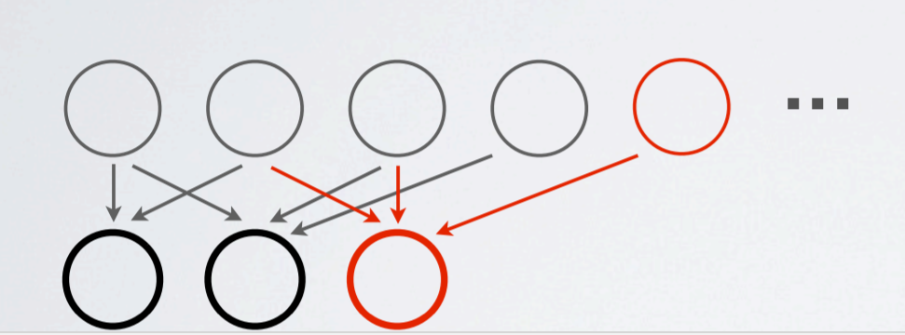
Indian Buffet Process
a stochastic process defining a probability distribution over sparse binary matrices with a finite number of rows and an infinite number of columns.

Slide 13
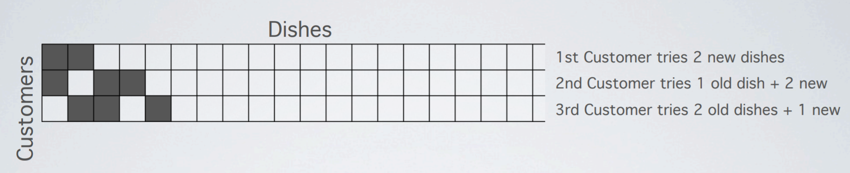
When customer 1 entered, he chose O1 new dishes, O1 has Poisson distribution with parameter

Slide 14
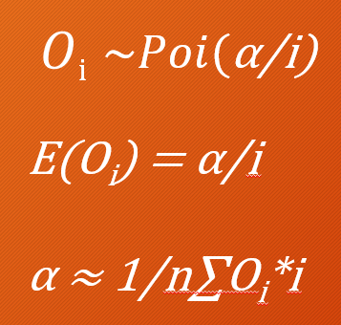
In this case,
Entities = Customers
Officers = Dishes
Countries = Restaurants
Where the number of new officers connected to entity i Oi follows Poisson Distribution with parameter α/i.

Slide 15
Normalization
Formula:
(vij - mean(vj))/sd(vj)
For j th year, for country i.
Purpose: Make things comparable
1. Countries are of different sizes
2. Six measures are of different units (do not want certain
measure to dominate)

Slide 16
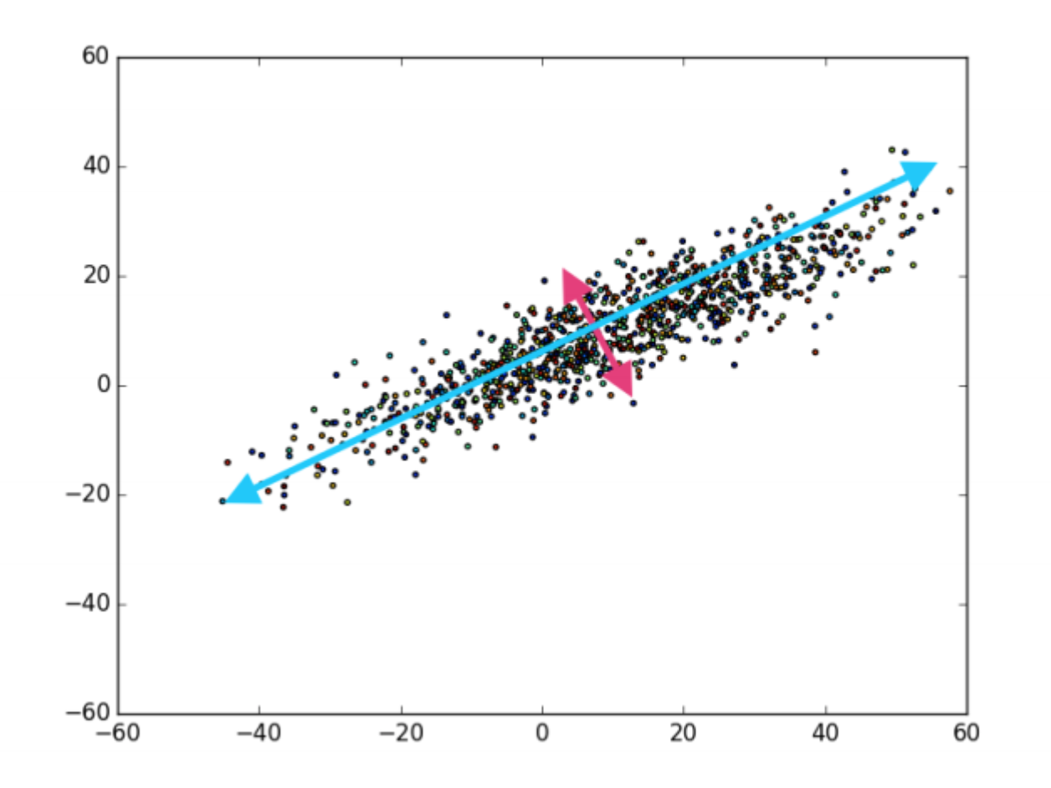
PCA
Reduce the higher correlated
dimensions to orthogonal dimensions
Like the The Gram-Schmidt process in Linear algebra to get orthonormal basis

Slide 17
Why do the normalization first?
Initial PCA result without normalization:
Only one dimension matters. I suspect the industry size dominate
all measures.
PCA after normalization:
Two or three dimensions matter.

Slide 18
PCA Results and Interpretations

Slide 19
K - means Clustering
Metrics: Typical L2 metrics
Future: Can use Random Forest to do the clustering

Slide 20
Result and Conclusion

Slide 21
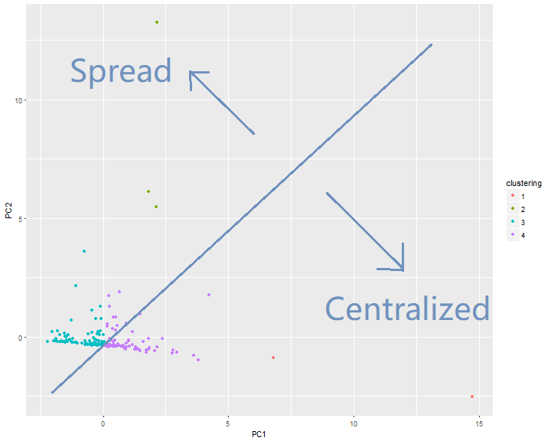
Clustering Result and Discussions

Slide 22
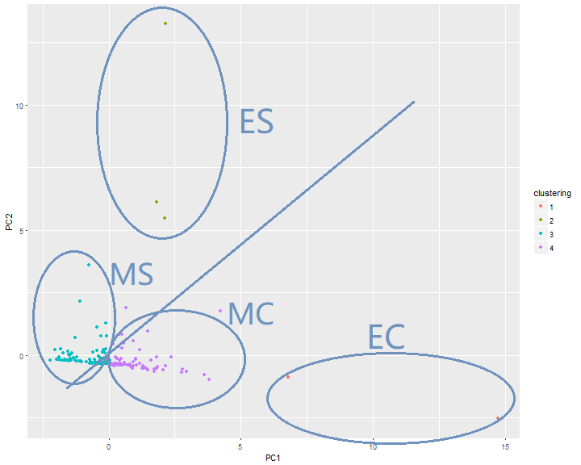

Slide 23
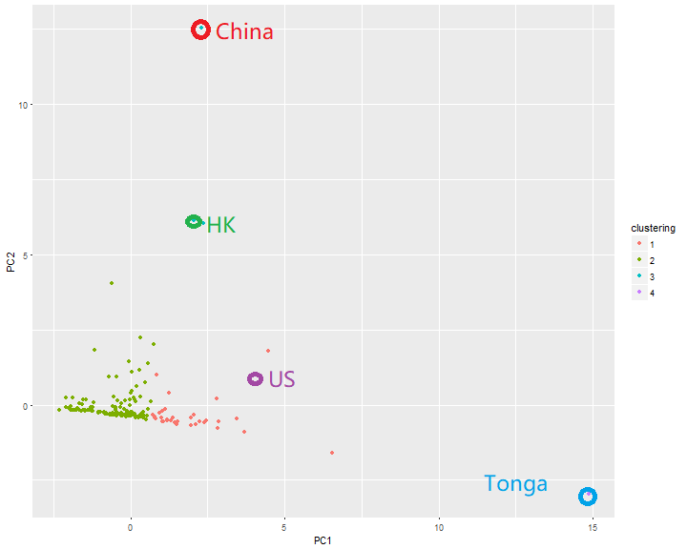
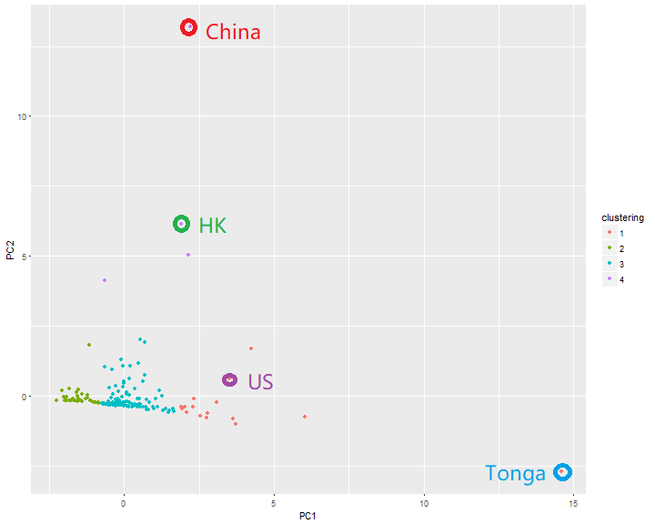
2012
2013

Slide 24
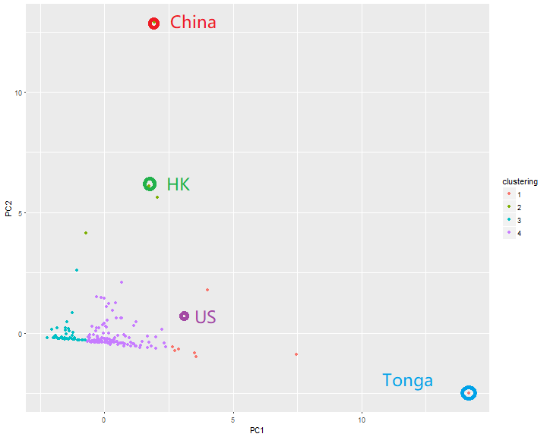
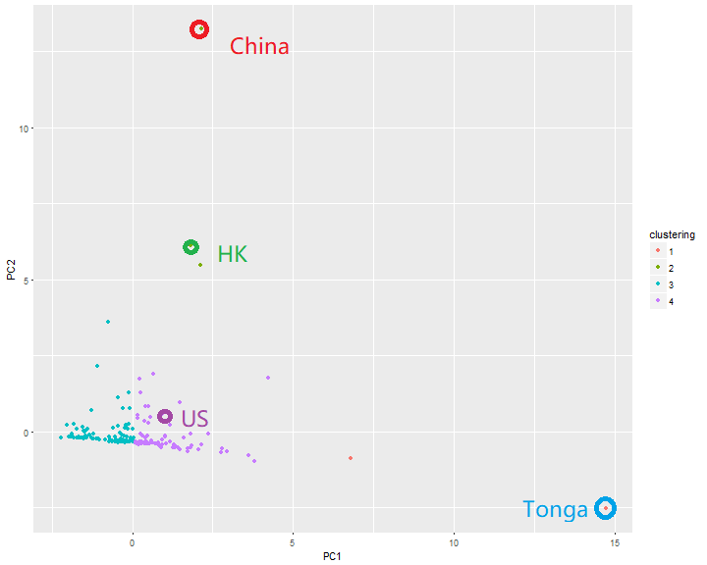
2014
2015

Slide 25
Reference
R Core Team (2017). R: A language and environment for statistical computing. R Foundation for
Statistical Computing, Vienna, Austria. URL https://www.R-project.org/.
H. Wickham. ggplot2: Elegant Graphics for Data Analysis. Springer-Verlag New York, 2009.

