Slide 1
Neo4j & GREG
Songqing, Xiaowei
2019.5.24

Slide 2
Comment
First, we will learn how to access the GREG database through Neo4J.
Second, we will learn how to use Cypher,basic examples.

Slide 3
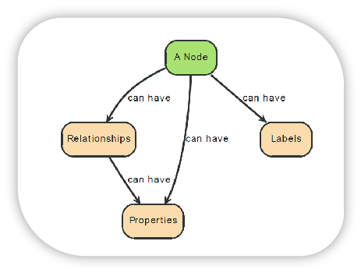
neo4j introduction
Neo4j is a graph database, which can store anykind of data using a few simple concepts.
1. Nodes - graph data records
2. Relationships - connect node
3.Properties -named data values

Slide 4
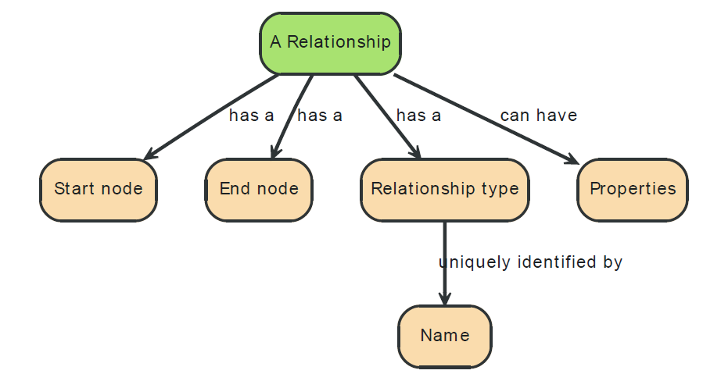
Labels
Apply a Label to each member, we can group together nodes.
    A node can have zero or more labels
    Labels do not have any properties
Relationships
Add a Relationships to describes how the records are releted.

Slide 5
install neo4j
1.Confirm installation of Java
2.Download neo4j
    Website: https://neo4j.com/download-center/#releases
3.Unzip the file
    Find the zip file you just downloaded and right-click, extract all.

Slide 6
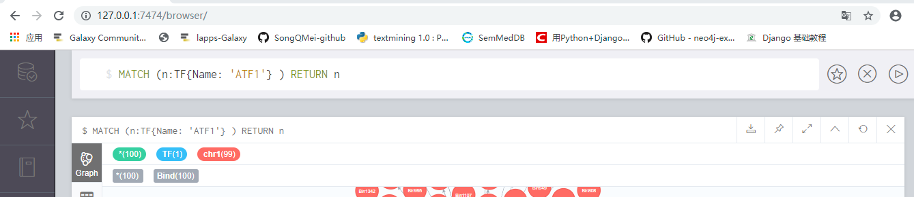
install neo4j
Input Command here
Run

Slide 7
http://210.38.57.54:8080/index.html
GREG (The Gene Regulation Graph Database) is a graph database written in the Neo4J language.
Look a graph to know interactions between proteins, lncRNAs, and DNA for a given transcription factor, lncRNA, or genomic region (ie., its “regulatory landscape”)
GREG include three type of relationships
TF_DNA Binding LncRNA_DNA Binding
TF_TF Interaction DNA _DNA Interaction
TF_ LncRNA Interaction

Slide 8
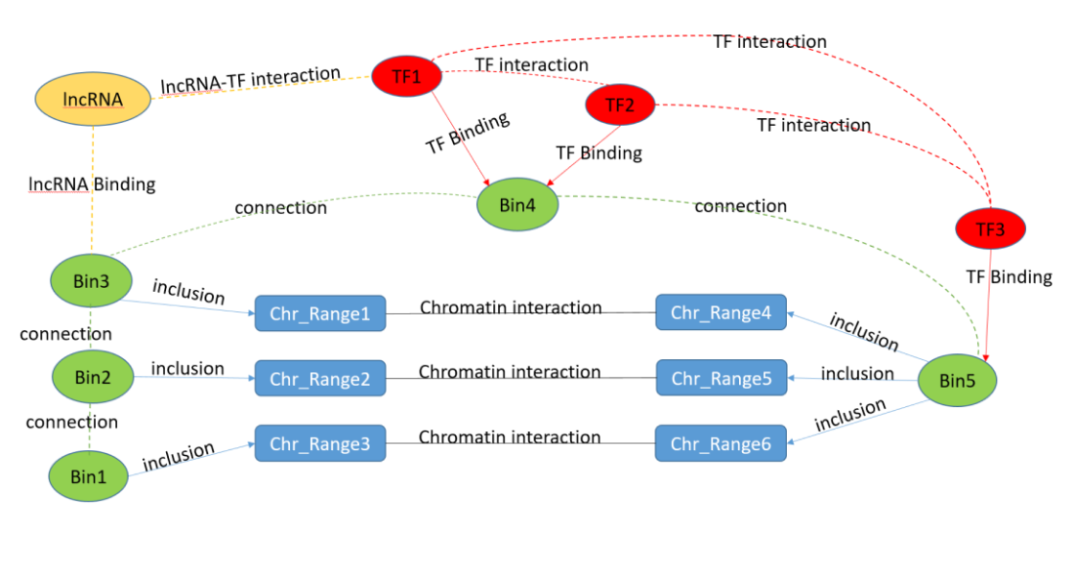
Directly find the relationships
between proteins, ncRNAs and DNA in GREG graph.

Slide 9
GREG data came from database of iRefIndex, 4DGenome, LnChrom, POSTAR2/starBase and Cistrome.
GREG only supports hg38 genome versions and works with human data of 8 human cell types.
stem cells: H1, IPS19.11, IPS6.9
cancer cells: A549, K562, MCF-7, HeLa
other cells: IMR-90
GREG accept:
TFs and lncRNAs: gene names.
DNA Annotation:Ensemble gene ID, gene type (protein coding, miRNA, lincRNA, etc), and gene name

Slide 10
install Greg
1、Unzip the database file
    In the path：neo4j-community-3.4.0\data\databases
    2. Congfig Greg as the active database
        In the path： neo4j-community-3.4.0\conf
        Open the file: neo4j.conf, enter the database name of Greg,then save the config file.
        # The name of the database to mount
        dbms.active_database=GREG-small-undirected
    3、pen the Browser
    Enter the address: http://localhost:7474
    Enter PW：msq2651yy
    The default PW on neo4j is “neo4j”.
    4、You can start your journey in GREG.

Slide 11
Cypher
Cypher is Neo4j's graph query language, which allows for expressive and efficient querying and updating of the graph.
Cypher is designed to be simple, yet powerful; so highly complicated database queries can be easily expressed.

Slide 12
Cypher
CQL command | description
CREATE | create nodes, relationships and proroperties
MERGE | ensures that an expected pattern exists in the graph, reconciling whether data was found, or needs to be created
MATCH | retrieve nodes, relationships and proroperties
RETURN | return the result of retrieving
WHERE | filter the result of retrieving
DELETE | delete nodes and relationships identified. Remember that you can not delete a node without also deleting relationships that start or end on said node.
SET | updates properties on nodes and relationships.

Slide 13
Examples
1、Retrieve all nodes and relationships:
The "MATCH" command can be used to retrieve all nodes in GREG with a specific label. and we want to use “Return" command to get the result. The following example returns the TF nodes but limits the results to only 25 TFs:
MATCH (n:TF) RETURN n LIMIT 25

Slide 14
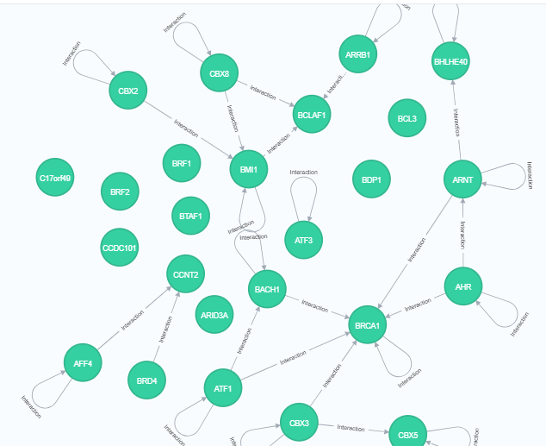
Examples
1、Retrieve all nodes and relationships:
MATCH (n:TF) RETURN n LIMIT 25

Slide 15
Examples
1、Retrieve all nodes and relationships:
MATCH (n:TF) RETURN n LIMIT 25
TF is the label of the nodes
n is Variable name, Used to represent the results obtained.
MATCH(n:TF) selects all nodes with the TF label
RETURN n to get the retrieved result.
LIMIT 25 limits the results to 25 nodes

Slide 16
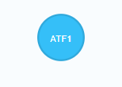
Examples
1、Retrieve nodes and relationships:
we can use "MATCH" command to retrieve a node by property in GREG with a specific label.
we can retrieve a TF by name. For example: “ATF1”:
MATCH (n:TF{Name: 'ATF1'} ) RETURN n

Slide 17
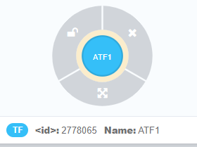
Examples
1、Retrieve nodes and relationships:
We can expand the view by clicking on the "ATF1" icon: click on node, then expand for interactors
click
Click to Expand

Slide 18
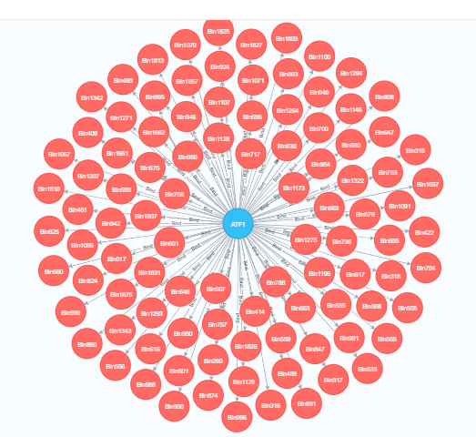
Examples
1、Retrieve nodes and relationships:
expand for interactors

Slide 19
Examples
1、Retrieve nodes and relationships:
MATCH (n:TF{Name: 'ATF1'} ) RETURN n
{ } the property-values pairs must put in a set of braces.
Name: 'ATF1’: property-values pairs
Name: it is a property of the TF Nodes
'ATF1’: it is the value of the property.

Slide 20
Examples
1、Retrieve nodes and relationships:
Another way
we can use “where" command to Setting search conditions
MATCH (n:TF) where n.Name = 'ALX1' RETURN n
. :This is the operation to access node properties

Slide 21
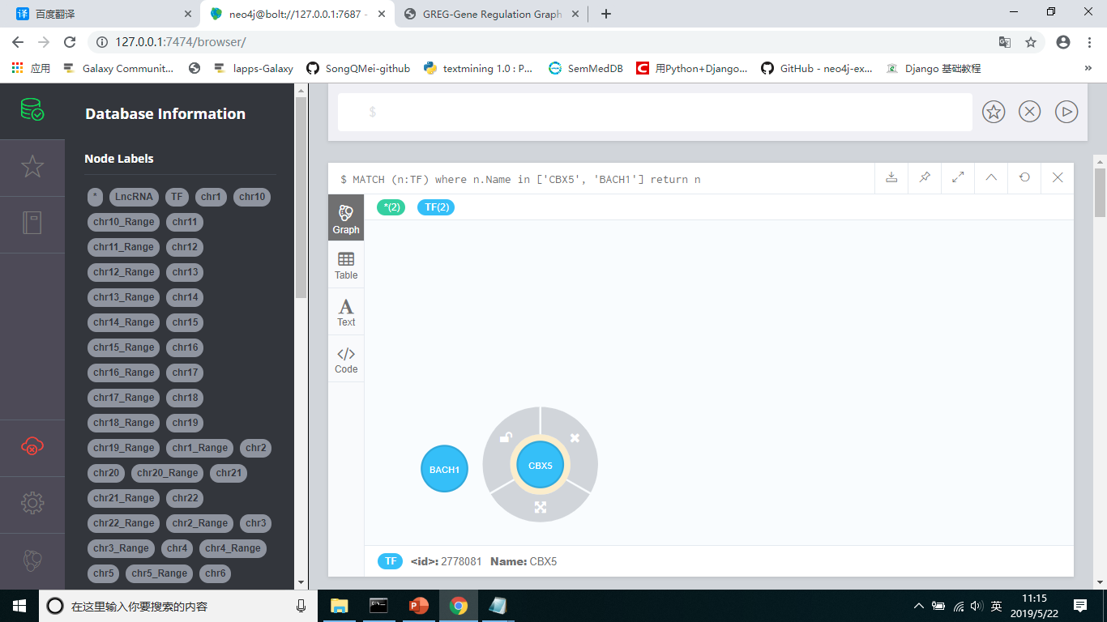
Examples
1、Retrieve all nodes and relationships:
If we want to retrieve more than one TF by property(name) . We must use the command “in”。
MATCH (n:TF) where n.Name in [ 'CBX5', 'BACH1' ] return n

Slide 22
Examples
1、Retrieve all nodes and relationships:
TF’s name is begin with Letter A
MATCH (n:TF) where n.Name =~ 'A.*' RETURN n
TF’s name is have Letter A
MATCH (n:TF) where n.Name =~ '.*A.*' RETURN n
TF’s name is end with Letter A
MATCH (n:TF) where n.Name =~ '.*A’ RETURN n

Slide 23
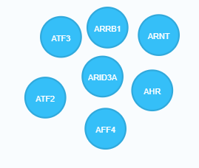
Examples
1、Retrieve all nodes and relationships:
MATCH (n:TF) where n.Name =~ 'A.*' RETURN n
=~ : Represents that the following value is a regular expression

Slide 24
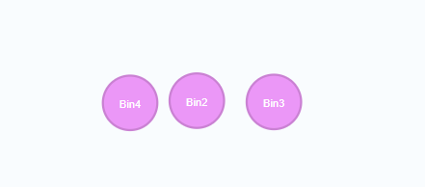
1、Retrieve nodes :
GREG can be used to query all the information associated to a given genomic range in a specific chromosome
MATCH (n:chr10)
where toInteger(n.Start)>1000 and toInteger(n.End)<10000
RETURN n

Slide 25
2、Retrieve relationships:
GREG can be used to query all the information associated to a Relation type in a specific nodes
For example:
MATCH p=(n: TF)-[r:Bind]->() RETURN p
This Command will retrive all TF Binding to Protien.

Slide 26
2、Retrieve relationships:
Actuelly, we always qury Relationship information for a specific TF or genomic range…….
For example:
MATCH p=(n: TF {Name:’BCL3’})-[r:Bind]->(m:chr3) RETURN p limit 25

Slide 27
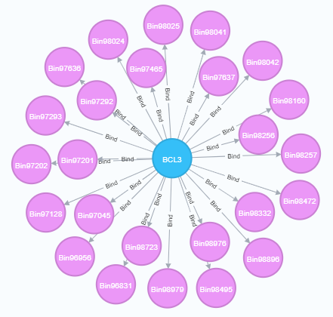
2、Retrieve relationships:
Actuelly, we always qury Relationship information for a specific TF or genomic range…….
For example:

Slide 28
2、Retrieve relationships:
Actuelly, we also can qury Relationship information for a specific TF in a specific genomic range…….
For example:
MATCH p=(n: TF {Name:'BCL3'})-[r:Bind]->(m:chr3)
where toInteger(m.Start)>194000000 and toInteger(m.End)<195000000
RETURN p

Slide 29
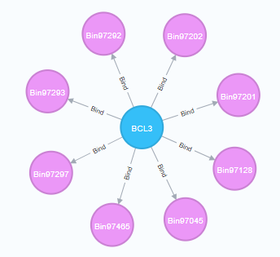
2、Retrieve relationships:

Slide 30
2、Retrieve relationships:
we can qury more then one Relationship information for a specific TF in a specific genomic range…….
For example:
MATCH p= (n: TF {Name:'BCL3'})-[r:Bind]->(m:chr3)-[]->(m2:chr3_Range) -[r2:Interaction]->(m3:chr3_Range)
where toInteger(m.Start)>194000000 and toInteger(m.End)<195000000
return p

Slide 31
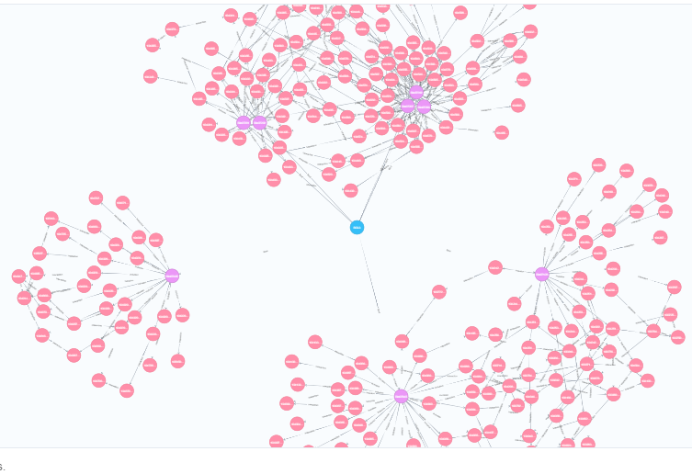
2、Retrieve relationships:

Slide 32


