Slide 1
Galaxy-GSA tools report
Xiaowei
2021.1.14

Slide 2
Content
GMT/GeneSet download from KEGG/Msigdb
SPIA tool
GSVA tool

Slide 3

GMT/GeneSet download from KEGG/MSigDB
h: hallmark gene sets
c1: positional gene sets
c2: curated gene sets
c3: regulatory target gene sets
c4: computational gene sets
cancer gene neighborhoods
cancer modules
c5: Ontology gene sets
GO biological processes
GO cellular components
GO molecular functions
Human Phenotype Ontology
c6: oncogenic signature gene sets
c7: immunologic signature gene sets
c8: cell type signature gene sets
chemical and genetic perturbations
all canonical pathways
BioCarta
KEGG
PID
Reactome
WikiPathways
C2
MIRDB targets
legacy microRNA targets
all transcription factor targets
GTRD targets
legacy transcription factor targets
C3
https://www.gsea-msigdb.org/gsea/msigdb

Slide 4

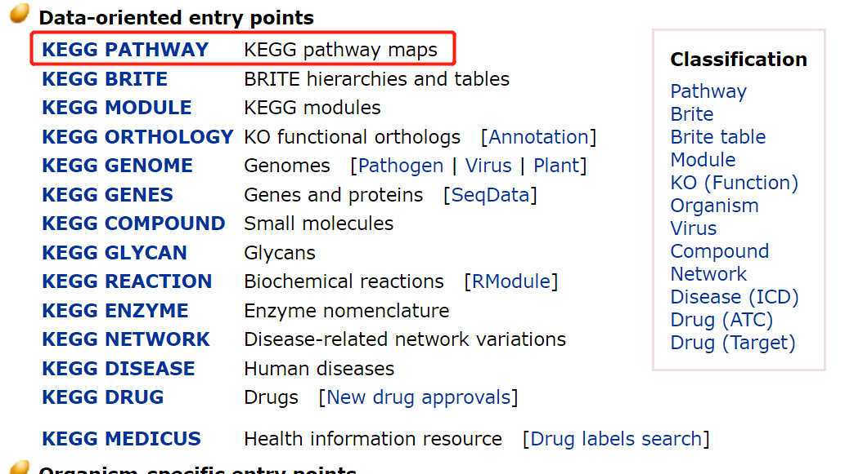
GMT/GeneSet download from KEGG/MSigDB
https://www.kegg.jp/kegg/pathway.html

Slide 5
GMT/GeneSet download from KEGG/MSigDB
#download pathway from kegg
KEGGREST::keggGet()
#download gene sets from MSigDB
msigdbr::msigdbr()
Library(GSEABase)
GeneSet() #build geneSet object
GeneSetCollection() #build geneSetCollection object
toGmt() #save as GMT file

Slide 6
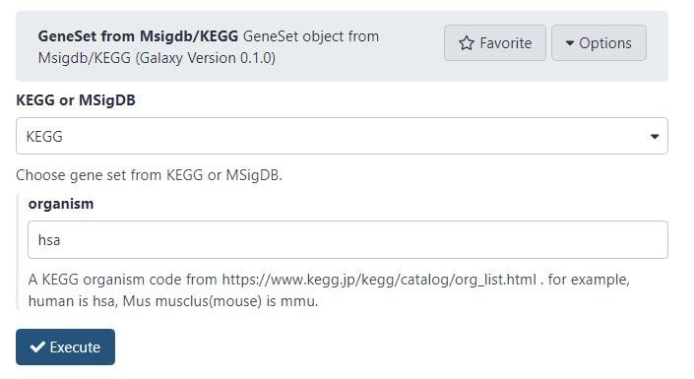
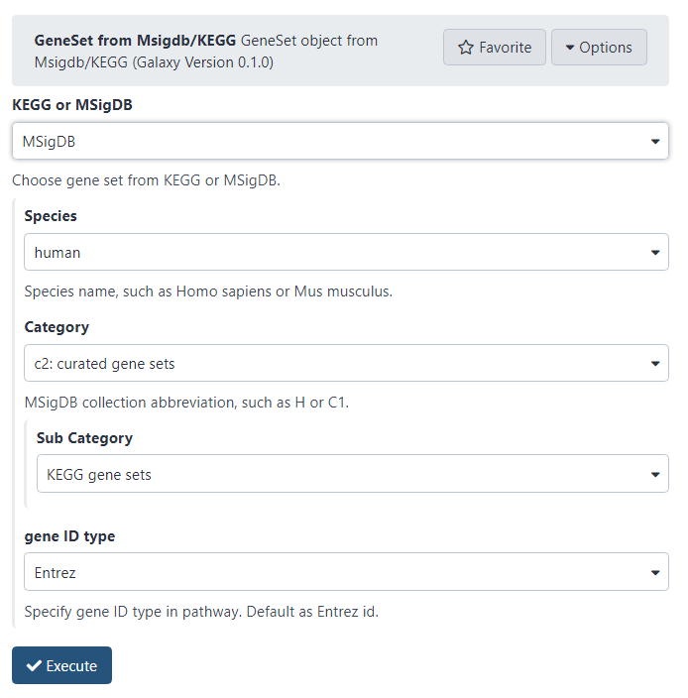
GMT/GeneSet download from KEGG/MSigDB

Slide 7
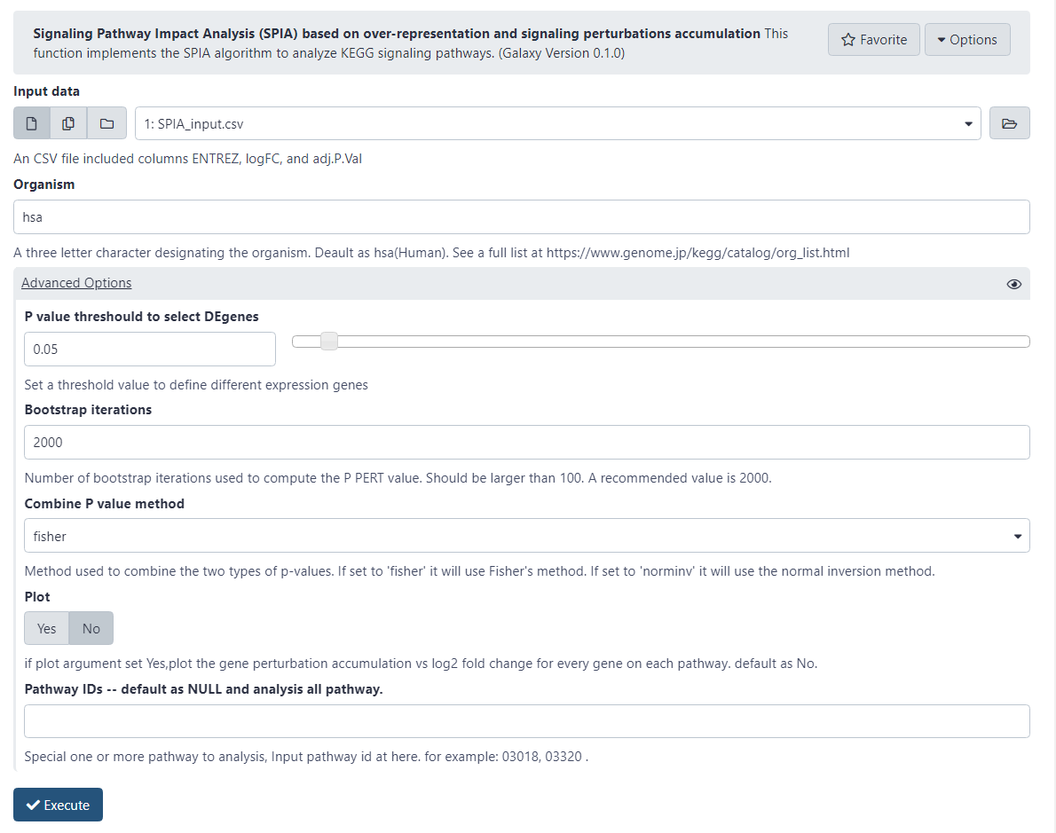
SPIA tool

Slide 8
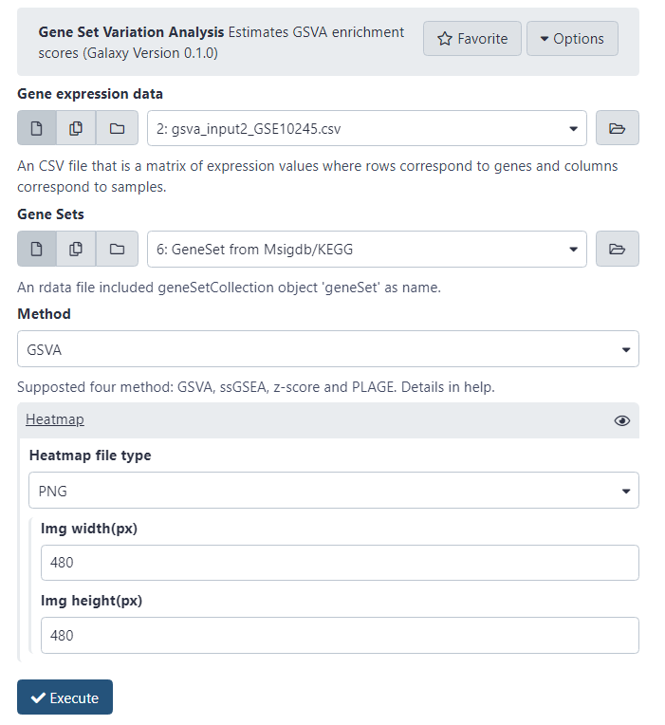
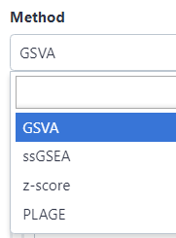
GSVA tool

Slide 9
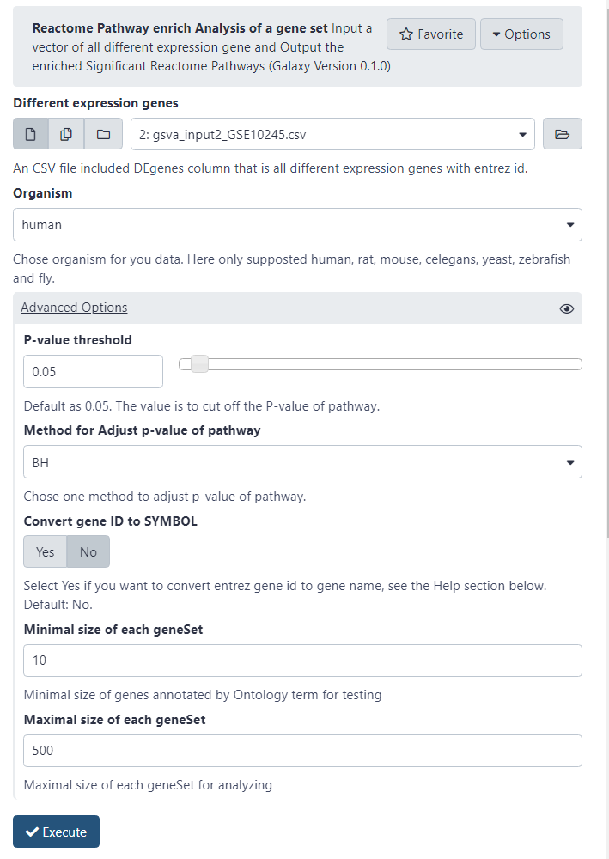
ReactomePA tool

Slide 10
Thank you!

