Slide 1
Project Report
Xiaowei
2020.1.10

Slide 2
DIFFERENTIATION-DB
Dynamic GSA review
DYPER
Others

Slide 3
Diffrentiation-DB
http://10.168.119.229:7474/browser/
gene1
WGCNA
gene2
day3Weight: 0.2974
day5Weight: 0.3789
day8Weight: 0.4012
relationship: 111
belong
belong
PGRType: 111
PGRType: 111
pahtway1
pahtway2
Description: Cytokine-cytokine receptor interaction
ID: mmu04060

Slide 4

relationship: 111
PGRType: 111
111
YES
day3
day5
day8
NO
000

Slide 5
Respectively for day3, day5 and day8
Expression Data
limma
Different expression genes
WGCNA
clusterProfiler
Enrich KEGG
relationships
pathway

Slide 6
Shiny App
https://github.com/xiaowei3223/neo4j_time_course_shiny

Slide 7
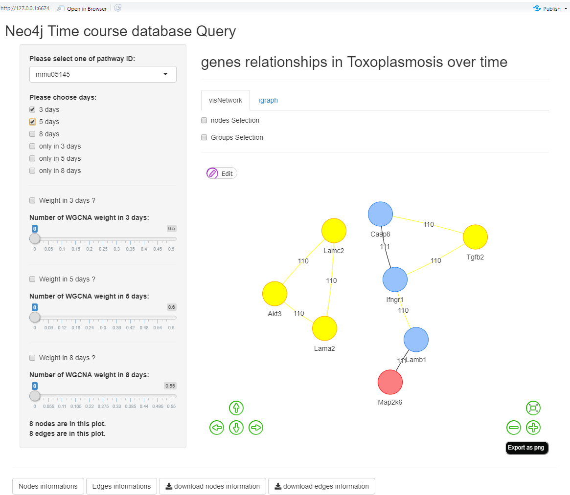

Slide 8
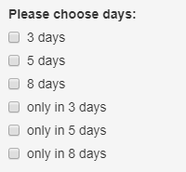
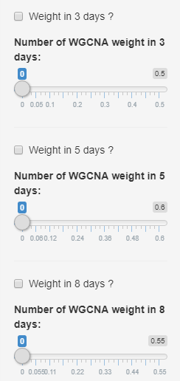
Genes relationships in a pathway
in the whole database
CASE 1
in one to three time points
±
weights bigger than one number
CASE 2
Notes:
Genes relationships in a pathway in the whole database.
Genes relationships in a pathway in one to three time points
Genes relationships weights bigger than one number in a pathway

Slide 9
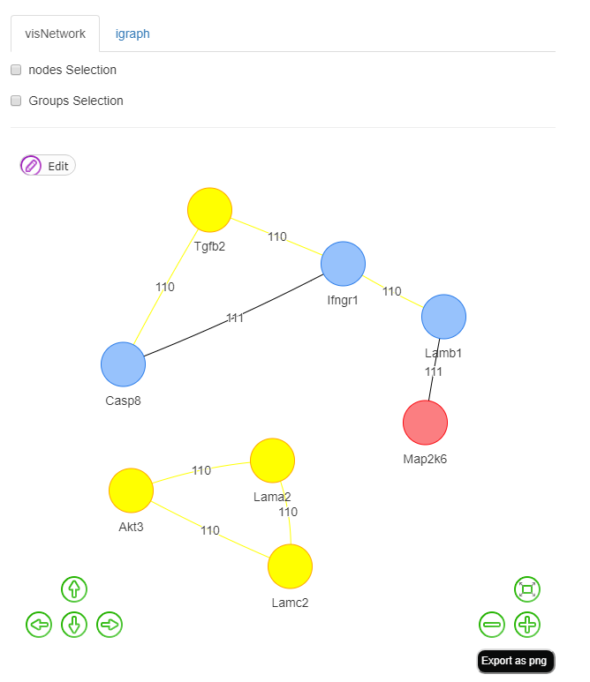
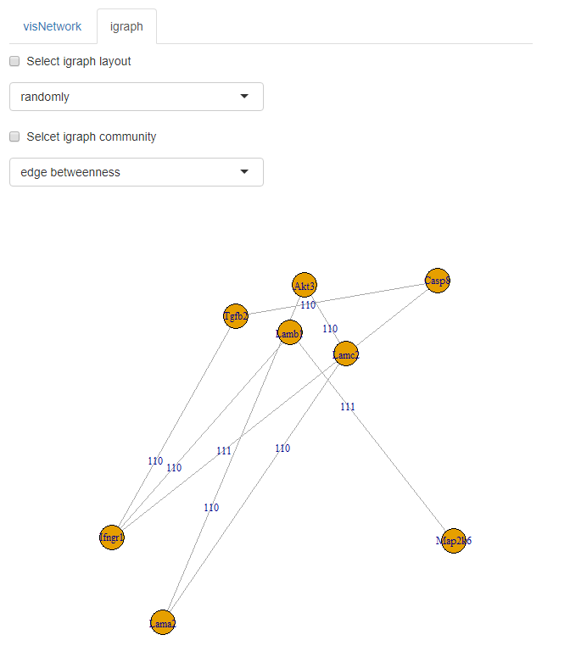
Plot
visNetwork
igraph
Export graph
Edit plot (Add or remove nodes/edges)
Nodes/group Selection
Igraph layout
Igraph community

Slide 10

Cluster
Make cluster via cypher in neo4j
❌
Plot genes relationships in R
Time more than 5 minutes
Relationships up to 929158
Rstudio crash fault

Slide 11
Dynamic GSA

Slide 12
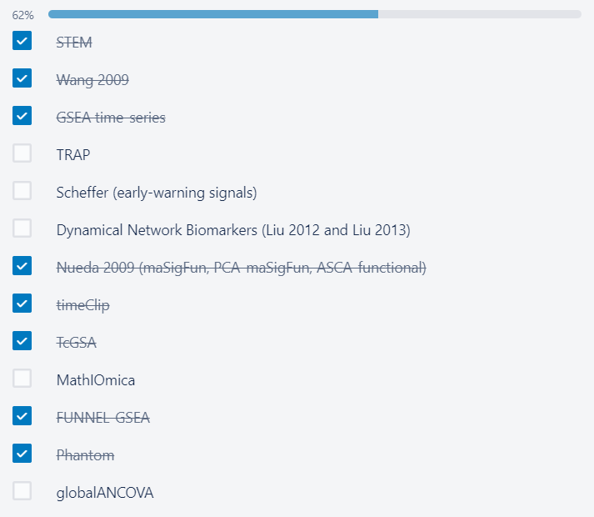
TRAP assumes that there are two time series from control and treatment samples.
For time-course data to be properly modeled by functional data analysis techniques, we in general recommend >7 time points.
In general, we recommend to conduct the analysis in individual replicate and then combine the p-values using some meta data analysis techniques, such as Fisher’s p-value combination (as we did in the paper)

Slide 13
Global ANCOVA
test on phenotype effects and gene-phenotype interaction.
Likelihood ratio approach
For categorical variables (e.g. SNPs) and even mixed data
Closed and hierarchical testing procedures in testing many groups
the experiment-wise error rate equals the required level of
confidence of the overall test

Slide 14
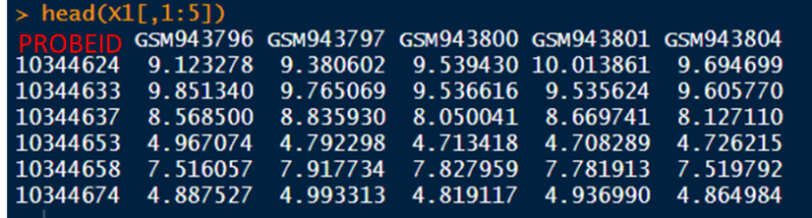
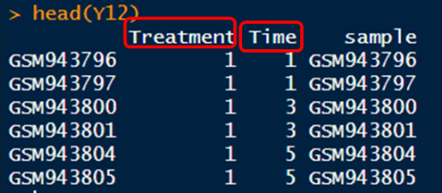
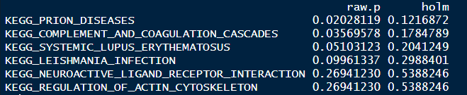
Expression data
Phenotype
X1
Y12
KEGG geneset
broad<- getGmt("c2.cp.kegg.v7.0.symbols.gmt",
collectionType = BroadCollection(category="c2"),
geneIdType = SymbolIdentifier())
GABroad(xx=X1,
formula.full=~Treatment*Time, formula.red=~Treatment+Time,
model.dat=Y12, collection=broad,
annotation='mogene10sttranscriptcluster')
Results

Slide 15
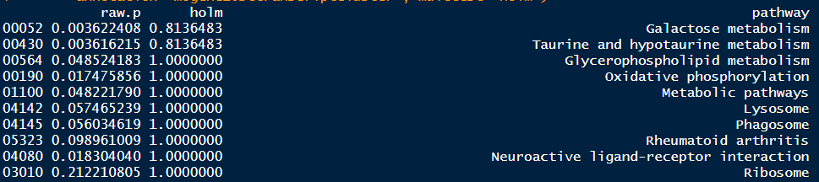
GAKEGG(xx=X1,
formula.full=~Treatment*Time, formula.red=~Treatment+Time,
model.dat=Y12,
annotation='mogene10sttranscriptcluster', multtest="holm")
Results
The method of multiple testing correction.
BH: Benjamini and Hochberg FDR control
BY: Benjamini and Yekutieli FDR control
holm: Holm familywise error control

Slide 16
Both way made different results, one is only 6 pathway, but broad object include 186 pathway. I used data of DyPER project we used.
Why only 6 pathway?
And GAKEGG result included 225 pathway.
Why GAKEGG functions will get different results when we used same data?

Slide 17
DYPER

Slide 18
Pipeline of DYPER
Dataset selection
(GSE36221)
Data Analysis
TcGSA
GSVA
Single sample Methods
Naive Methods
Dynamic Methods
Phantom
Comparison of results

Slide 19
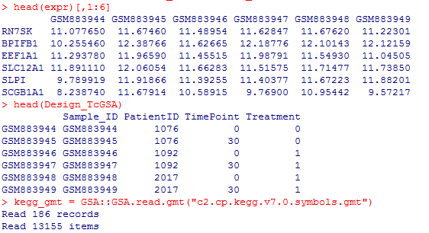
TcGSA
Using TcGSA need argument that are
a matrix or dataframe of gene expression,
gmt object,
and a matrix or dataframe containing the expermental variables.
gene expression dataframe
design of experiment
gmt object

Slide 20
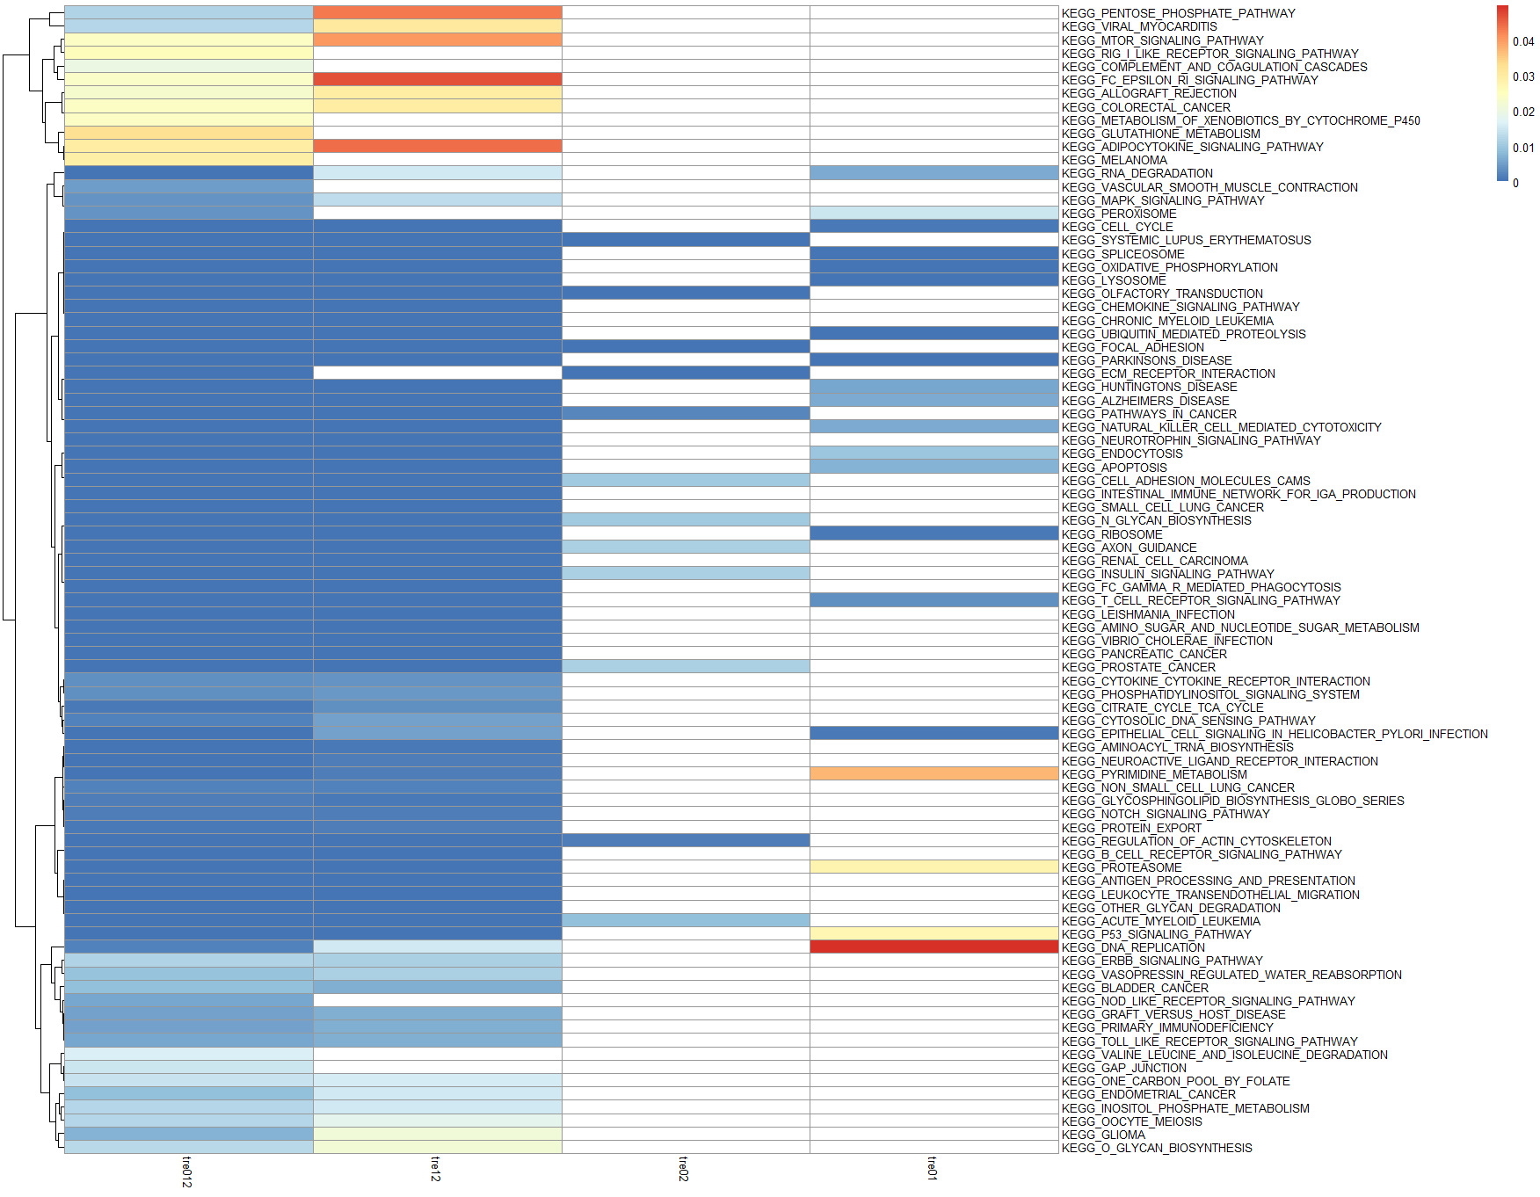
TcGSA
Varible | compare | number of Significant pathways
tre01 | treatment 1 VS treatment 0 | 20
tre02 | treatment 2 VS treatment 0 | 12
tre12 | treatment 1 VS treatment 2 | 75
tre012 | treatment 0 VS treatment 1 VS treatment 2 | 86
This plot made from all P values for significant pathways in each comparing varibles.
In this plot, white cell means it not had this significant pathway for p ≤ 0.05.

Slide 21
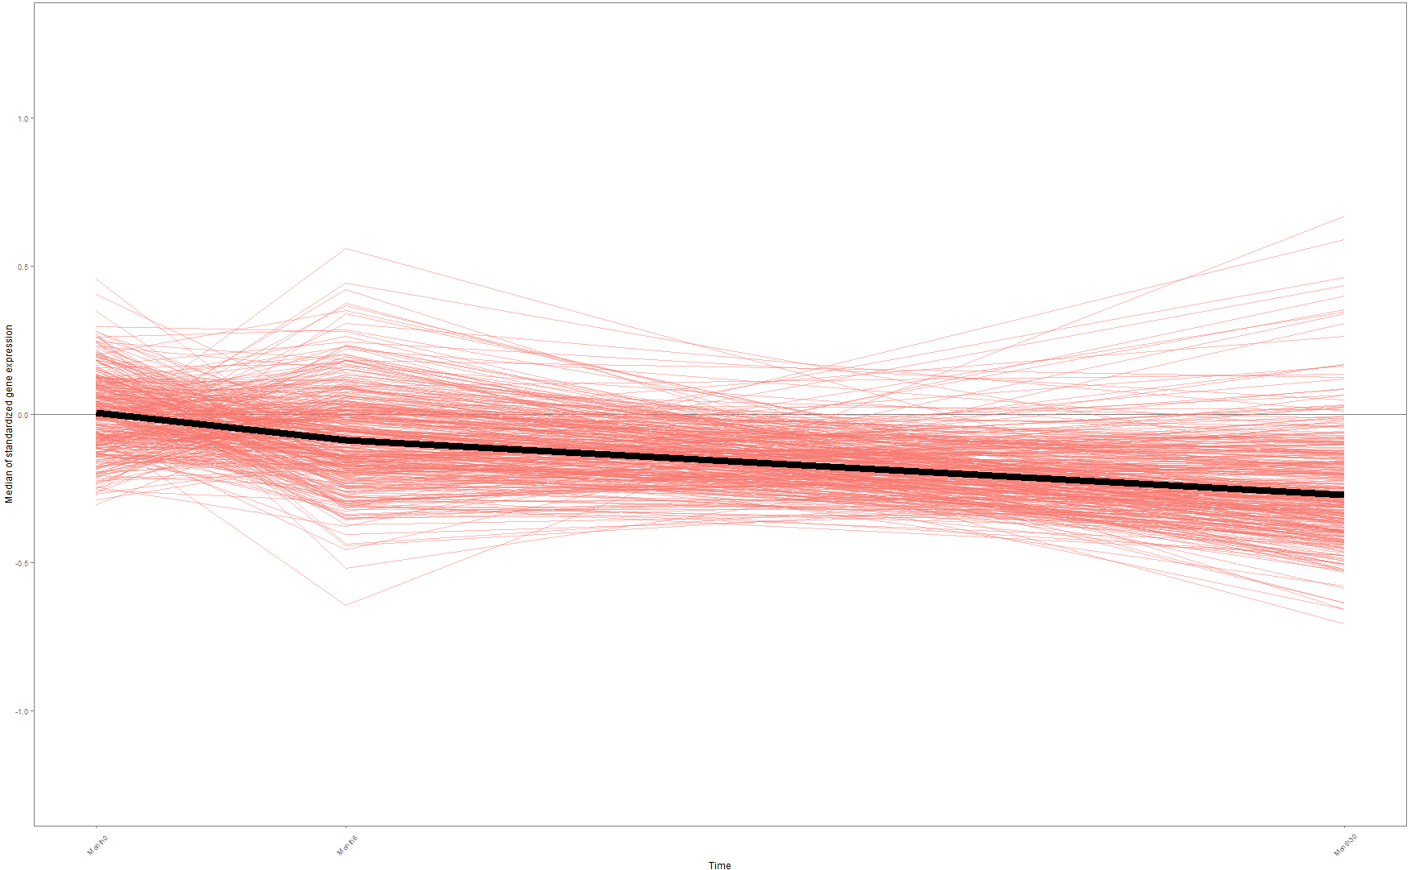
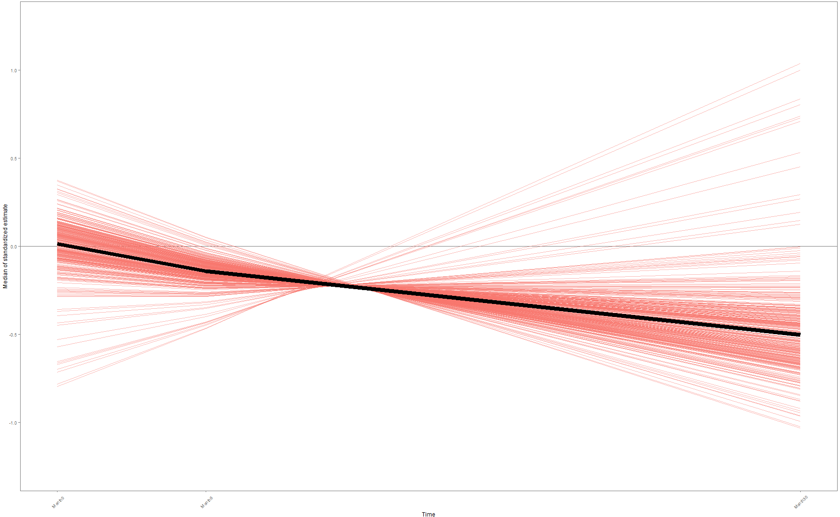
TcGSA
We use genes in the tre012 dataset in KEGG OLFACTORY TRANSDUCTION pathway as an example to plot genes expression in each time, because this pathway had minimum P value in TcGSA result for tre012.
KEGG OLFACTORY TRANSDUCTION
made from raw expression data
made from TcGSA estimations data

Slide 22

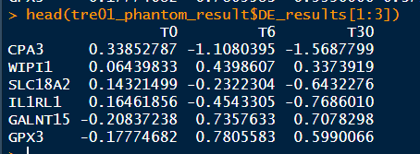
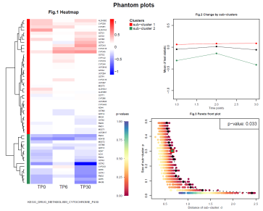
Phantom
Expression Data
genesets
limma
genesets
Different expression genes
run phantom batch analysis
run phantom batch analysis
run.phantom.batch(data = as.matrix(DE_results[,1:3]),
geneset_list = geneset_phantom,maxncluster = 5,
nsample = 1000, report_pval = 0.05, report_nmin = 5,
output_dir = file_path)
result
results are a set of plots.

Slide 23
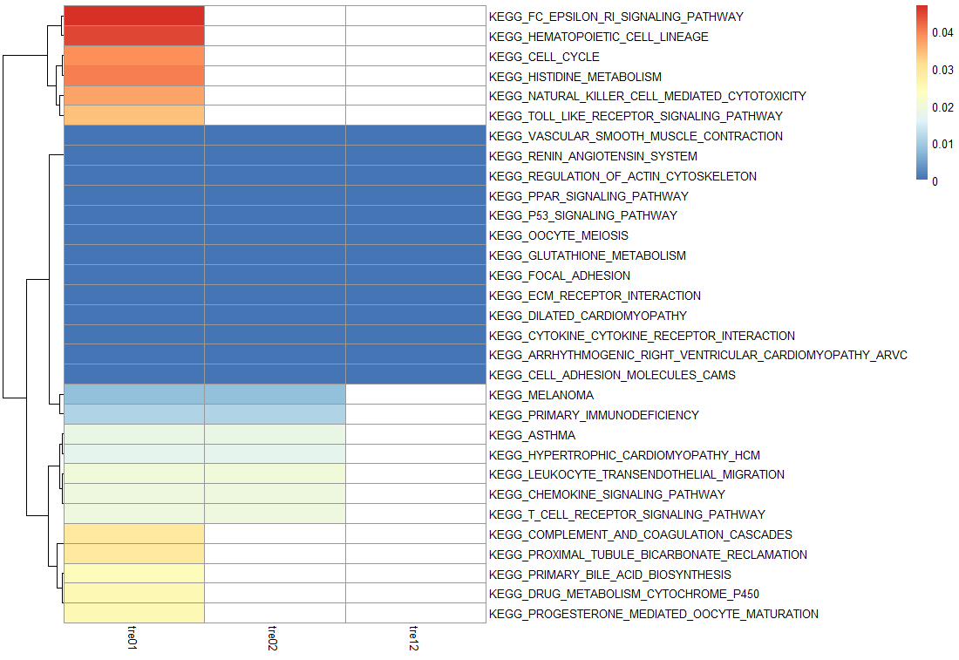
Phantom
Varible | compare | number of Significant pathways
tre01 | treatment 1 VS treatment 0 | 31
tre02 | treatment 2 VS treatment 0 | 20
tre12 | treatment 1 VS treatment 2 | 13
This plot made from all P values for significant pathways in each comparing varibles.
In this plot, white cell means it not had this significant pathway for p ≤ 0.05.

Slide 24
Others

Slide 25
Linux learning:
small_bin: http://10.168.119.229:9005/browser/ big_bin: http://10.168.119.229:9000/browser/
How to install neo4j in our server
https://nbviewer.jupyter.org/github/xiaowei3223/database/blob/master/neo4j_install_in_linux/neo4j%20installed%20in%20linux%20database.ipynb

Slide 26
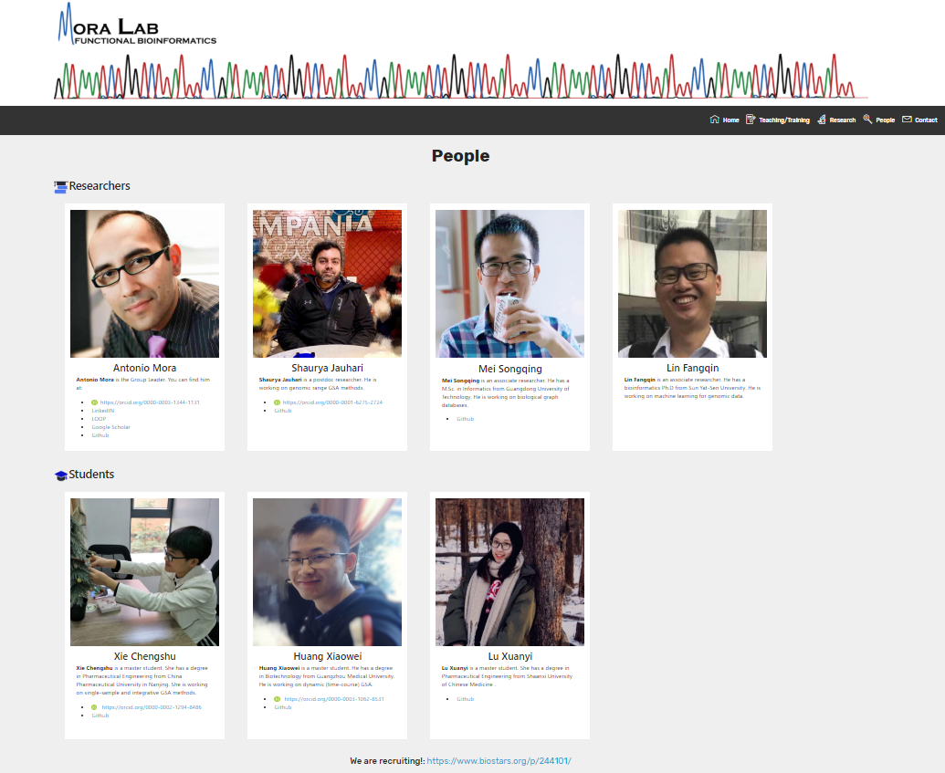
Website building:
https://mora-lab.github.io/Our_team.html

Slide 27
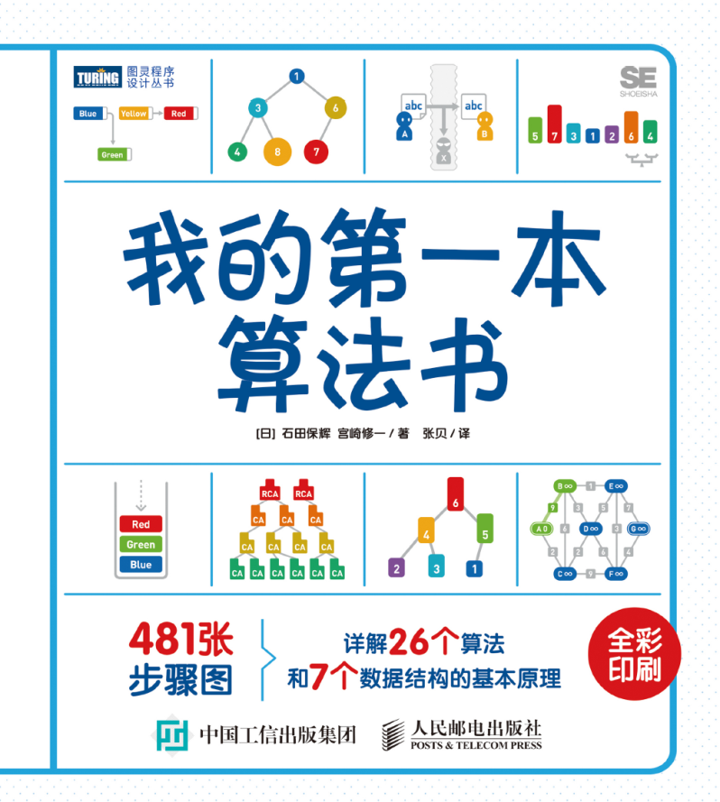
Read algorithm book
How to order data?
Search in graph?
Search in array
Security algorithm
K-mean cluster
Euclidean algorithm
……
For learning how make small cluster in neo4j database……

Slide 28

Start learn JAVA
Lab website
Java Script
Update GREG
Java project

Slide 29


