Slide 1
Index | Sepal Length | Sepal Width | Pedal Length | Pedal Width | Iris Class
1 | 5.1 | 3.5 | 1.4 | 0.2 | 0
2 | 4.9 | 3.0 | 1.4 | 0.2 | 0
3 | 4.6 | 3.4 | 1.4 | 0.3 | 0
4 | 5.4 | 3.9 | 1.7 | 0.4 | 0
5 | 4.3 | 3.0 | 1.1 | 0.1 | 0
6 | 7.0 | 3.2 | 4.7 | 1.4 | 1
7 | 6.9 | 3.1 | 4.9 | 1.5 | 1
8 | 6.3 | 3.3 | 4.7 | 1.6 | 1
9 | 4.9 | 2.4 | 3.3 | 1.0 | 1
10 | 6.3 | 3.3 | 6.0 | 2.5 | 2
11 | 5.8 | 2.7 | 5.1 | 1.9 | 2
12 | 7.1 | 3.0 | 5.9 | 2.1 | 2
13 | 5.8 | 2.8 | 5.1 | 2.4 | 2
14 | 6.4 | 2.7 | 5.3 | 1.9 | 2

Slide 2
Index | Sepal Length | Sepal Width | Pedal Length | Pedal Width | Iris Class
1 | 5 | 3 | 1 | 0.5 | 0
2 | 4 | 3 | 1 | 0.5 | 0
3 | 4 | 3 | 1 | 0.5 | 0
4 | 5 | 3 | 1 | 0.5 | 0
5 | 4 | 3 | 1 | 0.5 | 0
6 | 7 | 3 | 4 | 1 | 1
7 | 6 | 3 | 4 | 1 | 1
8 | 6 | 3 | 4 | 1 | 1
9 | 4 | 2 | 3 | 1 | 1
10 | 6 | 3 | 6 | 2 | 2
11 | 5 | 2 | 5 | 2 | 2
12 | 7 | 3 | 5 | 2 | 2
13 | 5 | 2 | 5 | 2 | 2
14 | 6 | 2 | 5 | 1 | 2

Slide 3
Day | Outlook | Temperature | Humidity | Wind | PlayTennis
D1 | Sunny | Hot | High | Weak | No
D2 | Sunny | Hot | High | Strong | No
D3 | Overcast | Hot | High | Weak | Yes
D4 | Rain | Mild | High | Weak | Yes
D5 | Rain | Cool | Normal | Weak | Yes
D6 | Rain | Cool | Normal | Strong | No
D7 | Overcast | Cool | Normal | Strong | Yes
D8 | Sunny | Mild | High | Weak | No
D9 | Sunny | Cool | Normal | Weak | Yes
D10 | Rain | Mild | Normal | Weak | Yes
D11 | Sunny | Mild | Normal | Strong | Yes
D12 | Overcast | Mild | High | Strong | No
D13 | Overcast | Hot | Normal | Weak | Yes
D14 | Rain | Mild | High | Strong | No

Slide 4
z
z
y₁
y₂
x₁
y₁
y₂
x₁
x₂
x₃
x₂
x₃

Slide 5
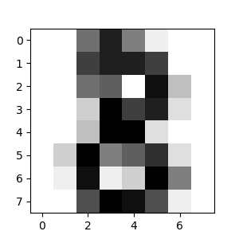

Slide 6

Feature Extractor
Trainable Classifier
Panda
Trainable Feature Extractor & Classifier
Panda

Slide 7
Layer 1
Layer 2
Layer 1
Layer 2
w_{21,11}
w_{22,11}
w_{21,12}
w_{22,12}
w_{21,13}
w_{22,13}
w_{21,14}
w_{22,14}
w_{21,15}
w_{22,15}
w_{21,16}
w_{22,16}

Slide 8
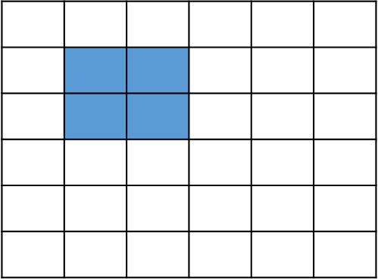



Slide 9
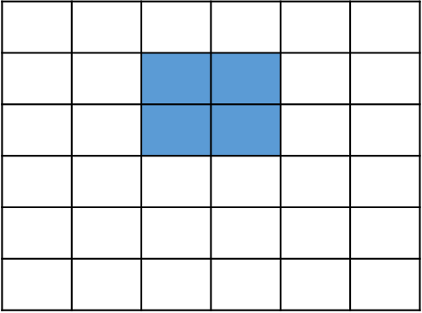
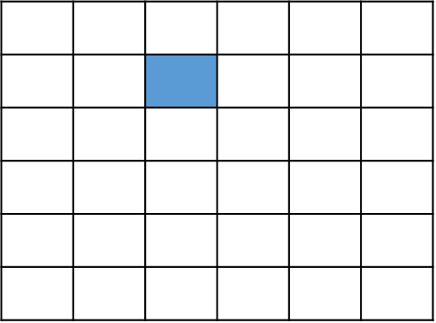

Slide 11
0 | 0 | 0 | 0 | 0 | 0
0 | 4 | 0 | 1 | 7 | 0
0 | 5 | 6 | 9 | -5 | 0
0 | -3 | 8 | 3 | 6 | 0
0 | 2 | -2 | -1 | 4 | 0
0 | 0 | 0 | 0 | 0 | 0
4 | 0 | 1 | 7
5 | 6 | 9 | -5
-3 | 8 | 3 | 6
2 | -2 | -1 | 4

Slide 12
input
4 | 0 | 1 | 7
5 | 6 | 9 | -5
-3 | 8 | 3 | 6
2 | -2 | -1 | 4
filter
7 | -3
5 | 2

Slide 13
Y
Y
X₁
X₂
X_{n}
X₁
X₂
X_{n}
…
…
Usual Classification
Naïve Bayes

Slide 14
X | Y | P(X,Y)
x⁰ | y⁰ | 0.08
x⁰ | y¹ | 0.32
x¹ | y⁰ | 0.12
x¹ | y¹ | 0.48
X
X
X
Y
Y
Y
G₀
G₁
G₂

Slide 15
I
i₀ | i₁
0.7 | 0.3
 | g₁ | g₂ | g₃
i₀ | 0.2 | 0.34 | 0.46
i₁ | 0.74 | 0.17 | 0.09
 | s₀ | s₁
i₀ | 0.95 | 0.05
i₁ | 0.2 | 0.8
G
S

Slide 16
X | Y | Z | P(X,Y,Z)
x₀ | y₀ | z₀ | 0.02
x₀ | y₁ | z₀ | 0.08
x₁ | y₀ | z₀ | 0.03
x₁ | y₁ | z₀ | 0.12
x₀ | y₀ | z₁ | 0.06
x₀ | y₁ | z₁ | 0.24
x₁ | y₀ | z₁ | 0.09
x₁ | y₁ | z₁ | 0.36
X | Y | Z | P(X,Y,Z)
x₀ | y₀ | z₀ | 0.01
x₀ | y₁ | z₀ | 0.04
x₁ | y₀ | z₀ | 0.015
x₁ | y₁ | z₀ | 0.06
x₀ | y₀ | z₁ | 0.07
x₀ | y₁ | z₁ | 0.28
x₁ | y₀ | z₁ | 0.105
x₁ | y₁ | z₁ | 0.42
(a)
(b)

Slide 17
A
P(B|A)
 | b⁰ | b¹
a⁰ | 0.1 | 0.9
a¹ | 0.4 | 0.6
P(A)
a⁰ | a¹
0.7 | 0.3
B

Slide 18
8
7
6
5
X₂
4
3
2
1
0
1
2
3
4
5
6
7
8
9
10
X₁

Slide 19
Camera
Radar
Fog
Detected
Away
Stopped

Slide 20
Camera
Radar
c₀ | c₁
0.6 | 0.4
r₀ | r₁
0.5 | 0.5
Fog
Detected
Away
 | f₀ | f₁
c₀ | 0.5 | 0.5
c₁ | 0.3 | 0.7
 | d₀ | d₁
c_{0,} r₀ | 1.0 | 0.0
c_{0,} r₁ | 0.6 | 0.4
c_{1,} r₀ | 0.7 | 0.3
c_{1,} r₁ | 0.1 | 0.9
 | a₀ | a₁
r₀ | 0.2 | 0.8
r₁ | 0.6 | 0.4
Stopped
 | s₀ | s₁
d_{0,} a₀ | 0.6 | 0.4
d_{0,} a₁ | 0.9 | 0.1
d_{1,} a₀ | 0.1 | 0.9
d_{1,} a₁ | 0.5 | 0.5

Slide 21
c₀ | c₁
0.6 | 0.4
r₀ | r₁
0.5 | 0.5
Camera
Radar
 | f₀ | f₁
c₀ | 0.5 | 0.5
c₁ | 0.3 | 0.7
 | a₀ | a₁
r₀ | 0.2 | 0.8
r₁ | 0.6 | 0.4
Fog
Detected
Away
 | d₀ | d₁
c_{0,} r₀ | 1.0 | 0.0
c_{0,} r₁ | 0.6 | 0.4
c_{1,} r₀ | 0.7 | 0.3
c_{1,} r₁ | 0.1 | 0.9
 | s₀ | s₁
d_{0,} a₀ | 0.6 | 0.4
d_{0,} a₁ | 0.9 | 0.1
d_{1,} a₀ | 0.1 | 0.9
d_{1,} a₁ | 0.5 | 0.5
Stopped

Slide 22
X
Y
Z
Z
Z
X
Y
Y
X
X
Y
Z

Slide 23
X
Camera
Radar
Z
Fog
Detected
Away
Y
Stopped

Slide 25
Camera
Radar
Z
Fog
Detected
Away
X
Y
Stopped

Slide 26
Camera
Radar
Z
Fog
Detected
Away
X
Y
Stopped

