Slide 1




EDSF: FAST AND ACCURATE ELLIPSE DETECTION VIA DISJOINT-SET FOREST
Jingen Jiang*^{1,2} Mingyang Zhao*^{1,3} Zeyu Shen^{2,4} Dong-Ming Yan^{1,2}
¹ NLPR, Institute of Automation, Chinese Academy of Sciences, Beijing, China
² School of Artificial Intelligence, University of Chinese Academy of Sciences, Beijing, China
³ Beijing Academy of Artificial Intelligence, Beijing, China
⁴ State Key Laboratory of Computer Science, Institute of Software, Chinese Academy of Sciences
Notes:
Hello, everyone. I am very glad to report our research here.
My presentation is Fast and accurate ellipse detection via disjoint-set forest.
15

Slide 2
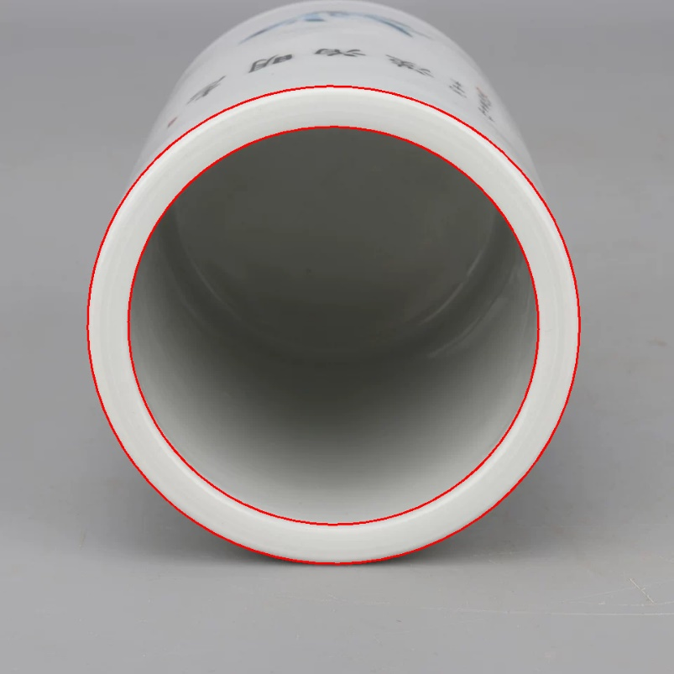
Problem Statement
Ellipse detection
Goals:
Find all ellipses
Estimate parameters
Criteria:
Quality
Precision, Recall, F-measure
Efficiency
Notes:
Given an input image,
the goal of ellipse detection is to find all the ellipses,
and estimate the elliptical parameters accurately.
Typically, we concern about two criteria,
the detection quality including
precision, recall and F-measure,
as well as the detection efficiency.
20

Slide 3
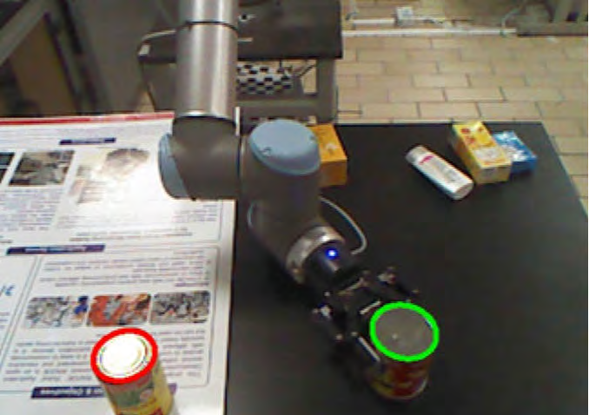
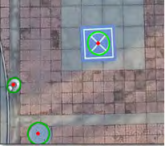
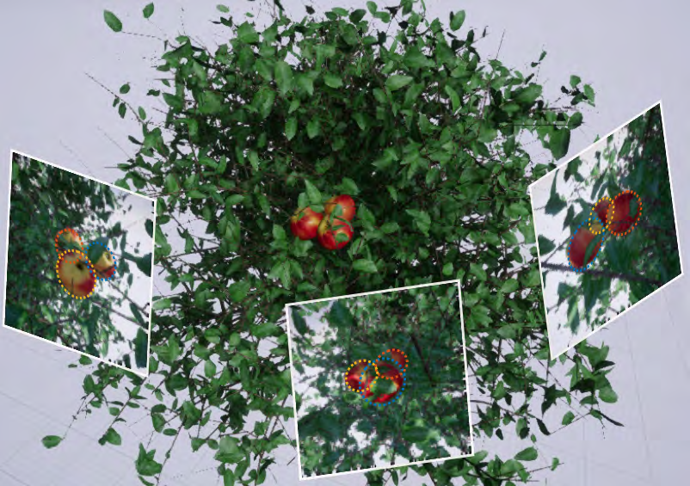
Applications
Robotic grabbing
Assisted positioning
3D reconstruction
Dong et al. 2018
Jin et al. 2019
Dong et al. 2020
Notes:
Ellipse detection has many applications in real life, such as Robotic grabbing, Assisted positioning, 3D reconstruction, and so on.
15

Slide 4
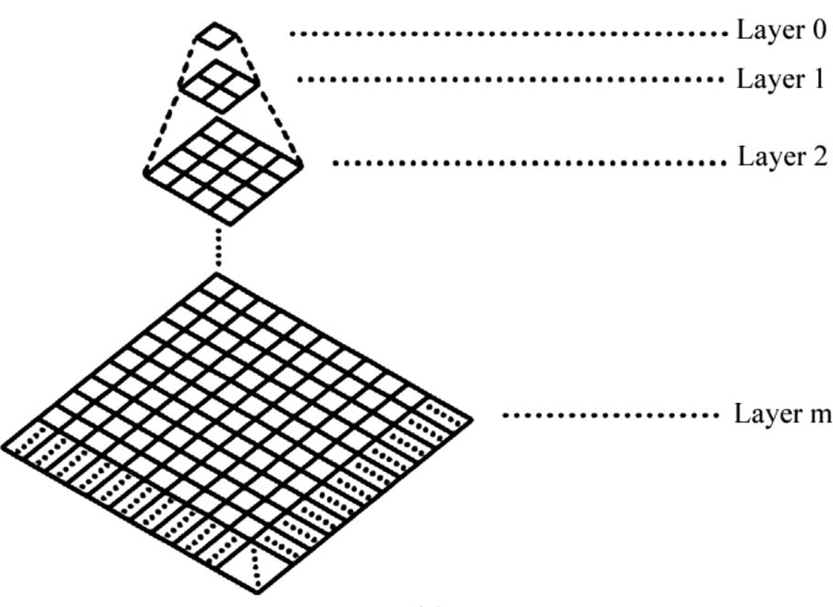
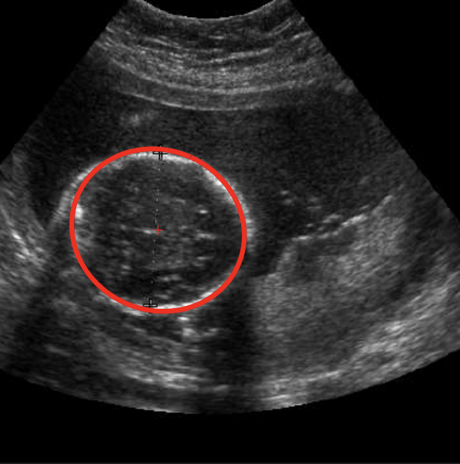
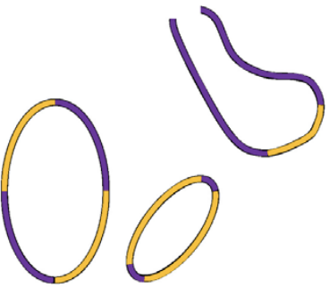
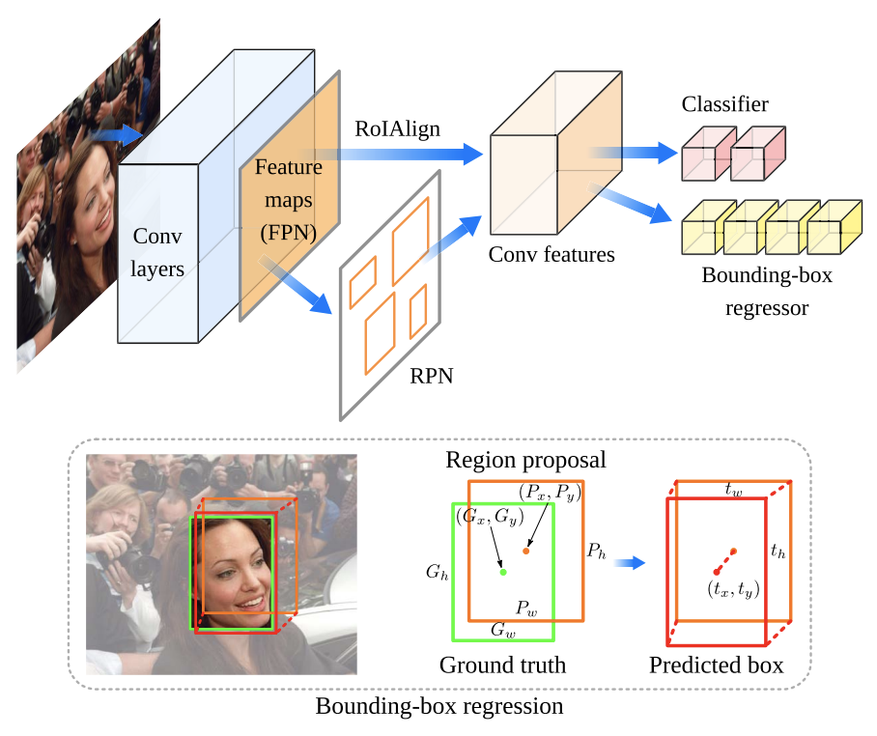
Related Work
Hough transform
Iterative
optimization
Edge
following
Deep learning
Voting
Peak searching
RANSAC
Genetic algorithm
Arc extraction
Arc grouping
Ellipse R-CNN
Chien et al. 2011
Sabo et al. 2020
Fornaciari et al. 2014
Dong et al. 2020
Notes:
Many methods have been proposed previously. They can be classified into four types.
the first one is Hough transform. Edge pixels are used to vote in the parameter space. Then the peaks of the voting histogram are found, which indicate the parameters with the highest probability.
The second type includes RANSAC and Genetic algorithm. Both methods require iterative optimization. Meanwhile, these methods only detect one ellipse at once, so they usually consume much time.
The third type is edge following based methods. These methods first detect arcs in the image, and then group the arcs that come from the same ellipse, followed by the estimation of the parameters via least-squares fitting or Hough transform.
There’re also deep learning-based methods. Ellipse R-CNN use a structure like Mask R-CNN for ellipse regression. This method can detect elliptic objects like fruits and human faces, however, it cannot estimate parameters precisely.
点一下，播放动画
In this work, we adopt the edge following framework for ellipse detection.
70

Slide 5
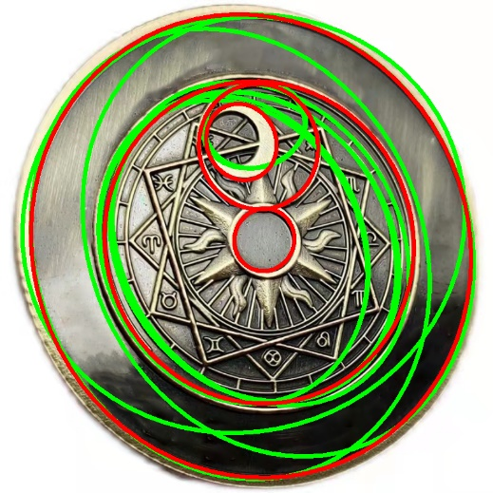
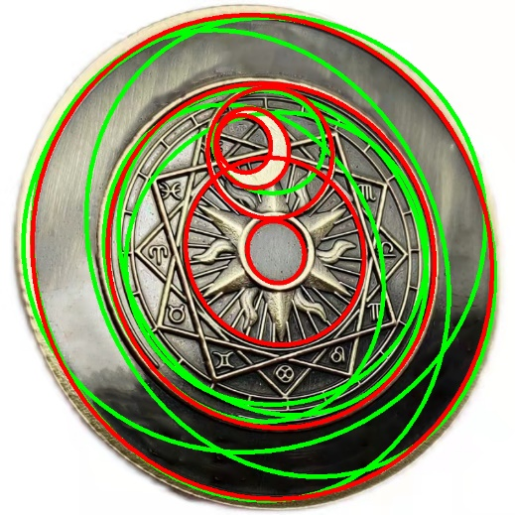
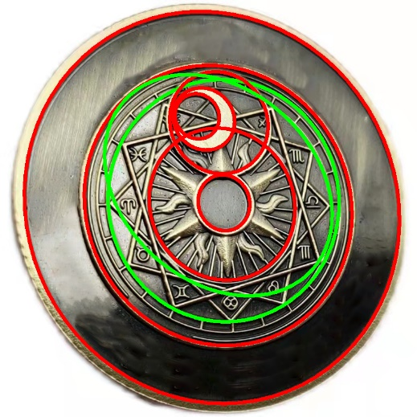
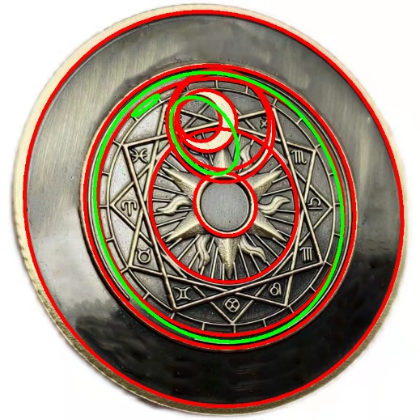
Motivation
True Ellipse
False Ellipse
Fornaciari et al. 2014
Jia et al. 2017
Meng et al. 2020
Shen et al. 2021
Problem : Incorrect and insufficient arc grouping
Notes:
The motivation of our work is that the performance of the SOTA methods degades significantly for multiple concentric ellipses.
As can be seen, these methods detect many false ellipses.
点一下 播放动画
We argue that the reason is from the incorrect and insufficient arc grouping.
15

Slide 6
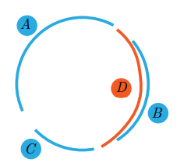
Analysis
The arc grouping order will affect the detection results
A
C
D
False ellipse
B
True ellipse
Single arc cannot fit the true ellipse well alone
Exhaustive grouping will lead to inefficient detection
We need an efficient data structure to store candidate ellipses and help arc clustering
Notes:
After analysis, we find that the arc grouping order will affect the detection results.
点一下，播放动画
If we first group arcs A，C，D together，then we will get a false ellipse
点一下，播放动画
and the left single arc B can not fit the true ellipse well alone
As a result, the true ellipse is lost and a false detection is generated.
点一下，播放动画
Of course, we can exhaust all arc grouping cases, however, this will lead to inefficient detection
点一下，播放动画
So, we need an efficient data structure to store candidate ellipses , meanwhile help the arc clustering process.
70

Slide 7
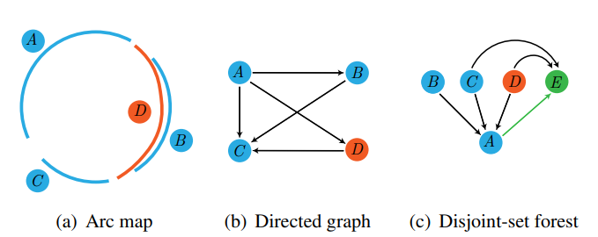
Arc Grouping by the Disjoint-Set Forest
Notes:
To this end, first, we convert the arc map into a directed graph., where each node corresponds to an arc in the arc map.
Two nodes are connected if they meet our four grouping constraints as presented next.
the directed edges are pointed from the longer arc to the shorter one.
The disjoint-set forest will be constructed during the arc grouping process.
30

Slide 8
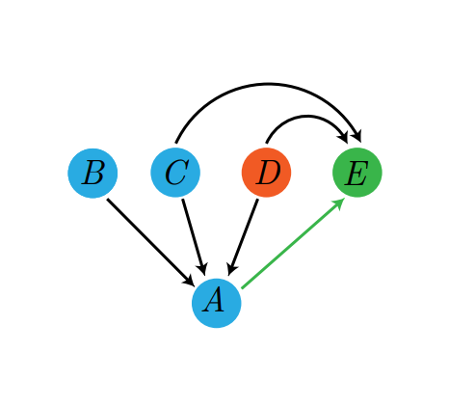
Arc Grouping by the Disjoint-Set Forest
Relationship
Parent-child
Brotherhood
Root
Two candidate ellipses
Notes:
Black arrows denote the parent-child relationship and green arrows denote the brotherhood relationship.
parent-child relationship helps us query the candidate ellipses that are generated by the arcs.
Brotherhood relationship helps us query the candidate ellipses which share the same arc.
点一下播放动画
There are two candidate ellipses in the figure.
30

Slide 9
Gradient Projection
Ground truth
overlap
False candidate ellipse
No supporting arc
Notes:
However, there are many false candidate ellipses.
Indeed, if the candidate ellipse is correct, then it will match well with the original ellipse in the image.
Two blue arcs fit the red candidate ellipse and the green is the ground truth.
However, most areas of the candidate ellipse have no supporting arc in the image.
20

Slide 10
Gradient Projection
Ellipse gradient
Pixel gradient
Ground truth
False candidate ellipse
Notes:
To depress false detections, we sample n points from the elliptical parameter equation.
Count the number of pixels that the angle between the ellipse and pixel gradients are less than a pre-defined threshold.
Then we will get a match score to distinguish if the candidate ellipse is true or false.
20

Slide 11
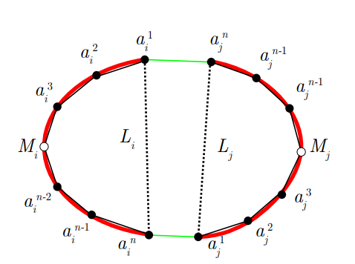
Grouping Constraints
Position constraint
chord
midpoint
Notes:
Next, I will introduce the four grouping constraints used in our directed graph construction.
The first constraint is position.
This constraint requires the midpoints of two arcs locating at the both sides of two arc’s chords.
This constraint indeed reflects the convexity of two elliptical arcs in the two half planes.
20

Slide 12
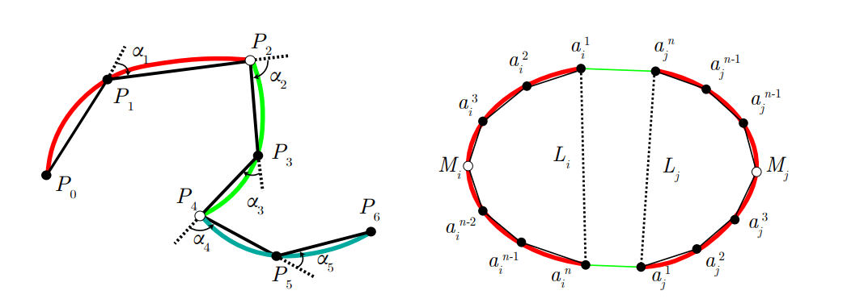
Grouping Constraints
Blending constraint
No inflection point
Inflection point
No inflection point
Notes:
The second one is blending constraint.
It requires no inflection point at the joint of two arc segments.
This constraint can reduce the concentric arcs for grouping
10

Slide 13



Grouping Constraints
Arc length constraint
Notes:
The third one is arc length constraint, which requires the length difference of two arcs below some threshold.
Because if the length difference of two arcs is too large, the long arc will play a dominant role among the fitting, which is almost the same as the long arc fitting alone, hence such a directed edge has little effect on the detection result.
20

Slide 14

Grouping Constraints
Distance constraint
too far away
Notes:
The last constraint is distance.
Due to the limited object shape in images, two arcs with large distance are less likely from the same ellipse.
10

Slide 15
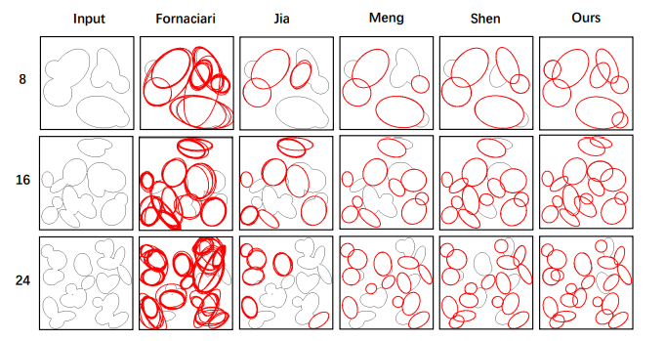
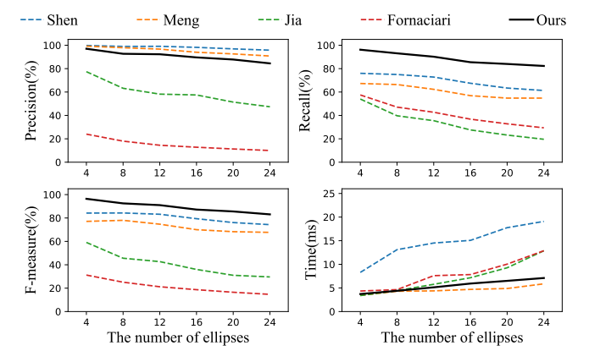
Results
Our method achieves the highest F-measure for occlusion ellipse detection
Notes:
We conduct many experiments to validate our method.
Incomplete ellipses are quite common in practical scenarios, which is one of the challenges in ellipse detection.
As observed, the proposed method attains comparable precision with Shen and Meng.
but We won the highest recall and F-measure, indicating that our method can find as many correct combinations of elliptic arcs as possible.
40

Slide 16
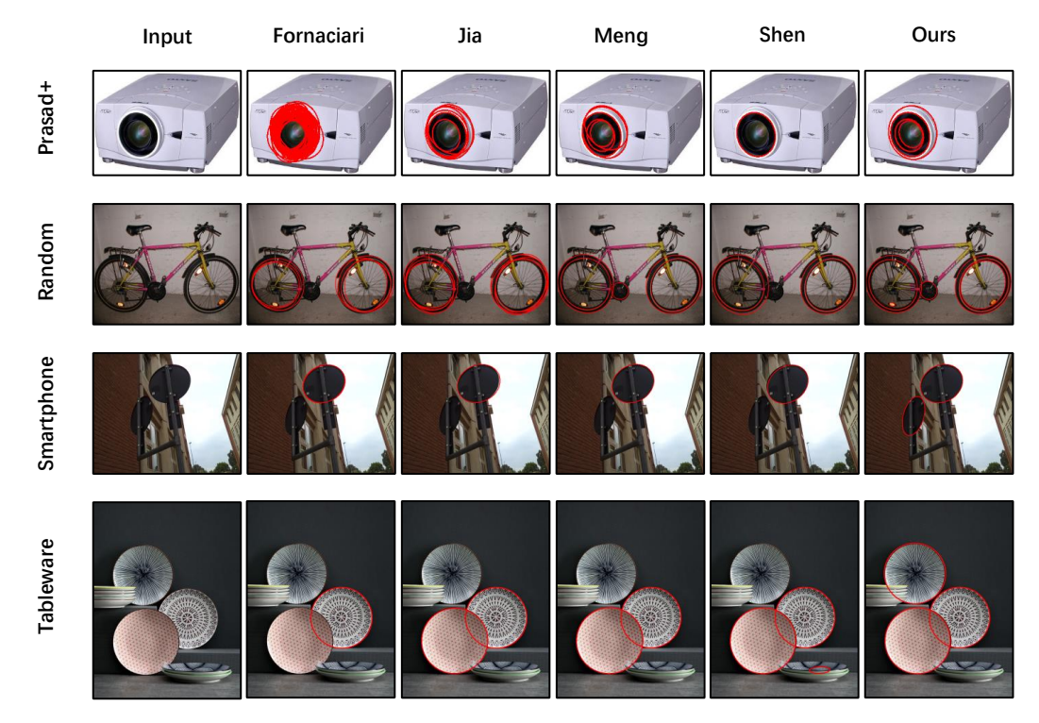
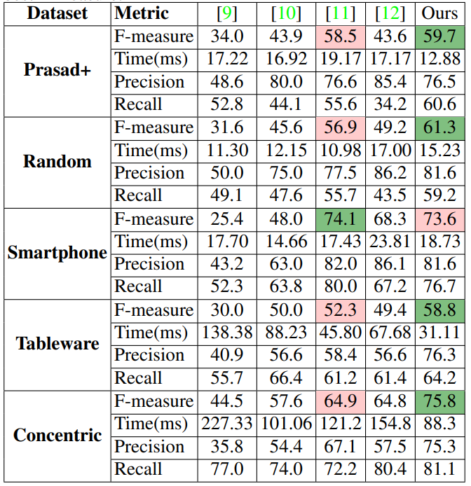
Results
Best
Second Best
Our method has the overall best performance in real-world databases
Notes:
Moreover, we test the our method’s performance on four public real-world datasets, including Prasad+ , Random, Smartphone and Tableware.
Our method achieves the best F-measure on the three datasets.
We particularly test the performance on a concentric dataset collected by ourselves, which has a number of images with concentric ellipse structure.
Our method is much better than the SOTA approach.
30

Slide 17



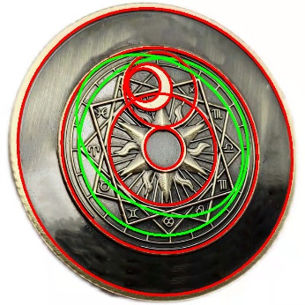

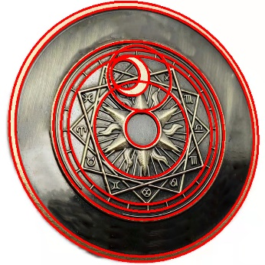
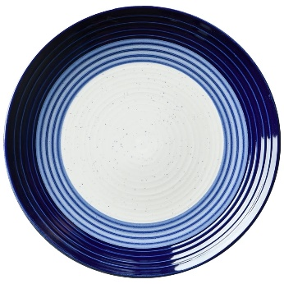
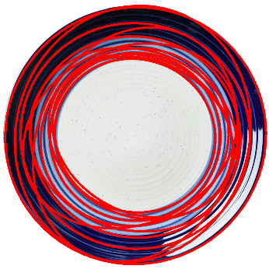
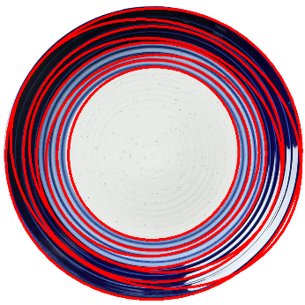
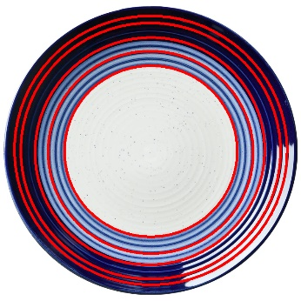
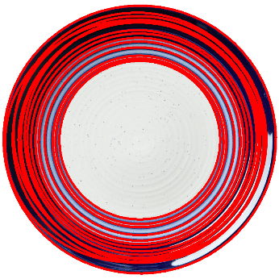
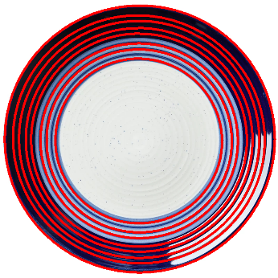
Results
Input
Fornaciari
Jia
Meng
Shen
Ours
Notes:
We present some results in concentric experiments.
Compared with the state-of-art method, our method detects all concentric ellipses.
点一下，播放动画
Even in the challenging case of the second row with dense concentric ellipses，our method can still successfully detect ellipses, reporting clear inner and outer structures.
20

Slide 18


Thank you for your attention!
Scan it
https://github.com/xiaowuga/EDSF
Notes:
That's all my presentation, thanks for listening. our code is publicly available online.
You can scan the code to get it.
10

