Slide 1
Principles of Distributed Database Systems
Lecture 1
Basic Concepts
分布式数据库系统基本概念
Notes:
难读
语言:作者: 法国+法属殖民地(土耳其).
写作风格:自己的研究成果:编著&专著
https://nageshbattula.com/

Slide 2
Outline
Introduction: Course Content and Objectives
Distributed Computing(Data Processing)
What is a Distributed Database System
Distributed DBMS Promises
DDBMS Design Issues
DDBMS Architectures
Summary
Notes:
计算机有两种功能:存储数据和对数据进行计算

Slide 3
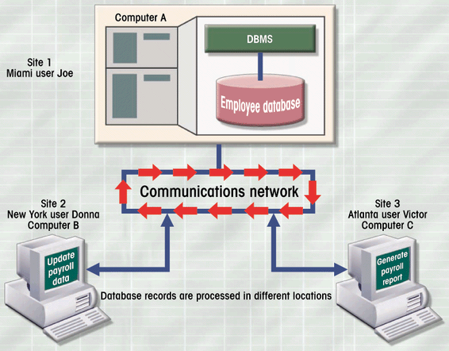
What is Distributed Computing?
Distributed computing（分布式计算）
    or Distributed processing（分布式处理）
A number of autonomous processing elements (not necessarily homogeneous) that are interconnected by a computer network and that cooperate in performing their assigned task.
Notes:
分布式计算系统：多台计算机+网络
协调完成任务的很好例子:网络游戏

Slide 4



What is Distributed Computing(cont’d)?
A fundamental question??
What is being distributed :
  Process logic(Process elements)
    Presentation logic
    Business logic: inventory, sales,personnel
    Data processing logic
  Function
    Printing
    Email
  Data
  Control
分布式计算&分布式数据存贮
（云计算&云数据库）
Storage
Database
Application
Notes:
协同任务:多层体系结构共同合作完成一个复杂任务

Slide 5
Why Distributed Computing?
Another reasonable question?
Respond to organization structure of today’s enterprise
  Current computer systems are inherently distributed
Complex systems: divide-and-conquer(分而自治)
  Incremental growth:增量增长
  Local control（局部控制）: more reliable, more responsive
Economics
  Low cost of workstations
  Combine systems developed locally
Cost of shifting (移植) and of setting up and maintaining the computer network.
Notes:
企业现状：淘宝、中国石油、中国电信
复杂问题解决需求：银行
成本因素：互联网企业
但是… …

Slide 6
Outline
Introduction: Course Content and Objectives
Distributed Computing(Data Processing)
What is a Distributed Database System
Distributed DBMS Promises
DDBMS Design Issues
DDBMS Architectures
Summary
Notes:
基本概念:数据库，数据库管理系统、数据库系统，分布式数据库系统

Slide 7
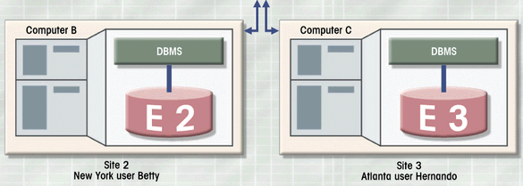
What is a Distributed Database System (DDBS)?
Distributed database (DDB)
  Is a collection of multiple, logically interrelated databases(逻辑相关性)
    physical distributed over a computer network (分布性).
数据库系统组成
DBS→DDBS
Notes:
传统的数据库定义没有强调数据存储
从系统组成看：
分布式数据库一个典型却又相当含糊的定义是：分布式数据库是一种数据集合，这些数据逻辑上属于同一系统，但却分布于一个计算机网络的各个节点。这个定义强调了DDB的两个同等重要的方面
1）分布性：即数据并非存储在同一个节点上。根据这一点我们可以对分布式数据库和单一的集中式数据库加以区分。
2）逻辑相关性：即数据具有相互关联的特性。根据这一特性我们可以将DDB与一组局部数据库或存于计算机网络不同节点的文件区分开来。
上述定义存在的问题是：分布性和逻辑相关性这两个性质的定义非常含糊，它不能确切地辨别哪些情形真正地属于分布式数据库。

Slide 8
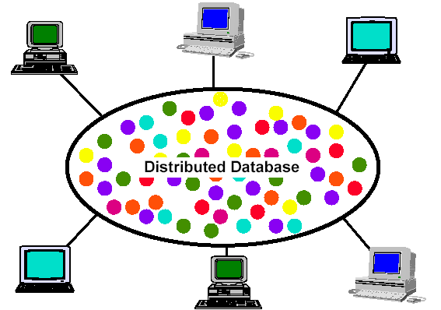
What is a DDBS? (cont’d)
DDBMS provides an access mechanism that makes this distribution transparent to the users
User View
Hide the implementation from users
DDBMS
Notes:
外部用户认为的

Slide 9
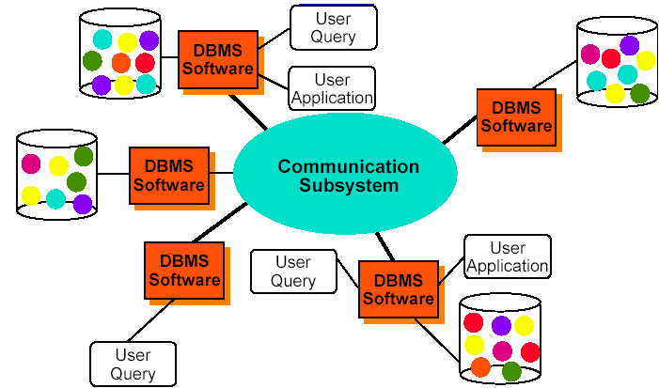
What is a DDBS? (cont’d)
System architecture
Distributed DBMS - Reality
物理（局部）数据库/逻辑 (全局、虚拟)数据库
Notes:
非形式化：DBA看到的 DDBS（教课书例子，DBA看到的）
Distributed database management system (DDBMS)
Software manages the DDB and
makes the distribution transparent to the user
Distributed database system (DDBS) = DDB + DDBMS
Example: (bank branch, supermarket）
Physically many (local) :物理（局部）数据库
Logically one database (global, virtual):逻辑 (全局、虚拟)数据库

Slide 10
What is a DDBS? (cont’d)
Database schema architecture
逻辑 (全局、虚拟)数据库
EMP
NAME
JOB
Logical
joe
manager
adam
analyst
DDBMS:
Distribution Transparency
sue
analyst
david
programmer
peter
manager
tom
analyst
bruce
programmer
Physical
jean
programmer
物理（局部）数据库
EMP
@Beijing
EMP
@Shanghai
NAME
JOB
NAME
JOB
joe
manager
sue
analyst
adam
analyst
david
programmer
bruce
programmer
peter
manager
jean
programmer
tom
analyst
Notes:
前面宏观的看系统组成，下面以关系数据库的数据模式为例说明不同用户看到的 DDBMS
高铁订票系统：伪分布式数据库（应用层提供分布式事务处理）

Slide 11
What is a DDBS? (cont’d)
Summary：Implicit assumptions of DDB
  Data stored at a number of sites(nodes)
    each site logically consists of a single/multiple processor.
  Processors at different sites are interconnected by a computer network
    not multiprocessors, not simply a parallel database system
  Distributed database is a database
    not a collection of files(WEB applications)
  DDBMS is a full-fledged DBMS
    not remote file system, not simply a (distributed) TP（Transaction Process:J2EE）system
所以分布式数据库是多个物理数据库的集合，数据分布存储在通过网络连接的各个计算机内，网络的每个节点有独立的处理能力，并且能执行局部应用请求，每一个节点也要参与至少一个全局应用请求，这种应用请求需要在多个节点上使用网络通信子系统来存取数据。
Notes:
集中式数据库的特点：
集中控制、数据独立、低冗余度、复杂的物理结构和有效的存取、数据语义完整性控制、恢复、并行控制、保密与安全等。
根据上述的定义，分布式数据系统的主要特点
1）物理分布性
2）逻辑整体性
3）站点自治性
4）有一个分布式数据库管理系统
所以分布式数据库是数据的集合，这些数据分布于一个计算机网络的各个计算机内，网络的每个节点有独立的处理能力，并且能执行局部应用请求，每一个节点也要参与至少一个全局应用请求，这种应用请求需要在多个节点上使用通信子系统来存取数据。

Slide 12
Distributed Computing & Distributed Database
Distributed computing (processing)
  Does not require distributed databases
    May be based on a single database on single computer (C/S DBS)
    Copies or parts of database processing functions (business transactions) must be distributed to all data storage sites
Distributed database (Data stored at a number of sites/nodes)
  Requires distributed processing
Both
  Require a network to connect DCS components

Slide 13
Outline
Introduction: Course Content and Objectives
Distributed Computing(Data Processing)
What is a Distributed Database System
Distributed DBMS Promises
DDBMS Design Issues
DDBMS Architectures
Summary
Notes:
优点很多

Slide 14
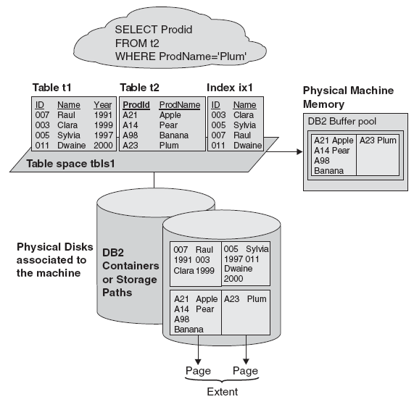
Advantages of DBMS
Data independence
App
Cache manager
ACID properties
DBMS
Auxiliary functions
OS
Notes:
三个优点：三层模式支持数据独立性、缓存管理保证性能、事务特性保证数据的一致性等 ACID特性
Advantages of DBMS
The database management system has promising potential advantages, which are explained below:
1. Controlling Redundancy: In file system, each application has its own private files, which cannot be shared between multiple applications. 1:his can often lead to considerable redundancy in the stored data, which results in wastage of storage space. By having centralized database most of this can be avoided. It is not possible that all redundancy should be eliminated. Sometimes there are sound business and technical reasons for· maintaining multiple copies of the same data. In a database system, however this redundancy can be controlled.
For example: In case of college database, there may be the number of applications like General Office, Library, Account Office, Hostel etc. Each of these applications may maintain the following information into own private file applications:
It is clear from the above file systems, that there is some common data of the student which has to be mentioned in each application, like Rollno, Name, Class, Phone_No~ Address etc. This will cause the problem of redundancy which results in wastage of storage space and difficult to maintain, but in case of centralized database, data can be shared by number of applications and the whole college can maintain its computerized data with the following database:
It is clear in the above database that Rollno, Name, Class, Father_Name, Address,
Phone_No, Date_of_birth which are stored repeatedly in file system in each application, need not be stored repeatedly in case of database, because every other application can access this information by joining of relations on the basis of common column i.e. Rollno. Suppose any user of Library system need the Name, Address of any particular student and by joining of Library and General Office relations on the basis of column Rollno he/she can easily retrieve this information.
Thus, we can say that centralized system of DBMS reduces the redundancy of data to great extent but cannot eliminate the redundancy because RollNo is still repeated in all the relations.
2. Integrity can be enforced: Integrity of data means that data in database is always accurate, such that incorrect information cannot be stored in database. In order to maintain the integrity of data, some integrity constraints are enforced on the database. A DBMS should provide capabilities for defining and enforcing the constraints.
For Example: Let us consider the case of college database and suppose that college having only BTech, MTech, MSc, BCA, BBA and BCOM classes. But if a \.,ser enters the class MCA, then this incorrect information must not be stored in database and must be prompted that this is an invalid data entry. In order to enforce this, the integrity constraint must be applied to the class attribute of the student entity. But, in case of file system tins constraint must be enforced on all the application separately (because all applications have a class field).
In case of DBMS, this integrity constraint is applied only once on the class field of the
General Office (because class field appears only once in the whole database), and all other applications will get the class information about the student from the General Office table so the integrity constraint is applied to the whole database. So, we can conclude that integrity constraint can be easily enforced in centralized DBMS system as compared to file system.
3. Inconsistency can be avoided : When the same data is duplicated and changes are made at one site, which is not propagated to the other site, it gives rise to inconsistency and the two entries regarding the same data will not agree. At such times the data is said to be inconsistent. So, if the redundancy is removed chances of having inconsistent data is also removed.
Let us again, consider the college system and suppose that in case of General_Office file
it is indicated that Roll_Number 5 lives in Amritsar but in library file it is indicated that
Roll_Number 5 lives in Jalandhar. Then, this is a state at which tIle two entries of the same object do not agree with each other (that is one is updated and other is not). At such time the database is said to be inconsistent.
An inconsistent database is capable of supplying incorrect or conflicting information. So there should be no inconsistency in database. It can be clearly shown that inconsistency can be avoided in centralized system very well as compared to file system ..
Let us consider again, the example of college system and suppose that RollNo 5 is .shifted from Amritsar to Jalandhar, then address information of Roll Number 5 must be updated, whenever Roll number and address occurs in the system. In case of file system, the information must be updated separately in each application, but if we make updation only at three places and forget to make updation at fourth application, then the whole system show the inconsistent results about Roll Number 5.
In case of DBMS, Roll number and address occurs together only single time in General_Office table. So, it needs single updation and then an other application retrieve the address information from General_Office which is updated so, all application will get the current and latest information by providing single update operation and this single update operation is propagated to the whole database or all other application automatically, this property is called as Propagation of Update.
We can say the redundancy of data greatly affect the consistency of data. If redundancy is less, it is easy to implement consistency of data. Thus, DBMS system can avoid inconsistency to great extent.
4. Data can be shared: As explained earlier, the data about Name, Class, Father __name etc. of General_Office is shared by multiple applications in centralized DBMS as compared to file system so now applications can be developed to operate against the same stored data. The applications may be developed without having to create any new stored files.
5. Standards can be enforced : Since DBMS is a central system, so standard can be enforced easily may be at Company level, Department level, National level or International level. The standardized data is very helpful during migration or interchanging of data. The file system is an independent system so standard cannot be easily enforced on multiple independent applications.
6. Restricting unauthorized access: When multiple users share a database, it is likely that some users will not be authorized to access all information in the database. For example, account office data is often considered confidential, and hence only authorized persons are allowed to access such data. In addition, some users may be permitted only to retrieve data, whereas other are allowed both to retrieve and to update. Hence, the type of access operation retrieval or update must also be controlled. Typically, users or user groups are given account numbers protected by passwords, which they can use to gain access to the database. A DBMS should provide a security and authorization subsystem, which the DBA uses to create accounts and to specify account restrictions. The DBMS should then enforce these restrictions automatically.
7. Solving Enterprise Requirement than Individual Requirement: Since many types of users with varying level of technical knowledge use a database, a DBMS should provide a variety of user interface. The overall requirements of the enterprise are more important than the individual user requirements. So, the DBA can structure the database system to provide an overall service that is "best for the enterprise".
For example: A representation can be chosen for the data in storage that gives fast access for the most important application at the cost of poor performance in some other application. But, the file system favors the individual requirements than the enterprise requirements
8. Providing Backup and Recovery: A DBMS must provide facilities for recovering from hardware or software failures. The backup and recovery subsystem of the DBMS is responsible for recovery. For example, if the computer system fails in the middle of a complex update program, the recovery subsystem is responsible for making sure that the .database is restored to the state it was in before the program started executing.
9. Cost of developing and maintaining system is lower: It is much easier to respond to unanticipated requests when data is centralized in a database than when it is stored in a conventional file system. Although the initial cost of setting up of a database can be large, but the cost of developing and maintaining application programs to be far lower than for similar service using conventional systems. The productivity of programmers can be higher in using non-procedural languages that have been developed with DBMS than using procedural languages.
10. Data Model can be developed : The centralized system is able to represent the complex data and interfile relationships, which results better data modeling properties. The data madding properties of relational model is based on Entity and their Relationship, which is discussed in detail in chapter 4 of the book.
11. Concurrency Control : DBMS systems provide mechanisms to provide concurrent access of data to multiple users.

Slide 15
Distributed DBMS Promises
Transparent management of data(数据独立性)
  Type: distributed, fragmented, and replicated data
  Level: access layer, DBMS layer , OS layer
Improved reliability/availability（高可靠/高可用）
  Fragmentation and replication
  Distributed transactions
Improved performance（高性能）
  Data location
  Intra-query parallelism
Easier&more economical system expansion(可伸缩)
Notes:
概括起来4点

Slide 16
Transparency management of data
透明性
Separation of the higher level semantics of a system(接口)
  from the lower level implementation issues(实现).
Extension of the data independence concept in centralized databases
  Immunity of user applications to change in the definition and organization of data, and vice versa
    Provide data independence in the distributed environment
Provides for the development of complex applications
Notes:
隐藏底层的实现细节，简易复杂系统的开发
来自于艺术与建筑学
在计算机技术中，一种本来是存在的事物或属性，但从某个角度看似乎不存在，称为透明性现象。通常，在计算机系统中，低层次的机器级的概念性结构和功能特性，对高级程序员来说是透明的。
数据独立性是数据库方法追求的主要目标之一，分布透明性指用户不必关心数据的逻辑分区，不必关心数据物理位置分布的细节，也不必关心重复副本（冗余数据）的一致性问题，同时也不必关心局部场地上数据库支持哪种数据模型．分布透明性的优点是很明显的．有了分布透明性，用户的应用程序书写起来就如同数据没有分布一样．当数据从一个场地移到另一个场地时不必改写应用程序．当增加某些数据的重复副本时也不必改写应用程序．数据分布的信息由系统存储在数据字典中．用户对非本地数据的访问请求由系统根据数据字典予以解释、转换、传送．

Slide 17
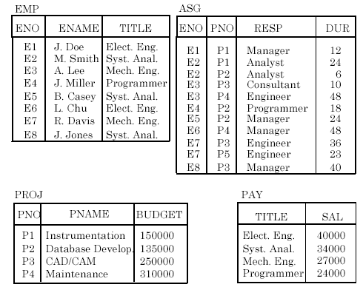
Example Database
Fig3.3_p77

Slide 18
Example (cont’d)
Fragmentation(Sharding) and replication
Tokyo Info?
For performance, reliability, … …
Boston
Tokyo
Paris
Communication
Network
Paris projects
Paris employees
Paris assignments
Boston employees
Paris projects
Paris employees
Paris assignments
Boston employees
Boston projects
Boston employees
Boston assignments
Boston projects
Boston employees
Boston assignments
New York
Beijing
Beijing projects
Beijing employees
Beijing assignments
Paris projects
New York projects
with budget > 20000
Beijing projects
Beijing employees
Beijing assignments
Paris projects
New York projects
with budget > 20000
New York employees
New York projects
New York assignments
Boston projects
Fig1.5 A Distributed Application
Notes:
分割:属地化管理
复制:减少远程访问带来的网络延迟

Slide 19

Example (cont’d)
Transparent Access
(Ex) Find the names and salaries of employees who worked on a project for more than 12 months
SELECT ENAME,SAL
FROM EMP, ASG, PAY
WHERE DUR > 12
AND EMP.ENO = ASG.ENO
AND EMP.TITLE = PAY.TITLE
If fully transparent access
Require a transaction from what is called a global query to several fragment queries.
Notes:
DB集中管理:

Slide 20
Transparency (cont’d)
Who should provide transparency
  A compromise between
    ease of use
    and the difficulty and overhead cost of providing high levels of transparency
  Three distinct layers
    Access layer(访问层)
      Transparency features built into the user language
        compiler or interpreter translates the requested services into required operations
  no transparent service（DBMS）
middleware service layer: service oriented
Notes:
透明性的实现

Slide 21
Transparency (cont’d)
  DBMS layer->DDBMS（分布式数据库管理系统）
    DBMS should be responsible for a high level of data independence
      together with distribution, replication and fragmentation transparency(DDBMS)
    by an underlying distributed operating system
  OS layer->DFS（分布式文件系统）
    Distributed operating system (DOS)
      usually provides network transparency
      e.g., distributed file services, naming, timing, etc
    Distributed file system (DFS)
      E.g., GFS, Hadoop, NoSQL
Notes:
NoSQL

Slide 22
Distributed DBMS Promises: reliability/availability
Improved reliability/availability
  Through replicated components
    Eliminate single points of failure
      Managing the ‘reachable’ data requires distributed transaction support which provides correctness in the presence of failures
  Distributed transactions(ACID)
    Means that user applications do not need to be concerned with coordinating their accesses to individual local databases
      nor do they need to worry about the possibility of site or communication link failures
        during the execution of their transaction

Slide 23
Distributed DBMS Promises: Performance
Potentially Improved Performance
  Data location: proximity(接近) of data to its points of use (requires some support for fragmentation and replication)
    Reduction of contention for CPU and I/O services
    Localization reduces remote access delays
  Parallelism in execution
    Inter-query parallelism: executing multiple queries at the same time
    Intra-query parallelism: breaking up a single query into a number of sub-queries each of which is executed at a different site.
  Cloud computing: scalability and elasticity（弹性）

Slide 24
Performance (cont’d)
Parallelism Requirements
Query: needs to have as much of the data required by each application
    at the site where the application executes
  Full or partial replication/fragmentation?
Update overhead
  Updates to replicated data requires
    distributed concurrency control protocol
    distributed reliability (i.e., commit) protocol and
      distributed recovery protocol
Notes:
Have as much of the data required by each application at the site where the application executes
Full replication
How about updates?
Updates to replicated data requires implementation of distributed concurrency control and commit protocols

Slide 25
Distributed DBMS Promises: economical system expansion
Easier and more economical system expansion
  by adding processing and storage power to the network – new nodes:
Easier to accommodate increasing DB sizes
  More economical to scale up distributed control systems
    rather than purchasing a new single large mainframe
  Emergence of microprocessor and workstation technologies
    client-server model of computing
  Local processing cost&telecommunication cost

Slide 26
Disadvantages of Distributed DBMS
Lack of experience and standards.
Complexity
  Human beings: our limit to understand the number of things happening in parallel is 3-7
Cost
  Shifting from(移植) a centralized system
  Setting up and maintaining the computer network.
Distribution of control
  Data equal to power and money in the sense of business
Security
Difficulty of change
Notes:
主要缺点
编辑
（1）系统开销大，主要花在通信部分。
（2）复杂的存取结构，原来在集中式系统中有效存取数据的技术，在分布式系统中都不再适用。
（3）数据的安全性和保密性较难处理。

Slide 27
Outline
Introduction: Course Content and Objectives
Distributed Data Processing
What is a Distributed Database System
Distributed DBMS Promises
DDBMS Design Issues
DDBMS Architectures
Summary

Slide 28
DDBMS Design Issues
Distributed database design (chapter 3~4)
  How to distribute the database: partition/nonpartition
  Replicated & non-replicated database distribution
Distributed directory management(chapter 3)
  Global or local
  Single copy or multiple copies
Distributed query processing (chapter 6~8)
  Optimization problem
    min{cost = data transmission + local processing}
  General formulation is NP-hard
    Distribution of data, communication costs, and lack of sufficient locally available information
Notes:
We can list the following issues on the research and development of distributed database systems:
Distributed database design: The two fundamental design issues are
fragmentation, the separation of the database into partitions called fragments,
and distribution, the optimum distribution of fragments.
Distributed query processing: Query processing deals with designing algorithms that analyze queries and convert them into a series of data manipulation operations. The problem is how to decide on a strategy for executing each query over the network in the most cost-effective way. The factor to be considered are the distribution of data, communication costs, and lack of sufficient locally available information. The objective is to optimize where the inherent parallelism is used to improve the performance of executing the transaction.
Distributed directory management: A directory contains information about data items in the database. It may be global to the entire DDBS or local to each site;
it can be centralized at one site or distributed over several sites; there can be a single copy or multiple copies.
Distributed concurrency control: It involves the synchronization of accesses to the distributed database, such that the integrity of the database is maintained.
Two fundamental primitives are locking, which is based on the mutual exclusion of accesses to data items, and timestamping, where the transactions are executed in some order.
Distributed deadlock management: The deadlock problem in DDBSs is similar in nature to that encountered in operating systems. The competition among users for access to a set of resources can result in a deadlock if the synchronization mechanism is based on locking. The well-known alternatives of prevention, avoidance, and detection/recovery also apply to DDBSs.
Reliability of DDBMSs: It is important that mechanisms be provided to ensure the consistency of the database as well as to detect failures and recover from them.
Operating system support: In distributed environments there is the problem of having to deal with multiple layers of network software. The work is to provide both adequate support for distributed database operations and general operating system support for other applications.
Heterogeneous databases: When there is no homogeneity among the databases at various sites, it becomes necessary to provide a translation machanism between database systems. This translation mechanism usually involves a canonical form to facilitate data translation, as well as program templates for translating data manipulation instructions.

Slide 29
DDBMS Design Issues (cont’d)
Distributed concurrency control (chapter 11)
  Synchronization of concurrent accesses
    integrity of a single DB
    consistency of multiple copies of DB
Distributed deadlock management (chapter 11)
Reliability of distributed DBMS (chapter 12)
  Atomicity and durability
    DB at the operational sites remain consistency
    consistent recovery at the failed sites
  Reliability Protocol: resilient to various failures
Replication (chapter 13)
  Eager/lazy updates: eventual consistency
  Replication protocol: mutual consistency
Notes:
prevention, avoidance, and detection/recovery
Concurrency Control
synchronization of concurrent accesses
consistency and isolation of transactions' effects
deadlock management
Reliability
how to make the system resilient to failures
atomicity and durability

Slide 30
Additional DDBMS Design Issues
Multidatabase systems: federated databases and data integration systems
  Data warehouse & database integration(Chapter 4)
  Query processing challenges(Chapter 9)
Distributed networking platform (Internet)
  Peer-to-peer data management (Chapter 16)
  Web data management (Chapter 17)
Data scalability
  Parallel databases (Chapter 14)
  Data stream management and cloud data management (Chapter 18)

Slide 31
Outline
Introduction: Course Content and Objectives
Distributed Data Processing
What is a Distributed Database System
Distributed DBMS Promises
DDBMS Design Issues
DDBMS Architectures
Summary

Slide 32


DDBMS Architectures :SPARC Architecture
ANSI/SPARC Architecture
Users
External
Schema
External
view
External
view
External
view
Conceptual
view
Data
organization
perspective
Conceptual
Schema
Internal
Schema
Internal view

Slide 33
Architectures models for DDBMS (cont’d)
Distribution
Peer-to-peer
multi-DBMS(A₀, D₂, H₀)
Distributed
multi-DBMS(A₂,D_{x},H_{y})
Client/server
DBMS(A_{x},D₁,H_{x})
Autonomy
(A_{o},D₀,H₀)
Locally integrated and homogeneous multiple DBMS
Multi-DBMS
Federated DBMS：
IBM Data Server
Heterogeneity
3*3*2 = 18 Alternatives
Some alternatives are meaningless or not practical!
Notes:
集中节点结合
数据库是用户共享的资源．在集中式数据库中，为了保证数据库的安全性和完整性，对共享数据库的控制是集中的，并设有DBA负责监督和维护系统的正常运行．在分布式数据库中，数据的共享有两个层次：一是局部共享，即在局部数据库中存储局部场地上各用户的共享数据．这些数据是本场地用户常用的．二是全局共享，即在分布式数据库的各个场地也存储可供网中其它场地的用户共享的数据，支持系统中的全局应用．因此，相应的控制结构也具有两个层次：集中和自治．分布式数据库系统常常采用集中和自治相结合的控制结构，各局部的DBMS可以独立地管理局部数据库，具有自治的功能．同时，系统又设有集中控制机制，协调各局部DBMS的工作，执行全局应用。当然，不同的系统集中和自治的程度不尽相同．有些系统高度自治，连全局应用事务的协调也由局部DBMS、局部DBA共同承担而不要集中控制，不设全局DBA，有些系统则集中控制程度较高，场地自治功能较弱。（3）、支持全局数据库的一致性和和可恢复性 分布式数据库中各局部数据库应满足集中式数据库的一致性、可串行性和可恢复性。除此以外还应保证数据库的全局一致性、并行操作的可串行性和系统的全局可恢复性。这是因为全局应用要涉及两个以上结点的数据．因此在分布式数据库系统中一个业务可能由不同场地上的 多个操作组成．例如，银行转帐业务包括两个结点上的更新操作。这样，当其中某一个结点出现故障操作失败后如何使全局业务滚回呢？如何使另一个结点撤销已执行的操作（若操作已完成或完成一部分）或者不必再执行业务的其它操作（若操作尚没执行)？这些技术要比集中式数据库复杂和困难得多，分布式数据库系统必须解决这些问题．

Slide 34
DDBMS Architectural Alternatives: C/S DBMS (cont’d)
Multiple clients/multiple servers
SQL Interface
Programmatic interface
Other application support environments
caching
Application
Client Service
Communications
Network
Query decomposition
2 phaseCommit protocols
Directory
Communications
Communications
DBMS Service
DBMS Service
DB
DB
C/S architecture task distribution
Notes:
伪分布式数据?

Slide 35
DDBMS Architectural Alternatives: C/S DBMS (cont’d)
Application server approach (N-tier distributed approach)
…
Client
Client
Network
…
Application Server
Application Server
Network
Database Server
Database Server
Database Server
Database
Database
Database
Notes:
不是本课程讨论的: Oracle RAC?

Slide 36
DDBMS Architectural Alternatives :P2P DDBMS
Distributed homogeneous database systems
    peer-to-peer distributed DBMS(A0,D2,H0)
  Global conceptual schema (GCS)
    Describes the logical structure of the data at all sites
  Local internal schema (LIS)
    describes the physical structure of the data
  Local conceptual schema (LCS): logically integrated distributed DB
    Global database is the union of LCS
  DB design is typically
    A top-down process
      Global CS → Local CS
Notes:
Peer to peer distributed systems
Local Internal Schema (LIS)
Global Conceptural Schema (GCS)
Local Conceptual Schema (LCS)
External Schemas (ESs)

Slide 37
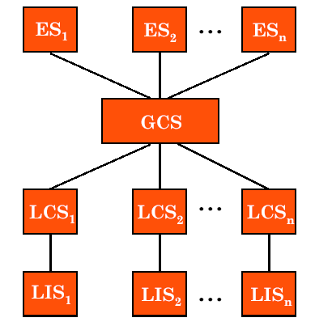
P2P DDBMS (cont’d)
External schema
本地数据库有外模式吗？
Data
organizational
view
Global conceptual schema
(全局数据库/虚拟数据库)
Local conceptual schema
（局部数据库概念模式）
Local internal schema
（本地数据库内部模式）
Peer-to-peer DDBMS Reference Architecture

Slide 38
P2P DDBMS (cont’d)
Different Levels of Transparency
GLOBAL SCHEMA
FRAGMENTATION SCHEMA
ALLOCATION SCHEMA
Local mapping
Local mapping
schema 1
schema 2
DBMS at site 1
DBMS at site 2
Local
Database
Local
Database
Notes:
Global schema global tables
e.g. Student(SNo, Name, Address, Course, Faculty)
Fragmentation schema which parts of tables
e.g. StudentIT(SNo, Name, Address, Course, Faculty)
StudentEngg(SNo, Name, Address, Course, Faculty)
StudentSc(SNo, Name, Address, Course, Faculty)
Allocation schema at which sites
e.g. StudentSc_City(SNo, Name, Address, Course, Faculty)
StudentSc_St.(SNo, Name, Address, Course, Faculty)
Local schema which local tables
e.g. StudentSc_City_personal(SNo, Name, Address)
StudentSc_City_course(SNo, Course, Faculty)
Local DBMS which local data
e.g. Oracle at city campus
Sybase at St. Leonards campus

Slide 39
DDBMS Architectural Alternatives : Distributed Multi-DBMS
Distributed Multi-Database System architecture
  Global conceptual schema represents
    only the collection of some of the local databases
      that each local DBMS wants to share
  DB design is typically
    a bottom-up process
      Local CS → Global CS
Distributed Multi-Database System
DBMS₁
DBMS₂
legacy
web site
data
data
data
data

Slide 40
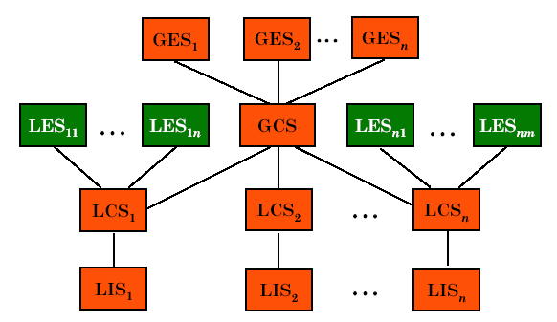
Distributed Multi-DBMS(cont’d)
Distributed Multi-Database System (MDBS) with GCS
Data
organizational
view

Slide 41
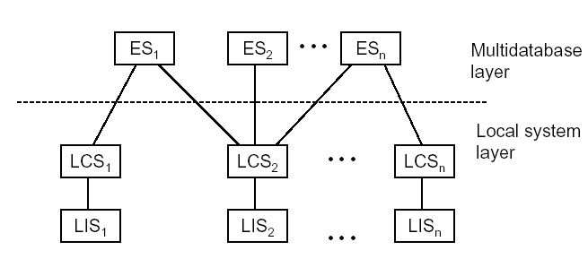
Distributed Multi-DBMS(cont’d)
Distributed Multi-Database System without GCS
Data
organizational
view
Federated DB architectures do not use a GCS, either
Notes:
MDBS without a GCS
Existence of GCS in MDBS is a controversial issue
absence of GCS in MDBS may be advantageous
(ex) MRDSM
Each local DBMS defines an export schema
the global DB is the union of all the export schemas
Each user accesses the global DB by an import schema
import schema: a global external view

Slide 42
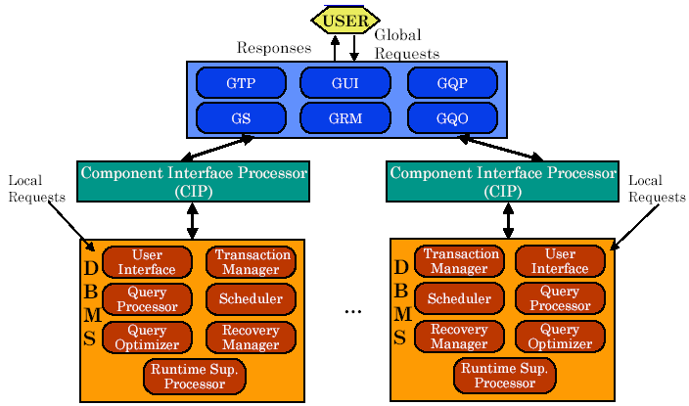
Distributed Multi-DBMS(cont’d)
Components of MDBS
Components of a MDBS
Components & Execution view
Global User
Request
MDBS layer
Local User
Request
Local User
Request
Global Subrequest
Local DBMS
Notes:
When heterogeneity in MDBS with GCS
Unilingual MDBS
Every user uses a single canonical language
When accessing the GCS
for the user, languages for GES and LES may be different
(ex) MULTIBASE, DDTS
Multilingual MDBS
Each user accessing the global DB uses the language of the user’s local DBMS
for the user’s perspective, querying the DB is easier
(ex) Sirius-Delta, HD-DBMS

Slide 43
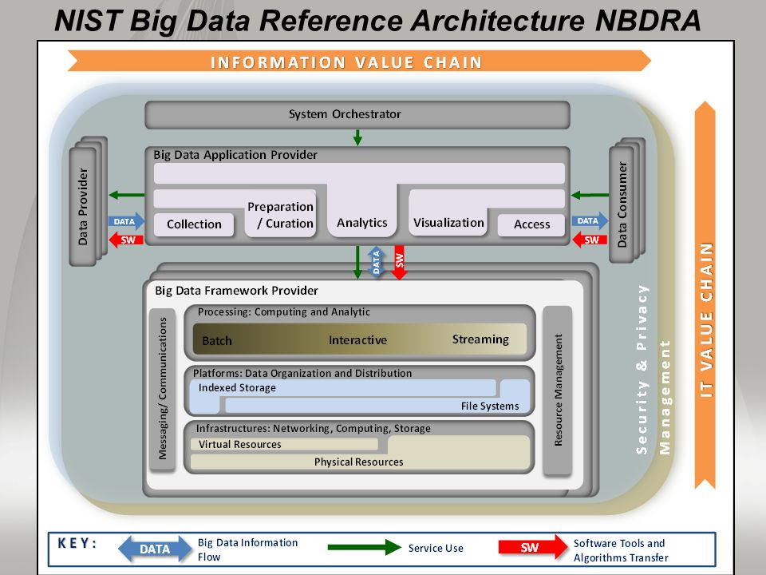
NIST Big Data Reference Architecture

Slide 44
Outline
Introduction: Course Content and Objectives
Distributed Data Processing
What is a Distributed Database System
Distributed DBMS Promises
DDBMS Design Issues
DDBMS Architectures
Summary

Slide 45
What Have We Covered?
What is Distributed Computing (Processing)
What is a Distributed Database System
Distributed Computing & Distributed Database
Distributed DBMS Promises
  Transparency of distributed, fragmented, and replicated data
DDBMS design Issues
DDBMS Architectures : C/S, P2P, MDBMS
Summary

Slide 46
Home work
复习第一章内容，思考下列问题
  List Advantages of DDBMS
  Explain the transparency of DDBMS
  Compare the architecture difference between DDBMS and MDBMS
提交作业:文献报告阅读
  IOUG Cloud Database Survey， 2018， https://d1.awsstatic.com/whitepapers/RDS/IOUG-AWS-Databases-in-the-Cloud-Final-Report.pdf.
  Joe McKendrick, Research Analyst, Database as a Service Enters the Enteprise Mainstream, 2016， www.oracle.com/us/solutions/cloud/database-cloud-ioug-survey-3000282.pdf

Slide 47
Q
&
Q U E S T I O N S
A N S W E R S

