Slide 1
Principles of Distributed Database Systems
Lecture 3
Distributed Database Design
分布式数据库设计

Slide 2
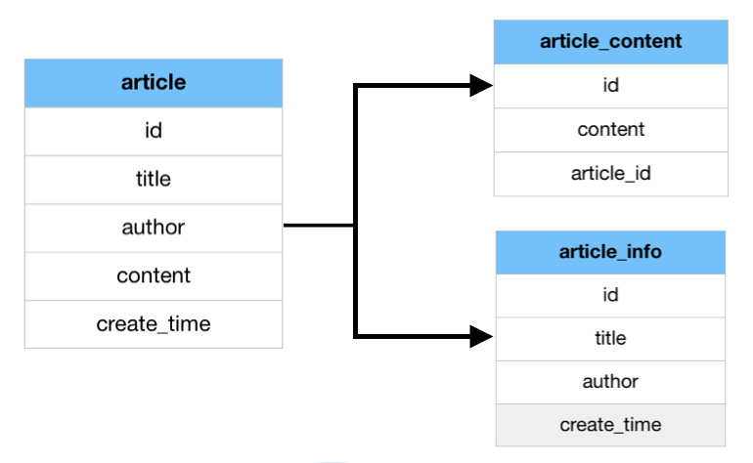
Outline
Introduction
Top-down Design process
Distribution Design Issues
Data Fragmentation Design
Data fragmentation Information
Horizontal Fragmentation (HF)
Vertical Fragmentation (VF)
Vertical Fragmentation
Vertical Clustering Algorithm
Vertical Partitioning Algorithm
Hybrid Fragmentation (HF)
Data Allocation Design
Data Directory
Summary
Notes:
一般对表进行水平分割和垂直分隔会极大的提高数据库性能。
1、水平分割：
一般适用于下列情况：
A、表很大，分割后可以降低在查询时需要读的数据和索引的页数，同时也降低了索引的层数，提高了查询速度
B、表中的数据本来就有独立性，例如表中分别记录了各个地区或不同时期的数据；或者有些数据常用，有些数据不常用
C、需要把数据存放到多个介质上。
水平分割会给应用增加复杂度，它通常在查询时，需要多个表名，查询所有数据的话，就需要union操作。在许多数据库应用中，这种复杂性会超过它带来的优点，因为只要索引关键字不大，则在索引用于查询时，表中增加2到3倍的数据量，查询时，也就增加读一个索引层的磁盘次数，IO交互会比较多。
2、垂直分割：
一个表中某些列很常用，另外一些列不常用，则可以进行垂直分割，把主码和一些列放到一个表，然后把主码和另外的列放到另外一个表中。
这样做的好处在于：数据行数会变小，一个数据页句能存放更多的数据，在查询时，会减少IO次数。
缺点在于：需要管理冗余列，查询所有数据需要join操作。
3、库表散列：
一般来说，我们会按照业务或者功能模块将数据库进行分离，不同的模块对应不同的数据库或者表，再按照一定的策略对某个页面或者功能进行更小的数据库散列，比如用户表，按照用户ID进行表散列，散列128张表，则应就能够低成本的提升系统的性能并且有很好的扩展性。

Slide 3
Vertical Fragmentation(VF)
R[A] ⇒ R₁[A₁] A_{i} ⊆ A
…
R_{n}[A_{n}]
Just like normalization of relations(规范化)
Data redundancy/performance(?)
Properties
Completeness
Disjointness
Reconstruction: Lossless join
垂直分段/分片/分割
U A_{i} = A
all i
A_{i}∩A_{j}=Primary Key for all i,j i≠j
R_{i} = R
all i
Notes:
Idea:
Split schema of relation R into smaller schemas Ri. Splitting is based on which attributes are typically accessed together. Each fragment Ri must contain primary key in order to reconstruct original relation R.
Has been studied within the centralized context
- design methodology
- physical clustering
More difficult than horizontal, because more alternatives exist.
Two approaches :
- grouping: attributes to fragments
- splitting:relation to fragments
Example: EMP1(EmpNo; EName; Sal); EMP2(EmpNo; Job; Deptno)
More difficult than horizontal fragmentation, because more alternatives exist. Two approaches: (1) grouping attributes to fragments, (2) splitting relation into fragments.
确定全局关系的垂直分段存储，就要由应用请求以相同方式访问的属性进行分组。我们应该区分纵向划分和纵向聚类，前者不能相交，叫垂直分片，后者则可以，叫垂直群集。垂直分片和垂直群集目的在于使得许多重要应用可以只访问一个片段来执行，从而使操作具有本地性。
垂直分段的目的是标识出分段Ri，从而可使许多应用请求用一个分段来执行。设全局关系R分为两个垂直分段Ri和Rl。若某个应用请求只用Ri和Rj即可完成，则此应用请求就利用了垂直划分的优势，因为在这两种情况下，可避免对关系R进行较大的访问；然而，若某应用请求既需要Ri又需要Rj，则认为垂直分段是无益的，因为对于重建R需要一个附加的连接，这一规则也适用于非分布数据库。
在分布式数据库中，当许多只使用Ri和许多点使用Rj的应用请求发自不同的节点时，垂直划分的优点是很多的。
由于可能划分数据随R的属性个数组合增长，并且可能的聚类数会很大。所以确定全局关系的分段并非容易。因此应该使用启发方法对大的关系决定划分和聚类。
Vertical fragmentation of a relation R produces fragments R1, ..., Rr, each of which contains
a subset of R’s attributes as well as the primary key of R.
The objective of vertical fragmentation is to partition a relation into a set of smaller relations
so that many of the user applications will run on only one fragment with the minimum
execution time.
Vertical fragmentation is more complicated than horizontal fragmentation because of the
large number of available alternatives. Two types of heuristic approaches are usually used
to obtain optimal solutions to the vertical fragmentation problem.
. Grouping: starts by assigning each attribute to one fragment, and at each step,
joins some of the fragments until some criteria is satisfied.
. Splitting: starts with a relation and decides on beneficial partitionings based on
the access behaviour of applications to the attributes.
The major information required for vertical fragmentation is realted to applications. The
major data requirement related to applications is their access frequencies.

Slide 4
Vertical Fragmentation (cont’d)
How do we decide what attributes are grouped with which?（操作具有本地性）
E1(ENO,NAME,LOC)
E2(ENO,SAL)
Example:
EMP(ENO,ENAME, LOC,SAL)
E1(ENO,NAME)
E2(ENO,LOC)
E3(ENO,SAL)
?
More difficult than horizontal, because more alternatives
for m non-primary key attributes, the possible number of fragments is B(m), i.e, m-th Bell number
for large m, B(m) ≈ m^{m}
e.g., B(10) ≈ 115,000, B(15) ≈ 10⁹, B(30) ≈ 10²³
Notes:
使用垂直分片垂直群集目的在于使得许多重要应用可以只访问一个片段来执行，从而使操作具有本地性。例如全局关系，其码为ENO。如果使用垂直分片，可以分为
在组合数学里，贝尔数给出了集合划分的数目，以数学家埃里克·坦普尔·贝尔（Eric Temple Bell）命名，是组合数学中的一组整数数列。

Slide 5
Vertical Fragmentation (cont’d)
Two types of heuristic(启发式) approaches
Grouping(组合方法/成组法)
From a set of attributes to fragments
starts by assigning each attribute to one fragment, and at each step, joins some of the fragments until some criteria is satisfied.
Splitting (分离方法/分裂法)
From an entire relation to fragments
starts with a relation and decides on beneficial partitionings based on the access behaviour of applications to the attributes.
Overlapping(部分重叠)/Non-overlapping fragments
Not consider the replicated key to be overlapping
Notes:
We do not consider the replicated key attributes to be overlapping：
Easier for completeness, i.e., lossless decomposition
necessary for reconstruction of the global relation
Easier to enforce many functional dependencies for integrity checking etc.
most dependencies involve key attributes

Slide 6
Vertical Fragmentation(cont’d)
Database information?
Application qualitative information
Information requirements
Attribute affinity(耦合度) measure
indicating how closely the attributes are related
can be obtained from more primitive usage data
Attribute usage values: use(q_{i}, A_{j})
Given a set of queries Q = {q₁, q₂, …, q₃} that will run on the relation R(A₁, A₂, …, A_{n}),
1 if attribute A_{j} is referenced by query q_{i}
0 otherwise
use(q_{i}, A_{j}) =
Vertor use(q_{i} ,•) can be defined accordingly for each query
Notes:
水平分段使用的是Where子句中的查询条件
垂直分段需要考虑select, where等子句涉及的属性
数据库信息为什么不考虑？
The basic idea is to group most frequently accessed columns “together”. In an extreme case, if half applications always access columns 2, 5, 6 together and the other half applications always access the rest columns, the columns 2, 5, 6 with primary kay should be grouped as one fragment and the rest columns with primary key should be grouped as the other fragment. In reality, there will be some applications access columns 2, 5, 6, as well as other columns. The keys in vertical fragmentation are how to define the measure of “togetherness” and how to define algorithms to find out the “togetherness”.
Note that the primary key must be included in all vertical fragments in order to construct the whole table by joining all fragments.
For vertical fragmentation, the whole relation (table) can be reconstructed by the join of all fragments based on the primary key. If a table J is fragmented into J1, J2, and J3 vertically, then
J J1∞J2∞J3 =

Slide 7
Vertical Fragmentation(cont’d)
(Ex3.15) Attribute usage
Consider the following 4 queries for relation PROJ:
PNO, PNAME, BUDGET, LOC
q1: SELECT BUDGET FROM PROJ WHERE PNO = Value
q2: SELECT PNAME, BUDGET FROM PROJ
q3: SELECT PNAME FROM PROJ WHERE LOC = Value
q4: SELECT SUM(BUDGET) FROM PROJ WHERE LOC = Value
Notes:
每个查询的含义是什么？

Slide 8
Vertical Fragmentation(cont’d)
Let A1 = PNO, A2 = PNAME, A3 = BUDGET, A4 = LOC.
Attribute usage matrix（属性使用矩阵）

Slide 9
Vertical Fragmentation(cont’d)
Application quantitative information
Attribute affinity measure (亲和度度量) : aff(A_{i}, A_{j})
Measures the bond（键能） between two attributes
according to how they are accessed by applications
aff(A_{i}, A_{j})= Σall queries that access Ai and Aj (query_accesses)
UPDATE EMP SET ENo=1123, Ename=‘张三’ WHERE ENo=9999;
Notes:
只有当属于同一分片的任意两个元组被任一应用以同等概率进行访问时
Attribute affinity measure: aff(A_{i}, A_{j})
Measures the bond between two attributes of a relation
according to how they are accessed by applications
The attribute affinity measure between two attributes A_{i} and A_{j} of a relation R(A₁, A₂, …, A_{n}) with respect to the set of applications Q = (q₁, q₂, …, q_{q}) is defined as follows:
query_accesses = Σ_{all sites}(frequency of query q_{k}) *
(# of accesses to A_{i} and A_{j} together per execution of q_{k})

Slide 10
Vertical Fragmentation(cont’d)
Attribute affinity matrix (属性亲和度矩阵).
Assume
Each query accesses the attributes once during each execution.
following frequencies of queries at three sites
(Example 3.16)
查询访问每个节点频率
Notes:
freq(Q_{i}) = access frequency of Q_{i} as a percentage of all applications accessed

Slide 11
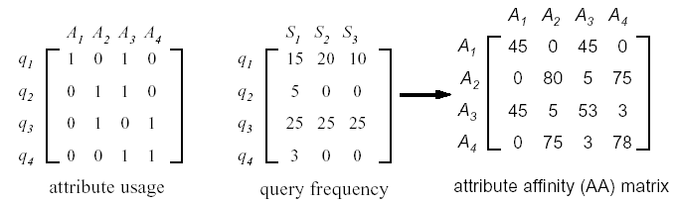
Vertical Fragmentation(cont’d)
(Example cont’d)
属性亲和度矩阵（AA） 计算方法
e.g. aff(A₁,A₃)=acc1(q₁)*rel₁(s₁)+ acc2(q₁) *rel₁(s₂)
+acc3(q₁) *rel₁(s₃) =15*1+20*1+10*1
e.g. aff(A₂,A₄)⇒ q₃
e.g. aff(A₃,A₄) ⇒ q₄
Notes:
只有当属于同一分片的任意两个元组被任一应用以同等概率进行访问时

Slide 12
Vertical Fragmentation(cont’d)
?
 | A1 | A2 | A5 | A4 | A3
A1 | 96 | 50 | 0 | 1 | 45
A2 | 50 | 100 | 0 | 2 | 48
A5 | 0 | 0 | 79 | 75 | 4
A4 | 1 | 2 | 75 | 78 | 0
A3 | 45 | 48 | 4 | 0 | 97
A3 | 45 | 48 | 4 | 0 | 97
A5 | 0 | 0 | 79 | 75 | 4
Cluster of attribute affinity matrix（聚类亲和度矩阵）
Notes:
人们认识事物时往往先把被认识的对象进行分类，以便寻找其中同与不同的特征，因而分类学是人们认识世界的基础科学。统计学中常用的分类统计方法主要是聚类分析与判别分析。
聚类分析是直接比较各事物之间的性质，将性质相近的归为一类，将性质差别较大的归入不同的类。判别分析则先根据已知类别的事物的性质，利用某种技术建立函数式，然后对未知类别的新事物进行判断以将之归入已知的类别中。聚类分析与判别分析有很大的不同，聚类分析事先并不知道对象类别的面貌，甚至连共有几个类别也不确定；判别分析事先已知对象的类别和类别数，它正是从这样的情形下总结出分类方法，用于对新对象的分类

Slide 13
Vertical Fragmentation(cont’d)
属性亲和度度量: aff(A_{i}, A_{j})
 | A1 | A2 | A3 | A4 | A5
A1 | 96 | 50 | 45 | 1 | 0
A2 | 50 | 100 | 48 | 2 | 0
A3 | 45 | 48 | 97 | 0 | 4
A4 | 1 | 2 | 0 | 78 | 75
A5 | 0 | 0 | 4 | 75 | 79
A4 | A5
A4
A5
R1[K,A1,A2,A3] R2[K,A4,A5]
Vertical Fragmentation of attribute affinity matrix
Notes:
Permute columns of affinity matrix in all possible ways
Don’t forget to interchange rows when you interchange columns
Find a good “split point”
Maximize affinity within each partition, minimize cross-partition accesses
Vertical fragmentation process
First clustering together the attributes with high affinity for each other: Clustering algorithm(BEA)
And then splitting the relation accordingly: find a split point: Partitioning Algorithm

Slide 14
Vertical Fragmentation: VF-Clustering
VF-Clustering Objective(聚类算法): grouping the attributes based on the attribute affinity values in AA.
take the attribute affinity matrix AA, and
reorganize the attribute orders to form clusters
where the attributes in each cluster demonstrate high affinity to one another
Bond Energy Algorithm (BEA，键能算法) :finds an ordering of attributes such that the global affinity measure(AM)
is maximized.
[Hoffer and Severance,1975]
Notes:
Naïve algorithm is exponential
Permute rows/columns in all possible ways, try each split point
One approach to speed it up:
Cluster attributes using “bond energy” algorithm

Slide 15


Fragmentation: VF-Clustering(cont’d)
Global affinity measure(AM，全局亲和度)
Since AA matrix is symmetric, we can simply define:
Grouping large values with large ones, and
small values with small ones
Notes:
周长固定的长方形面积最大：正方形

Slide 16
Fragmentation: VF-Clustering(cont’d)
Bond Energy Algorithm (BEA，键能算法)
input: AA Matrix
output: clustered affinity matrix CA
1. Initialization
place and fix one of the columns of AA in CA.
2. Iteration
suppose i is the number of columns already placed in CA
pick each of the remaining n-i columns, and place it in the first i+1possible positions in the CA matrix.
for each column, choose the placement that makes the most contribution to the global affinity measure.
3. Row ordering
order the rows according to the column ordering.

Slide 17

Fragmentation: VF-Clustering(cont’d)
“Best” placement? Define contribution（贡献） of placing attribute A_{k} between A_{i} and A_{j}
cont(A_{i},A_{k},A_{j})=2bond(A_{i}, A_{k})+2bond(A_{k},A_{j})-2bond(A_{i},A_{j})
where 属性之间粘合度（bong）
Notes:
在BEA算法的第二步怎么度量位置的摆放是最佳的，就需要一个算法。

Slide 18


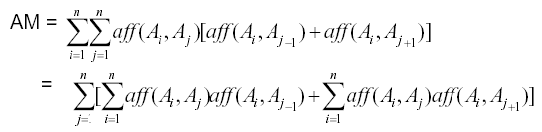
Fragmentation: VF-Clustering(cont’d)
Definition of AM
Bond between two attributes
Then,

Slide 19
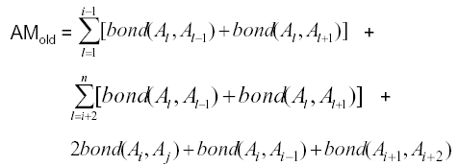


Fragmentation: VF-Clustering(cont’d)
Consider the following n attributes
Then, the global affinity measure can be written as:

Slide 20



Fragmentation: VF-Clustering(cont’d)
Consider a new attribute A_{k} between A_{i} and A_{j}
Thus,contribution of placing A_{k} between A_{i} and A_{j}:

Slide 21
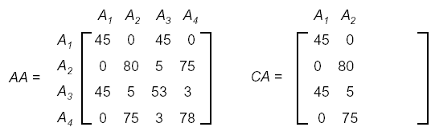
Fragmentation: VF-Clustering(cont’d)
(Ex3.18) Attribute clustering by BEA
Consider the following AA matrix and the CA matrix
where A₁ and A₂ have been
Now try to place A₃:

Slide 22
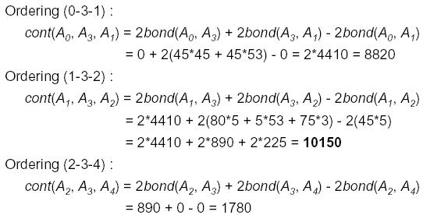
Fragmentation: VF-Clustering(cont’d)
(Example cont’d)

Slide 23
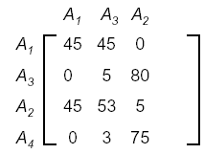
Fragmentation: VF-Clustering(cont’d)
(Example cont’d)
Therefore, the CA matrix has the form

Slide 24
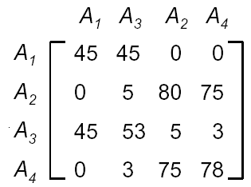
Fragmentation: VF-Clustering(cont’d)
(Example cont’d)
Now, try to place A₄
by similar calculation A₄ should be placed to the right of A₂ .
Thus, the CA matrix has the form

Slide 25
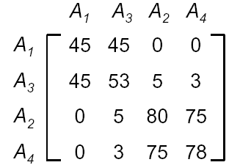
Fragmentation: VF-Clustering(cont’d)
(Example cont’d)
Row ordering
the final form of the CA matrix (after row ordering) is
When the CA matrix is big, usually more than two clusters are formed and there are more than one candidate partitionings

Slide 26
Fragmentation: VF-Partitioning
VF Partitioning algorithm(划分算法)
Divide a set of clustered attributes {A₁, A₂, …,A_{n}} into two (or more) sets {A₁, A₂, …, A_{i}} and {A_{i+1}, …, A_{n}}
such that these sets of attributes are accessed
solely, or
for the most part, by distinct sets of applications
根据具有“相同性质”的元组或属性进行分组，是具有相同性质（例如访问频率相同）的元组或属性划分在一个组中，每组就构成一个片段。因此，如果同一个片段的任意两个元素具有“相同性质”的话，那么数据分配时所使用的任意一种方法都将把这两个元素放在一起，以这种方式得到的片段是分布式数据库中数据合适的分配和存储单位。
SB Navathe, S. Ceri, G. Wiederhold, and J. Dou. Vertical partitioning algorithms for database design. ACM Transactions on Database Systems, 9(4):680--710, 1984
Notes:
A General Purpose Multiple Way Partitioning Algorithm : 数据挖掘 ...
分布环境下实时数据的分配算法A Data Partitioning Algorithm in ...
基于数据分区的并行DBSCAN算法Data-Partitioning-Based Parellel ...
基于Improved-Hash方法的多维数据划分Multi-dimensional-data ...
一种基于代表元的数据划分算法
This paper addresses the vertical partitioning of a set of logical records or a relation into fragments. The rationale behind vertical partitioning is to produce fragments, groups of attribute columns, that "closely match" the requirements of transactions. Vertical partitioning is applied in three contexts: a database stored on devices of a single type, a database stored in different memory levels, and a distributed database. In a two-level memory hierarchy, most transactions should be processed using the fragments in primary memory. In distributed databases, fragment allocation should maximize the amount of local transaction processing.
Fragments may be nonoverlapping or overlapping. A two-phase approach for the determination of fragments is proposed; in the first phase, the design is driven by empirical objective functions which do not require specific cost information. The second phase performs cost optimization by incorporating the knowledge of a specific application environment. The algorithms presented in this paper have been implemented, and examples of their actual use are shown.
Copyright © 1984 by the ACM, Inc., used by permission. Permission to make digital or hard copies is granted provided that copies are not made or distributed for profit or direct commercial advantage, and that copies show this notice on the first page or initial screen of a display along with the full citation.

Slide 27
Fragmentation: VF-Partitioning(cont’d)
Navathe et al., 1984
Consider the clustered attribute matrix:
A₁ A₂ … A_{i} … A_{n}
A₁
A₂
A_{i}
A_{n}
TA
TA: top set of attributes
BA: bottom set of attributes
BA
Dividing point
Notes:
Hammer and Niamir [ll] summarize the problems left unsolved by the approach in [12] in the following two points:
(i) The BEA determines an ordering of attributes, but it is still left to the subjective judgment of the designer to decide how to “clump” the attributes together to form fragments.
(ii) Similarity of pairs of attributes can be inadequate if the similarity among larger groups of attributes is not taken into account.
Hammer and Niamir [ 111 developed two heuristics to be used in combination.
The “grouping” heuristic starts by assigning each attribute to a different partition;
at each step, all groupings of partitions of the current candidate solution are
considered, and the one that represents the greatest improvement over the current
candidate grouping becomes the new candidate. The process iterates until no
improvement is found over the current candidate. The “regrouping” heuristic
attempts to move attributes from their current partition to another partition.
Grouping and regrouping are iterated until no further benefit can be achieved.
When the set of all partitions is viewed as a lattice, grouping moves attributes
“up” and regrouping moves attributes “sideways” [ll].
The major criticism of this approach is regarding the direction in which to
explore the lattice-while Hammer and Niamir proceed “up” by grouping, we
proceed “down” by splitting. The rationale behind this approach is that the
“optimal” solution, in our opinion, is much closer to the group composed of all
attributes, assumed to be our starting point, than to groups that are single-
attribute partitions, as assumed in [ll]. A typical solution will not incur too
much splitting because of the disadvantage of storing too many small subrecords.
Thus, in our approach, the “moves” along the lattice will be in a direction that
promises optimality; Hammer and Niamir, on the contrary, recognized that their
approach introduces many discrepancies at the first iterations (in fact, they
introduced the regrouping heuristics to get rid of these discrepancies).

Slide 28
Fragmentation: VF-Partitioning(cont’d)
Define:Sets of applications
TQ = set of applications that access only TA
BQ = set of applications that access only BA
OQ = set of applications that access both TA and BA
And Cost equations for the applications
CTQ = total number of accesses to attributes by applications that access only TA
CBQ = total number of accesses to attributes by applications that access only BA
COQ = total number of accesses to attributes by applications that access both TA and BA

Slide 29
Fragmentation: VF-Partitioning(cont’d)
Then, find the point along the diagonal that maximizes
CTQ*CBQ - COQ²
defines two fragments
such that CTQ and CBQ are as equal as possible
balance the processing loads
when the fragments are distributed
partitioning algorithm has complexity O(n)
n: number of attributes
Notes:
教科书上是针对最复杂的情况给出的公式：To consider the replicated allocation in the multiple-site case, we first solve the problem of nonreplicated partitioning using the algorithm MULTI-ALLOCATE-
N; then we apply the algorithm MULTI-ALLOCATE-R to each fragment
in the solution of that problem independently.

Slide 30

Fragmentation: VF-Partitioning(cont’d)
(Ex3.19) Partitioning the CA matrix
Consider the CA matrix in the previous example.
after partitioning,
F = {F1, F2}
F1 = (A₁, A₃)
F2 = (A₂, A₄)

Slide 31
Fragmentation: VF-Partitioning(cont’d)
Problems in the partitioning algorithm
Design of m-way partitioning
Try 1, 2, …, m-1 split points along diagonal, and
check the best point for each of these
problem: its cost has complexity O(2^{m})
Recursive application of the binary partitioning
apply the binary partitioning algorithm to each of the fragment obtained in the previous iteration, recursively
may be better alternative
Refer to Algorithm PARTITION in page 111 in the text: O(m²)
Notes:
Cluster forming in the middle of the CA matrix
Shift a row up and a column left and apply the algorithm to find the “best” partitioning point
Do this for all possible shifts
Cost O(m2)
Refer to Algorithm PARTITION in page 144 in the text: O(m²)

Slide 32

Vertical Fragmentation(cont’d)
Correctness of the partitioning algorithm
generates the vertical partitioning F_{R}= {R₁, R₂, …, R_{r}}.
Completeness
the following should be true for A :
A = ∪A_{Ri}
Reconstruction
reconstruction can be achieved by
Disjointness
Duplicated keys (or TID’s) are not considered to be overlapping

Slide 33
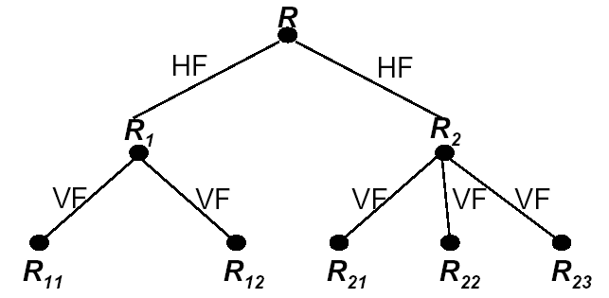
Hybrid Fragmentation: HF
Hybrid fragmentation:Hybrid, mixed, nested.
VF may be followed by HF, or vice versa
producing a tree-structured partitioning
Reconstruction of Hybrid Fragmentation
Notes:
Applying horizontal fragmentation to vertical fragments
Applying vertical fragmentation to horizontal fragments
If a simple horizontal or vertical fragmentation does not satisfy the requirements of user
applications, then a vertical fragmentation may be followed by a horizontal one, or vice
versa, producing a tree-structured partitioning.
The number of levels of nesting can be large, but in practical applications they do not
exceed 2. This is due to the fact that normalised global relations already have smaller
degrees and one cannot perform too many vertical fragmentation before the cost of joins
becomes very high.
The reconstruction for the hybrid fragmentation in Figure 7 will be

Slide 34
Outline
Introduction
Top-down Design Process
Distribution Design Issues
Data Fragmentation Design
Data Allocation Design（物理存储设计）
Introduction
Information Requirements
Allocation Models
Database Sharding
Data Directory
Summary

Slide 35
Data (Fragment) Allocation
Example: EMP(ENO,ENAME,LOC,SAL) ⇒
F1 = _{σloc=Sa} EMP ; F2 = _{σloc=Sb} EMP
Q_{a}: select … where loc=S_{a}...
Q_{b}: select … where loc=S_{b}…
Where do
F₁,F₂ go?
Site a
Site b
Replicas?

Slide 36
Data(Fragment) Allocation(cont’d)
Allocation problem definition（形式化定义）
Allocation of resources across the network has been much studied
however, most of this work is about placing files
rather than DDB design
Given
F = {F₁, F₂, …, F_{n}} fragments
S = {S₁, S₂, …, S_{m}} network sites
Q = {q₁, q₂, …, q_{q}} applications
Find the “optimal” distribution of F to S.
Notes:
Assume that there are a set of fragments F = {F1, ..., Fn} and a network consisting of sites
S = {S1, ..., Sm} on which a set of applications Q = {q1, ..., qq} is running. The allocation
problem involves finding the “optimal” distribution of F to S.
The optimality can be defined with respect to two measures:
1 Minimal cost. The cost function consists of the cost of storing each Fi at a site Sj,
the cost of querying Fi at site Sj, the cost of updating Fi at all sites where it is
stored, and the cost of data communication.
2 Performance. The allocation strategy is designed to maintain a performance metric,
for example, to minimise the response time and to maximise the system throughput
at each site.
There are no general models (even heuristic models) that take as input a set of fragments
and produce a near-optimal allocation subject to database constraints. The models developed
to date make a number of simplifying assumptions and are applicable to certain specific
formulations.

Slide 37
Fragment Allocation (cont’d)
Definition of optimality[Dowdy and Foster, 1982]
1. Minimal cost
communication cost +
storage cost +
processing cost (read & update)
2. Performance
response time and/or
throughput
Optimality measure should include both performance and the cost factors
Constraints
Per site constraints (storage and processing)
Available bandwidth, power
Notes:
What is best placement of fragments and/or best number of copies to:
minimize query response time
maximize throughput
minimize “some cost”
...
Subject to constraints?
Available storage
Available bandwidth, power,…
Keep 90% of response time below X
...
在传统的文件服务器以及多结点并行处理应用中，被处理数据的分布合理与否将很大程度影响解决问题的效率。因此文件分配问题（File Allocation /Assign Problem, FAP）一直是计算机系统优化的主要研究内容之一。但FAP是一个复杂问题，在允许多副本存在条件下n个结点，m个文件的可能分配方案有种，即使不允许副本条件下其分配方案仍然有种。而且不同的设计目标、系统条件、以及技术方案都会导致不同的文件优化配置结果。目前，虽然没有可行的算法可以给出通用的分配方案，但文件分配问题存在于各种不同应用场合，人们根据这些应用场合的特点分别建立了不同的启发模型，相应的启发算法可以在合理的开销内和精度范围内给出可行解。此外已有的结论还表明在一些特殊应用场合下，文件分配优化问题可以通过精心设计的模型得到具有多项式复杂性的解法。Web服务器中的对象一般以文件方式保存，因此可以把Web服务对象在服务器集群多结点之间复制分布抽象为一般的文件分配问题加以研究。
求解FAP问题的传统做法是建立合理的简化模型，并在此基础上研究可行的启发算法。因为FAP问题往往与直观观察所得到的结论相反。例如对于追求系统最大吞吐率的FAP问题中，把文件分配给最常用到的结点可能带来性能的下降。相反地把相应文件分配给不常用的结点可能会给其它结点造成较少的通信拥塞，而方案的选择及其效果则直接取决于“最优解”的定义。最优解的目标之一是最小开销。其目标函数的设计可能包括文件存储开销，访问开销，更新开销以及通信开销，设备容量，排队延迟等，它们一般隶属于非线性的整数规划问题。由于目标函数本身可以给出精确定义，因此如果能够求解的话则所得到的就是问题的精确解。但困难之处在于整数规划问题本身一般都很难求解。如果采用启发式算法，则由于无法预知启发解与最优解之间的差别而很难衡量算法的优劣。另外一类优化目标是性能，经常考虑的性能指标是最短响应时间和最大吞吐率。这类FAP问题主要用于解决具有排队延迟特性以及随机路由（即可以重新选择路径来访问文件）功能的系统。对于这样的系统，首先需要建立一种排队网络模型，然后通过对其参数（设备速度，访问概率等）设置对模型的性能进行优化，最后在此基础上确定文件分配方案。如果能够找到一种方案可以达到上述优化排队模型参数的要求，则可认为方案本身也接近最优。这类问题中，一般可以预先知道最优性能的上界，因此可以对启发算法的优劣进行有把握的评价。
传统的做法是系统设计阶段一般采用优化开销的目标函数，而取决于动态负载情况的性能指标则需推迟到系统运行之后再考虑。在经过合理的简化和抽象后，利用FAP问题的启发解结果可以取得很好的系统优化效果。

Slide 38
Fragment Allocation (cont’d)
Simple FAP Model
Single fragment F
Sites S₁, … S_{m}
Variables X₁, …, X_{m}
0 if F not stored at S_{j}
1 if F stored at S_{j}
X_{j} =
Total cost=Read Cost+Write Cost+Storage Cost
Determine the values for X_{j}, 1 ≤ j ≤ m, such that total cost is minimized

Slide 39
Fragment Allocation (cont’d)
Stream of read
requests at site S_{i}for F
t_{i} REQ/SEC
Read cost
1 2
.
. .
F
F
.
.
c_{i,1}
c_{i,2}
m
3
c_{i,3}
C=inf
Read cost = ∑ [t_{i} × MIN C_{ij}]
i: Originating site of request
t_{i}: Read traffic at S_{i：}t_{i} REQ/SEC
C_{ij}:Retrieval cost of accessing fragment F at S_{j} from S_{i}
F
.
i
i=1
C=inf
C=inf

Slide 40
Fragment Allocation (cont’d)
Write cost
Updates
u_{i} updates/sec
. .
F
F
Write cost = ∑ ∑ X_{j} u_{i} C’_{ij}
i: Originating site of request
j: Site being updated
X_{j}: 0 if F not stored at S_{j}
1 if F stored at S_{j}
u_{i}: Write traffic at S_{i}
C’_{ij}: Write cost of updating F at S_{j} from S_{i}
.
.
m
m
i=1
j=1
F
.
.
i

Slide 41
Fragment Allocation (cont’d)
Storage cost(p.115):
m
X_{i}: 0 if F not stored at S_{i}
1 if F stored at S_{i}
d_{i}: storage cost for F at S_{i}
∑ X_{i} d_{i}
i=1
FAP Target function:
m
m
min ∑ （t_{i} ×MIN C_{ij} + ∑ X_{j} × u_{i} × C’_{ij} )
+ ∑ X_{i} × d_{i}
i=1
j
j=1
m
Casey 1972: Allocation of copies of a file in an information network
i=1

Slide 42
Fragment Allocation for Distributed Database
Issues
Where do queries originate
What is communication cost? and size of answers, relations,…
What is storage capacity, cost at sites? and size of fragments?
What is processing power at sites?
More Issues
What is query processing strategy?
How are joins done?
Where are answers collected?
Do we replicate fragments?
Cost of updating copies?
Writes and concurrency control?
...

Slide 43
Fragment Allocation (cont’d)
Can add more complications (p.116):
- Relationship of fragments: not individual files
- Fragment access data size: not simple “remote file access”
- Integrity enforcement cost:
- Concurrency control cost
File allocation (FAP)&Database allocation (DAP)
Even simplest FAP formulation is NP-complete
DAP problem is more complex
Often, place fragments where they are most heavily accessed
Rothnie and Goodman, 1977
A survey of research and development in
distributed database management
Notes:
File allocation (FAP)&Database allocation (DAP)
FAP problem is NP-complete
DAP problem is more complex
Fragments are not individual files
relationships between fragments have to be considered(maintained)
Access to databases is more complicated
relationship between allocation and query processing
simple “remote file access model” may not be applicable
Cost of integrity enforcement should be considered
Cost of concurrency control should be considered

Slide 44
Outline
Introduction
Top-down Design Process
Distribution Design Issues
Data Fragmentation Design
Data Allocation Design
Introduction
Information Requirements
Allocation Models
Database Sharding
Data Directory
Summary

Slide 45
Information requirements
Database information
Selectivity of fragment F_{j} with respect to query q_{i}
# of tuples in F_{j} that need to be accessed for q_{i}
Size of a fragment
Application information
Number of read accesses of query q_{i} to fragment F_{j} :RR_{i,j}
Number of update accesses of query q_{i} to fragment F_{j} :UR_{i,j}
A matrix UM indicating which queries updates which fragments
A similar matrix RM for retrievals
A vector O of values o(i) is also defined, where o(i) specifies the originating site of query q_{i}.
size(F_{j}) = card(F_{j})*length(F_{j})
Notes:
Database information
Selectivity of fragments
Size of fragments
Application information
Access types and numbers
Access localities
Communication information
Unit cost of storing data at a site
Unit cost of processing at a site
Computer system information
Bandwidth
Latency
Communication overhead

Slide 46
Information requirements(cont’d)
Site information
Storage capacity
Processing capacity
Unit cost of storing data at a site S_{k}: USC_{k}
Unit cost of processing at a site S_{k}: LPC_{k}
Network information
Bandwidth (channel) capacity
Protocol overhead: latency
Communication cost per frame between two sites S_{i} and S_{j}: g_{i,j}
Calculation of the number of messages
Frame size
Notes:
换句话说对数据库系统要有更深入的了解才能进行物理存储设计

Slide 47
Outline
Introduction
Top-down Design Process
Distribution Design Issues
Data Fragmentation Design
Data Allocation Design
Introduction
Information Requirements
Allocation Models
Database Sharding
Data Directory
Summary

Slide 48
Allocation Model
DAP Allocation model(p.118)
Minimize the total cost of processing and storage
while trying to meet response time constraints
min(Total cost)
subject to
response time constraint
storage constraint
processing constraint
Decision Variable

Slide 49
Allocation Model(cont’d)
Total cost
Σ_{all queries} (query processing cost) +
Σ_{all sites}Σ_{all fragments} (storage cost of a fragment at a site)
STC_{jk}: Storage cost of fragment F_{j} at site S_{k}
(unit storage cost at S_{k}) * (size of F_{j}) * x_{jk}
QPC_{i:}Query processing cost
processing component + transmission component
QPC_{i}=PC_{i}+TC_{i}

Slide 50
Allocation Model(cont’d)
Query processing cost for one application
① Processing component:PC_{i}
access cost + integrity enforcement cost + concurrency control cost
Access cost
Σ_{all sites}Σ_{all fragments} (# of read accesses + # of update accesses) * x_{ij} * (local processing cost at a site)
simple assumption
read cost = update cost
Integrity enforcement costs(IE_{i}) and concurrency control costs (CC_{i})
can be similarly calculated

Slide 51
Allocation Model(cont’d)
② Transmission component: TC_{i}
cost for updates + cost for retrievals
Cost of updates:TCU_{i}
Σ_{all sites}Σ_{all fragments}(cost of update message) * x_{ij} +
Σ_{all sites}Σ_{all fragments}(cost of acknowledgment) * x_{ij}
Cost for retrieval: TCR_{i}
Σ_{all fragments} min _{all sites} (cost of retrieval request +
cost of sending back the result) * x_{ij}

Slide 52
Allocation Model(cont’d)
Constraints
Response time constraint
(execution time of a query) ≤ (maximum allowable response time for that query)
Storage capacity constraint (for a site)
Σ_{all fragments} (storage requirement of a fragment at that site) ≤(storage capacity at that site)
Processing capacity constraints (for a site)
Σ_{all queries} (processing load of a query at that site) ≤(processing capacity of that site)

Slide 53
Solution methods(cont’d)
Solution methods
FAP is NP-complete, DAP is also NP-complete
Look for heuristic methods developed by operations researchers:
Knapsack problem solutions[Ceri et al., 1982]
Branch and bound techniques[Fisher and Hochbaum, 1980]
Network flow problem solutions[Chang and Liu, 1982]
Single commodity warehouse location (for FAP) [Ramamoorthy and Wah, 1983].
Other attempts to reduce the complexity of the problems
costs and benefits in terms of query processing
ignore replication at first and find an optimal non-replicated solution

Slide 54
Outline
Introduction
Top-down Design Process
Distribution Design Issues
Data Fragmentation Design
Data Allocation Design
Introduction
Information Requirements
Allocation Models
Database Sharding
Data Directory
Summary

Slide 55
Database Sharding
The term "sharding” was coined by Google and popularized through "Big Table" architecture
Database sharding can be simply defined as a "shared-nothing" partitioning scheme for large databases across a number of servers.
However, the concept of "shared-nothing" database partitioning has been around for more than a decade and there have been many implementations during this period from in-house solutions to commercial database management tools
The business reasons for database sharding are also driven by cost.
Notes:
https://en.wikipedia.org/wiki/Shard_(database_architecture)
A database shard is a horizontal partition of data in a database or search engine. Each individual partition is referred to as a shard or database shard. Each shard is held on a separate database server instance, to spread load.
In practice, sharding is complex. Although it has been done for a long time by hand-coding, this is often inflexible. There is a desire to support sharding automatically, both in terms of adding code support for it, and for identifying candidates to be sharded separately. Consistent hashing is one form of automatic sharding to spread large loads across multiple smaller services and servers
http://www.dbta.com/Editorial/Trends-and-Applications/Database-Sharding--The-Key-to-Database-Scalability-55615.aspx
The concept of database sharding has gained popularity over the past several years due to the enormous growth in transaction volume and size of business-application databases. This is particularly true for many successful online service vendors, software-as-a-service companies and social networking websites.
Database sharding can be simply defined as a "shared-nothing" partitioning scheme for large databases across a number of servers, enabling new levels of database performance and scalability. If you think of broken glass, you can get the concept of sharding-breaking your database down into smaller chunks called "shards" and spreading them across a number of distributed servers.
The term "sharding" was coined by Google and popularized through its publication of the "Big Table" architecture. However, the concept of "shared-nothing" database partitioning has been around for more than a decade and there have been many implementations during this period from in-house solutions to commercial database management tools.
What Drives the Need for Database Sharding?
Database sharding is a highly scalable approach for improving the throughput and overall performance of high-transaction, large, database-centric business applications. Since the inception of the relational database, application engineers and architects have required ever-increasing performance and capacity due to the simple observation that business databases generally grow in size over time. Adding to this trend is the extreme expansion of business data due to the evolution of the Internet economy, the Information Age and the prevalence of high-volume electronic commerce.
The business reasons for database sharding are also driven by cost. With today's stressful economy, organizations need to reduce infrastructure costs, while improving performance and scalability to remain competitive. At first glance, it may seem that "sharding" a single database across a number of independent servers could actually increase costs, but given a correct implementation, the financial benefits are significant.
As any experienced database administrator or application developer knows all too well, it is axiomatic that as the size and transaction volume of the database tier incurs linear growth, response times tend to grow logarithmically.
The reasons for the performance and scalability challenges are inherent to the fundamental design of the database management systems themselves. Databases rely heavily on the primary three components of any computer: CPU, memory and disk.
Each of these elements on a single server can only scale to a given point-after that, you need to take additional measures to improve performance. While it is common knowledge that disk I/O is the primary bottleneck, as database management systems have improved they also continue to take greater advantage of CPU and memory. In fact, we have observed that obtaining the correct balance of these three resources is the key to maximizing performance and scalability. In other words, you cannot add an unlimited number of CPUs (or processing cores) and see a commensurate increase in performance without also improving the memory capacity and performance of the disk-drive subsystem. It is also common to see a diminishing return as resources are added to a single database server. These factors are especially true in mixed-use business transaction systems and ones that perform a high volume of read and write transactions, as well as supporting generalized business reporting tasks.
Therefore, as business applications gain sophistication and continue to grow in demand, architects, developers and database administrators have been presented with a constant challenge of maintaining database performance for mission-critical systems. This landscape drives the need for database sharding.
Database Sharding-The "Shared-Nothing" Approach
Database sharding provides a method for scalability across independent servers, each with its own CPU, memory and disk. The technique allows the proper balancing of database size with system resources, resulting in dramatic performance improvements and scalability for a given application. Although the concept of a "shared-nothing" database implementation has been under discussion for more than 15 years, it appears that the business application market is just now identifying a generalized need for database sharding due to the exponential increase in data volumes over the past several years.
The basic concept of database sharding is very straightforward: take a large database and break it into a number of smaller databases across multiple servers. Each "shard" (running on its own server) contains a portion of the original monolithic database, and is "sharded" based on application-specific rules. For example, many organizations "shard" by customer, with each shard containing a specific group of customer-related information. Database queries and write operations are then performed in one of two modes:
Single-Shard: Each database operation (read or write) is performed against a single "shard," such as for a single customer transaction.
Multi-Shard: This typically applies to analytic queries, performed in parallel across one or more "shards," enabling impressive performance results.
How fast is database sharding? It depends on your application and its specific requirements. However, in general, you can plan on near-linear scalability as you add "shards" and servers for typical single-shard transactions. For multi-shard queries, especially analytic operations, the results can be many times faster when compared to a single monolithic database due to the parallel processing capability and the correct balancing of database size to system resources.
The obvious advantage of the shared-nothing database sharding approach is improved scalability, growing in a near-linear fashion as more servers are added to the network. However, there are several other advantages of smaller databases, which should not be overlooked when considering a sharding solution:
Smaller Databases are Easier to Manage. Production databases must be fully managed for regular backups, database optimization and other common tasks. With a single large database these routine tasks can be very difficult to accomplish, if only in terms of the time window required for completion. Routine table and index optimizations can stretch from hours to days, in some cases making regular maintenance infeasible. By using the sharding approach, each individual "shard" can be maintained independently, providing a far more manageable scenario, performing such maintenance tasks in parallel.
Smaller Databases are Faster. The scalability of sharding is apparent and achieved through the distribution of processing across multiple shards and servers in the network. What is less apparent is the fact that each individual shard database will outperform a single large database due to its smaller size. By hosting each shard database on its own server, the ratio between memory and data on disk is properly balanced, thereby reducing disk I/O and maximizing system resources. This results in less contention, greater join performance, faster index searches and fewer database locks. Therefore, not only can a sharded system scale to new levels of capacity, individual transaction performance is benefited as well.
Database Sharding can Reduce Costs. Most database sharding implementations take advantage of low-cost open source databases and commodity databases. The technique can also take full advantage of reasonably priced "workgroup" versions of many commercial databases. Sharding works well with commodity multi-core server hardware, systems that are far less expensive when compared to high-end, multi-CPU servers and expensive storage area networks (SANs). The overall reduction in cost due to savings in license fees, software maintenance and hardware investment is substantial-in some cases 70% when compared to traditional solutions.
There is no doubt that database sharding is a viable solution for many organizations, supported by the number of large online vendors and SaaS organizations that have implemented the technology, including Amazon, eBay and, of course, Google.
This article has provided a brief overview of database sharding, what it is and why it's of benefit to today's business organizations. Database sharding has been proven in many organizations, large and small (but growing ...), and may very well be applicable to your specific application problems. When implemented properly, database sharding can deliver on the objective of cost-effective, near-linear scalability for high-volume business transaction applications.

Slide 56
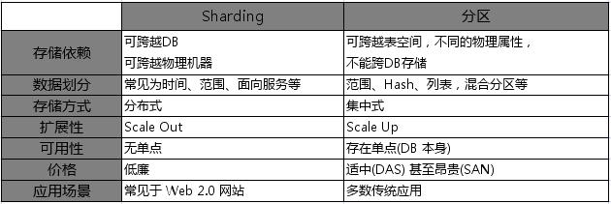
Shards compared to horizontal partitioning
Horizontal partitioning splits tables by row, usually within a single instance of a schema and a database server.
Sharding goes beyond this: it partitions tables in the same way, but it does this across multiple instances of the schema.
The obvious advantage would be that search load for the large partitioned table can now be split across multiple servers (logical or physical), not just multiple indexes on the same logical server.
Notes:
Shards compared to horizontal partitioning[edit]
Horizontal partitioning splits one or more tables by row, usually within a single instance of a schema and a database server. It may offer an advantage by reducing index size (and thus search effort) provided that there is some obvious, robust, implicit way to identify in which table a particular row will be found, without first needing to search the index, e.g., the classic example of the 'CustomersEast' and 'CustomersWest' tables, where their zip code already indicates where they will be found.
Sharding goes beyond this: it partitions the problematic table(s) in the same way, but it does this across potentially multiple instances of the schema. The obvious advantage would be that search load for the large partitioned table can now be split across multiple servers (logical or physical), not just multiple indexes on the same logical server.
Splitting shards across multiple isolated instances requires more than simple horizontal partitioning. The hoped-for gains in efficiency would be lost, if querying the database required both instances to be queried, just to retrieve a simple dimension table. Beyond partitioning, sharding thus splits large partitionable tables across the servers, while smaller tables are replicated as complete units.
This is also why sharding is related to a shared nothing architecture—once sharded, each shard can live in a totally separate logical schema instance / physical database server / data center / continent. There is no ongoing need to retain shared access (from between shards) to the other unpartitioned tables in other shards.
This makes replication across multiple servers easy (simple horizontal partitioning does not). It is also useful for worldwide distribution of applications, where communications links between data centers would otherwise be a bottleneck.
There is also a requirement for some notification and replication mechanism between schema instances, so that the unpartitioned tables remain as closely synchronized as the application demands. This is a complex choice in the architecture of sharded systems: approaches range from making these effectively read-only (updates are rare and batched), to dynamically replicated tables (at the cost of reducing some of the distribution benefits of sharding) and

Slide 57
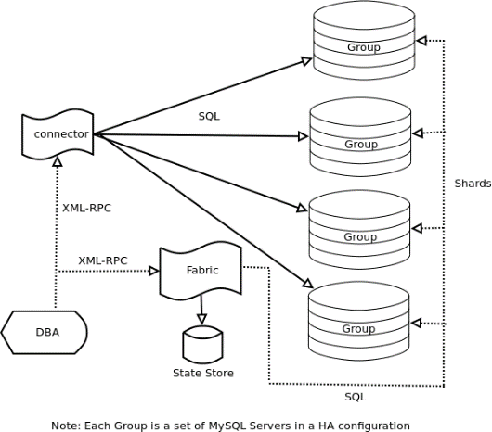
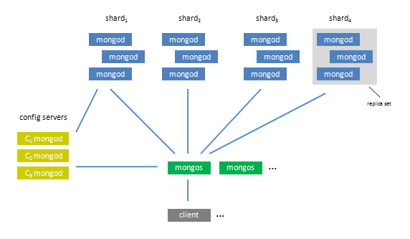
Database Sharding
MySQL Sharding
MySQL Fabric Sharding - Basic Architecture
Three types of nodes or processes
MongoDB Sharding
Azure SQL
Oracle Sharding
Notes:
http://www.tuicool.com/articles/eum2maE
http://dbanotes.net/database/database_sharding-2.html
从 Shard 到 Sharding
“Shard” 这个词英文的意思是”碎片”，而作为数据库相关的技术用语，似乎最早见于大型多人在线角色扮演游戏(MMORPG)中。”Sharding” 姑且称之为”分片”。
Sharding 不是一门新技术，而是一个相对简朴的软件理念。如您所知，MySQL 5 之后才有了数据表分区功能，那么在此之前，很多 MySQL 的潜在用户都对 MySQL 的扩展性有所顾虑，而是否具备分区功能就成了衡量一个数据库可扩展性与否的一个关键指标(当然不是唯一指标)。数据库扩展性是一个永恒的话题，MySQL 的推广者经常会被问到：如在单一数据库上处理应用数据捉襟见肘而需要进行分区化之类的处理，是如何办到的呢? 答案是：Sharding。
Sharding 不是一个某个特定数据库软件附属的功能，而是在具体技术细节之上的抽象处理，是水平扩展(Scale Out，亦或横向扩展、向外扩展)的解决方案，其主要目的是为突破单节点数据库服务器的 I/O 能力限制，解决数据库扩展性问题。
事关数据库扩展性
说起数据库扩展性，这是个非常大的话题。目前的商业数据都有自己的扩展性解决方案，在过去相对来说比较成熟，但是随着互联网的高速发展，不可避免的会带来一些计算模式上的演变，这样很多主流商业系统也难免暴露出一些不足之处。比如 Oracle 的 RAC 是采用共享存储机制，对于 I/O 密集型的应用，瓶颈很容易落在存储上，这样的机制决定后续扩容只能是 Scale Up（向上扩展） 类型，对于硬件成本、开发人员的要求、维护成本都相对比较高。
Sharding 基本上是针对开源数据库的扩展性解决方案，很少有听说商业数据库进行 Sharding 的。目前业界的趋势基本上是拥抱 Scale Out，逐渐从 Scale Up 中解放出来。
Sharding 的应用场景
任何技术都是在合适的场合下能发挥应有的作用。 Sharding 也一样。联机游戏、IM、BSP 都是比较适合 Sharding 的应用场景。其共性是抽象出来的数据对象之间的关联数据很小。比如IM ，每个用户如果抽象成一个数据对象，完全可以独立存储在任何一个地方，数据对象是 Share Nothing 的；再比如 Blog 服务提供商的站点内容，基本为用户生成内容(UGC)，完全可以把不同的用户隔离到不同的存储集合，而对用户来说是透明的。
这个 “Share Nothing” 是从数据库集群中借用的概念，举例来说，有些类型的数据粒度之间就不是 “Share Nothing” 的，比如类似交易记录的历史表信息，如果一条记录中既包含卖家信息与买家信息，如果随着时间推移，买、卖家会分别与其它用户继续进行交易，这样不可避免的两个买卖家的信息会分布到不同的 Sharding DB 上，而这时如果针对买卖家查询，就会跨越更多的 Sharding ，开销就会比较大。
Sharding 并不是数据库扩展方案的银弹，也有其不适合的场景，比如处理事务型的应用就会非常复杂。对于跨不同DB的事务，很难保证完整性，得不偿失。所以，采用什么样的 Sharding 形式，不是生搬硬套的。
Sharding与数据库分区(Partition)的区别
有的时候，Sharding 也被近似等同于水平分区(Horizontal Partitioning)，网上很多地方也用 水平分区来指代 Sharding，但我个人认为二者之间实际上还是有区别的。的确，Sharding 的思想是从分区的思想而来，但数据库分区基本上是数据对象级别的处理，比如表和索引的分区，每个子数据集上能够有不同的物理存储属性，还是单个数据库范围内的操作，而 Sharding 是能够跨数据库，甚至跨越物理机器的。（见对比表格）
(转载别忘了此图。注明全文来自 http://www.dbanotes.net)
Sharding 策略
数据 Sharding 的策略与分区表的方式有很多类似的地方，有基于表、ID 范围、数据产生的时间或是SOA 下理念下的基于服务等众多方式可选择。而与传统的表分区方式不同的是，Sharding 策略和业务结合的更为紧密，成功的 Sharding 必须对自己的业务足够熟悉，进行众多可行性分析的基础上进行，”业务逻辑驱动”。
Sharding 实现案例分析：Digg 网站
作为风头正劲的 Web 2.0 网站之一的 Digg.com，虽然用户群庞大，但网站数据库数据并非海量，去年同期主数据大约只有 30GB 的样子，现在应该更大一些，但应该不会出现数量级上增长，数据库软件采用 MySQL 5.x。Digg.com的 IO 压力非常大，而且是读集中的应用(98%的 IO 是读请求)。因为提供的是新闻类服务，这类数据有其自身特点，最近时间段的数据往往是读压力最大的部分。
根据业务特点，Digg.com 根据时间范围对主要的业务数据做 Sharding，把不到 10% 的”热”数据有效隔离开来，同时对这部分数据用以更好的硬件，提供更好的用户体验。而另外 90% 的数据因用户很少访问，所以尽管访问速度稍慢一点，对用户来说，影响也很小。通过 Sharding，Digg 达到了预期效果。
现有的 Sharding 软件简介
现在 Sharding 相关的软件实现其实不少，基于数据库层、DAO 层、不同语言下也都不乏案例。限于篇幅，作一下简要的介绍。
MySQL Proxy + HSCALE
一套比较有潜力的方案。其中 MySQL Proxy (http://forge.mysql.com/wiki/MySQL_Proxy) 是用 Lua 脚本实现的，介于客户端与服务器端之间，扮演 Proxy 的角色，提供查询分析、失败接管、查询过滤、调整等功能。目前的 0.6 版本还做不到读、写分离。HSCALE 则是针对 MySQL Proxy 插件，也是用 Lua 实现的，对 Sharding 过程简化了许多。需要指出的是，MySQL Proxy 与 HSCALE 各自会带来一定的开销，但这个开销与集中式数据处理方式单条查询的开销还是要小的。
Hibernate Shards
这是 Google 技术团队贡献的项目（http://www.hibernate.org/414.html），该项目是在对 Google 财务系统数据 Sharding 过程中诞生的。因为是在框架层实现的，所以有其独特的特性：标准的 Hibernate 编程模型，会用 Hibernate 就能搞定，技术成本较低；相对弹性的 Sharding 策略以及支持虚拟 Shard 等。
Spock Proxy
这也是在实际需求中产生的一个开源项目。Spock（http://www.spock.com/）是一个人员查找的 Web 2.0 网站。通过对自己的单一 DB 进行有效 Sharding化 而产生了Spock Proxy(http://spockproxy.sourceforge.net/ ) 项目，Spock Proxy 算得上 MySQL Proxy 的一个分支，提供基于范围的 Sharding 机制。Spock 是基于 Rails 的，所以Spock Proxy 也是基于 Rails 构建，关注 RoR 的朋友不应错过这个项目。
HiveDB
上面介绍了 RoR 的实现，HiveDB (http://www.hivedb.org/)则是基于Java 的实现，另外，稍有不同的是，这个项目背后有商业公司支持。
PL/Proxy
前面几个都是针对 MySQL 的 Sharding 方案，PL/Proxy 则是针对 PostgreSQL 的，设计思想类似 Teradata 的 Hash 机制，数据存储对客户端是透明的，客户请求发送到 PL/Proxy 后，由这里分布式存储过程调用，统一分发。 PL/Proxy
的设计初衷就是在这一层充当”数据总线”的职责，所以，当数据吞吐量支撑不住的时候，只需要增加更多的 PL/Proxy 服务器即可。大名鼎鼎的 Skype 用的就是 PL/Proxy 的解决方案。
Pyshards
http://code.google.com/p/pyshards/wiki/Pyshards 这是个基于 Python的解决方案。该工具的设计目标还有个 Re-balancing 在里面，这倒是个比较激进的想法。目前只支持 MySQL 数据库。
结束语
Sharding 是一项仍处于高速发展中的”老”技术，随着 Web 2.0 的发展，Sahrding逐渐从比较”虚”的概念变成比较”实”的运用思路，开放源代码软件大潮也给 Sharding 注入新的活力，相信会有越来越多的项目采用 Sharding 技术，也会有更多成熟的 Sharding 方案和数据库附加软件涌现。
你的站点 Sharding 了么?

Slide 58
Oracle Sharding
https://blog.csdn.net/stevensxiao/article/details/86589326
System-managed sharding (12c):哈希水平分片，
Composite sharding (12c):先按列表和范围分，后按照哈希分
User-defined Sharding (18c): 更灵活，如合规性
List item (18c): 列表分片
PDB Sharding (18c): PDB充当分片
RAC Sharding (18c)：RAC实例充当分片
JSON & Spatial capabilities and Multi-shard query enhancements (18c)
Midtier Sharding:增加了web和应用的分片，类似于泳道
https://docs.oracle.com/en/database/oracle/oracle-database/19/shard/sharding-overview.html
Notes:
分片数据库的合集称为SDB。每一个分片是独立的Oracle数据库，一个服务器建议部署一个分片。分片和分区逻辑上是相似的。分片数据库外，还需要一个数据库，即Shard Catalog，其中存储了全局Schema以及其它元数据。此数据库只影响管理（如增删分片，数据分布等），和跨多个分片的查询。Shard Director用于路由，根据是shard key。可以部署多个，本质是Listener。从Shard Director到分片数据库之间，可以建立连接池。在分片环境中，可以有分片表（Sharded tables）和复制表（Duplicated tables）。后者可用于参照数据或主数据。但复制使用的技术？分片建议采用Data Guard保护。是整个环境的复制，还是部分分片的复制？应该都可以，但前者可以保护整个环境。支持DG（默认），ADG和OGG。各分片数据库的版本要一致，版本大于12.2.0.1。尽管可以不一致，但可能有兼容性问题。在组件上，需要多安装一个GSM，相当于客户端和目标数据库间的hub。SDB适合跨地理区域部署吗?可能不建议。SDB支持数据自动重新分布。
————————————————
版权声明：本文为CSDN博主「dingdingfish」的原创文章，遵循 CC 4.0 BY-SA 版权协议，转载请附上原文出处链接及本声明。
原文链接：https://blog.csdn.net/stevensxiao/article/details/86589326

Slide 59
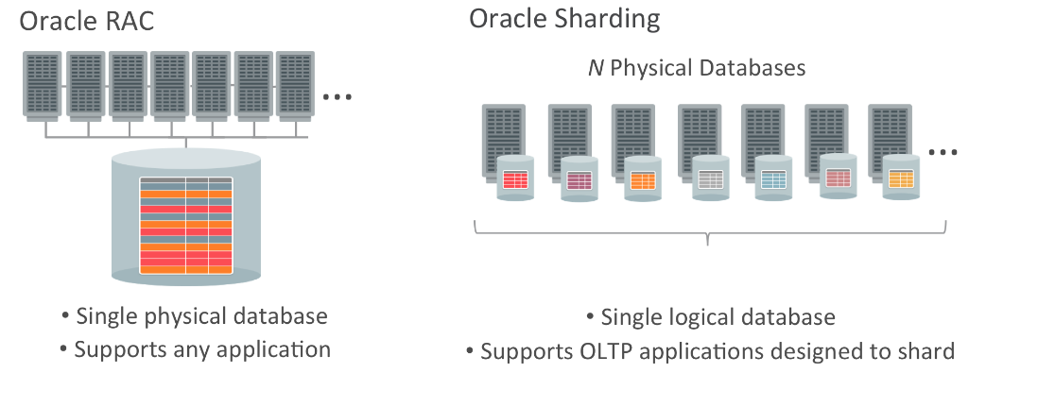
Oracle RAC & Oracle Sharding
http://www.oracle.com/technetwork/database/availability/oraclesharding-whitepaper-3675509.pd

Slide 60
Outline
Introduction
Top-down Design Process
Distribution Design Issues
Data Fragmentation Design
Data Allocation Design
Data Directory
Summary
Notes:
http://www.dbmsmag.com/9705d15.html
The promise of distributed databases has been with us a long time. Until relatively recently, though, the technology available to set up a distributed database was either too limited or too complicated. Today, database replication, the copying and maintenance of data on multiple servers, has come of age. Every major database vendor has a replication solution of one kind or another, and many nondatabase vendors also offer alternative methods for replicating data.
In this article, I look at three of the top databases and compare their replication technology. For various reasons, I have chosen to look at replication solutions from Microsoft Corp. (Redmond, Wash.), Oracle Corp. (Redwood Shores, Calif.), and Sybase Inc. (Emeryville, Calif). Other database products, including those from Informix Software Inc. (Menlo Park, Calif.), IBM Corp. (Armonk, N.Y.), and Computer Associates International Inc. (Islandia, N.Y.), have advanced replication technology, and you can build solid replication architectures with middleware products such as those from Tuxedo and TopEnd. Before I look at descriptions of the three different approaches, though, it would be worthwhile to discuss some of the issues with replication.
As I look at more replication products, I keep thinking the same thing: This is not a toy to be taken lightly. Don't be fooled by the easy configuration of some products, notably Microsoft's -- replication is serious business. Even if the user interface simplifies the implementation and administration, replication requires careful analysis and planning. It is also important to have a thorough understanding of the mechanism that your database uses for replication.
Managing a distributed database is vastly more difficult than managing a centralized database, and time spent justifying and planning for the extra work is worthwhile. Write down your reasons for setting up a distributed database. Draw a diagram of your database network, then define exactly which data you wish to replicate and which form it will take -- will it be a full copy, subset, summary, or combination of source data? Use a word processor, spreadsheet, drawing program, or CASE tool to document your requirements. This should give you a good idea of the task ahead.
If you are replicating in order to have a "hot standby" system, look into alternatives to replication, such as hardware solutions and database mirroring. In such situations, it pays to use a system that was built for hot standby -- some of the issues are different from those for regular data distribution.
It is extremely important to plan for all or part of your network going down. Often, this is the main reason for replicating in the first place -- remote users can continue working even if the connection to the central site is down. Some replication systems automatically synchronize all replicas when the network is available again, and some require manual intervention. You will need to decide whether your applications will have to change in order to take advantage of this.
Finally, make sure that all database administration takes the distributed database into account. This is especially important in an environment where the staff is familiar with a centralized database. Decisions regarding database manipulation, recovery, and network management are different when the data is distributed.

Slide 61
DDBMS Architectures: P2P DDBMS (recall)
Functional description of the reference model
Enterprise
administrator
Database
administrator
Conceptual database
schema process
Application
administrator
Internal database
schema process
External database
schema process
Local Database
administrator
DD
GD/D
Local data management
Local data management
DD
DD
LD/D
LD/D
Notes:
Data replication refers to the storage of data copies at multiple sites served by a computer
network. The unit of data replication can be at the level of tables or fragments. The existence
of multiple copies can enhance data availability and response time, and can help to
reduce communication cost and query cost.
Employing replicated (or redundant) components is a common concept in real life. An air
craft has four engines so that if any of the engines shuts down, the remaining engines can
still keep the craft in the air and land safely. Computer hardware systems often employ
duplicated parts (i.e. dual processors) to survive partial failures as well.
The reasons for replication are reliability and efficiency of read-only queries. Replications have three forms:
Full replication, where each replica has exactly the same data as other replicas.
Partial replication, in which some portions of the database are replicated while other portions are not replicated.
Partitioning. No data is replicated.

Slide 62
Data Directory
Data directory (database dictionary or system catalog)：a database contains information about entities of organizations and profiles of databases
A database about the database，commonly referred to as metadata，DBMS often maintains the DD
Why
Table Statistics
Number of rows
Number of blocks that have been used *
Number of blocks never used
Average available free space
Number of chained rows
Average row length
Number of distinct values in a column
The low value in a column *
The high value in a column *
System metadata are critical in a DBMS

Slide 63
DDBMS Directory Issues
Global directory（数据目录）
An extension of the data dictionary
as described in the ANSI/SPARC report
Includes information about the location of the fragments
As well as the makeup(组成结构) of the fragment
Directory management strategies
Type: a global directory to the entire database or many local directories to each site.
Location: maintained centrally at one site or in a distributed fashion by a number of sites.
Replication: a single copy of the directory or multiple copies.
Notes:
It is related with databases that use global conceptual schema
It contains meta-data about the actual data stored in the database.
Issues
Directory type: it may be global to the entire database or many local directories to each site.
Location: maintained centrally at one site or in a distribute fashion by a number of sites.
Replication: a single copy of directory or multiple copies.
Excerpts from academic.cs.15-721: 7-Oct-101 directory question by Neal Burns@andrew.cmu.ed > This is probably a dumb question, but what is meant by a > "directory based structure" for managing free space? Is that a > specific data structure? Hrm. I'll post since no response seems to have materialized yet. Generically? A directory consists of administrative data, such as structure that tells you how much space is available on any given data page. If you look at heapfile.h, there is a "DataPageInfo" structure that you may want to use. It's a fixed-size record that has room for - space available on a data page - number of records on data page - page ID of data page And the comments above it suggest a particular structure: Remember that the database functions require that a filename be associated with a page. One method would be to have no directory, and have the associated page be the first data page, which would be chained to the rest as a doubly-linked list. This would have a number of nasty drawbacks, however, such as having to read in every data page to count the number of records, and in general having to read many more pages than you should when inserting variable-size records. A far superior alternative is to have the associated page to be the first page of a doubly-linked list of directory pages. Since a DataPageInfo structure is pretty small -- for an X86, it's 12 bytes, methinks -- you can fit many DataPageInfo structures on a page. You could even use HFPage itself for the directory pages, treating each DPI as a record. This speeds up many tasks. For instance, to find out where you should insert a record, you need to scan the free space list. But because a DPI is small, a single page read can tell you the amount of free space on many data pages, rather than just one. Likewise, since record counts are stored in the suggested DPI structure, you no longer need to read every data page to count the total. Are there other possible directory structures? Sure. For starters, it _may_ be useful to treat the free space as a sort key for some kind of on-disk balanced tree, to speed up searches for a suitable page for a record insertion [*]. But, er, I doubt you really need to take that complicated an approach. If you use HFPage to store your directory pages, the prev/next pointers fit better with a doubly- linked list, anyway. [*] May, because this idea just popped into my head and hasn't been vetted at all.

Slide 64
DDBMS Directory Issues (cont’d)
Type
Global & central
& non replicated
Local & central
& nonreplicated(?)
Local & distributed
& non replicated
Global & distributed
& non replicated(?)
Local & central
& replicated(?)
Global & central
& replicated(?)
Location
Local & distributed
& replicated
Replication
Global & distributed
& replicated
Notes:
Directory management strategies
Type:a global directory to the entire database or many local directories to each site.
Location:maintained centrally at one site or in a distributed fashion by a number of sites.
Replication:a single copy of the directory or multiple copies.
Centralized - a complete catalog stored at one site
Fully replicated - each site hold a full copy of the complete catalog
Local - local catalog only describes local data

Slide 65
DDBMS Directory Issues (cont’d)
R* Solution (IBM project R*)
One entry stored at the birth site of the object
If the object is stored at birth site, the catalog contains all the information;
Otherwise it indicates the sites where copies of the object are held.
One entry stored at each site where a copy of object is held
Object Naming - System Wide Names :
identifier of the user who created the object (Joe)
site of the creator (Melbourne)
name of the object (EMP)
the birth site of the object (Sydney)
Joe@Melbourne.EMP@Sydney
Notes:
All schemata are stored in catalog (s) of DDB.
Purpose:
Support site autonomy
Local catalogs should not store information about objects not stored or created at the site
Name resolution should not require a random search of catalog entries in the network
Support transparent migration of objects (i.e. without program changes)
Systemwide names are unique names given to each object (table) in the system. Their components are:
identifier of the user who created the object (Joe)
site of the creator (Melbourne)
name of the object (EMP)
the birth site of the object (Sydney)
Joe@Melbourne.EMP@Sydney

Slide 66
DDBMS Directory Issues (cont’d)
Oracle
schema.schema_object@global_database_name
Example
Create database links
Schema Objects and Database Links
Using view and synonym to create location transparency
CREATE DATABASE LINK foo
CONNECT TO CURRENT_USER USING 'am_sls';
SELECT loc FROM scott.dept@foo
CREATE [PUBLIC] synonym_name FOR [schema.]object_name[@database_link_name];
Notes:
All synonyms are schema objects that are stored in the data dictionary of the database in which they are created. To simplify remote table access through database links, a synonym can allow single-word access to remote data, hiding the specific object name and the location from users of the synonym.
The syntax to create a synonym is:
CREATE [PUBLIC] synonym_name FOR [schema.]object_name[@database_link_name]; where:
PUBLIC is a keyword specifying that this synonym is available to all users. Omitting this parameter makes a synonym private, and usable only by the creator. Public synonyms can be created only by a user with CREATE PUBLIC SYNONYM system privilege.
synonym_name specifies the alternate object name to be referenced by users and applications.
schema specifies the schema of the object specified in object_name. Omitting this parameter uses the schema of the creator as the schema of the object.
object_name specifies either a table, view, sequence, materialized view, type, procedure, function or package as appropriate.
database_link_name specifies the database link identifying the remote database and schema in which the object specified in object_name is located.
A synonym must be a uniquely named object for its schema. If a schema contains a schema object and a public synonym exists with the same name, then the database always finds the schema object when the user that owns the schema references that name.

Slide 67
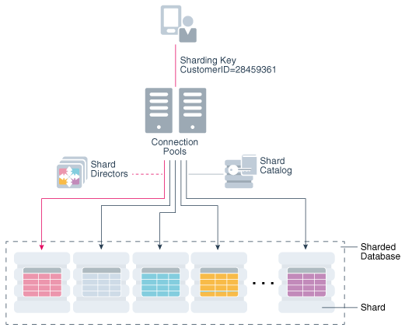
DDBMS Directory Issues (cont’d)
Oracle Sharding
Global service: provide access to data in an SDB
Shard catalog: An Oracle database that supports automated shard deployment, centralized management of multi-shard queries.
Shard directors: Network listeners that enable connection routing based on a sharding key.
Connection pools: route database requests across pooled connections.
Shard catalog
Notes:
Global service: Database services that provide access to data in an SDB and handle implementation of general services to a distributed service.
Shard catalog: An Oracle database that supports automated shard deployment, centralized management of a sharded database, and multi-shard queries, like leader nodes and config instances in MongoDB.
Shard directors: Network listeners that enable high-performance connection routing based on a sharding key. It's like a mongos instance and holds the key information stored in the shard catalog.
Connection pools: At runtime, these act as shard directors by routing database requests across pooled connections.

Slide 68
Outline
Introduction
Top-down Design Process
Distribution Design Issues
Data Fragmentation Design
Data Allocation Design
Data Directory
Summary

Slide 69
Distributed Database Design Summary
Design of centralized databases
Conceptual/logical schema design
Physical data mapping
Design of distributed databases
Conceptual Schema design (global schema)
Fragmentation design (logical criteria)
Allocation design (physical placement)
Physical data mapping (access methods, etc.)
Notes:
In addition to steps necessary for the design of centralized databases, distributed database design involves design steps specific distributed databases.
Although it is convenient to separate fragmentation and allocation design conceptually, in practice the two components of distributed database design are interrelated and cannot be treated independently.
Design of distributed databases requires a precise knowledge of application requirements :
1. Site at which the application is issued (site of origin)
2. The frequency of activation (for each given site)
Statistical character of accesses made by each site to different data objects.
Distributed database design is a relatively new field in database. While several design approaches have been documented in the literature, only limited experience exists with applying these design techniques to practical problems. Often, the complexity of real design situations makes the use of such techniques difficult without the support of CASE tools. Also, the design approach should take into account the limitations of the present DDBMS technology, if the design is to be implementable. The methodology presented here is based on S. Ceri and G. Pelagatti "Distributed Databases: Principles & Systems".
Good design of crucial importance in distributed database system; incorrect design decisions may result in severe degradation in performance.
In framework of DDB design, we learned what should be designed.
Main objective of design: How data should be distributed optimally?
What are the Issues:
Which criteria to use?
How to handle problem of lack of experience?
How to handle problem of lack of tools?

Slide 70
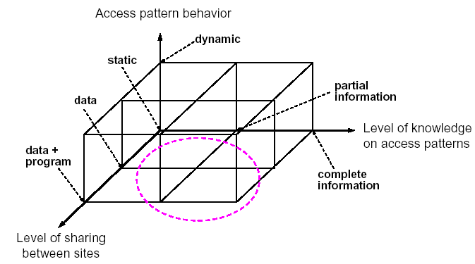
Distributed Database Design Summary (cont’d)
During design of distributed database following points should be considered:
During design it is useful to regard fragmentation and allocation as two separate design steps
In practice, the fragmentation and placement of fragments is often closely related, e.g. in geographically distributed systems
In a dynamic environment, the process becomes one of design-redesign-materialization of the redesign
In most simple distributed scenarios both fragmentation and allocation is a trivial exercise
Avoid vertical fragmentation and complex fragmentation schemas

Slide 71
Distributed Database Design Summary (cont’d)
Design motivation
Design will be driven by features of
DOMINANT APPLICATIONS
that must be estimated before design of
Fragmentation schema and
Allocation schema.

Slide 72
Distributed Database Design Summary (cont’d)
Dominant applications
Design is driven by sufficiently precise knowledge of main application (dominant) requirements.
The full extent of application requirements is impossible to anticipate in advance.
For all dominant applications, we need
site from which the application is issued
frequency of activation of applications
type of transactions in applications (i.e. retrieve/update)
the number and type (read/write) of data accesses made by each application (processing locality)
response time requirements of each application
Notes:
The full extent of application requirements is impossible to anticipate in advance.
Although the design of application programs is made after the design of schemata.
Systems once constructed should be able to support applications efficiently.
Design is driven by sufficiently precise knowledge of main application (dominant) requirements.
For all dominant applications, we need
site from which the application is issued
frequency of activation of applications
type of transactions in applications (i.e. retrieve/update)
the number and type (read/write) of data accesses made by each application (processing locality)
response time requirements of each application
Objectives of Design of Data Distribution DESIGN OBJECTIVES
PROCESSING LOCALITY
Placing data close to applications that use them. Minimization of remote references to each object.
LOCAL REFERENCES
REMOTE REFERENCES
COMPLETE LOCALITY
Application execute completely at site of origin.
AVAILABILITY AND RELIABILITY
AVAILABILITY
Multiple copies for read-only applications
RELIABILITY
Storage of multiple copies at different physical locations
WORKLOAD DISTRIBUTION
Maximizing parallelism
STORAGE COST AND AVAILABILITY
limitations on available storage at given site
cost of PC disk storage vs mainframe disk storage

Slide 73
What Have We Covered?
Introduction
Top-down Design Process
Distribution Design Issues
Data Fragmentation Design
Data Allocation Design
Data Directory
Summary

Slide 74
Homework
Review chapter 3 p.98~125 of the textbook
Exercises 3.6，3.8
Q
&
Q U E S T I O N S
A N S W E R S

