Slide 1
云数据管理1
大数据系统软件部分

Slide 2
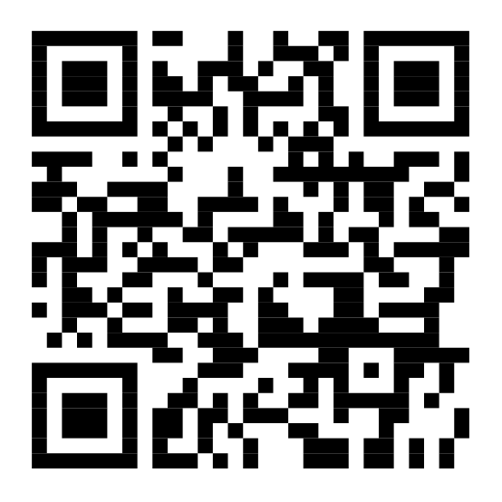
About me
宋韶旭
Research interests
Data quality
Data integration
主楼东配楼11-411
sxsong@tsinghua.edu.cn
http://ise.thss.tsinghua.edu.cn/sxsong/
TA
方晨光 fcg19@mails.tsinghua.edu.cn
龚怿焜 gyk19@mails.tsinghua.edu.cn
Open Office Hour: Monday 10:00-11:00 am

Slide 3
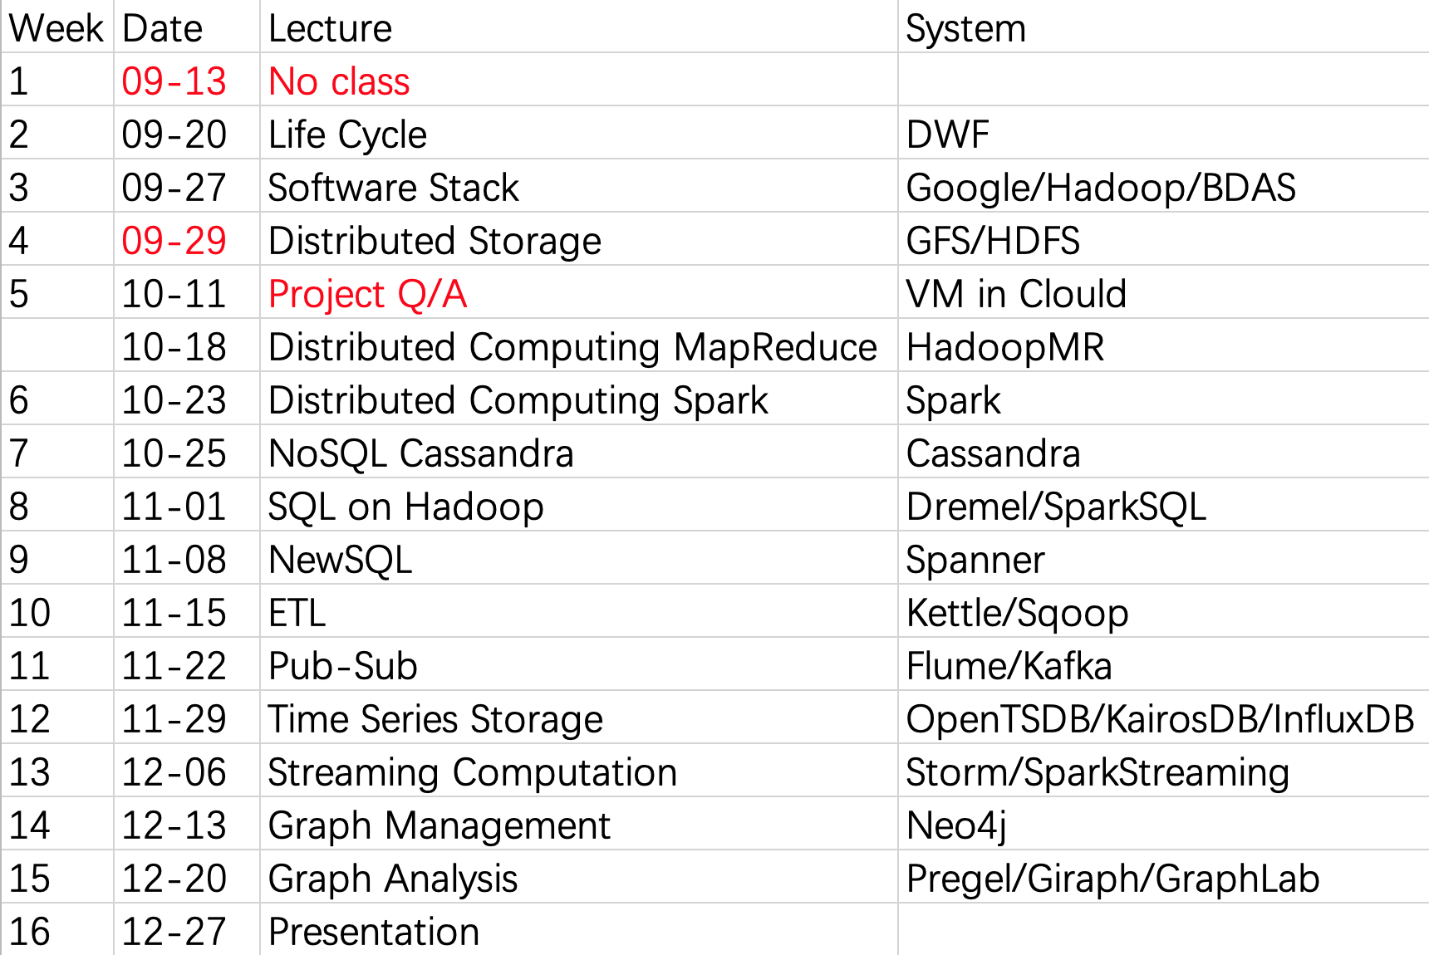
Syllabus

Slide 4
Project
Team work
At most 2 persons in a group
Develop a big data related open source software
Release it in Github at the end of this semester
Report
Proposal (deadline 09.29)
Design (deadline 10.25)
Document (deadline 11.29)
Evaluation (deadline 12.27)
Presentation

