Slide 1
Cost-Sensitive SVM
for Credit Card
Fraud Detection
Application • Theory • Weighted Pegasos
COMP6704 | Group 4 | Part 1
7-minute presentation
Notes:
Good morning, everyone. I will explain how fraud-detection costs become a convex SVM model, then connect its primal and dual forms to weighted stochastic updates.

Slide 2
Fraud detection and error costs
ULB credit card data
492 frauds / 284,807 transactions
0.173%
Predicting every transaction as legitimate gives
99.827% accuracy
0% fraud recall
FN: missed fraud
FP: false alarm
Cost = cFN · FN + cFP · FP
Example setting: cFN : cFP = 20 : 1
Source: Group 4 proposal, pp. 1–2 and §3.4. The cost ratio is an experimental assumption.
2
Notes:
The ULB dataset contains 492 labelled frauds among 284,807 transactions, a fraud rate of about 0.173 percent. Always predicting legitimate achieves 99.827 percent accuracy but zero fraud recall, so accuracy alone hides complete failure to detect fraud. A false negative misses fraud, whereas a false positive raises an alarm on a legitimate transaction. Our proposal considers several error-cost ratios, including twenty to one, as illustrative experimental settings rather than measured bank losses, and we will vary these ratios in sensitivity analysis. This means that, under that setting, we assign twenty times more cost to missing a fraud than to raising a false alarm.

Slide 3
Cost-dependent penalties
Fraud: y = +1 | Legitimate: y = −1
a₊ / a₋ = cFN / cFP
Cost ratio 20:1 → weight ratio 20:1
c̄ = p₊ cFN + p₋ cFP
aᵢ = c(yᵢ) / c̄
Cᵢ = C aᵢ
c(+1) = cFN; c(−1) = cFP
p₊ and p₋ are class proportions in the training set.
aᵢ sets relative error importance; C sets the overall penalty.
Sample-average normalization: (1/n) ∑ᵢ aᵢ = 1
Use training-set class proportions; C > 0 and both error costs are positive.
3
Notes:
We label fraud as positive one and legitimate transactions as negative one, then assign each example a weight based on its true class's error cost. Dividing by the training-data average cost, computed using training proportions only, makes the average sample weight one, while preserving the twenty-to-one ratio in this setting. Each sample's penalty, C i, is the common C multiplied by its weight, a i. The weight controls relative importance, while C controls the overall balance between regularization and loss. This is cost weighting, not an automatic correction for class frequency.

Slide 4
Cost-sensitive SVM: the primal
f(xᵢ) = wᵀxᵢ + b; mᵢ = yᵢ f(xᵢ)
A linear SVM boundary
min ½‖w‖² + ∑ᵢ Cᵢ ξᵢ
subject to mᵢ ≥ 1 − ξᵢ, ξᵢ ≥ 0
Wide margin + weighted margin violations
ξᵢ = max(0, 1 − mᵢ) at an optimum
0 < mᵢ < 1: correct, but inside the margin
f = −1
f = 0
f = +1
mᵢ < 0: misclassified
Schematic; points are illustrative.
Source: Group 4 proposal, §2.2; Cortes & Vapnik (1995). Linear main benchmark.
4
Notes:
For our main linear model, the score is w transpose x plus b: a positive score predicts fraud, and a negative score predicts legitimate. Multiplying this score by the true label gives the margin, so a positive margin means the prediction is on the correct side, while a margin of at least one also satisfies the desired separation. The primal objective combines a squared-norm regularizer with weighted slack penalties, balancing a wider margin against violations of that margin, with each cost entering through its sample-specific penalty coefficient, C i. At the optimum, each slack equals the hinge loss, the maximum of zero and one minus the margin. Crucially, positive slack does not always mean a wrong prediction: a margin of 0.6 gives slack 0.4 but is still correctly classified, whereas a margin of minus 0.4 gives slack 1.4 and is misclassified.

Slide 5
Dual coefficients and KKT
max ∑ᵢ αᵢ − ½ ∑ᵢ∑ⱼ αᵢαⱼyᵢyⱼ Kᵢⱼ
0 ≤ αᵢ ≤ Cᵢ and ∑ᵢ αᵢyᵢ = 0
Linear model: Kᵢⱼ = xᵢᵀxⱼ. Costs set the upper bounds Cᵢ.
At an optimum: KKT links coefficients to margins
αᵢ = 0 ⇒ mᵢ ≥ 1
No margin violation
0 < αᵢ < Cᵢ ⇒ mᵢ = 1
On the margin boundary
αᵢ = Cᵢ ⇒ mᵢ ≤ 1
May be correct or misclassified
Convexity and Slater’s condition support KKT optimality.
Source: Group 4 proposal, §2.2; Boyd & Vandenberghe (2004), Chapter 5. Derivation in backup.
5
Notes:
The dual solves the same model using sample coefficients between zero and their cost-dependent upper bounds, with label-weighted coefficients summing to zero. At an optimum, zero alpha means a margin of at least one, and an interior alpha means a margin of exactly one. Alpha at its upper bound means a margin of at most one, so the point can still be correctly classified. These KKT conditions connect the coefficients to sample positions; a higher cost allows a higher bound, rather than forcing a coefficient to be larger. Convexity and Slater's condition let us use the full KKT conditions to certify optimality.

Slide 6
Weighted Pegasos updates
F(w,b) = (λ/2) ‖w‖² + (1/n) ∑ᵢ aᵢ [1 − mᵢ]₊
λ = 1/(nC)
Same minimizers as the primal objective
Sample i uniformly. Compute the margin before updating.
ηₜ = 1/(λt), mᵢ = yᵢ(wₜᵀxᵢ + bₜ), Iₜ = 1 if mᵢ < 1, else 0
wₜ₊₁ = (1 − ηₜλ) wₜ + ηₜ aᵢ yᵢ xᵢ Iₜ
bₜ₊₁ = bₜ + ηₜ aᵢ yᵢ Iₜ
Shrink w, then add a weighted correction when mᵢ < 1.
O(d) work per update
Weighted Pegasos-style variant; b is unregularized. Original convergence guarantees require care.
6
Notes:
We first eliminate the slack variables and divide the primal objective by n times C, obtaining regularization plus the average weighted hinge loss, with lambda equal to one over n C and the same minimizer. At each iteration, we sample one example uniformly and check its current margin, then shrink w and add a weighted correction only if that margin is below one. The bias receives a corresponding correction without shrinkage, because it is unregularized, and the step size decreases as one over lambda t. A larger weight gives a stronger correction under otherwise identical conditions; each linear update costs order d, while a full pass costs order n d. We use an empirical Pegasos-style variant with an unregularized bias and no projection in the displayed rule, so its behavior must be validated and the original convergence guarantees cannot simply be assumed.

Slide 7
Summary and handover
1
Costs define which mistakes matter.
Convert the cost ratio into class-dependent penalties.
2
One convex SVM, several solver perspectives.
Primal, dual, and KKT describe the same model.
3
Pegasos makes cheap stochastic updates.
A candidate warm start for PA-ADMM; benefit to be tested.
Next: SMO solves the dual with cost-dependent bounds.
Research plan only: improvements must be tested, not assumed.
7
Notes:
Application costs become class weights and then one convex SVM objective, whose dual coefficients and stochastic updates provide different routes to a solution. Weighted updates are a proposed warm start for PA-ADMM, with any speedup still to be tested; next, Member Two will explain how SMO solves the dual using these cost-dependent bounds.

Slide 8
Backup: deriving the dual and KKT
L = ½‖w‖² + ∑ᵢ Cᵢξᵢ + ∑ᵢ αᵢ(1 − ξᵢ − mᵢ) − ∑ᵢ μᵢξᵢ
αᵢ, μᵢ ≥ 0; mᵢ = yᵢ(wᵀφ(xᵢ) + b)
Stationarity
w = ∑ᵢ αᵢyᵢφ(xᵢ); ∑ᵢ αᵢyᵢ = 0; Cᵢ − αᵢ − μᵢ = 0
Together with αᵢ, μᵢ ≥ 0, this gives 0 ≤ αᵢ ≤ Cᵢ.
Feasibility + stationarity + complementary slackness
mᵢ ≥ 1 − ξᵢ; ξᵢ ≥ 0; αᵢ(1 − ξᵢ − mᵢ) = 0; μᵢξᵢ = 0
Strictly feasible example: w = 0, b = 0, ξᵢ = 2.
Source: Boyd & Vandenberghe (2004), Chapter 5; weighted-SVM algebra.
B1
Notes:
The dual follows by minimizing the Lagrangian over the primal variables and keeping the resulting feasibility conditions on the multipliers. Because the constraints admit a strictly feasible point, convexity and Slater support the KKT characterization used here.

Slide 9
Backup: normalization and algorithm scope
Normalization convention
2c / (cFN + cFP) averages the two class weights to one.
Our convention makes the training-sample average one:
aᵢ = c(yᵢ) / (p₊cFN + p₋cFP), λ = 1/(nC)
Bias and convergence scope
b is unregularized, so only w receives shrinkage.
Use the same objective and bias convention across solvers.
This is a weighted Pegasos-style variant; the original
strong-convexity rate does not automatically transfer.
Source: Group 4 proposal, §§2.1–2.4; Pegasos (2011), §§2.2 and 6.
B2
Notes:
We normalize weights over the training samples and align the stochastic objective through lambda equal to one over n C. The bias is unregularized, so this weighted Pegasos-style implementation does not automatically inherit the original strong-convexity convergence rate.

Slide 10
ADMM and PA-ADMM
PART III
OPTIMIZATION METHODS

Slide 11
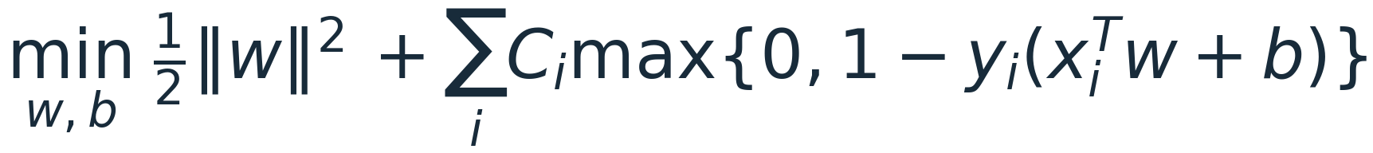
ADMM and PA-ADMM
PART III / OPTIMIZATION METHODS
Solve a cost-sensitive SVM through variable splitting.
ADMM
Pegasos
ρ and α
model, margin and dual updates
weighted warm initialization
penalty and relaxation controls
Variable splitting → ADMM updates → PA-ADMM controls
Same objective, with different initialization and update rules.
Proposal §§2.3, 3.2 · src/svm_admm.py · WP3 implementation
III · 01
Notes:
第 1 页｜25 秒｜ADMM and PA-ADMM
这一章节讲解如何求解同一个成本敏感线性 SVM，依次介绍变量拆分、ADMM 的三步更新，以及 PA-ADMM 的初始化和更新控制。这里 PA 指 Pegasos-warm-started adaptive ADMM。样本成本 C_i 和 SVM 目标保持不变。
来源：Proposal §§2.3, 3.2 · src/svm_admm.py · WP3 implementation

Slide 12
Split global rules from samplewise margins
PART III / ADMM INTUITION
Global model θ
z = Aθ
Auxiliary margins z₁, …, zₙ
One shared scoring rule
for every transaction
One temporary value per sample;
weighted hinge loss is separable
Fraud: y = +1, f = −0.2 → m = −0.2 → hinge loss = 1.2
The auxiliary z may move first; the next global update tries to follow.
At prediction time, only f(x) = xᵀw + b is used.
Proposal §2.3 · docs/WP3/WP3_ADMM.md: model and linear system
III · 02
Notes:
第 2 页｜40 秒｜Split global rules from samplewise margins
θ 包含所有交易共用的权重 w 和截距 b。模型给交易打分 f，乘上真实标签 y 后得到 signed margin m：正数表示相对零分类阈值方向正确，达到 1 表示没有 hinge 惩罚。引入 z 作为训练期间辅助变量，它暂时可以不同于 m，但 ADMM 要求二者最终一致。z 不是给每笔交易单独训练一个永久预测规则；新交易仍由同一个 w、b 计算。
来源：Proposal §2.3 · docs/WP3/WP3_ADMM.md: model and linear system

Slide 13
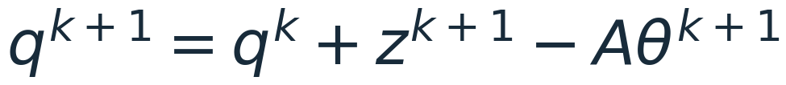
ADMM alternates three simple updates
PART III / FIXED-Ρ ADMM
q = u / ρ is the scaled dual: it accumulates the mismatch between z and Aθ.
1
Update the shared model
2
Update each auxiliary margin
3
Accumulate the agreement error
R = diag(I, 0): regularize w, keep the intercept b unregularized.
src/svm_admm.py: ADMMSVM._fit · constraint z − Aθ = 0; scaled dual q = u/ρ
III · 03
Notes:
第 3 页｜55 秒｜ADMM alternates three simple updates
ADMM 全称是交替方向乘子法。为了统一正负号，我们写约束 z−Aθ=0，并定义缩放对偶变量 q=u/ρ。第一步固定 z 和 q，更新全局规则 θ，相当于解带正则项的最小二乘方程。第二步逐样本更新 z，处理不可微 hinge。第三步把二者不一致的误差累积进 q；它不是标签，而是协调修正量。这里 R 最后一项为零，保证不惩罚截距。固定 ρ 的标准 ADMM 取 α=1。
来源：src/svm_admm.py: ADMMSVM._fit · constraint z − Aθ = 0; scaled dual q = u/ρ

Slide 14
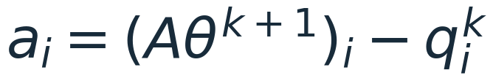
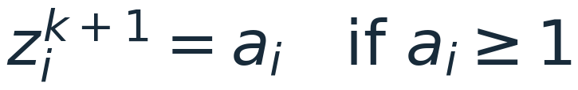
The hinge step has a closed-form solution
PART III / COST-SENSITIVE Z UPDATE
Example: same proximal input aᵢ = 0.2, different penalty strengths
Cᵢ / ρ
New auxiliary margin zᵢ
Interpretation
0.3
0.5
Partial push toward margin 1
0.8
1.0
Reaches zero hinge loss
Costs enter through Cᵢ / ρ; the solver uses Cᵢ exactly as supplied.
Proposal §2.3 · src/svm_admm.py: _hinge_prox · illustrative values, not measured data
III · 04
Notes:
第 4 页｜45 秒｜The hinge step has a closed-form solution
近端更新就是在降低 hinge 惩罚和靠近当前模型给出的值之间折中。a 是当前模型 margin 扣除协调修正 q。若 a 已经达到 1，hinge 为零，不需要再推；若不足 1，就向 1 推进 C_i/ρ，但最多推到 1。举例 a=0.2：C_i/ρ 为 0.3 得到 z=0.5，为 0.8 则得到 z=1。较大的样本成本产生较强的修正。这只是辅助 z 的变化，不能直接把它当作模型预测的变化。
来源：Proposal §2.3 · src/svm_admm.py: _hinge_prox · illustrative values, not measured data

Slide 15
PA-ADMM adds a warm start and two controls
PART III / HYBRID ALGORITHM
Weighted Pegasos
Initialize ADMM
Refine with ADMM
K shuffled passes
Best checkpoint, including
zero
θ⁰ = best warm model
z⁰ = Aθ⁰; q⁰ = 0
Adaptive ρ
Over-relaxation α
K: warm-start passes ρ: penalty strength α: relaxation factor
Initialize θ, z and q, then run the same ADMM loop.
K = 0 + adaptive ρ off + α = 1 exactly recovers cold ADMM.
Proposal §3.2 · src/svm_admm.py: PAADMMSVM · Pegasos scaling in WP3_ADMM.md
III · 05
Notes:
第 5 页｜50 秒｜PA-ADMM adds a warm start and two controls
PA-ADMM 不是改变 SVM 目标，而是在同一个 ADMM 循环外加三个可以独立开关的组件。先做 K 遍加权 Pegasos 随机次梯度，期望快速获得粗略解。为保证与原目标一致，令 S=ΣC_i、λ=1/S、a_i=C_i/mean(C)，则 P/S=λ||w||²/2+(1/n)Σa_i hinge，学习率 η_t=1/(λt)，偏置不做收缩。每个 epoch 记录目标，把零模型也作为候选，取最好检查点初始化 θ、z=Aθ、q=0。随后在 ADMM 内启用自适应 ρ 和过松弛。K=0 只关热启动；还要关闭自适应并令 α=1 才完全等同冷启动。
来源：Proposal §3.2 · src/svm_admm.py: PAADMMSVM · Pegasos scaling in WP3_ADMM.md

Slide 16
Adaptive ρ balances two residuals
PART III / RESIDUAL BALANCING
Condition
Action
Purpose
‖r‖ > 10 ‖s‖
ρ ← 2ρ
Stronger agreement penalty
‖s‖ > 10 ‖r‖
ρ ← ρ / 2
Reduce the agreement penalty
Otherwise
Keep ρ
Avoid unnecessary changes
Changing ρ also changes the linear system: refactor before the next solve.
src/svm_admm.py: residual / rho updates · Boyd et al. (2011), §3.4.1
III · 06
Notes:
第 6 页｜50 秒｜Adaptive ρ balances two residuals
ρ 是协调强度，不是训练成本 C。原始残差 r=z−Aθ 衡量辅助变量和真实模型是否一致。对偶残差 s=ρAᵀ(z_new−z_old) 是最优性相关的诊断量。代码使用标准的启发式规则：r 范数超过 s 十倍，就把 ρ 加倍；s 超过 r 十倍，就把 ρ 减半；否则保持。增加 ρ 会更强调一致性，但不保证更快。因为 q 是缩放变量，改变 ρ 时必须令 q 反向缩放，保持 u=ρq 不变。系统矩阵也依赖 ρ，所以必须重新分解，这会带来开销。这里比较的是原始范数，阈值是启发式，会受数据尺度影响。
来源：src/svm_admm.py: residual / rho updates · Boyd et al. (2011), §3.4.1

Slide 17
Over-relaxation extrapolates the model margin
PART III / RELAXATION PARAMETER Α
Illustration: zᵏ = 0.2, new model margin m = 0.4
α = 1.6
zᵏ = 0.2
m = 0.4
m̂ = 0.52
Use the same relaxed margin in both updates; α = 1 is standard ADMM.
src/svm_admm.py: relaxed / z / q updates · Boyd et al. (2011), §3.4.3
III · 07
Notes:
第 7 页｜45 秒｜Over-relaxation extrapolates the model margin
过松弛可以理解为顺着新 margin 的方向多走一点。先算 m=Aθ_new，再从旧 z 出发，用 α 倍的位移得到 m_hat。α=1 就是普通 ADMM；1<α<2 是过松弛。示例 z_old=0.2、新 m=0.4，α=1.6 时得到 0.52，比新 m 稍向前。这个 0.52 是中间计算值，不是永久改变模型的预测。实现中必须在 z 的近端更新和 q 的更新里一致使用 m_hat；残差 r 仍用真实 m。α 控制外推幅度，不能预设越大越好。
来源：src/svm_admm.py: relaxed / z / q updates · Boyd et al. (2011), §3.4.3

Slide 18
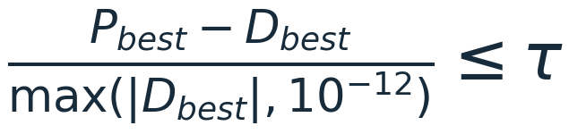
Efficient solves, with explicit convergence checks
PART III / IMPLEMENTATION
Exploit small feature dimension
Require all three conditions
Cache AᵀA once
Cholesky solve; no matrix inverse
Reuse until ρ changes
1 Small primal residual
2 Small dual residual
3 Small certified primal–dual gap
Setup: O(nd²)
Iteration: O(nd + d²)
D is a feasible SVM dual lower bound.
Budget exit returns the best recorded model and keeps converged = false.
src/svm_admm.py · diagnostics and complexity: WP3_ADMM.md
III · 08
Notes:
第 8 页｜40 秒｜Efficient solves, with explicit convergence checks
设模型有 d 个特征，加一个偏置后，模型更新只需求解 (d+1)×(d+1) 的线性系统。我们缓存 Gram 矩阵，用 Cholesky 解方程而不显式求逆；固定 ρ 可复用分解。停止条件不是目标值看起来不变，而是原始残差、对偶残差、可行对偶下界产生的相对 gap 三者都达标。对偶变量由 clip(ρq,0,C_i) 后缩小质量较大的一类，满足 yᵀν=0；这给出合法下界 D=Σν_i−||Xᵀ(y⊙ν)||²/2。用 ν 避免和过松弛 α 混淆。到预算则返回已记录最好模型，明确标未收敛。完整内存包含 O(nd+n+d²)，不是只有 O(d²)。
来源：src/svm_admm.py · diagnostics and complexity: WP3_ADMM.md

Slide 19
Method summary
PART III / METHOD SUMMARY
01
ADMM uses variable splitting
A linear model update and closed-form samplewise hinge updates.
02
PA-ADMM extends the ADMM loop
Weighted Pegasos initialization, adaptive ρ and over-relaxation α.
03
The stopping rule checks convergence
Check primal and dual residuals together with the primal–dual gap.
The SVM objective and supplied costs remain unchanged.
src/svm_admm.py · WP3_ADMM.md · WP3_REPORT.md
III · 09
Notes:
第 9 页｜30 秒｜Method summary
ADMM 通过变量拆分，将成本敏感 SVM 的求解分成全局模型更新、逐样本 hinge 近端更新和对偶更新。PA-ADMM 在同一目标下加入加权 Pegasos 热启动、自适应惩罚参数 ρ 和过松弛参数 α。实现时缓存 Gram 矩阵，在 ρ 不变时复用 Cholesky 分解，同时检查原始残差、对偶残差和原始—对偶 gap。两种流程改变的是初始化和更新方式，SVM 目标与给定的样本成本保持不变。
来源：src/svm_admm.py · WP3_ADMM.md · WP3_REPORT.md

Slide 20
Evaluation, Experiments and Results
PART IV
EVALUATION AND BENCHMARK
Generated 2026-10-27 14:43 from 136 recorded fits · results shown for ADMM, PA-ADMM, Pegasos, SMO
Notes:
Opening (15s): Parts I-III defined the cost-sensitive objective and the four solvers. My part is the measurement: what data we used, how we made the comparison fair, and what the runs actually show.

Slide 21
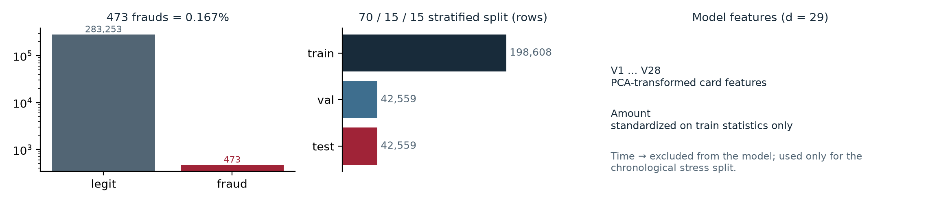
The data behind every number
PART IV / DATA
284,807 transactions, 492 frauds (0.172%). Removing 1,081 exact duplicate rows leaves 283,726 rows with 473 frauds (0.167%) — duplicates inflate apparent volume and leak across splits.
29 model features: V1–V28 plus Amount. Time is never a feature; it only drives the chronological stress split.
Amount is standardized with training-fold statistics only, so no test information reaches the solver.
0.167% positives: accuracy is meaningless here, cost is the headline
data/raw/creditcard.csv · SHA-256 76274b69…1a89 · src/data.py::clean_data
IV · 02
Notes:
~50s: introduce ULB, the deduplication decision and why it matters for leakage, the 29-feature protocol, and that every run is tied to a recorded SHA-256 so the audience knows the data cannot drift underneath a result.

Slide 22
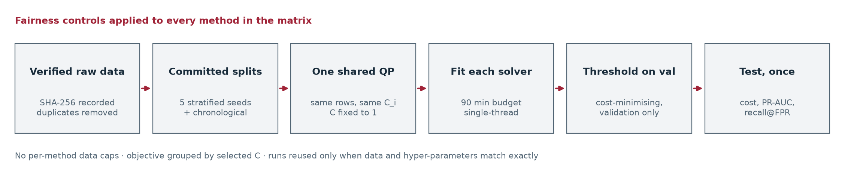
How the comparison is made fair
PART IV / PROTOCOL
Cost-sensitive objective min ½‖w‖² + Σ Cᵢ·max(0, 1−yᵢf(xᵢ)), Cᵢ = C·w_yᵢ, fraud:legit weight 10 / 20 / 50.
Fixed-QP rule solver ranking runs fix C=1 for every method; validation-tuned C lives in a separate predictive experiment.
Budgets 90 min per fit, single-threaded, one machine; timeouts are recorded as failures, never quietly dropped.
Same rows, same C, same budget — otherwise the objective is not comparable
configs/main_*.yaml · EXPERIMENTS.md §5.1, §6 · src/evaluate.py
IV · 03
Notes:
~50s: emphasise the two decisions that make the ranking honest — every method sees exactly the same rows (no per-method caps) and the objective comparison is only ever made at a shared C, because a different C is a different QP.

Slide 23
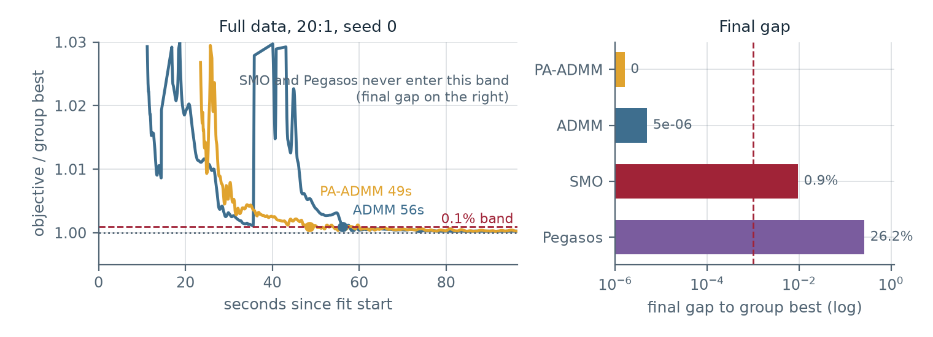
Primary metric: time to a shared tolerance
PART IV / METRICS
Reference best objective achieved by any method in the same dataset / ratio / seed / C group.
Tolerance first checkpoint within 0.1% of that reference, using the solver's own timestamped history.
Secondary metrics cost per example, PR-AUC, recall at FPR 0.1% and 1%, balanced accuracy, iterations, wall time, peak RSS.
Statistics 5 seeds, bootstrap 95% CI, paired Wilcoxon signed-rank.
We rank solvers by how fast they reach the best observed objective, not by final loss
src/evaluate.py::time_to_tolerance · ≥2 aligned history points required
IV · 04
Notes:
~50s: explain the curve plot: lower is the objective relative to the group best, the dashed line is the 0.1% tolerance, and the crossing time is the headline number in the next slides.

Slide 24
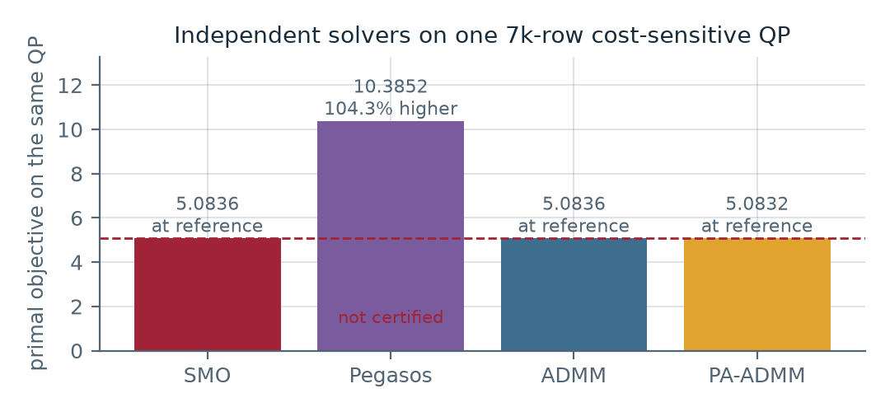
Correctness first: solvers agree on one QP
PART IV / CORRECTNESS
SMO P = 5.0836 certified (4,380 updates/iterations)
Pegasos P = 10.3852 not certified (550,000 updates/iterations)
ADMM P = 5.0836 certified (7,525 updates/iterations)
PA-ADMM P = 5.0832 certified (5,364 updates/iterations)
One 10k stratified subset (7,000 train / 1,500 val / 1,500 test), C fixed to 1, ratio 10:1, tolerance 1e-4. WP2 checks SMO against LIBSVM and WP3 checks ADMM against CVXPY/ECOS on identical rows, in their own runners.
Pegasos is reported as unconverged rather than smoothed away: a first-order method has no primal-dual certificate, so we never claim convergence for it.
Independent solvers agree to 7.7e-05 on one QP
configs/correctness.yaml · results/raw/correctness · external cross-checks run by WP2 (LIBSVM) and WP3 (CVXPY/ECOS), not by this harness
IV · 05
Notes:
~45s: this slide answers 'are your solvers even correct?' — 3 independent algorithms agreeing to four decimals, plus each member's external reference check.

Slide 25
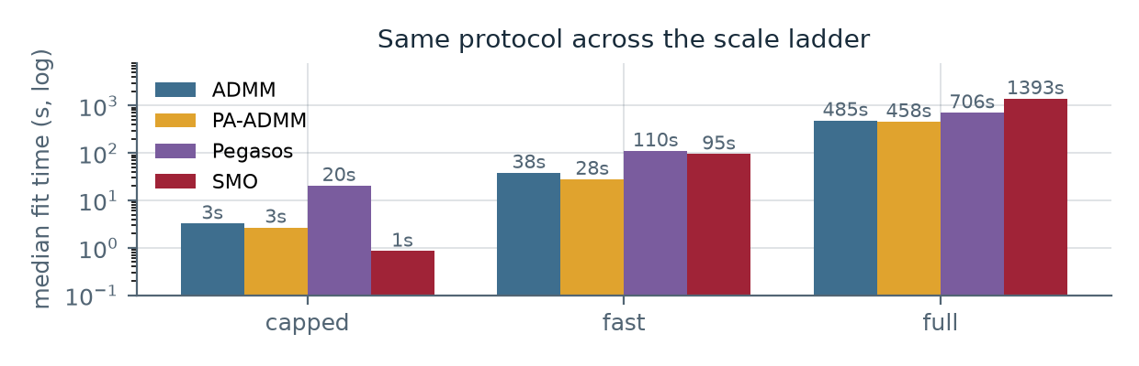
The experiment matrix we ran
PART IV / MAIN EXPERIMENT DESIGN
experiment | training rows | seeds | successful fits by method | reused
correctness | 7,000 train | 1 | SMO: 1 · Pegasos: 1 · ADMM: 1 · PA-ADMM: 1 | 0
main_capped | 7,000 train | 3 | SMO: 9 · Pegasos: 9 · ADMM: 9 · PA-ADMM: 9 | 27
main_fast | 34,999 train | 3 | SMO: 9 · Pegasos: 9 · ADMM: 9 · PA-ADMM: 9 | 27
main_full | 198,608 train | 5 | SMO: 15 · Pegasos: 15 · ADMM: 15 · PA-ADMM: 15 | 45
Ratios 10 / 20 / 50 are trained at their own weights; thresholds and test cost always use the deployment ratio of that run.
All four registered solvers have recorded runs here; incomplete cells are stated on the results slides.
One scale ladder: 7k → 35k → 198k rows, ratios 10 / 20 / 50, up to 5 seeds
methods with committed results: ADMM, PA-ADMM, Pegasos, SMO
IV · 06
Notes:
~45s: walk the ladder from 7k to 198k rows. Mention the reuse flag: earlier runs are kept when data and hyper-parameters match, so adding a solver never refits the others.

Slide 26
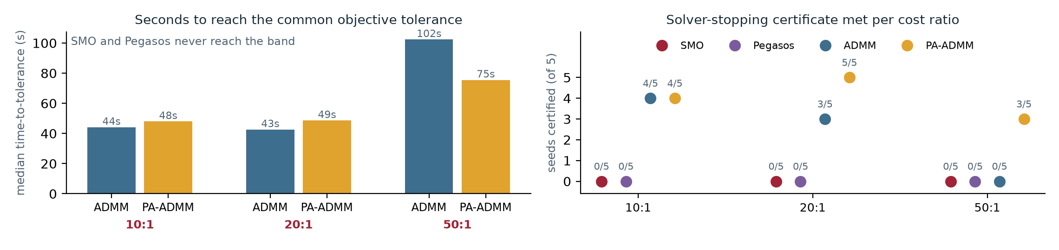
Main results: speed and certified convergence
PART IV / MAIN RESULTS · SPEED
At 20:1 on the full data, median time-to-tolerance: ADMM 43s, PA-ADMM 49s. SMO and Pegasos never reached the tolerance at 20:1. ADMM and PA-ADMM keep iterating past the tolerance until their own certificate is met; SMO stops at its 100k-update cap and Pegasos at its 5,000-epoch cap, which is why neither enters the band.
Right panel counts certified seeds at the hardest ratio 50:1 → ADMM 0/5, PA-ADMM 3/5, Pegasos 0/5, SMO 0/5. Pushing Cᵢ higher makes the QP stiffer; PA-ADMM certifies the most seeds there. SMO exhausted its own 100,000-update limit on 15 of 15 main_full fits after 1393s of a 5400s budget (7/9 already at 35k), finishing 1.6% above the group-best objective. We keep its default cap and report this as a scalability limit of SMO under this protocol, not a wall-clock timeout.
Only ADMM and PA-ADMM reach the band; certifying seeds is where they diverge
results/tables/main_full_*.csv · 5 seeds × 3 ratios · full data
IV · 07
Notes:
~55s: this is the solver-ranking slide. Two numbers matter: who reaches the 0.1% band at all (only the ADMM pair), and who can certify a solve at 50:1 (PA-ADMM 3/5, cold ADMM 0/5). Time-to-tolerance differences inside the band are not significant at 5 seeds.

Slide 27
Full data at a glance
PART IV / MAIN RESULTS · GRID
solver | ratio | certified | median t-to-tol (s) | median fit (s) | objective | PR-AUC | cost / example
SMO | 10:1 | 0/5 | n/a | 1363 | 1612.3 | 0.75 ± 0.05 | 0.00394
Pegasos | 10:1 | 0/5 | n/a | 688 | 1876.7 | 0.75 ± 0.05 | 0.00341
ADMM | 10:1 | 4/5 | 44 | 411 | 1584.1 | 0.75 ± 0.05 | 0.00380
PA-ADMM | 10:1 | 4/5 | 48 | 500 | 1584.1 | 0.75 ± 0.05 | 0.00385
SMO | 20:1 | 0/5 | n/a | 1373 | 2911.8 | 0.76 ± 0.05 | 0.00681
Pegasos | 20:1 | 0/5 | n/a | 726 | 3633.3 | 0.76 ± 0.05 | 0.00623
ADMM | 20:1 | 3/5 | 43 | 360 | 2877.9 | 0.76 ± 0.05 | 0.00648
PA-ADMM | 20:1 | 5/5 | 49 | 444 | 2877.9 | 0.76 ± 0.05 | 0.00651
SMO | 50:1 | 0/5 | n/a | 1431 | 6323.1 | 0.76 ± 0.05 | 0.01462
Pegasos | 50:1 | 0/5 | n/a | 706 | 8667.0 | 0.75 ± 0.05 | 0.01447
ADMM | 50:1 | 0/5 | 102 | 565 | 6214.4 | 0.76 ± 0.05 | 0.01462
PA-ADMM | 50:1 | 3/5 | 75 | 425 | 6214.2 | 0.76 ± 0.05 | 0.01484
t-to-tol = median over 5 seeds of the first checkpoint within 0.1% of the best; certified = the solver's stopping certificate; PR-AUC is mean ± seed sd.
Every cell is the same QP on the same 198,608 training rows
results/raw/main_full · 42,559 test rows with 71 frauds · C = 1 · tolerance 1e-3
IV · 08
Notes:
~40s: this is the table the audience should photograph. Point at one column (say 20:1) and compare across solvers: the objective and PR-AUC agree, the certified count and the wall time are where they differ.

Slide 28
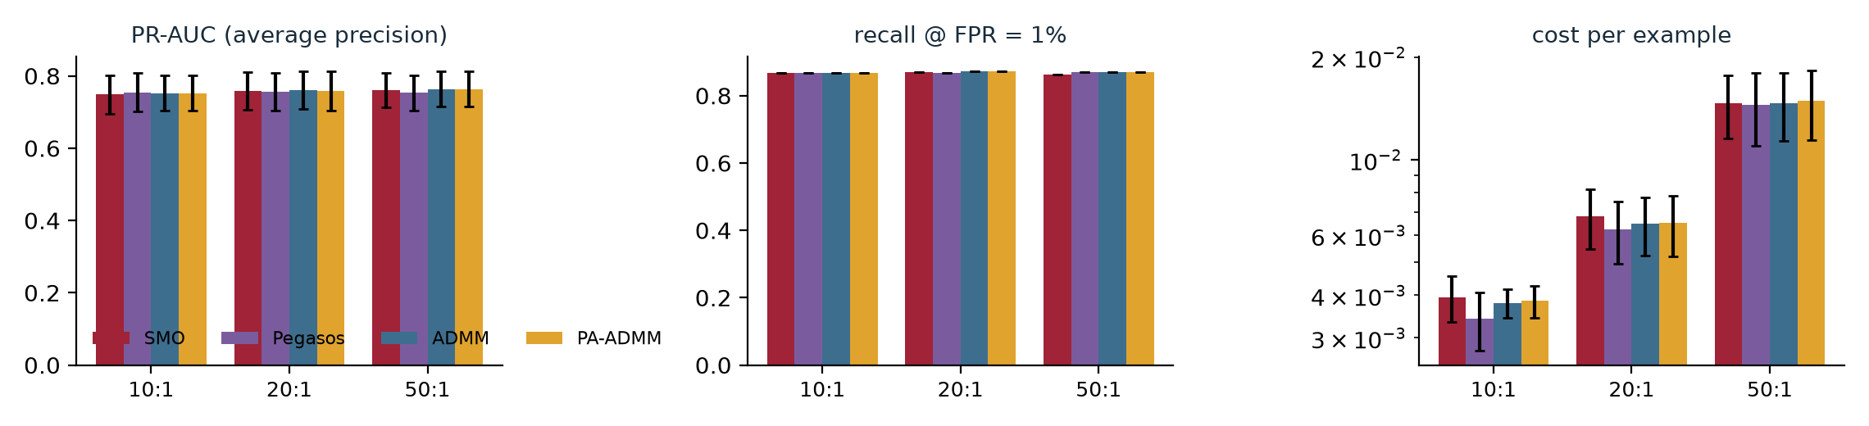
Performance under the deployment cost model
PART IV / MAIN RESULTS · QUALITY
Full data, 20:1, PA-ADMM: PR-AUC 0.76, recall at 1% FPR 87.3%, cost 0.00651 per example. The largest between-solver PR-AUC gap is 0.011 while the typical seed-to-seed sd is 0.051, so the ranking is noise, not method quality.
Test cost rises with the assumed fraud:legit ratio because the threshold is tuned for that ratio — that is a deployment choice, not a solver defect.
Detection quality is set by the data, not by which solver you pick
results/tables/main_full_pr_auc.csv · recall_at_fpr · cost_per_example
IV · 09
Notes:
~50s: state clearly that the fraud-detection performance is essentially the same across solvers; the interesting quantity for the group is which solver gets there reliably and how fast.

Slide 29
What we can and cannot claim
PART IV / FINDINGS
01
The QP solution separates the solvers
Same fixed-C QP on full data: ADMM and PA-ADMM end within 2.5e-05 of the group best, SMO 1.6% above it because it hits its update cap, Pegasos 18%–39% above it. Only the exact solvers reach the shared tolerance.
02
5 seeds cannot certify a winner
The smallest two-sided p that 5 paired seeds can produce is 0.062. The objective ordering is unanimous (p = 0.062), but PR-AUC never separates (min p = 0.12): the solver changes how fast and how certifiably you reach the QP solution, not what you detect.
03
Reliability is where the methods differ
At 50:1 the cold ADMM certified 0/5 seeds while PA-ADMM certified 3/5, for about +60s of extra fit time at 20:1 — the warm start buys convergence, not wall-clock speed.
04
Limits to state openly
SMO is update-capped (100k) and Pegasos is epoch-capped (5,000 epochs = 15.5M steps), so neither gap is a wall-clock failure; the capped-subset quality bars rest on three test frauds, and every timing comes from one single-threaded machine.
Certified time-to-solution separates the solvers; detection quality does not
results/tables/main_full_wilcoxon.csv · EXPERIMENTS.md §10
IV · 10
Notes:
~55s: close on the honest framing. The contribution is the measurement protocol: same QP, same rows, same budget. The solvers separate on certified time-to-solution and on reliability, not on detection quality, and 5 seeds put a floor of 0.0625 on any paired p-value.

Slide 30
Appendix: fairness controls in detail
PART IV / APPENDIX · CONTROLS
control | what it prevents
Identical rows, no per-method caps | comparing a solver on 10k rows against one on 198k rows
Fixed C=1 for ranking; C grouped otherwise | comparing objectives of two different QPs after independent C tuning
Validation-only threshold and C | test-set tuning; the test split is touched exactly once per run
≥ 2 aligned objective/timestamp checkpoints | a single-point solve being reported as a convergence curve
Objective recomputed from w, b | a solver reporting a differently normalised (e.g. per-example) objective
Nonlinear runs leave the objective comparison | an RKHS objective being ranked against linear-SVM objectives
90-minute budget, single thread, one machine | wall-clock comparisons across different hardware or thread counts
reuse_existing with exact metadata matching | silently mixing results produced from different splits or hyper-parameters
Each control exists because a first draft of the harness got it wrong
src/evaluate.py · EXPERIMENTS.md §5.1, §6.5 · tests/test_harness_smoke.py
IV · 11
Notes:
Backup for questions about fairness. Every row here came from a concrete review finding on our own harness, and each one is covered by a regression test.

Slide 31
Appendix: reproducing these numbers
PART IV / APPENDIX · REPRODUCTION
1. python experiments/check_solver.py --method smo|pegasos|admm|pa_admm
→ results/raw/solver_checks/<method>.json (contract + diagnostics)
2. python experiments/run_correctness.py
→ 7,000-row agreement check, reference = group best (no external solver)
3. python experiments/run_main.py --config configs/main_capped.yaml
configs/main_fast.yaml
configs/main_full.yaml
→ results/raw/<experiment>/… and results/tables/<experiment>_*.csv
4. python experiments/make_report_assets.py
→ results/figures/*.pdf from the aggregated tables
5. python slides/build_part4_deck.py --template … --check
→ this deck, rebuilt from the JSONs; nothing on these slides is typed in
Data is pinned by SHA-256 (76274b69…1a89) and the five stratified split files are committed, so a rerun reproduces the same rows. Raw run JSONs and logs stay out of git; aggregate tables and figures are versioned.
One command per experiment; every run carries a config hash
experiments/check_solver.py · run_correctness.py · run_main.py · make_report_assets.py
IV · 12
Notes:
Backup for 'how do I reproduce this?'. Emphasise that the deck itself is generated from the run JSONs, so slides and results cannot drift apart.

