Slide 1
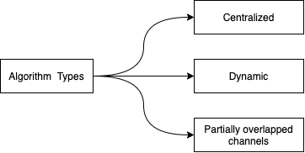
Channel Assignment Methods

Slide 2
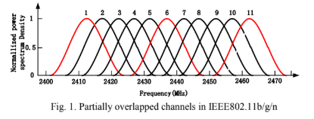
Channel Assignment Strategy
Partially Overlapped Assignment
Start
Min-interference and Connectivity-Oriented Partially Overlapped Channel Assignment (MC-POCA)
Calculate links assignment rank
Generate decreasing links queue
Utilize partially overlapped channels instead of 3 non-overlapped channels
Select channel by score function
Routing Selection
End
Partially Overlapped Channel Assignment
P. Kyasanur and N.H. Vaidya, Routing and Link-layer Protocols for Multi-Channel Multi-Interface Ad Hoc Wireless Networks, SIGMOBILE Mobile Computing and Communications Review, vol. 10, no. 1, pp.

Slide 3
Strategy Advantages
Low time complexity
Effectively utilized partially overlapped channels
Easy to assess the link interference

Slide 4
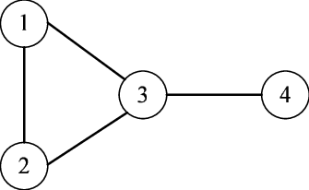
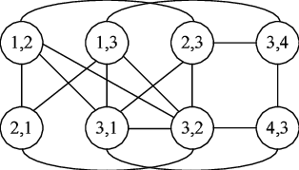
Strategy Drawbacks
Score function 1
Count how many the link pairs which have interference for each channel
Select the best channel with the minimum interference link pairs to assign
Example of a conflict graph
Figure Scource: https://www.researchgate.net/figure/The-conflict-graph-for-the-five-node-network_fig2_51915978

Slide 5
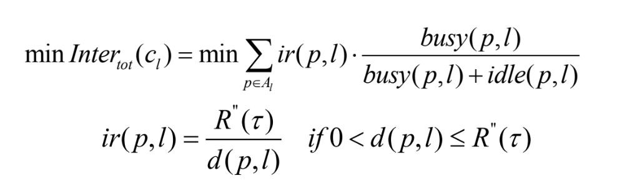
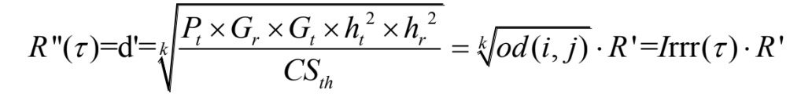
Strategy Drawbacks
Score function 2
Get the distance of closest nodes of 2 links
Get ir(p,l), the interference distance ratio
For any assigned links, sum interference up and then choose the best channel

Slide 6

Strategy Drawbacks
Partially overlapped channel network may have much more interference link pairs
Node Interference range may not reasonable for calculating link interference range
Current assigned channel will interference unassigned empty links

Slide 7
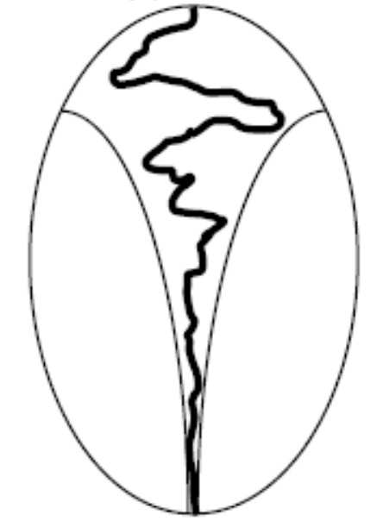
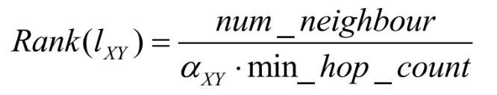
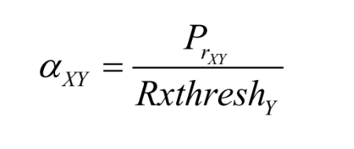
Strategy Drawbacks
Algorithm Structure
Once a link is assigned with certain channel, it’s impossible to modify or revise
The rank of links may change during the algorithm, but priority queue never update
Sequential Forward Channel Assignment
Figure Scource: https://www.cc.gatech.edu/~bboots3/CS4641-Fall2018/Lecture16/16_FeatureSelection.pdf

Slide 8
Score Function J(w) Design
Step 1. Measure $e_{0}(s,t)$ interferenced by other links
Step 2. Measure $e_{0}(s,t)$ interference assigned links
Step 3. Measure $e_{0}(s,t)$ interference unassigned empty links

Slide 9
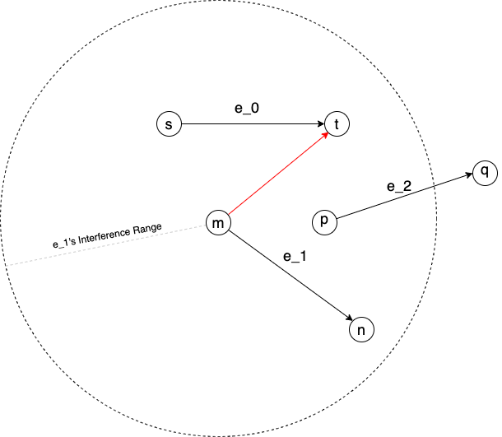
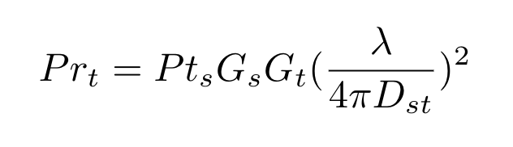
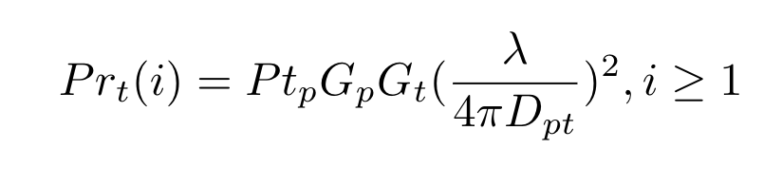
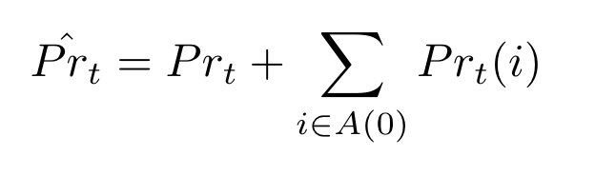
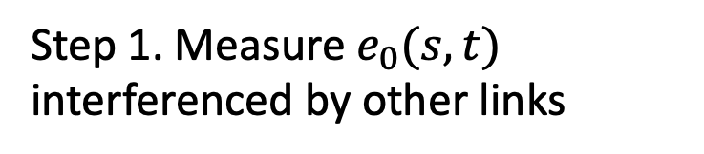
Score Function J(w) Design
Step 1. Measure $e_{0}(s,t)$ interferenced by other links

Slide 10
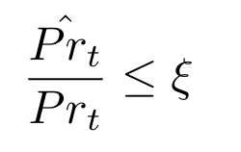
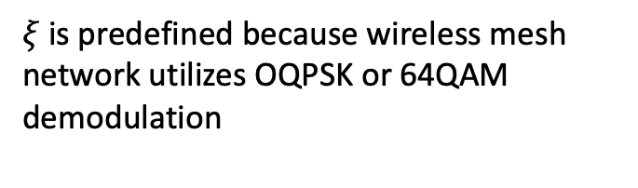
Score Function J(w) Design
Constraints
Define the receiver SNR as a threshold.
$ξ$ is predefined because wireless mesh network utilizes OQPSK or 64QAM demodulation

Slide 11
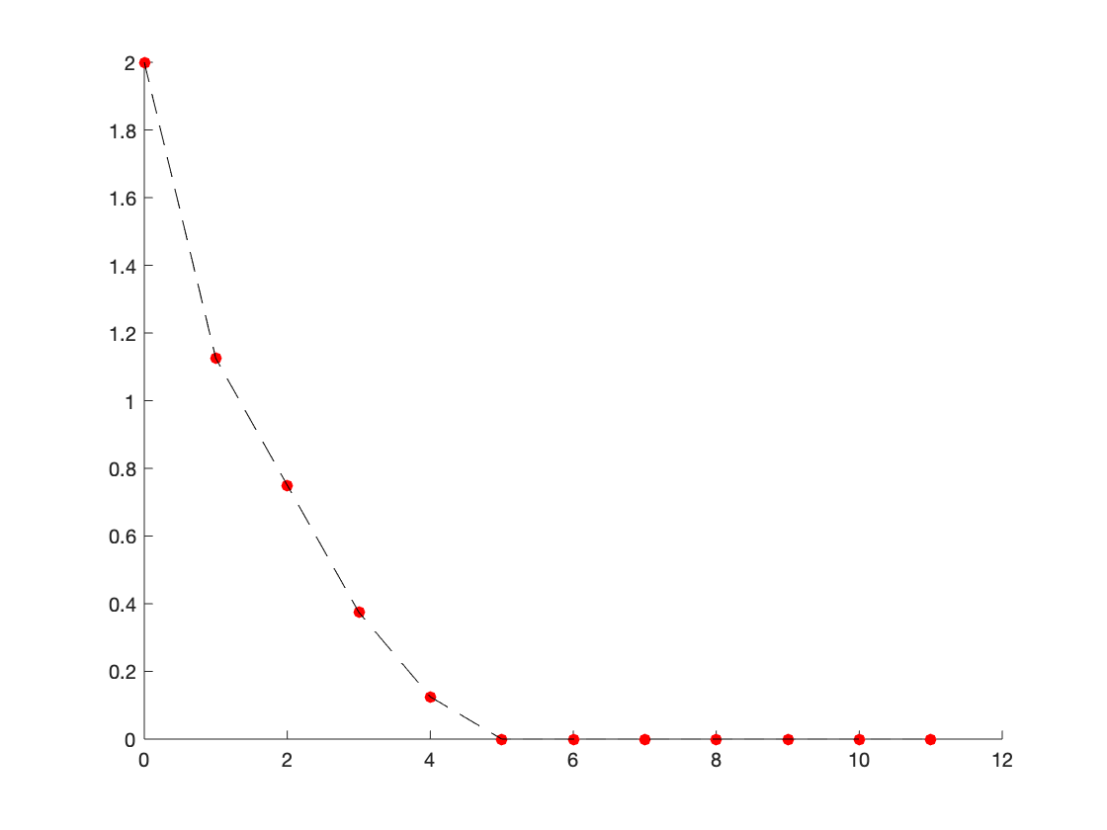
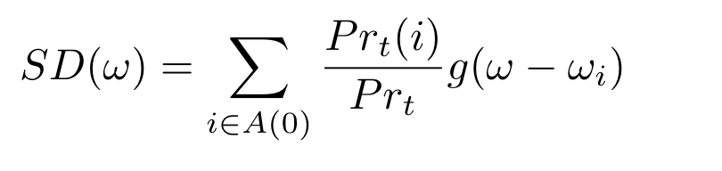

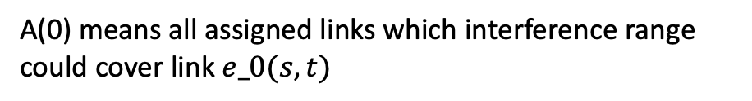

Score Function J(w) Design
Score for Step 1
Define the $g(Δω)$ function
A(0) means all assigned links which interference range could cover link $e_0(s,t)$
One example of$g(Δω)$ function

Slide 12
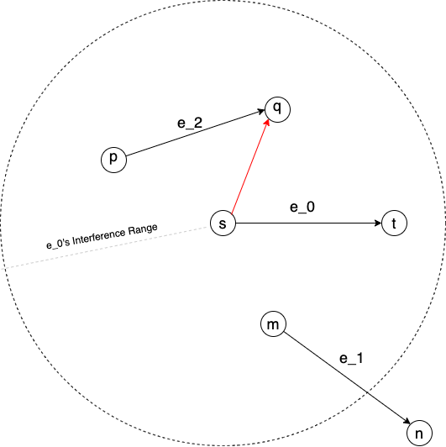
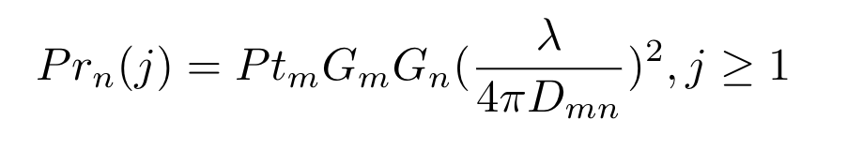
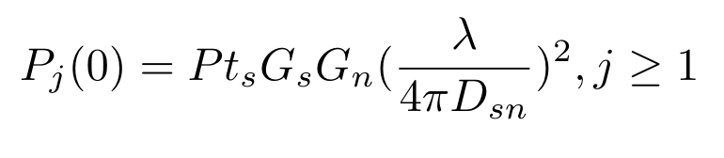
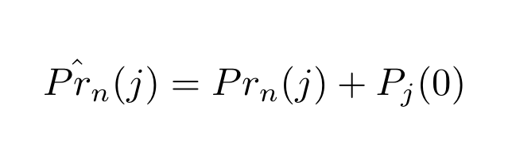
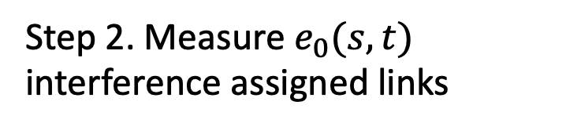
Score Function J(w) Design
Step 2. Measure $e_{0}(s,t)$ interference assigned links

Slide 13
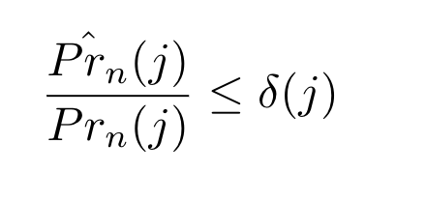
Score Function J(w) Design
Constraints 1
For each assigned link, we can define a SNR threshold.

Slide 14
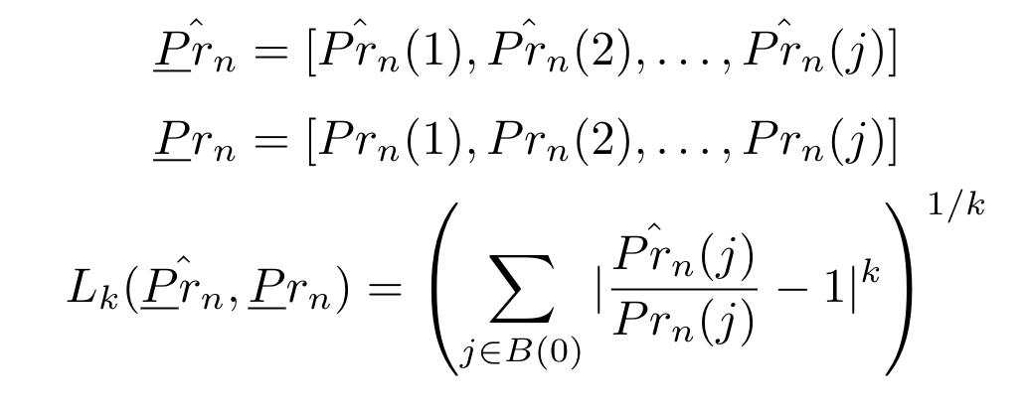
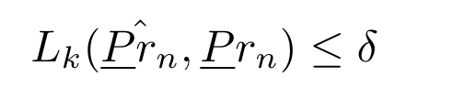
Score Function J(w) Design
Constraints 2
Calculate total variance of assigned links

Slide 15
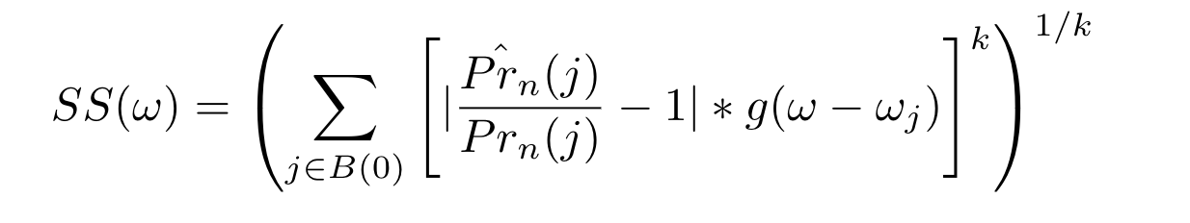
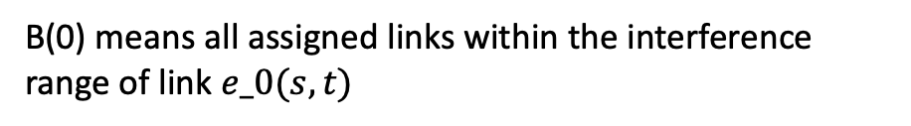

Score Function J(w) Design
Score for Step 2
B(0) means all assigned links within the interference range of link $e_0(s,t)$
One example of$g(Δω)$ function

Slide 16
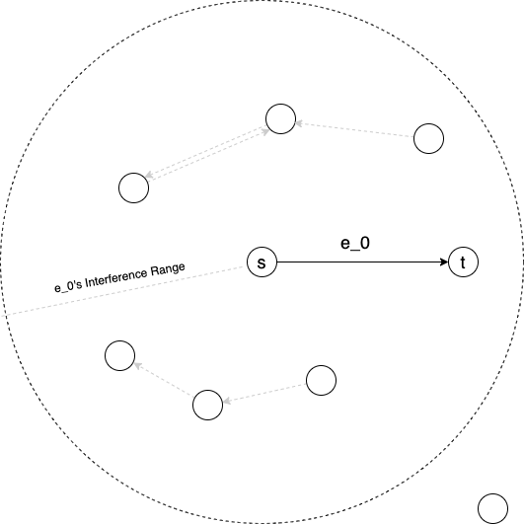
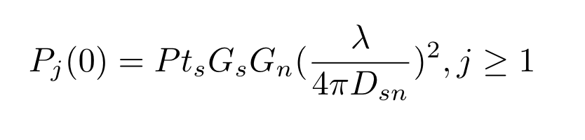
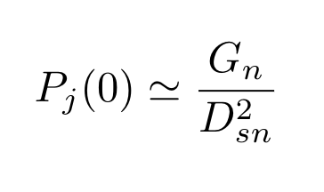
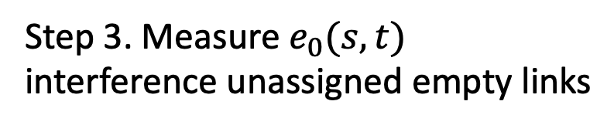
Score Function J(w) Design
Step 3. Measure $e_{0}(s,t)$ interference unassigned empty links

Slide 17
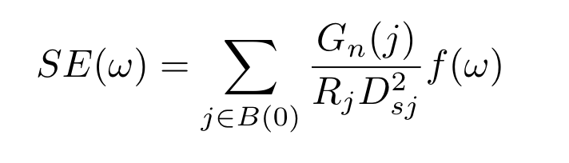
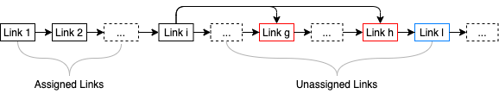
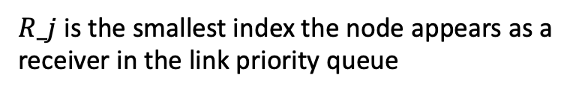
Score Function J(w) Design
Score for Step 3
$R_j$ is the smallest index the node appears as a receiver in the link priority queue

Slide 18
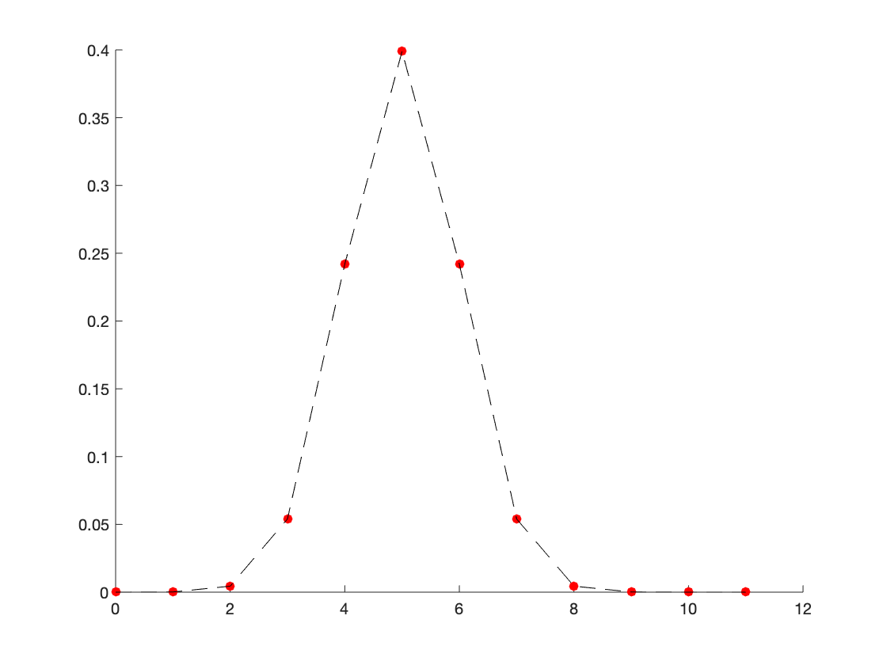

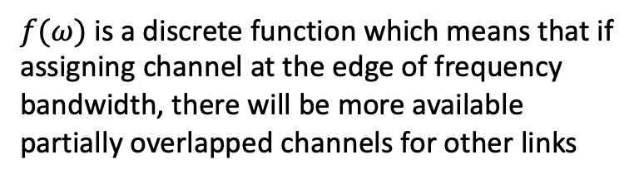
Score Function J(w) Design
Score for Step 3
$f(ω)$ is a discrete function which means that if assigning channel at the edge of frequency bandwidth, there will be more available partially overlapped channels for other links
One example of$f(ω)$ function

Slide 19
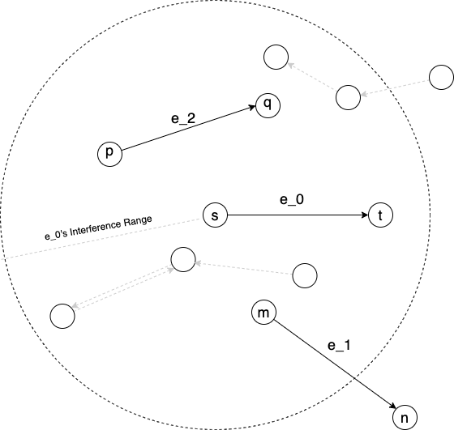
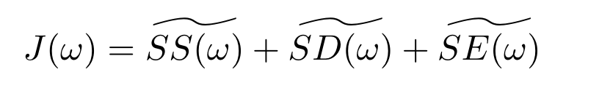
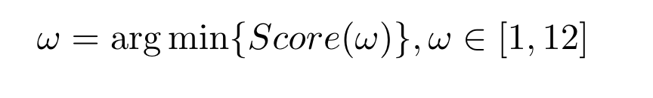
Score Function J(w) Design
One example of wireless mesh network

Slide 20
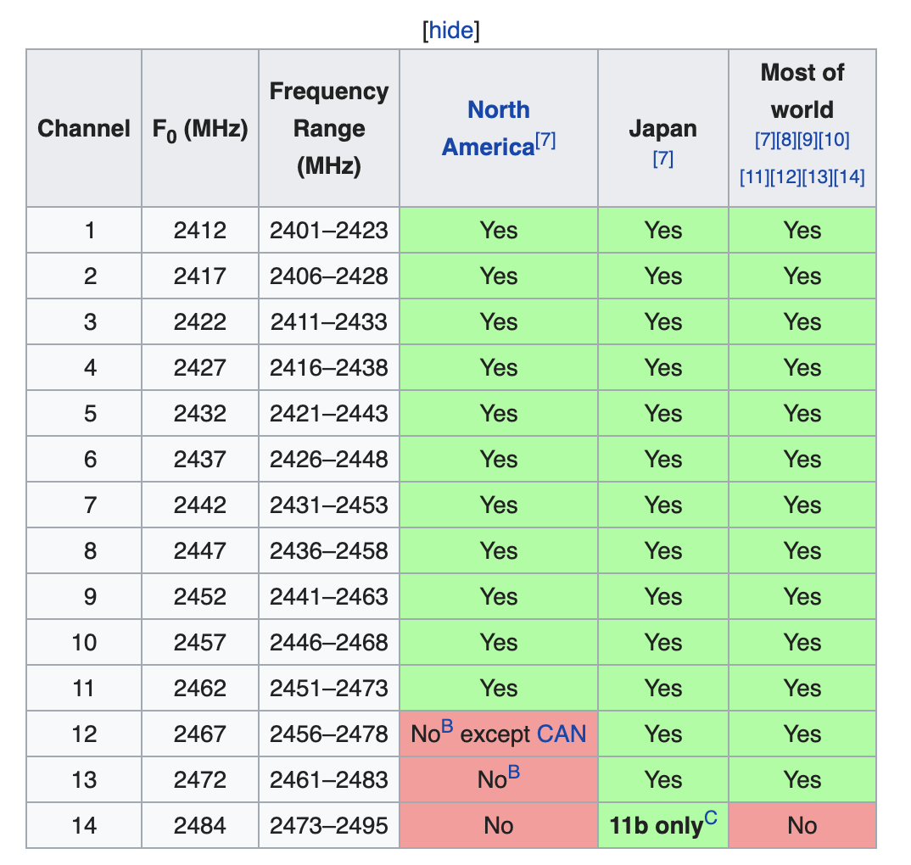
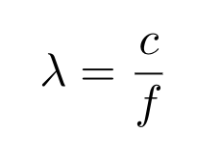


Score Function J(w) Design
Wavelength Estimation
$$0.1208m≤λ≤0.1244m$$
Estimate $λ$ as 0.12m to simplify calculation
Figure Scource: https://en.wikipedia.org/wiki/List_of_WLAN_channels

Slide 21
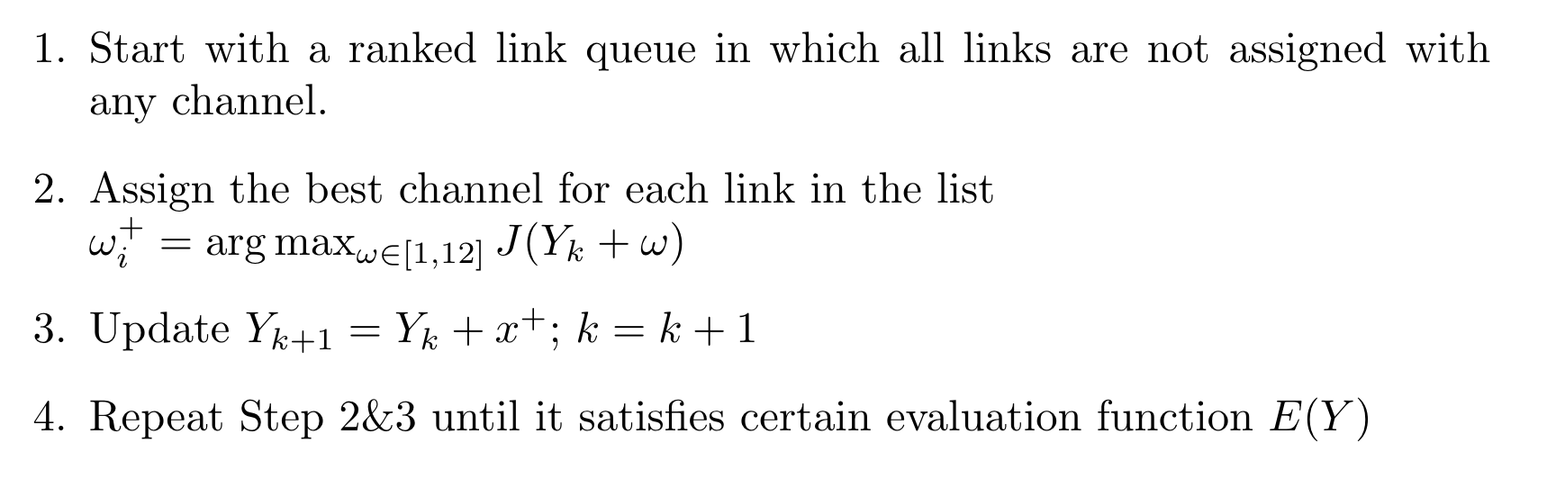
Algorithm Structure Design
Sequential Forward Channel Assignment (SFS)
Solution Space for SFS

Slide 22
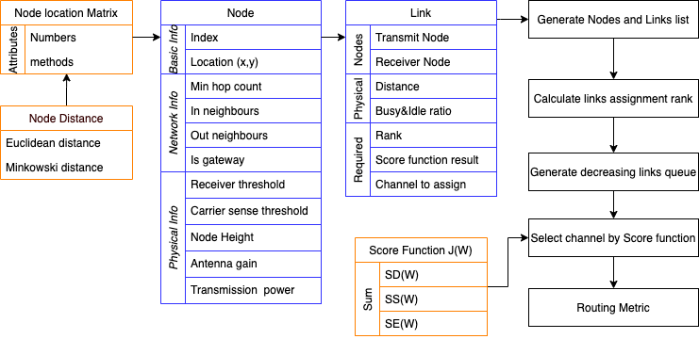
Algorithm Structure Design

Slide 23
Algorithm Structure Design
Drawbacks
Once a link is assigned with certain channel, it’s impossible to modify or revise
The rank of links may change during the algorithm, but priority queue never update
One example of wireless mesh network

Slide 24
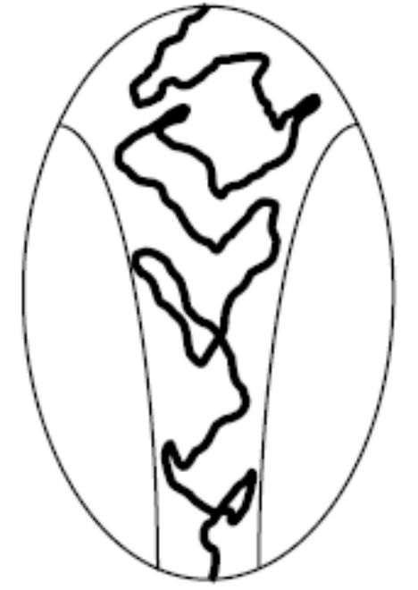
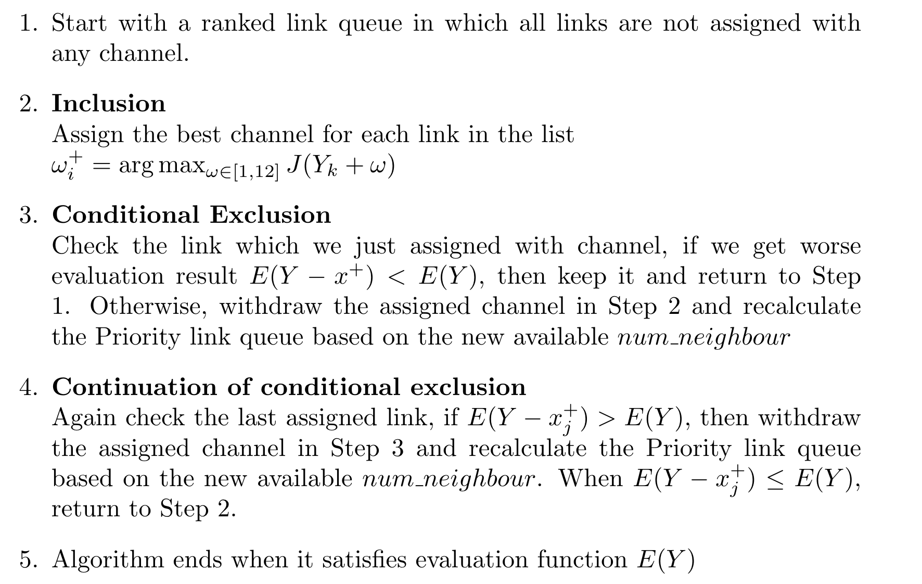
Algorithm Structure Design
Sequential Floating Forward Channel Assignment (SFFS)
Solution Space for SFFS
Future work

