Slide 1
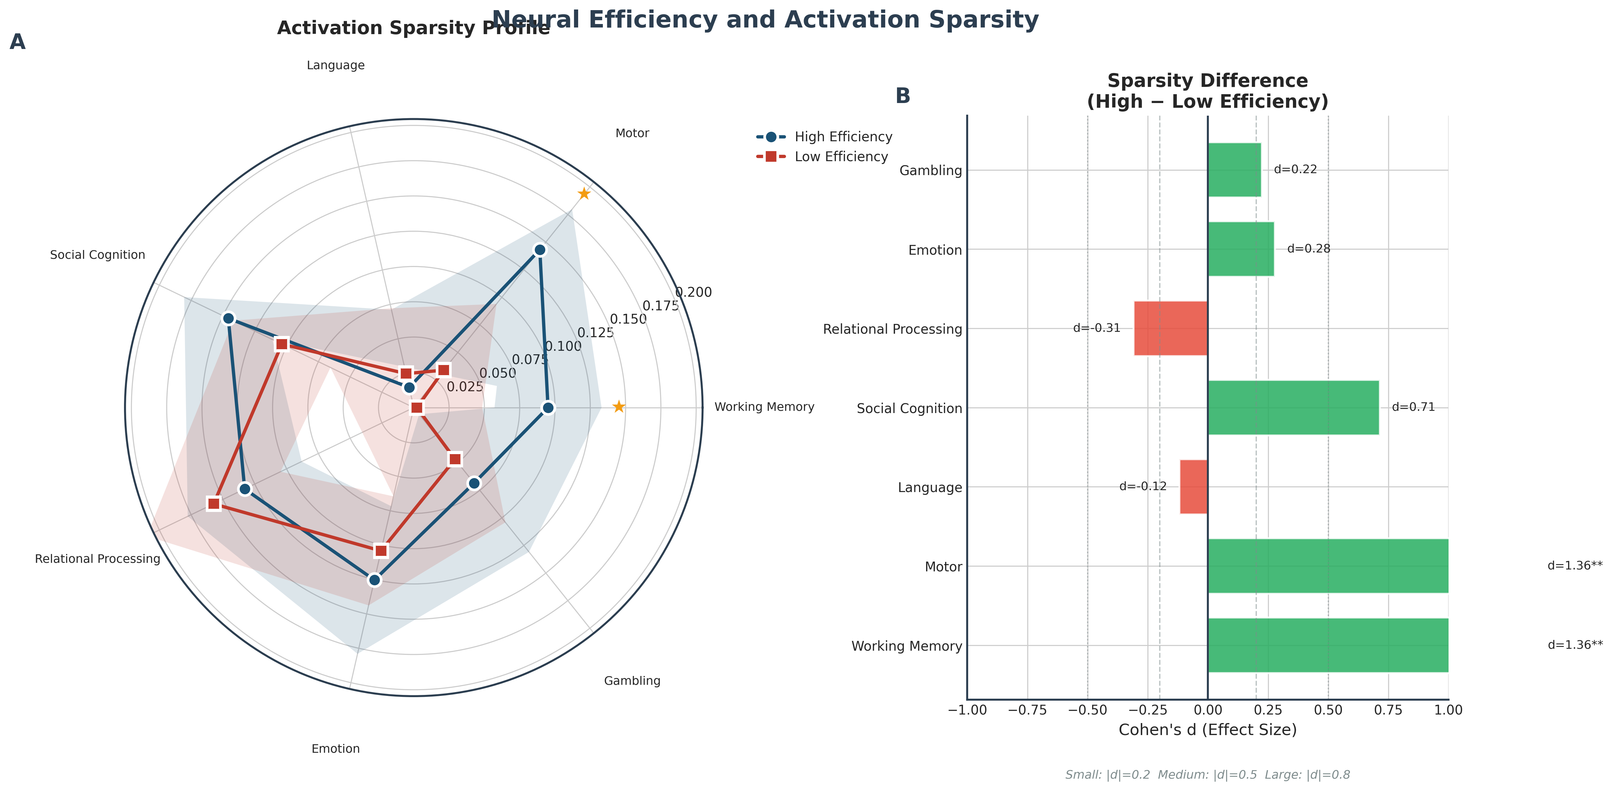
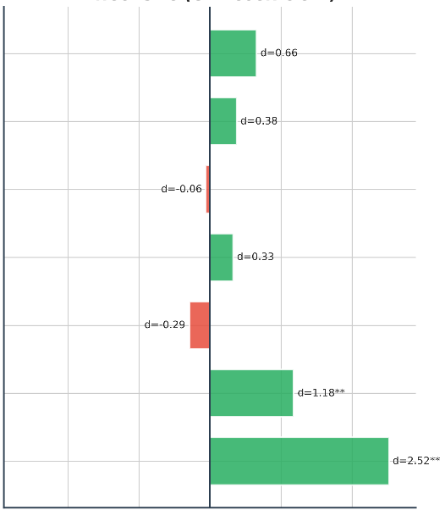
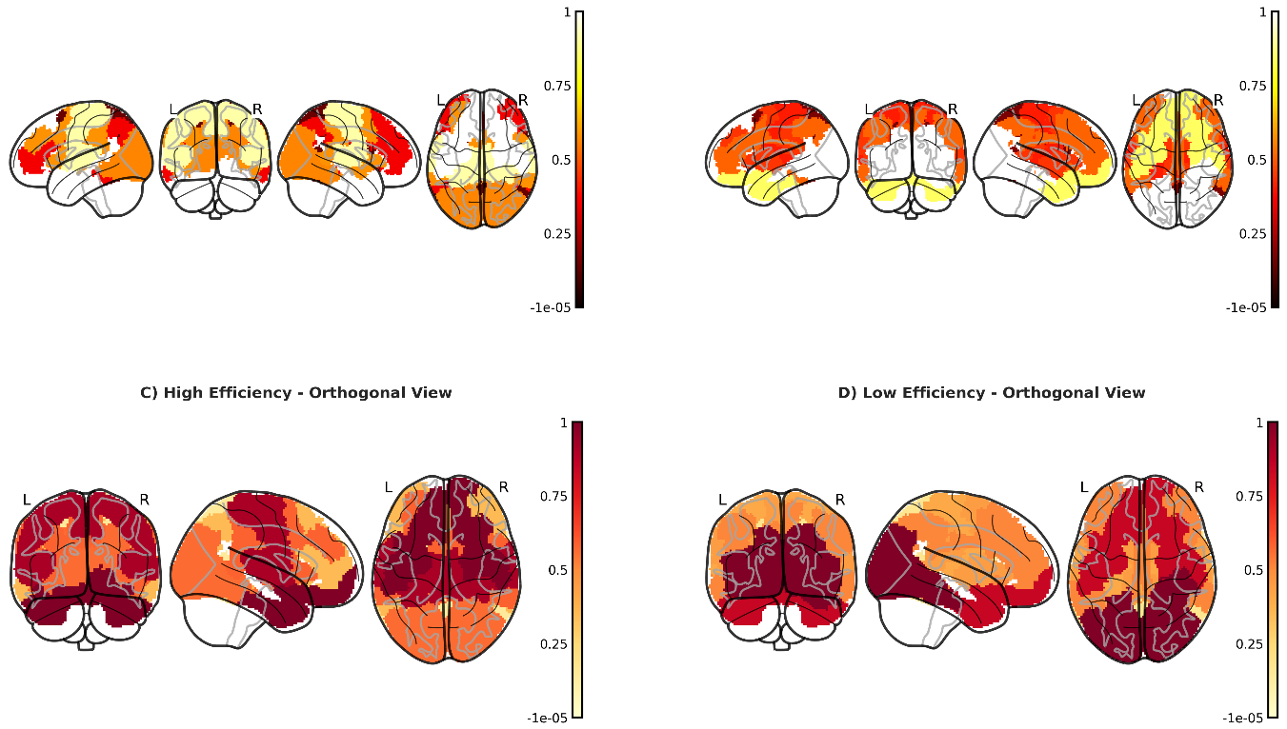
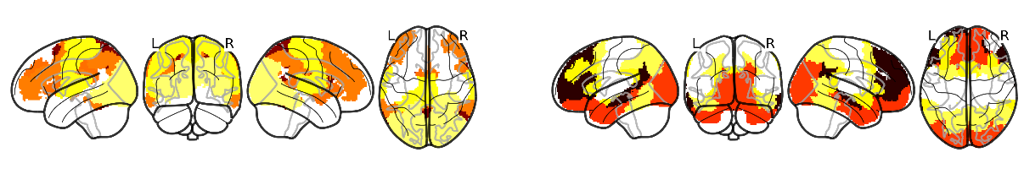
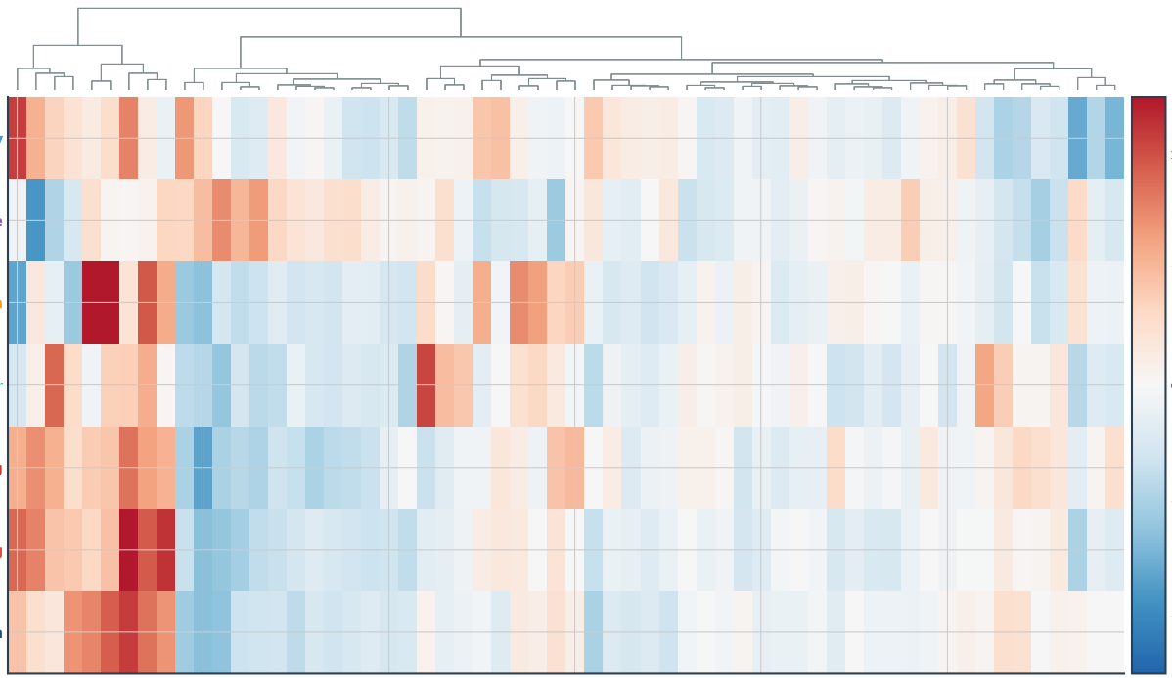
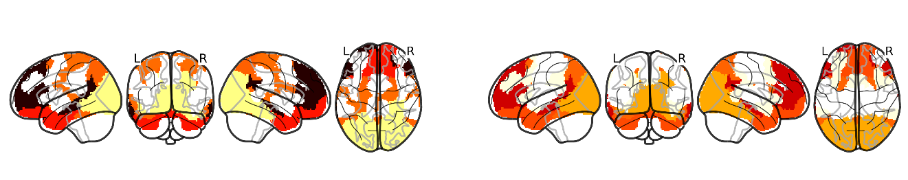
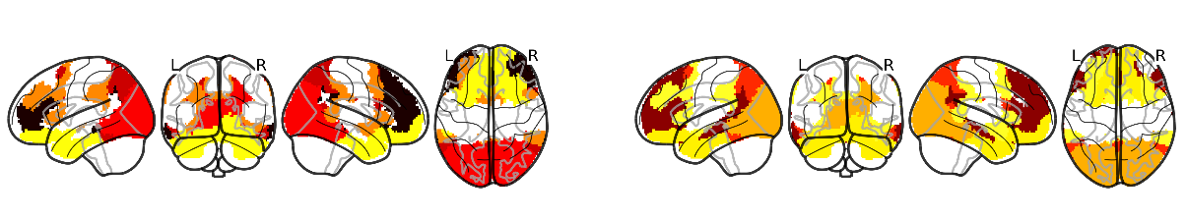
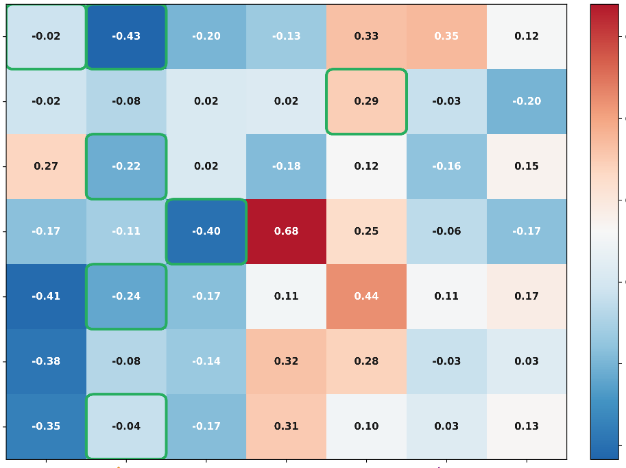
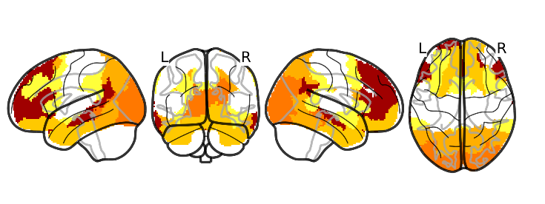
a
Composite Sparsity by rask
Effect Size（Gini Coefficient）
b
A.High-Efficiency Group (Sparser Activation)
High Efficiency
Language
Low Efficiency
L
R
L
R
Motor
Social
Cognition
Gambling
d=0.66
1
Emotion
d=0.38
0.75
Relational
Processing
d=﹣0.06
Working
Memory
0.5
Social
Cognition
d=0.33
B.Low-Efficiency Group (Diffuse Activation)
0.25
Relational
Processing
Language
d=﹣0.29
L
R
L
R
-1e-05
Motor
d=1.18**
Gambling
Emotion
Working
Memory
d=2.52**
Cohen‘s d
c
N=20 subjects × 7 tasks × 360 parcels, hierarchically clustered
d
Working Memory
2
1
0
-1
-2
Language
Working Memory
Social Cognition
Activation ( z-score)
Motor
Gambling
Language
RelationalProcessing
Emotion
L i6-8
R 5mv
R VIP
R IFJa
R 8Av
0.0
e
R POS1
Brain Region ( HCP-MMP Atlas)
0.2
Working Memory
0.6
Relational
0.4
Motor
0.4
0.6
Language
Gambling
0.8
0.2
Social Cognition
Activation Strength ( a.-u.)
1.0
Relational Processing
0
Motor
Emotion
-0.2
Gambling
Visual
-0.4
Social
Default Mode
Somatomotor
Limbic
Dorsal Attention
Frontoparietal Control
Ventral Attention/Salience
Emotion
Functional Brain Networks

Slide 2
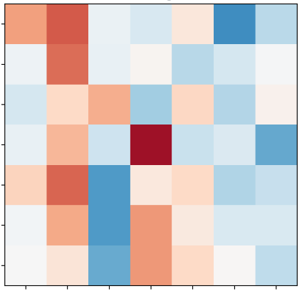
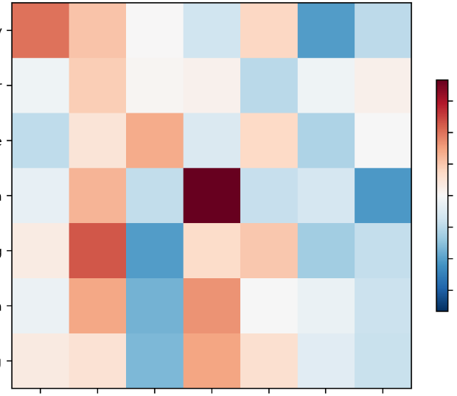
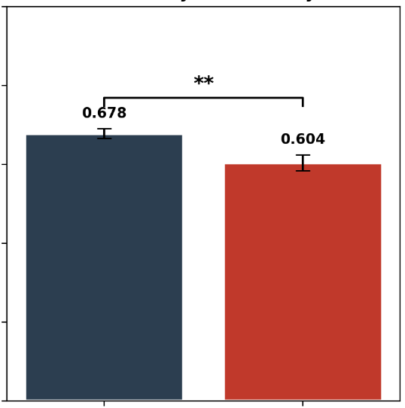
High-Efficiency Group Mean Routing Profile
Low-Efficiency Group Mean Routing Profile
Routing Consistency (Inter-Subject Similarity)
Working Memory
Working Memory
1.0
Motor
Motor
0.6
0.8
Language
Language
0.4
0.6
Cognitive Tasks
Cognitive Tasks
0.2
Inter-Subject Correlation ( r)
Activation ( a.-u.)
Social Cognition
Social Cognition
0.0
Relational Processing
-0.2
0.4
Relational Processing
-0.4
Emotion
Emotion
-0.6
0.2
Gambling
Visual
Limbic
Gambling
Visual
Limbic
0.0
Somatomotor
Default Mode
Somatomotor
Default Mode
High
Efficency
Low
Efficency
Dorsal Attention
Dorsal Attention
Frontoparietal Control
Frontoparietal Control
Ventral Attention/Salience
Brain Network
Ventral Attention/Salience
Brain Network
t=3.14, p=0.002, d=0.67

Slide 3
a
Composite Sparsity by rask
Effect Size（Gini Coefficient）
c
N=20 subjects × 7 tasks × 360 parcels, hierarchically clustered
High Efficiency
2
1
0
-1
-2
Language
Low Efficiency
Motor
Gambling
d=0.66
Social
Cognition
Emotion
Working
Memory
Relational
Processing
d=0.38
Language
Working
Memory
d=﹣0.06
Social
Cognition
Activation ( z-score)
Social
Cognition
d=0.33
Motor
Relational
Processing
Language
d=﹣0.29
Gambling
Motor
Relational
Processing
Gambling
d=1.18**
Emotion
Emotion
Working
Memory
d=2.52**
R POS1
L i6-8
R 5mv
R VIP
R IFJa
R 8Av
Cohen’s d
Brain Region ( HCP-MMP Atlas)
b
A.High-Efficiency Group (Sparser Activation)
d
L
R
L
R
1
Working Memory
0.75
B.Low-Efficiency Group (Diffuse Activation)
0.5
L
R
L
R
0.25
Language
-1e-05
0.0
e
0.6
Relational
0.2
Working Memory
0.4
Motor
0.4
0.6
Language
Gambling
0.8
0.2
Social Cognition
Activation Strength ( a.-u.)
1.0
Relational Processing
0
Motor
Emotion
-0.2
Gambling
Visual
-0.4
Social
Default Mode
Somatomotor
Limbic
Dorsal Attention
Frontoparietal Control
Ventral Attention/Salience
Emotion
f
Functional Brain Networks
B.Low-Efficiency Group Mean Routing Profile
A.High-Efficiency Group Mean Routing Profile
C.Routing Consistency (Inter-Subject Similarity)
Working Memory
Working Memory
1.0
Motor
Motor
0.6
0.8
Language
Language
0.4
0.6
Cognitive Tasks
Cognitive Tasks
0.2
Inter-Subject Correlation ( r)
Activation ( a.-u.)
Social Cognition
Social Cognition
0.0
Relational Processing
-0.2
0.4
Relational Processing
-0.4
Emotion
Emotion
Visual
-0.6
0.2
Gambling
Visual
Limbic
Gambling
Somatomotor
Limbic
Somatomotor
Default Mode
Dorsal Attention
Default Mode
0.0
High
Efficency
Low
Efficency
Dorsal Attention
Frontoparietal Control
Frontoparietal Control
Ventral Attention/Salience
Ventral Attention/Salience
Brain Network
Brain Network
t=3.14, p=0.002, d=0.67

Slide 4
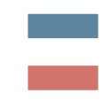
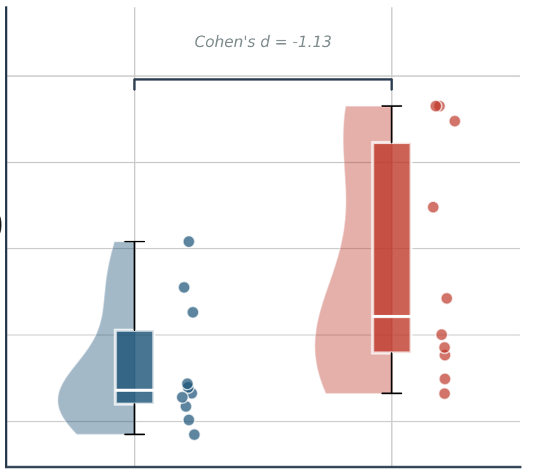
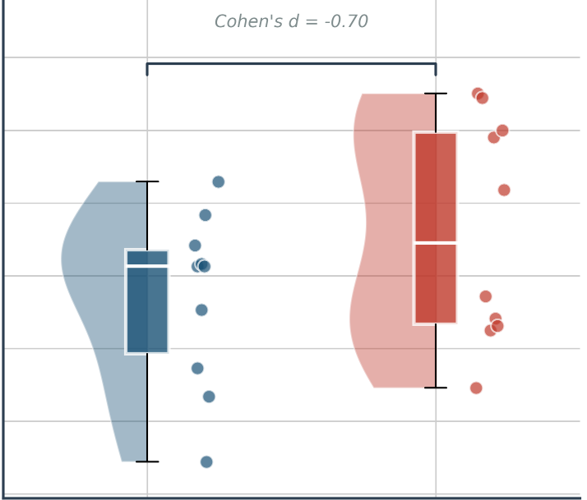
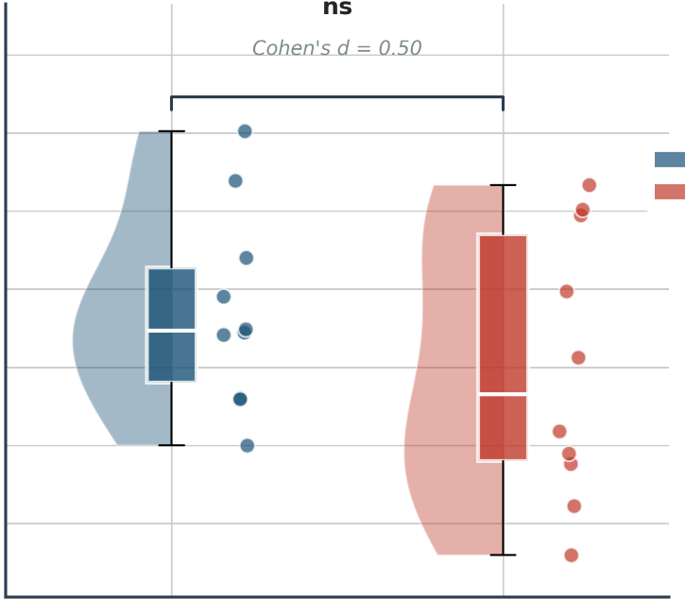

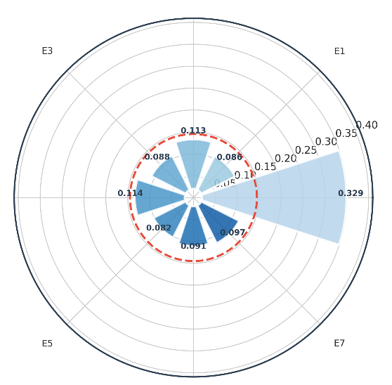
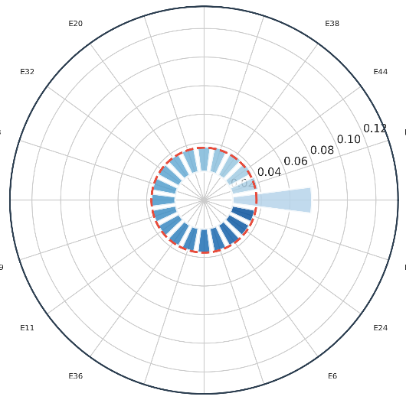
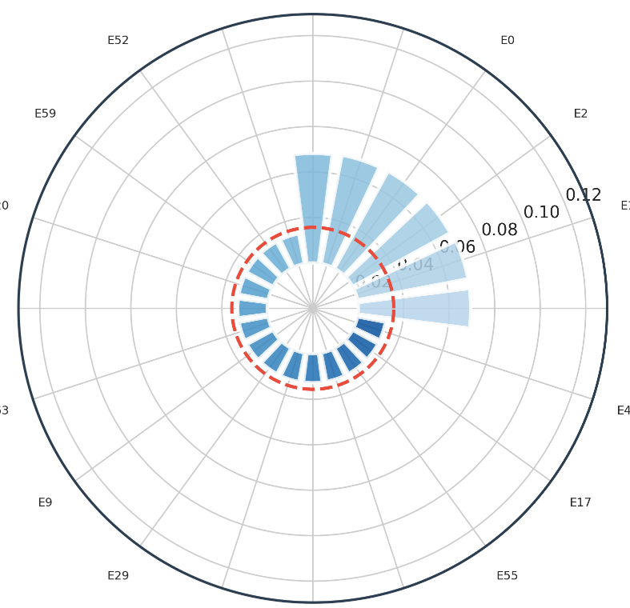
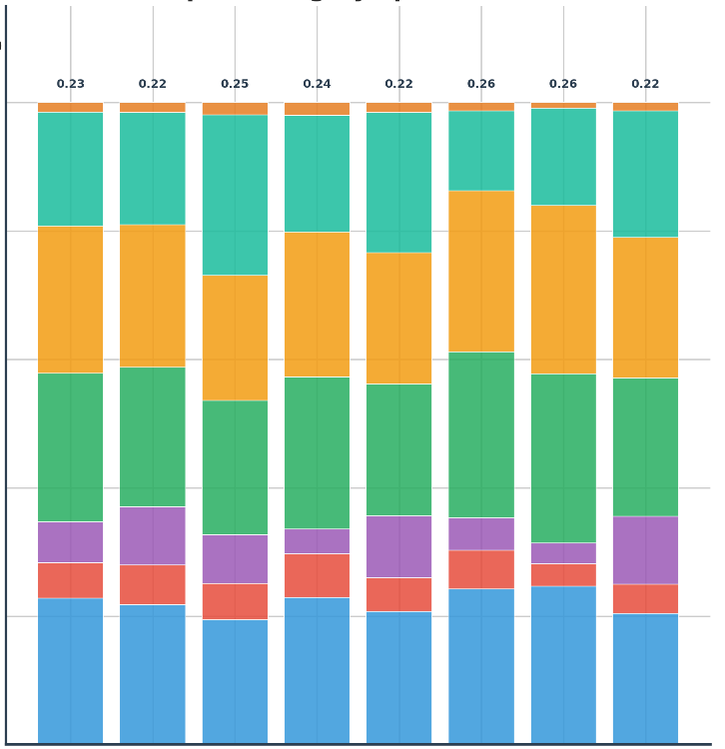
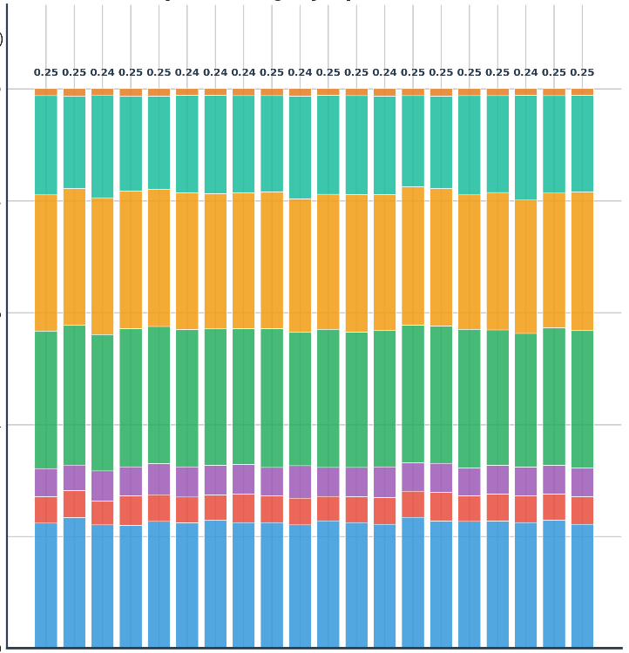
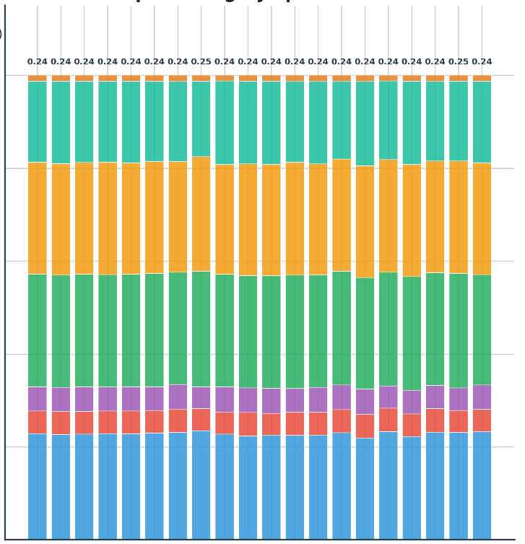

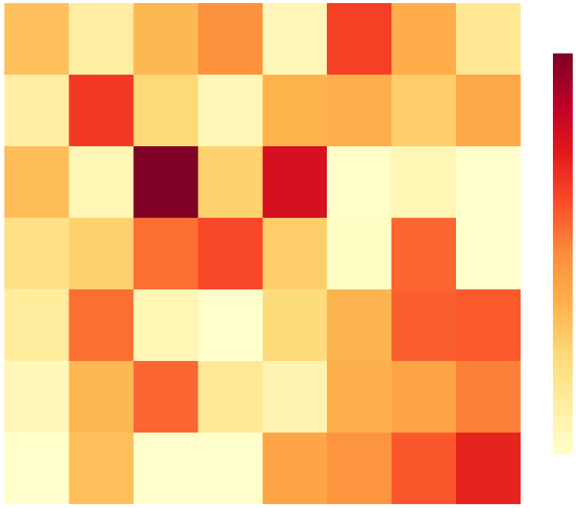
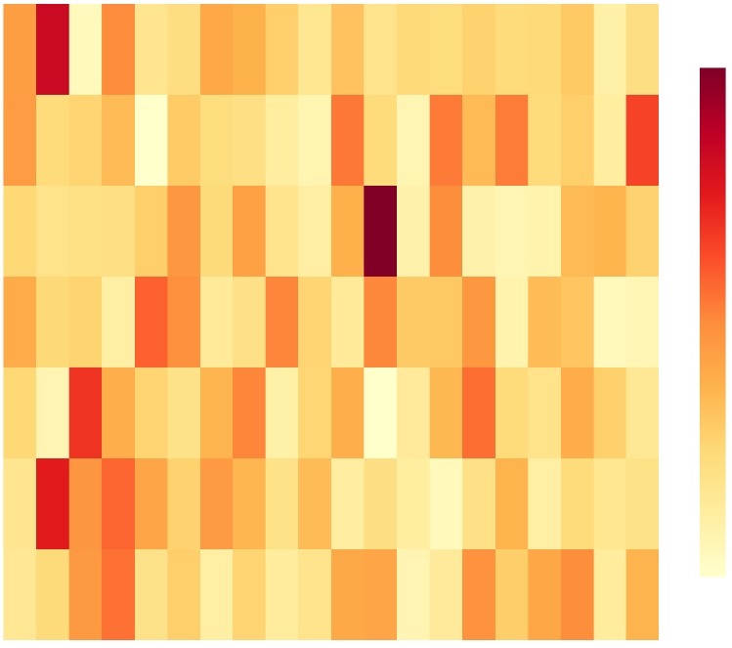
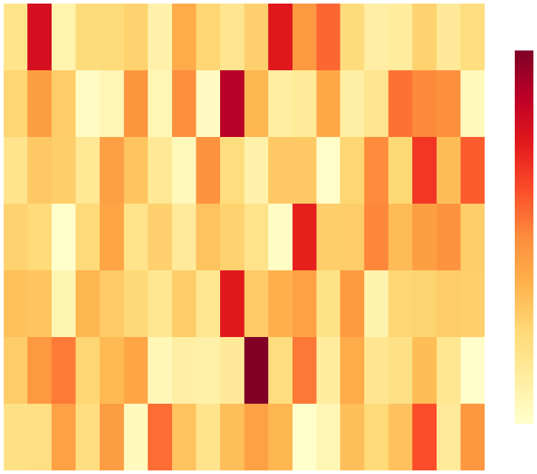

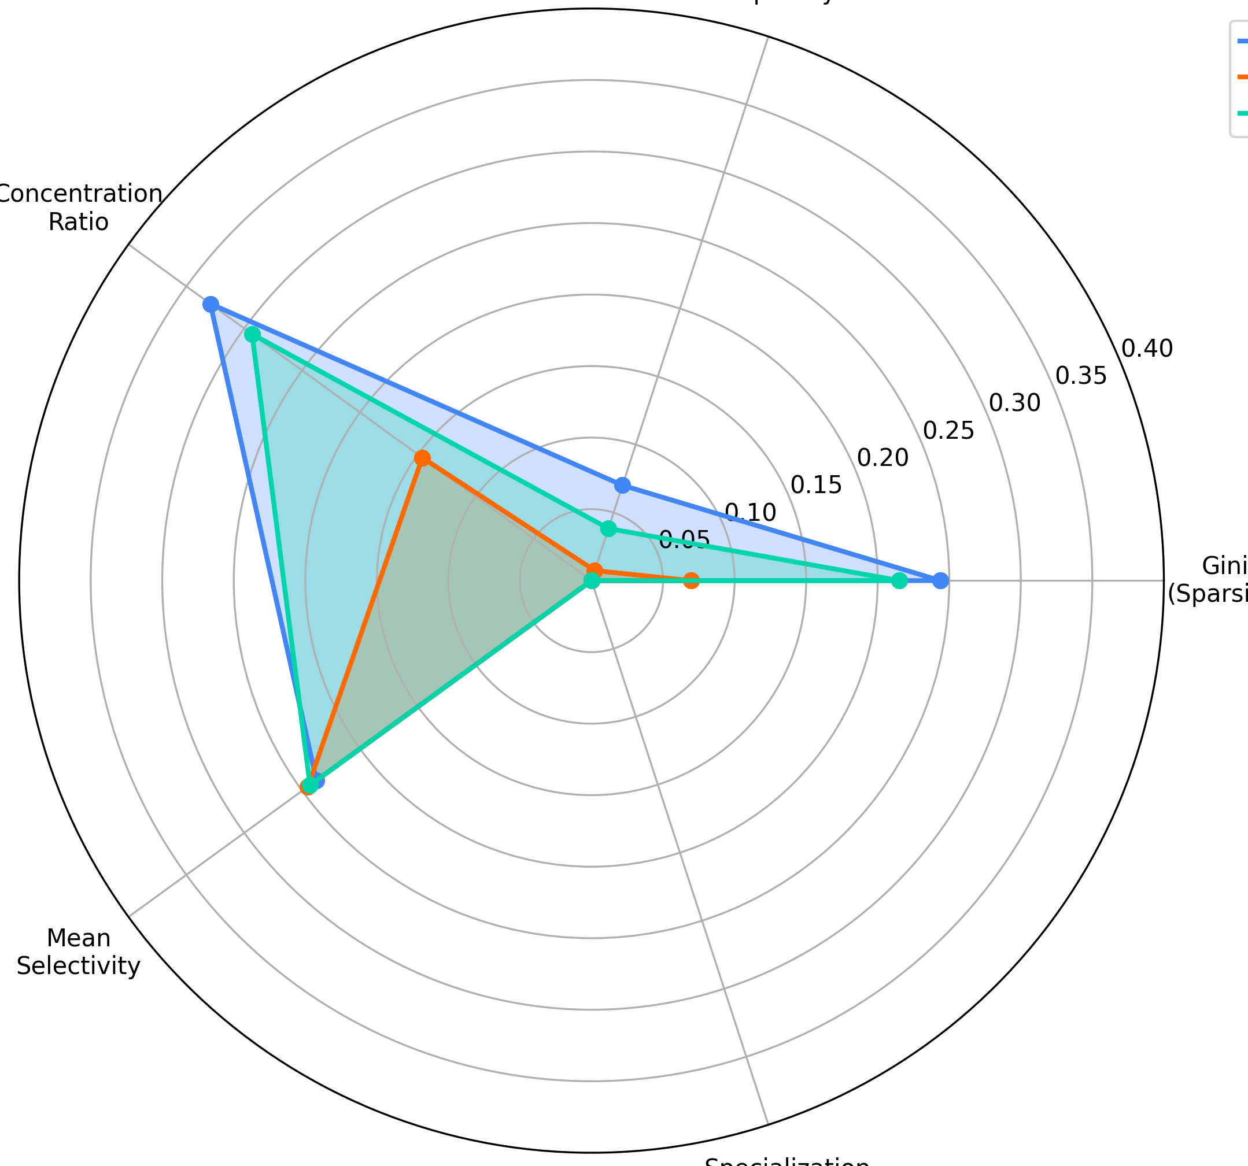
a
Modularity Index(Q)
B
High Efficency
C
A
Network Segregation
ns
Low Efficency
Participation Coefficientns
ns
0.095
0.31
0.84
0.090
0.30
0.83
0.29
0.82
Network Segregation
0.81
Modularity Index(Q)
Participation Coefficientns
0.085
0.28
0.80
0.080
0.27
0.79
0.075
0.26
0.78
High
Efficency
Low
Efficency
0.25
High
Efficency
Low
Efficency
High
Efficency
Low
Efficency
b
A
c
d
Expert Activation Frequency Gini=0.244
A
A
E2
Uniform(0.1250)
Expert Activation Frequency（Top 20）Gini=0.070
Expert Activation Frequency（Top 20）Gini=0.215
E20
E21
E40
E19
E38
Uniform(0.0167)
E52
E40
E4
E5
E0
Uniform(0.0156)
E3
E1
E32
E44
E59
E2
E3
E14
E20
E1
E4
E0
E17
E0
E58
E3
E29
E35
E63
E42
E5
E7
E11
E6
E24
E9
E29
E55
E17
E6
E36
E34
E18
E49
E35
E24
E10
B
Expert Category Specialization
B
Expert Category Specialization
B
Expert Category Specialization
Input Category
0.25
Scientific
0.25
0.24
0.25
0.25
0.24
0.24
0.24
0.25
0.24
0.25
0.25
0.24
0.25
0.25
0.25
0.25
0.24
0.25
0.25
0.24
0.24
0.24
0.24
0.24
0.24
0.24
0.25
0.24
0.24
0.24
0.24
0.24
0.24
0.24
0.24
0.24
0.24
0.25
0.0
0.23
0.22
0.25
0.24
0.26
0.22
0.26
0.22
1.0
1.0
0.24
Social
Emotional
Procedural
Narrative
Mathematical
0.2
0.8
0.8
Risk Decision
0.4
0.6
0.6
Category Distribution
0.6
0.4
0.4
0.8
0.2
0.2
1.0
0.0
0.0
E0
E21
E11
E6
E40
E14
E19
E20
E29
E34
E38
E32
E36
E49
E44
E3
E18
E24
E17
E3
E1
E2
E0
E5
E4
E40
E52
E59
E20
E58
E63
E9
E29
E35
E24
E10
E55
E17
E0
E1
E2
E3
E4
E5
E6
E7
E35
Expert ID(Top 20)
E42
e
Expert ID
Expert ID(Top 20)
f
Switch-8
Qwen-MoE
DeepSeek-16B
MoE Model Comparison: Multi-Metric Radar
Entropy Sparsity
Switch-8
scientific
scientific
scientific
Concentration
Ratio
Qwen-MoE
social
0.35
0.16
0.12
DeepSeek-16B
social
0.14
0.30
social
0.10
emotional
0.25
0.12
emotional
emotional
Input Category
0.20
0.10
0.08
procedural
procedural
0.08
0.15
procedural
0.06
Gini
(Sparsity)
narrative
narrative
0.06
0.10
narrative
mathematical
0.05
0.04
0.04
mathematical
mathematical
0.00
0.02
0.02
risk_decision
risk_decision
0.00
Mean
Selectivity
E0
risk_decision
Specialization Rate
E1
E2
E3
E4
E6
E5
E7
E0
E19
E1
E2
E3
E4
E5
E6
E7
E8
E9
E10
E11
E12
E13
E14
E15
E16
E17
E18
E0
E19
E1
E2
E3
E4
E5
E6
E7
E8
E9
E10
E11
E12
E13
E14
E15
E16
E17
Expert ID
Expert ID (first 20)
Expert ID (first 20)
E18

Slide 5
Modularity Index(Q)
Network Segregation
Participation Coefficientns
High Efficency
0.095
0.31
0.84
Low Efficency
0.090
0.30
0.83
0.29
0.82
Network Segregation
0.81
Modularity Index(Q)
Participation Coefficientns
0.085
0.28
0.80
0.080
0.27
0.79
0.075
0.26
0.78
High
Efficency
Low
Efficency
0.25
High
Efficency
Low
Efficency
High
Efficency
Low
Efficency

