Slide 1
Model Risk Assessment of Machine Learning-Based Credit Scoring
A Case Study Using the Give Me Some Credit Dataset
Model Validation Report
Xiaoyang Zhang (xz5476) · Yifan Xu (yx3598) · Yike Ma (ym2552)
FRE 7801 — Model Risk Management | NYU Tandon School of Engineering
Spring 2026 | Validation Standard: SR 11-7
Risk Tier: Tier 1 — High Risk (MRS 88/100)

Slide 2
Agenda
Model Risk Assessment — LightGBM Credit Scoring
01
Executive Summary
02
Dataset & Scope
03
Data Quality Review
04
Model Architecture
05
Quantitative Validation
06
Overfitting Analysis
07
Sensitivity Analysis
08
Fair Lending Analysis
09
Model Risk Tiering & SR 11-7 Checklist
10
Final Validation Opinion
FRE 7801 — Model Risk Management | NYU Tandon | Spring 2026

Slide 3
Executive Summary
Key Validation Findings
Validation Area | Result | Assessment
Champion Validation AUC | 0.8601 | Strong discriminatory power
Challenger Validation AUC | 0.8317 | Strong benchmark
Champion KS Statistic | 0.5700 | Excellent rank ordering
Champion Train AUC | 0.9245 | High in-sample fit
Champion AUC Gap (single split) | 0.0644 | Review finding
CV Mean AUC Gap (5-fold) | 0.1669 | Overfitting confirmed
Max PSI | 0.0005 | Stable on random split
Young-Borrower DIR (LGBM) | 0.3351 | ECOA-permitted; reflects 4.3x default rate diff.
Internal MRS Score | 88/100 | Tier 1 — High Risk
Validation Conclusion
Conditionally approved pending overfitting remediation and governance controls. Age use is ECOA-compliant.
Model Under Review
LightGBM Credit Scoring Pipeline Give Me Some Credit — Kaggle 2011
Validation Standard
SR 11-7 — Federal Reserve & OCC
FRE 7801 — Model Risk Management | NYU Tandon | Spring 2026

Slide 4
Dataset & Scope
Give Me Some Credit — Kaggle 2011
150,000
101,503
~6.7%
10
Training Observations
Test Observations
Default Rate
Input Features
Feature | Risk Consideration
RevolvingUtilizationOfUnsecuredLines | Extreme outliers require caps
age | Fair lending sensitivity
NumberOfTime30-59DaysPastDueNotWorse | Sentinel values require treatment
DebtRatio | Heavy right tail
MonthlyIncome | ~20% missingness
NumberOfOpenCreditLinesAndLoans | Nonlinear effect
NumberOfTimes90DaysLate | Strong risk signal
NumberRealEstateLoansOrLines | Ambiguous directional effect
NumberOfTime60-89DaysPastDueNotWorse | Sentinel values require treatment
NumberOfDependents | Missingness and weak sensitivity
Out of Scope
– Legal fair lending determination
– Independent second-line validation
– Internal audit review
– Production implementation testing
– Live monitoring vs. bank portfolio
– Adverse action reason-code validation
– True out-of-time back-testing
FRE 7801 — Model Risk Management | NYU Tandon | Spring 2026

Slide 5
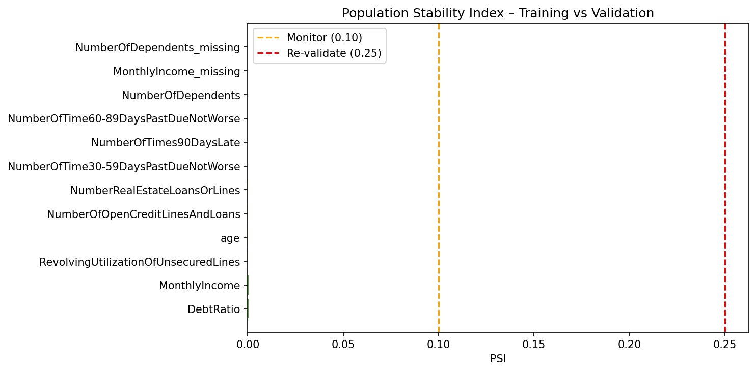
Data Quality Review
Missingness, Outliers & Population Stability
Missing Value Summary
MonthlyIncome: 19.82% missing (29,731 rows) NumberOfDependents: 2.62% missing (3,924 rows) Missingness indicators preserved as features
Feature | PSI | Status
DebtRatio | 0.0005 | Stable
MonthlyIncome | 0.0004 | Stable
RevolvingUtilization | 0.0003 | Stable
age | 0.0003 | Stable
OpenCreditLines | 0.0002 | Stable
RealEstateLoans | 0.0001 | Stable
30-59DaysPastDue | 0.0000 | Stable
90DaysLate | 0.0000 | Stable
NumberOfDependents | 0.0000 | Stable
MonthlyIncome_missing | 0.0000 | Stable
Max PSI 0.0005 — random split; not production drift evidence
FRE 7801 — Model Risk Management | NYU Tandon | Spring 2026

Slide 6
Model Architecture
Champion vs. Challenger Pipeline
Champion — LightGBM Pipeline
Challenger — Logistic Regression
1
Missing Value Treatment
– Standardized inputs via StandardScaler – Class weighting to handle imbalance – Traditional scorecard-style benchmark – Transparent, auditable, regulator-friendly – Fully interpretable coefficients
Impute + missingness indicator flags
2
Yeo-Johnson PowerTransformer
Reduce skew in numerical features
3
MiniBatchKMeans Clustering
Borrower-level segment assignment
4
Weight of Evidence Encoding
WOE transform of cluster labels
Champion — Key Risk Considerations
5
Polynomial Features (deg-2)
KMeans-WOE
Non-monotonic, difficult to audit
Capture nonlinear interactions
Polynomial
Overfitting and interpretability risk
6
SelectPercentile (ANOVA F)
Dimensionality reduction
LightGBM
Black-box model risk
7
LightGBM Classifier
Gradient-boosted tree w/ class weighting
Missingness
May encode demographic differences
FRE 7801 — Model Risk Management | NYU Tandon | Spring 2026

Slide 7
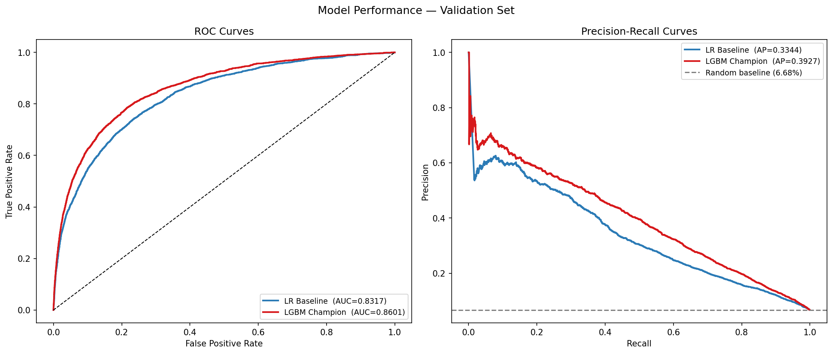
Quantitative Validation
Benchmark Performance — Champion vs. Challenger
Model | AUC-ROC | KS | Gini | PR-AUC | F-beta | Brier | Train AUC | AUC Gap
LR Baseline | 0.8317 | 0.5075 | 0.6635 | 0.3344 | 0.4619 | 0.1652 | 0.8291 | -0.0026
LGBM Champion | 0.8601 | 0.5700 | 0.7202 | 0.3927 | 0.5147 | 0.1253 | 0.9245 | 0.0644
+0.0284
+0.0625
-0.0399
+0.0583
AUC Lift
KS Lift
Brier Reduction
PR-AUC Lift
Note on Threshold Selection
Champion is a strong rank-ordering model. Production threshold ≠ 0.50 mechanically. Threshold should reflect: – Credit policy – Expected loss – Approval capacity – Calibration
FRE 7801 — Model Risk Management | NYU Tandon | Spring 2026

Slide 8
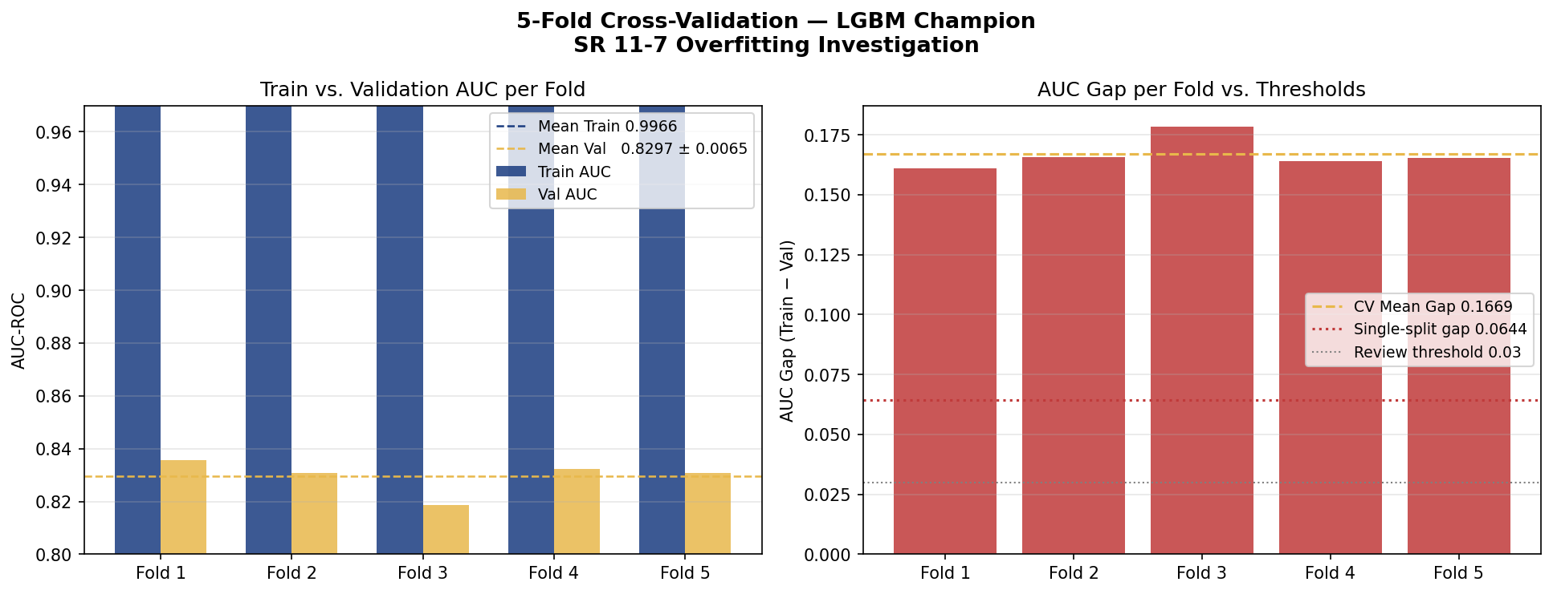
Overfitting Analysis
5-Fold Cross-Validation Evidence
LR Baseline
LGBM Champion
0.8291
0.8317
-0.0026
0.9245
0.8601
+0.0644
Train AUC
Val AUC
AUC Gap
Train AUC
Val AUC
AUC Gap
No overfitting — gap negligible
Exceeds 0.03 review threshold
5-Fold CV Results — LGBM Champion
Fold | Train AUC | Val AUC | AUC Gap | KS
Fold 1 | 0.9968 | 0.8358 | 0.1610 | 0.5325
Fold 2 | 0.9966 | 0.8309 | 0.1657 | 0.5131
Fold 3 | 0.9969 | 0.8186 | 0.1783 | 0.4925
Fold 4 | 0.9964 | 0.8324 | 0.1640 | 0.5204
Fold 5 | 0.9962 | 0.8308 | 0.1654 | 0.5123
Mean | 0.9966 | 0.8297 | 0.1669 | 0.5142
FRE 7801 — Model Risk Management | NYU Tandon | Spring 2026

Slide 9
Sensitivity Analysis
±10% Input Perturbation — Average Absolute Score Movement
Rank | Feature | Avg Abs. Score Movement
1 | age | 0.013805
2 | RevolvingUtilizationOfUnsecuredLines | 0.011690
3 | MonthlyIncome | 0.004820
4 | NumberOfOpenCreditLinesAndLoans | 0.004510
5 | DebtRatio | 0.003750
6 | NumberOfTime60-89DaysPastDueNotWorse | 0.001460
7 | NumberOfTimes90DaysLate | 0.001335
8 | NumberRealEstateLoansOrLines | 0.000965
9 | NumberOfDependents | 0.000225
10 | NumberOfTime30-59DaysPastDueNotWorse | 0.000175
Key Observation
Age is the most sensitive feature. This is assessed in the context of fair lending in the following slide. Age is an ECOA-permitted factor in empirically derived credit scoring systems (15 U.S.C. § 1691). The sensitivity finding means age is doing genuine predictive work proportional to actual default rate differences across age groups.
FRE 7801 — Model Risk Management | NYU Tandon | Spring 2026

Slide 10
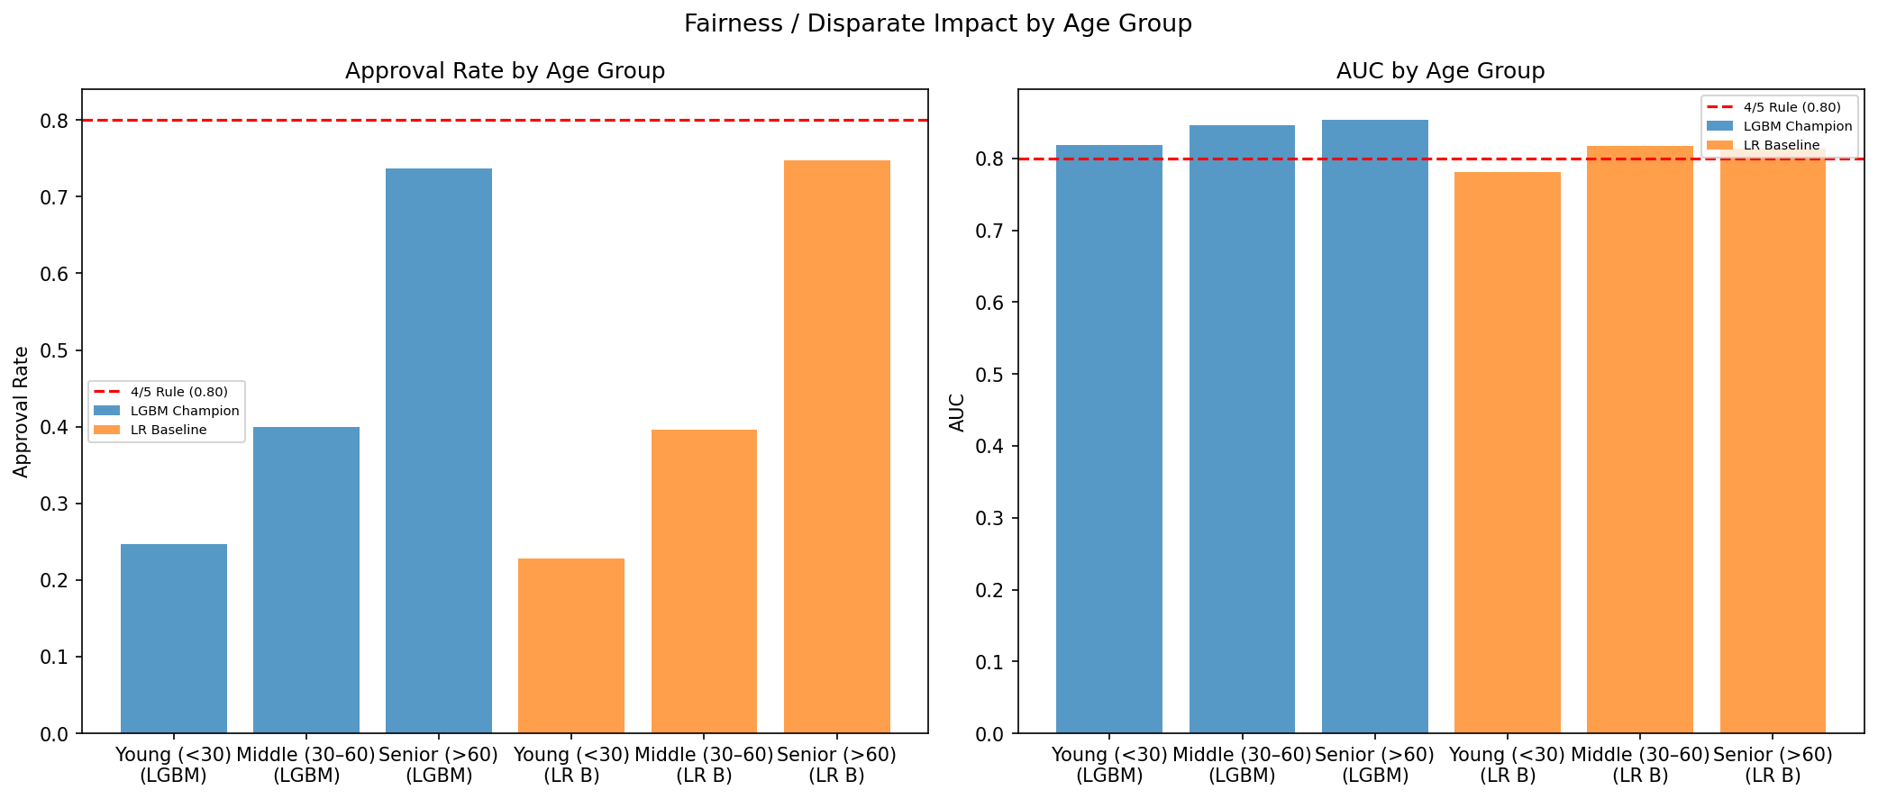
Fair Lending Analysis
Age-Based Disparate Impact — ECOA Context
Age is an ECOA-permitted factor (15 U.S.C. § 1691) in empirically derived credit scoring systems. DIR gap is consistent with a 4.3× actual default rate difference across age groups.
Age Group | Model | N | Default Rate | Approval Rate | AUC | DIR vs. Best
Young (<30) | LGBM Champion | 2,623 | 12.54% | 24.70% | 0.8189 | 0.3351
Young (<30) | LR Baseline | 2,623 | 12.54% | 22.80% | 0.7814 | 0.3051
Middle (30-60) | LGBM Champion | 27,795 | 8.12% | 39.94% | 0.8459 | 0.5418
Middle (30-60) | LR Baseline | 27,795 | 8.12% | 39.59% | 0.8173 | 0.5297
Senior (>60) | LGBM Champion | 14,582 | 2.89% | 73.72% | 0.8534 | 1.0000
Senior (>60) | LR Baseline | 14,582 | 2.89% | 74.74% | 0.8131 | 1.0000
Less-Discriminatory Alternative Test
Age-blind LGBM: DIR improves 0.3351 → 0.5081 (+0.173) but AUC drops −0.0372 (below LR baseline). Remaining DIR gap driven by age-correlated legitimate credit factors. Age use confirmed ECOA-compliant.
FRE 7801 — Model Risk Management | NYU Tandon | Spring 2026

Slide 11
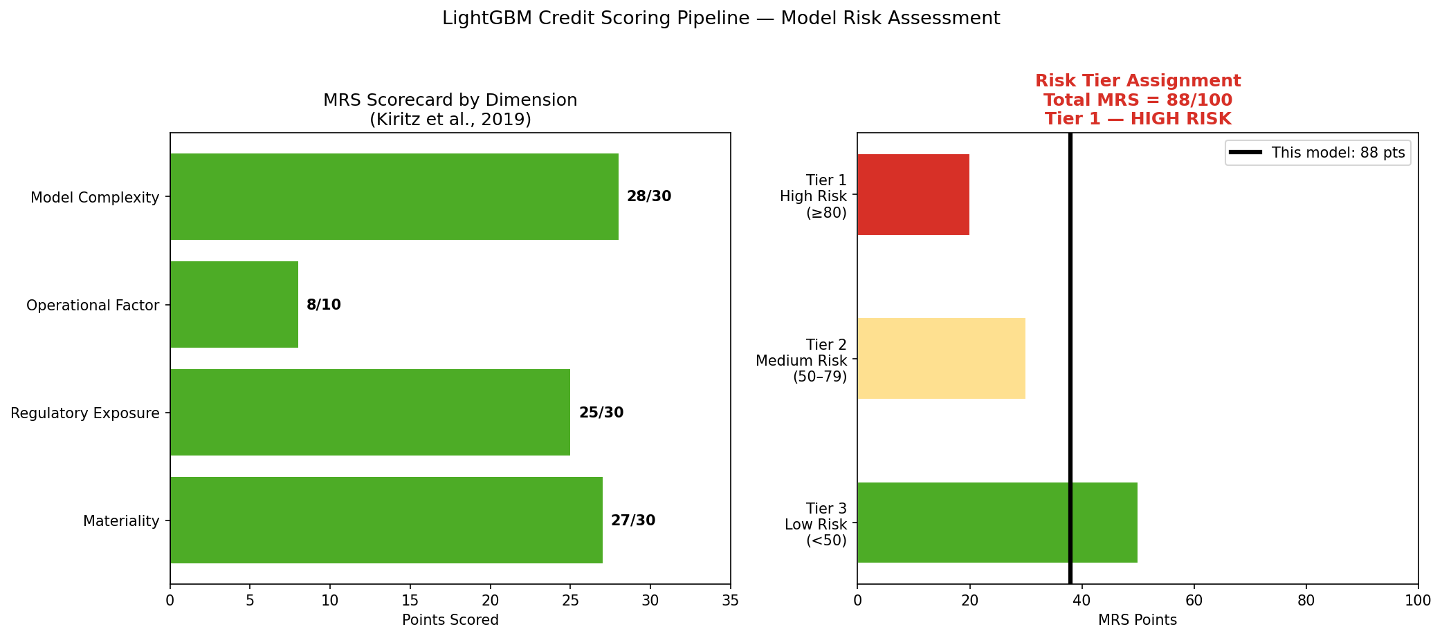
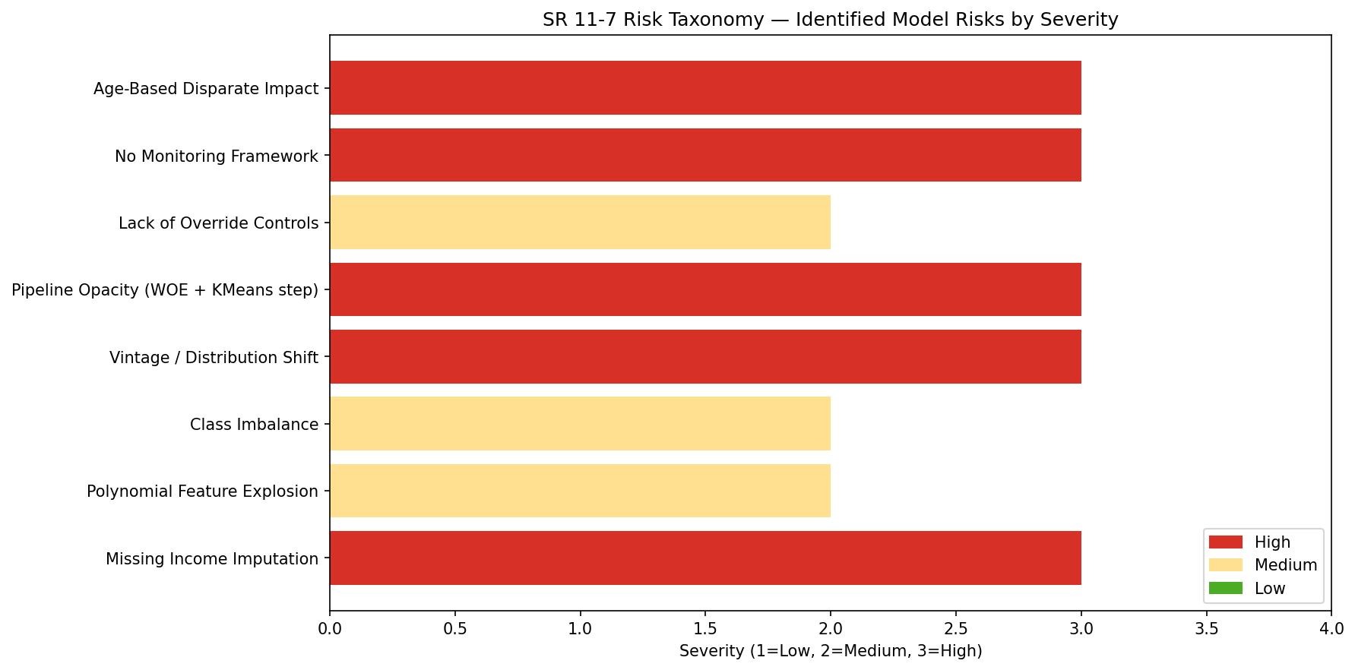
Model Risk Tiering & SR 11-7 Checklist
Internal Model Risk Scorecard
Dimension | Max | Score | % | Justification
Materiality | 30 | 27 | 90% | Credit decisions for large borrower population
Regulatory Exposure | 30 | 25 | 83% | SR 11-7, ECOA, explainability exposure
Operational Factor | 10 | 8 | 80% | Automated pipeline, no override control
Model Complexity | 30 | 28 | 93% | LightGBM + WOE + polynomial features
Total | 100 | 88 | 88% | Tier 1 — High Risk
SR 11-7 Validation Checklist
SR 11-7 Area | Status | Key Action
Purpose & Scope | Pass | Maintain model-use limits
Data Quality | Pass | Document Kaggle data limitations
Benchmarking | Pass | Explain complexity-performance tradeoff
Outcomes Analysis | Review | Simplify pipeline; apply early stopping
Ongoing Monitoring | Pass | Assign owner and monitoring cadence
Fair Lending | Pass | Monitor DIR semiannually
Governance | Pass | Document lack of independent validation
FRE 7801 — Model Risk Management | NYU Tandon | Spring 2026

Slide 12
Final Validation Opinion
Conditional Approval Pending Remediation
Age use is ECOA-compliant. SHAP explanations, 5-fold CV, and LDA test completed. Remaining gaps: overfitting, governance controls, threshold definition.
Strengths
Remaining Gaps
Academic Use
– Strong discrimination: AUC 0.8601, KS 0.5700
– CV mean AUC gap 0.1669 (overfitting)
– Suitable for case-study demonstration
– Outperforms LR challenger on all metrics
– No production score threshold defined
– All SR 11-7 checkpoints addressed
– ECOA-compliant age use documented
– No override / human review policy
– Tier 1 — High Risk (MRS 88/100)
– SHAP global and local explanations generated
– No independent validation performed
– Requires independent validation before
– Imputation assumptions empirically validated
– No live monitoring framework deployed
any real-world lending application
Thank You — Questions Welcome
FRE 7801 — Model Risk Management | NYU Tandon | Spring 2026

