Slide 1
Assignment6 Xiaoyan zhang

Slide 2
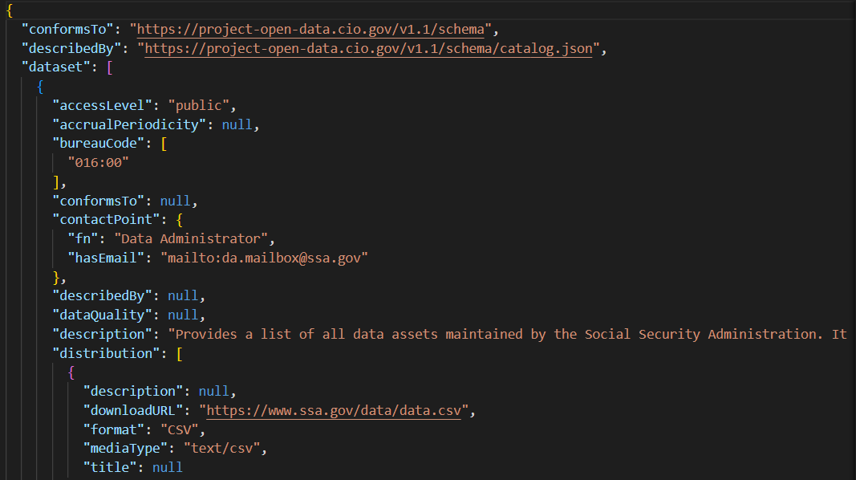
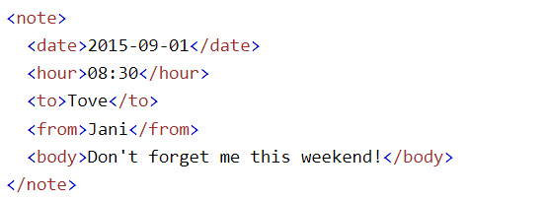
1.XML data, JSON data

Slide 3
JSON data is composed of two main structures :objects and arrays.
It is used in applications to exchange data between the server and client, and in many other contents where data needs to be exchangers between different systems and platforms.
XML data consists of hierarchy of elements, each of which have attributes and contain other elements or text. The root element contains all other child elements. Attributes provides additional information about an element.

Slide 4
2.SQL
i.
Select ID from student as s
left out join advisor as a on s.ID=a.s_id
Where a.i_ID is null
ii.

Slide 5
